Slide 1
Aviation-Accident-Analysis
Brian Waweru Moringa School

Slide 2
INTRODUCTION
As the company expands into the aviation industry, it seeks to purchase and operate aircraft for both commercial and private ventures. However, with no prior experience in the sector, the company must carefully assess potential risks associated with different aircraft types. Understanding historical accident data is crucial in determining which aircraft models offer the lowest risk, ensuring safety, regulatory compliance, and cost-effectiveness.

Slide 3
GENERAL OBJECTIVE
To identify the safest and most reliable aircraft for commercial and private operations by analysing historical accident data, assessing risk factors, and providing actionable insights for informed decision-making.

Slide 4
SPECIFIC OBJECTIVES
Examine historical accident data to identify aircraft models with the lowest accident and fatality rates.
Assess how factors such as aircraft age, manufacturer, engine type, and passenger capacity influence accident frequency and severity.
Determine how different weather conditions and regions contribute to aircraft accidents and identify aircraft best suited for various environments.

Slide 5
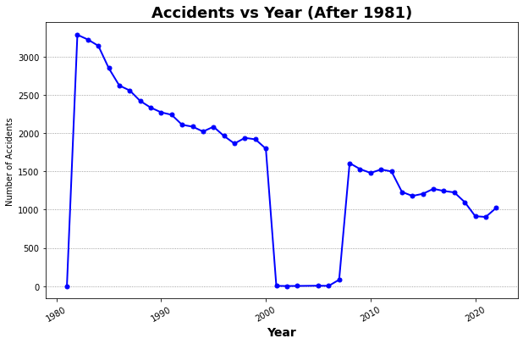

Slide 6
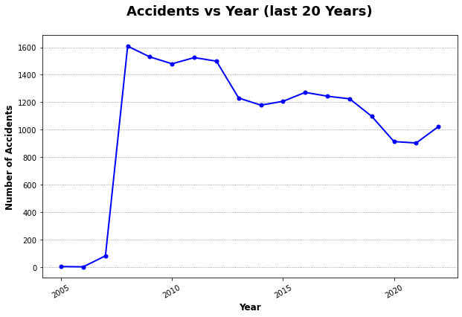

Slide 7
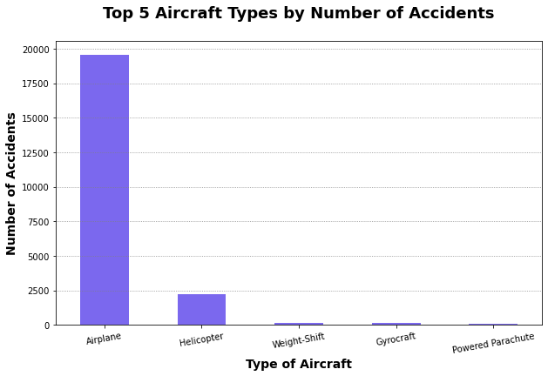

Slide 8
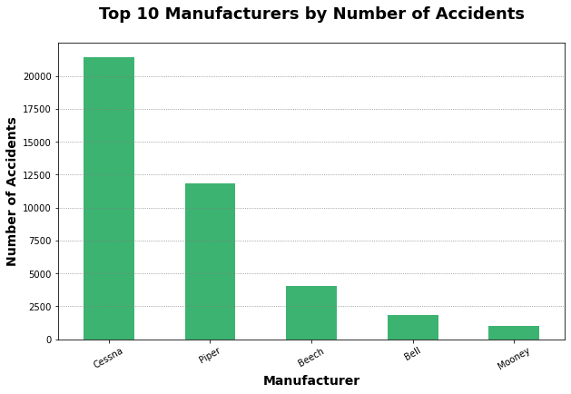

Slide 9
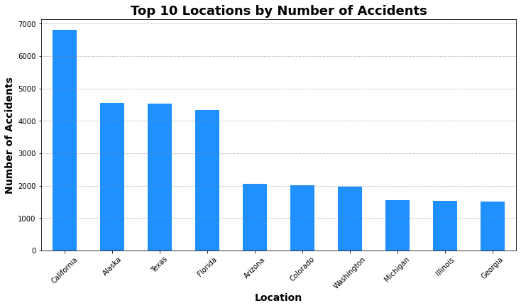

Slide 10
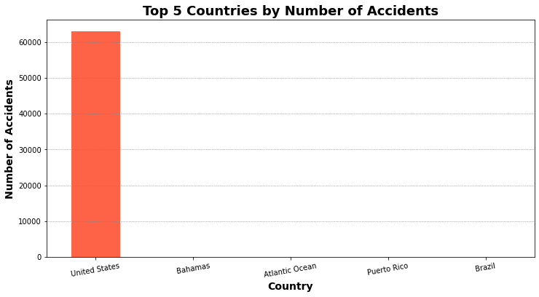

Slide 11
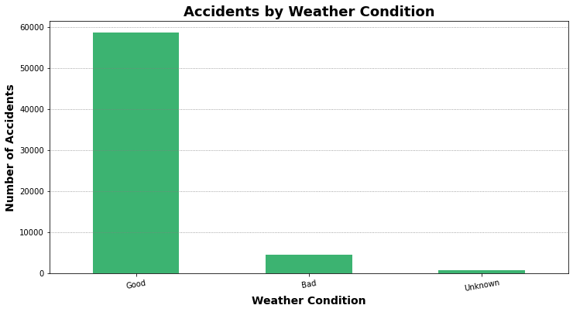

Slide 12
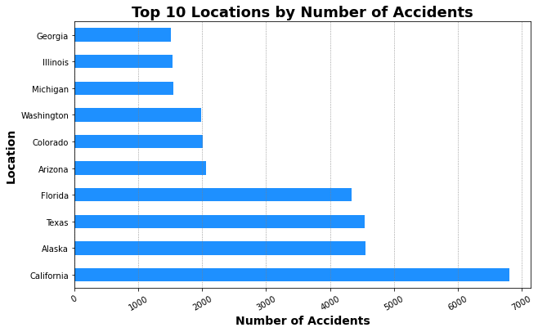

Slide 13
RECOMMENDATIONS
We recommend that the company choose any other manufacturer other than CESSNA.
Highly recommend not to have flight in the united states
Not to have flight in California because it is highly prone to aircraft accidents.

Slide 14
References
Tableau-Visualization: Version 2: https://public.tableau.com/authoring/waweru-dsc-phase-1-project-viz-v2/Sheet1/Dashboard%201#1 Version 3: https://public.tableau.com/app/profile/brian.waweru/viz/waweru-dsc-phase-1-project-viz-v3/Dashboard1?publish=yes
Git-Repository: rurigi-waweru/dsfpt10-p1-dsc-phase-1-project: Phase-01-Final-Project, 09-02-2025

