Slide 1
Aviation-Accident-Analysis
Brian Waweru Moringa School

Slide 2
INTRODUCTION
As the company expands into the aviation industry, it seeks to purchase and operate aircraft for both commercial and private ventures. However, with no prior experience in the sector, the company must carefully assess potential risks associated with different aircraft types. Understanding historical accident data is crucial in determining which aircraft models offer the lowest risk, ensuring safety, regulatory compliance, and cost-effectiveness.

Slide 3
OBJECTIVES
GENERAL OBJECTIVE: To identify the safest and most reliable aircraft for commercial and private operations by analysing historical accident data, assessing risk factors, and providing actionable insights for informed decision-making.
SPECIFIC OBJECTIVES:
Examine historical accident data to identify aircraft models with the lowest accident and fatality rates.
Assess how factors such as aircraft age, manufacturer, engine type, and passenger capacity influence accident frequency and severity.
Determine how different weather conditions and regions contribute to aircraft accidents and identify aircraft best suited for various environments.

Slide 4
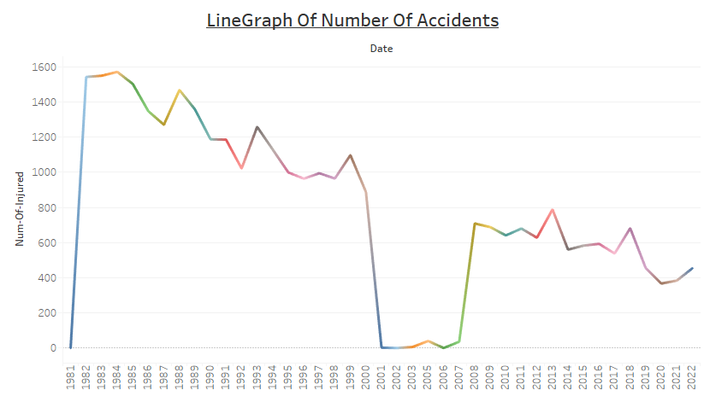
The number of accident cases has reduced over the last few years. This indicated a good grasp and integration of aviation measures. However, this needs to be zoomed in to the last 20 years.

Slide 5
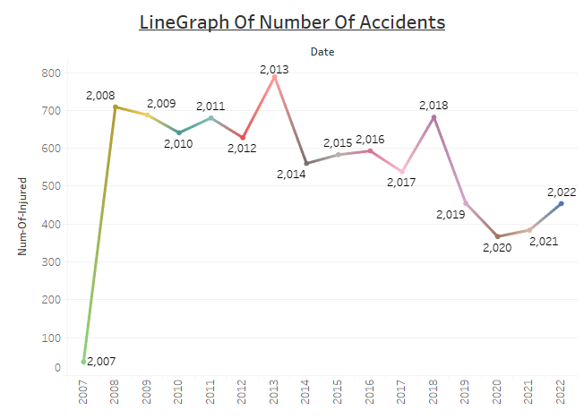
As at the 2007-08 the number of cases shoot up. This was more pronounced in 2013 and have come cross in 2018. This should not however be a deterrent to the company to have confident in measures in aviation.
On a bright note, the accidents have been on a note-worthy decline.

Slide 6
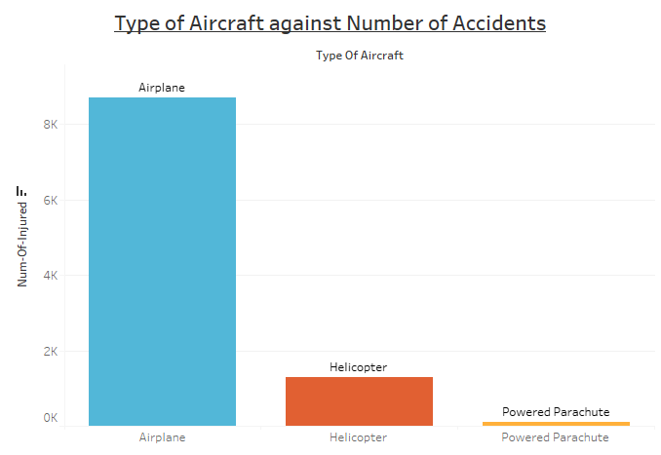
Airplane lead with an unprecedented difference with the other 2 type of aircraft. This could suggest that Airplanes are more prone to accidents than Helicopter and parachutes however their carrying capacity is to be considered as closely.

Slide 7
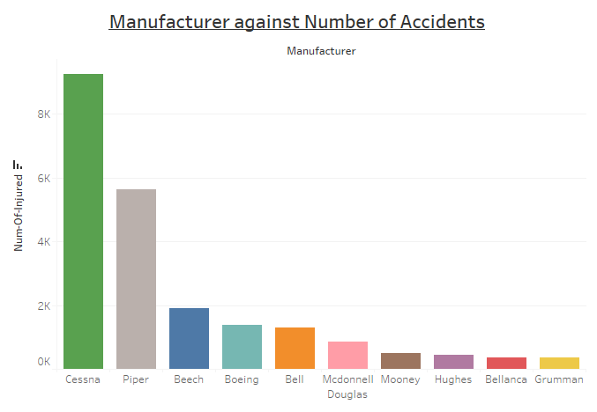
Cessna appeared to be leading the pack of makers with an alarming record of accidents followed closely by Piper, Beech and Boeing.
Despite this observation a close eye should be put on this list of top 10 manufacturers.

Slide 8
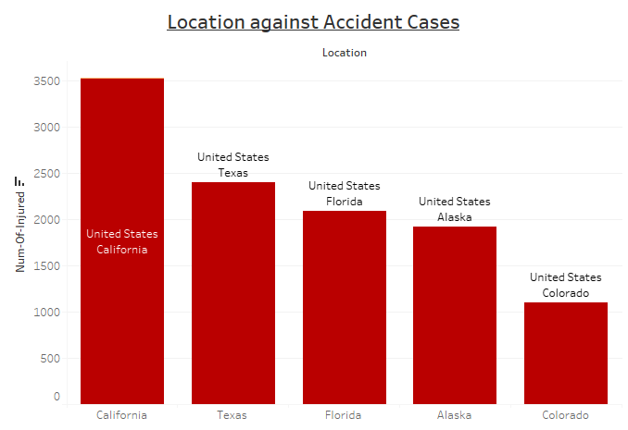
Inference:
The United States appeared to stand out on the number of accidents. A quick filter revealed that California, Texas, Florida, Alaska and Colorado are more prone to accidents than any other part in the world. This is a good reflection of the areas. Any action necessitates more attention.

Slide 9
CONCLUSION AND RECOMMENDATIONS
We recommend that the company choose any other manufacturer other than Cessna, Piper and Beech.
Any flight-plans in the United states especially in the mentioned 5 states prone to accidents should be considered with strict measures.
The Aircraft with the most record of accident is Airplane. However, this should be considered since they have a higher capacity that the rest.

Slide 10
References
Tableau-Visualization: Version 3: https://public.tableau.com/app/profile/brian.waweru/viz/waweru-dsc-phase-1-project-viz-v3/Dashboard1?publish=yes
Git-Repository: rurigi-waweru/dsfpt10-p1-dsc-phase-1-project: Phase-01-Final-Project, 09-02-2025

