Slide 1

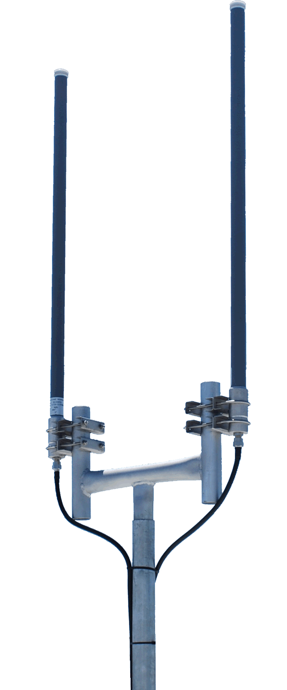
Churning Model for Telcom Company
SyriaTel Co Ltd.
Contributors: Brian-Waweru GitHub: rurigi-waweru email: rurigiwaweru@gmail.com

Slide 2
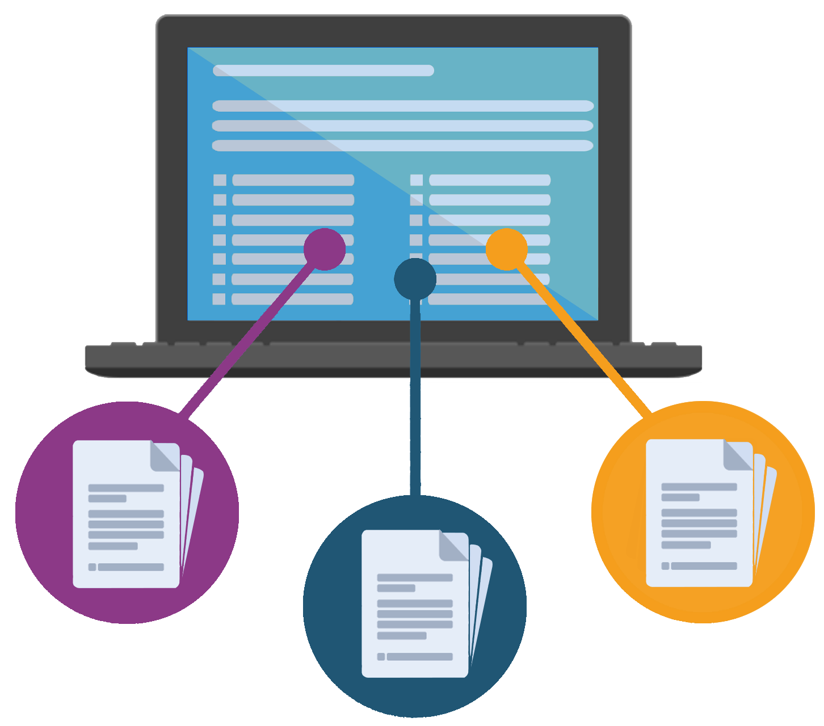
Overview
We aims to predict customer churn for SyriaTel using a sample of their historical customer data. By building a binary classification model we were able to identify patterns and factors that influence whether a customer will leave the company. The model will assist the company in targeting at-risk customers with retention strategies, thereby reducing customer attrition and preserving revenue.

Slide 3
Business Understanding
Customer churn is a critical business challenge for telco companies.
In a highly competitive and saturated market, retaining existing customers is often more cost-effective than acquiring new ones. Churn not only impacts immediate revenue but also affects long-term customer lifetime value, brand loyalty, and operational efficiency.
Understanding why customers leave — and more importantly, identifying who is likely to leave — can empower SyriaTel to take timely, targeted actions. These may include personalized marketing campaigns, service improvements, or tailored retention offers.

Slide 4

Objectives
Primarily we aimed at building a predictive model that accurately flags at-risk customers enabling SyriaTel to shift from reactive to proactive customer retention.
Here are the Specific Objectives:-
Build a Predictive Model for Churn
Improve Churn Prediction Accuracy
Develop a Repeatable ML Pipeline: Build a clean and modular workflow that can be reused with updated customer data in the future.
Then Communicate Findings Clearly: Present model insights

Slide 5

Models
We leveraged, trained and evaluated several models including Logistic Regression, Random Forest, and KNN. We also addressed class imbalance via SMOTE and class weighting.
We used classification metrics (accuracy, precision, recall, F1-score) and ROC-AUC to assess performance. Then focused on identifying the model’s ability to detect churned customers accurately.
We ran improvements to capture more accuracy and robustness of predictions.

Slide 6
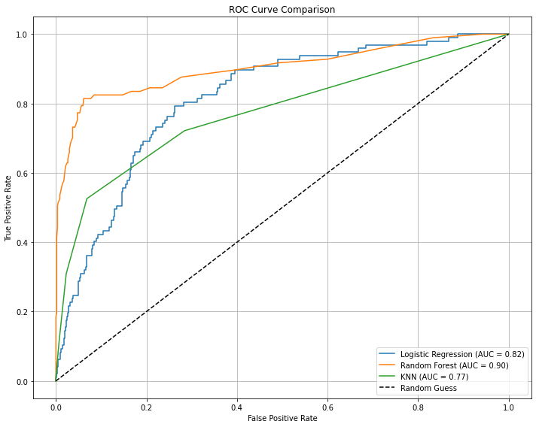
Interpretation
The Random Forest model ran well in capturing potential churn costumers.
This model will serve the company well so that it can leverage better customer retention strategies.

Slide 7
Recommendation
The ROC curve showing how your classifier performs across different thresholds. The AUC value, 0.90 summarizing overall performance for the Random Forest points the best performing model. This means that it is the closest to perfect classification. From this we infer and conclude that the Random Forest Model is the most accurate and reliable classifier among the three.

Slide 8
Thank you
The End!

