Slide 1
進捗報告会
永田研究室
F120613 三木康平

Slide 2
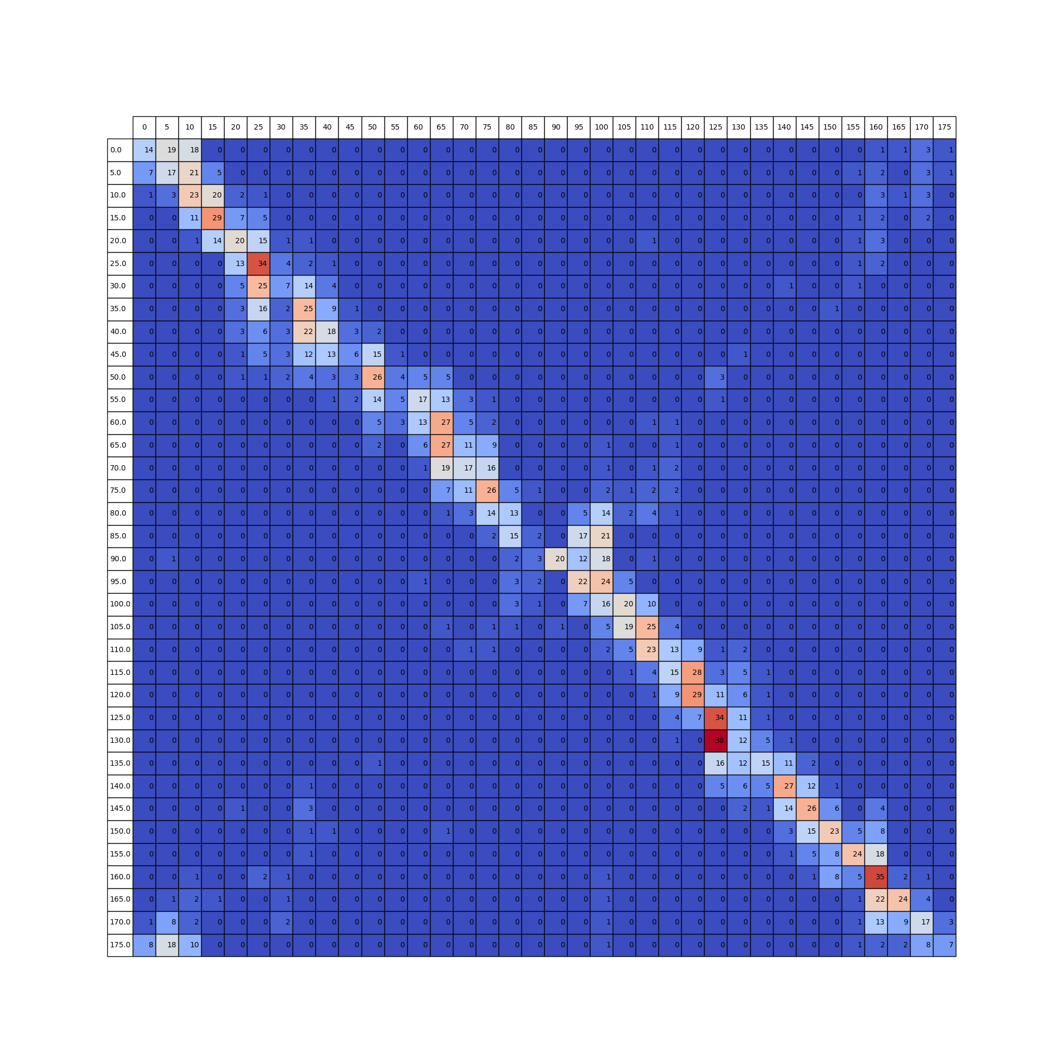

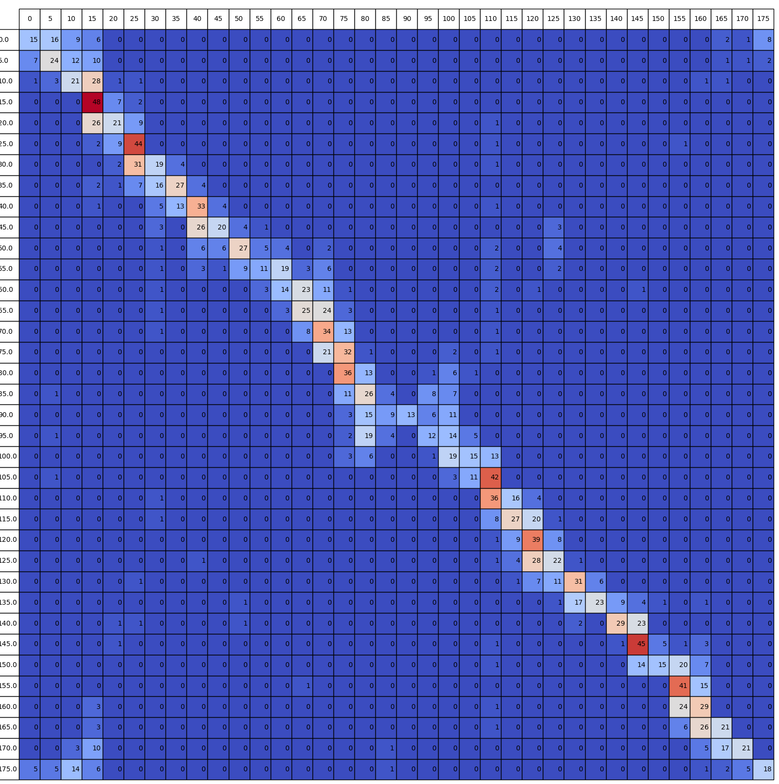
AlexNet
Allowed 50
Allowed 200
Allowed 1000
Accuracy 0.346
Accuracy 0.402
Accuracy 0.431

Slide 3
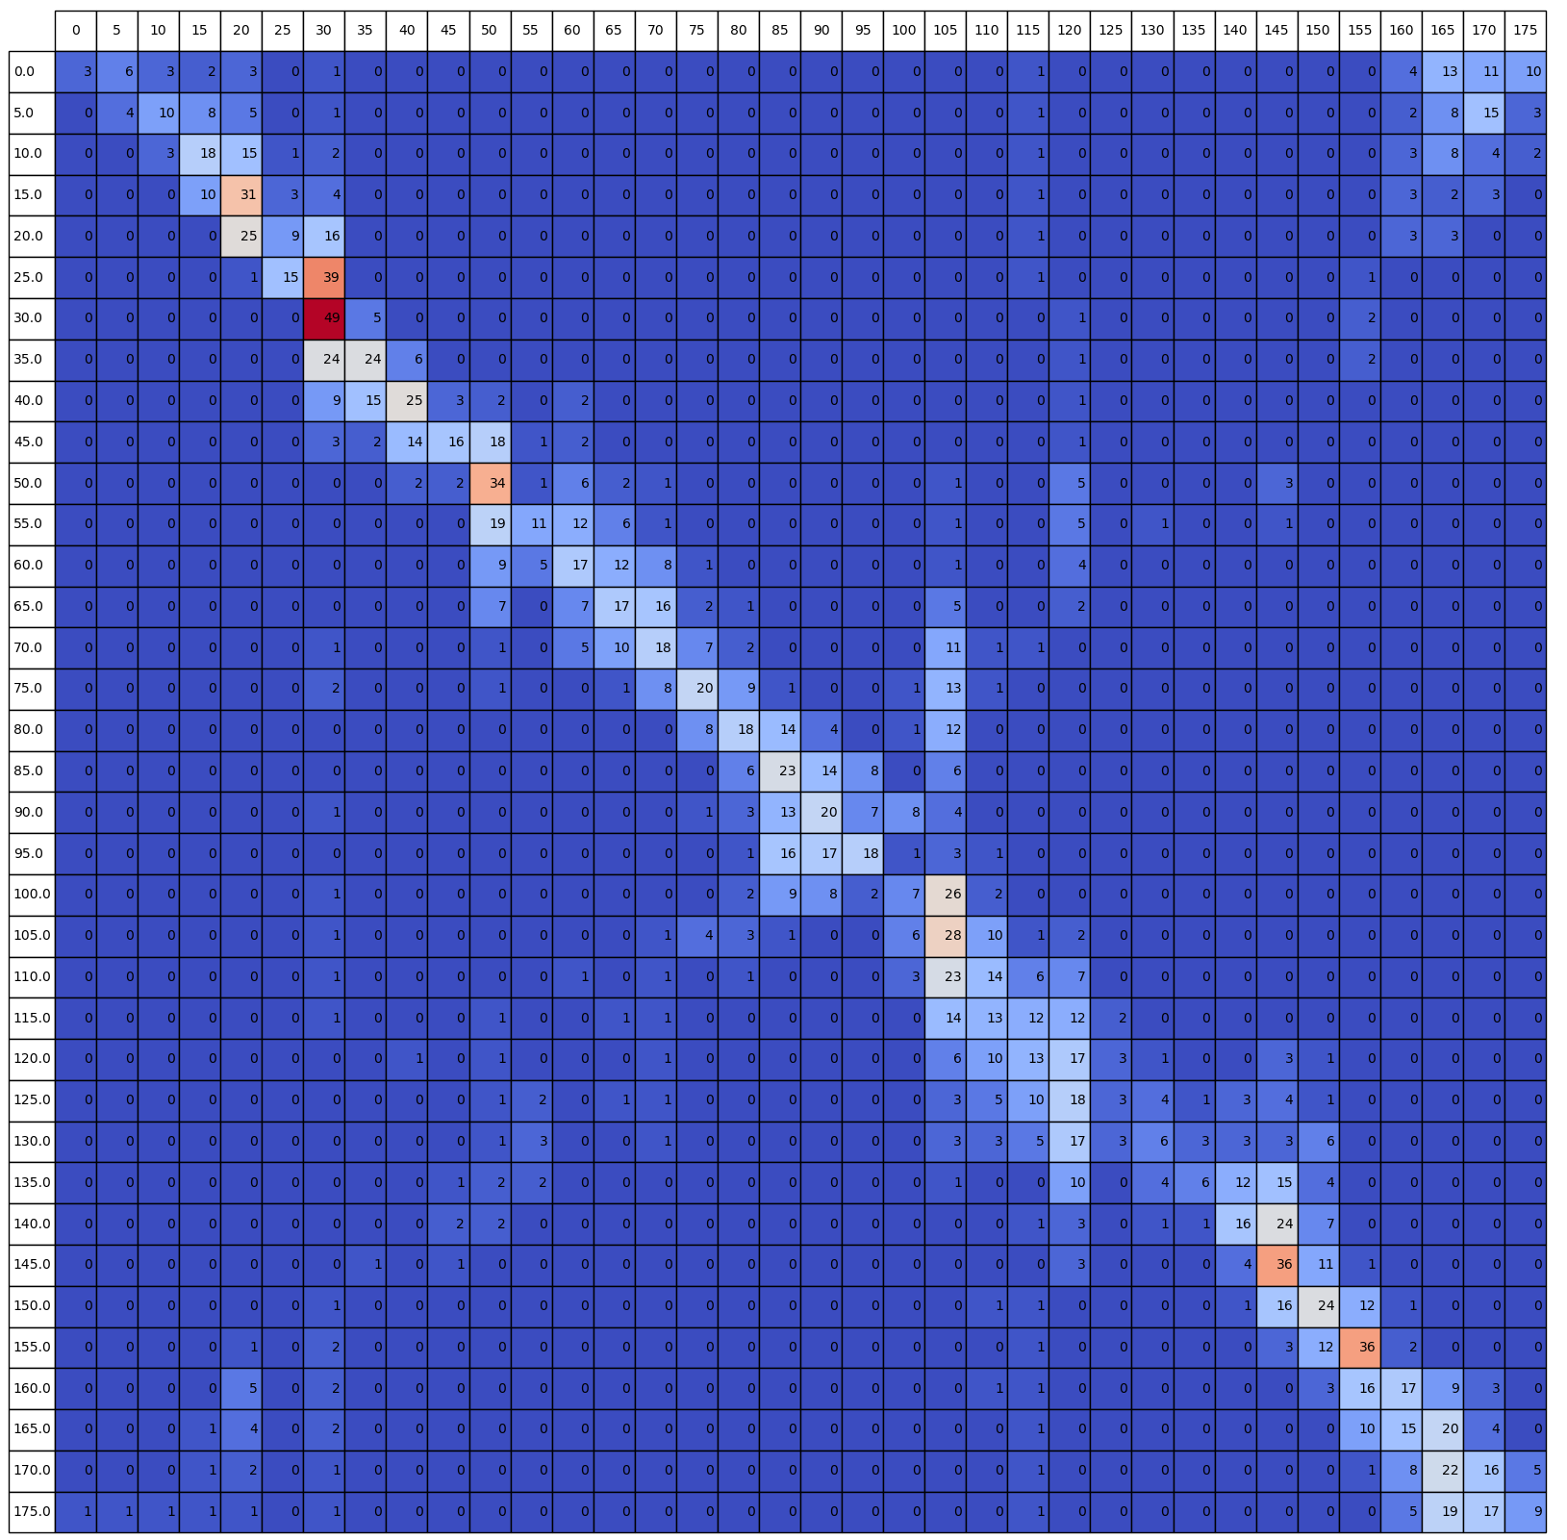
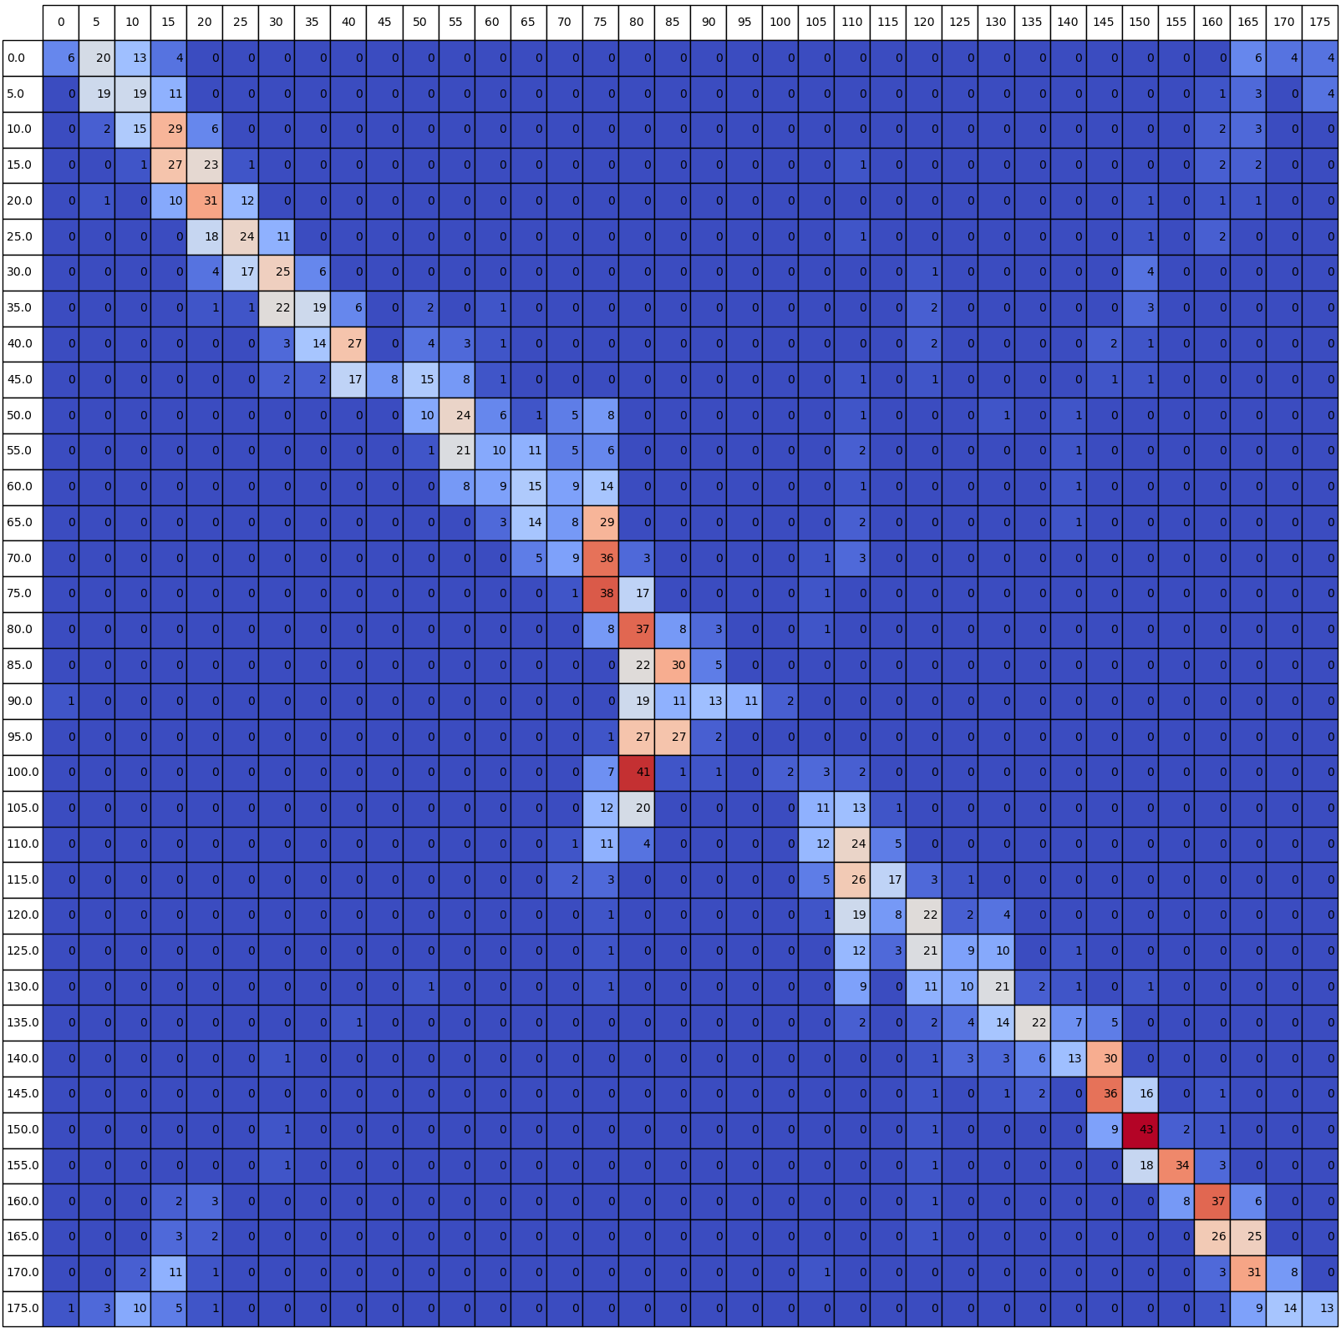
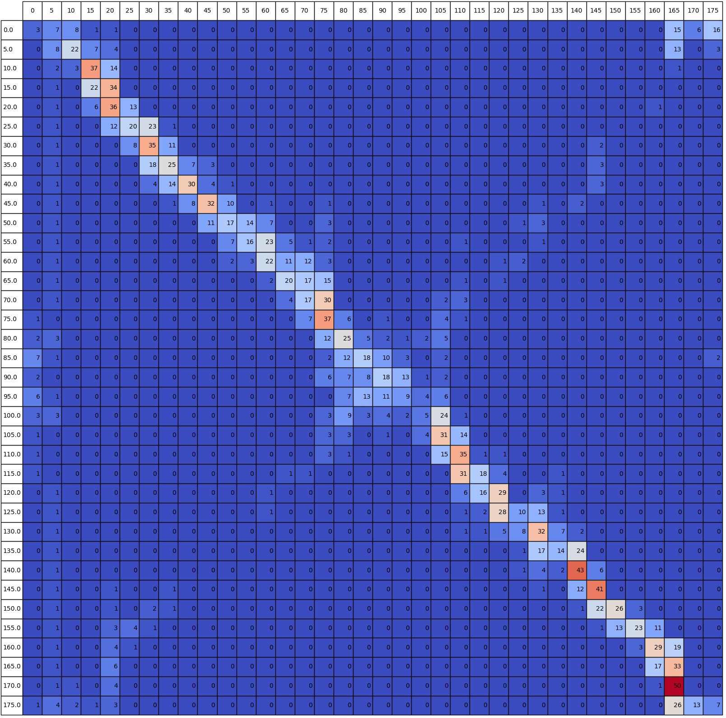
GoogLeNet
Allowed 50
Allowed 200
Allowed 1000
Accuracy 0.310
Accuracy 0.350
Accuracy 0.385

Slide 4
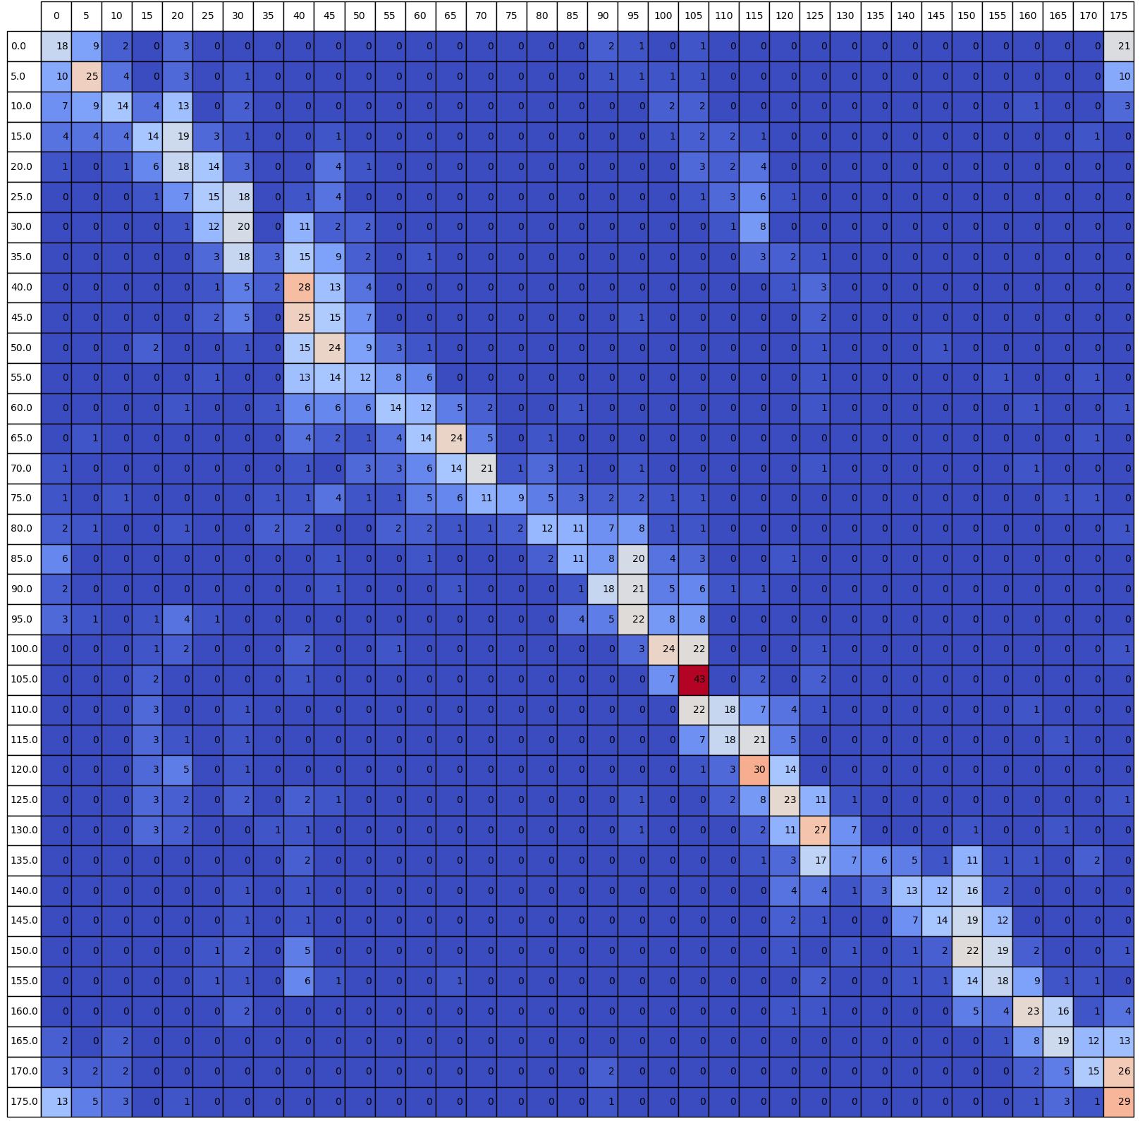
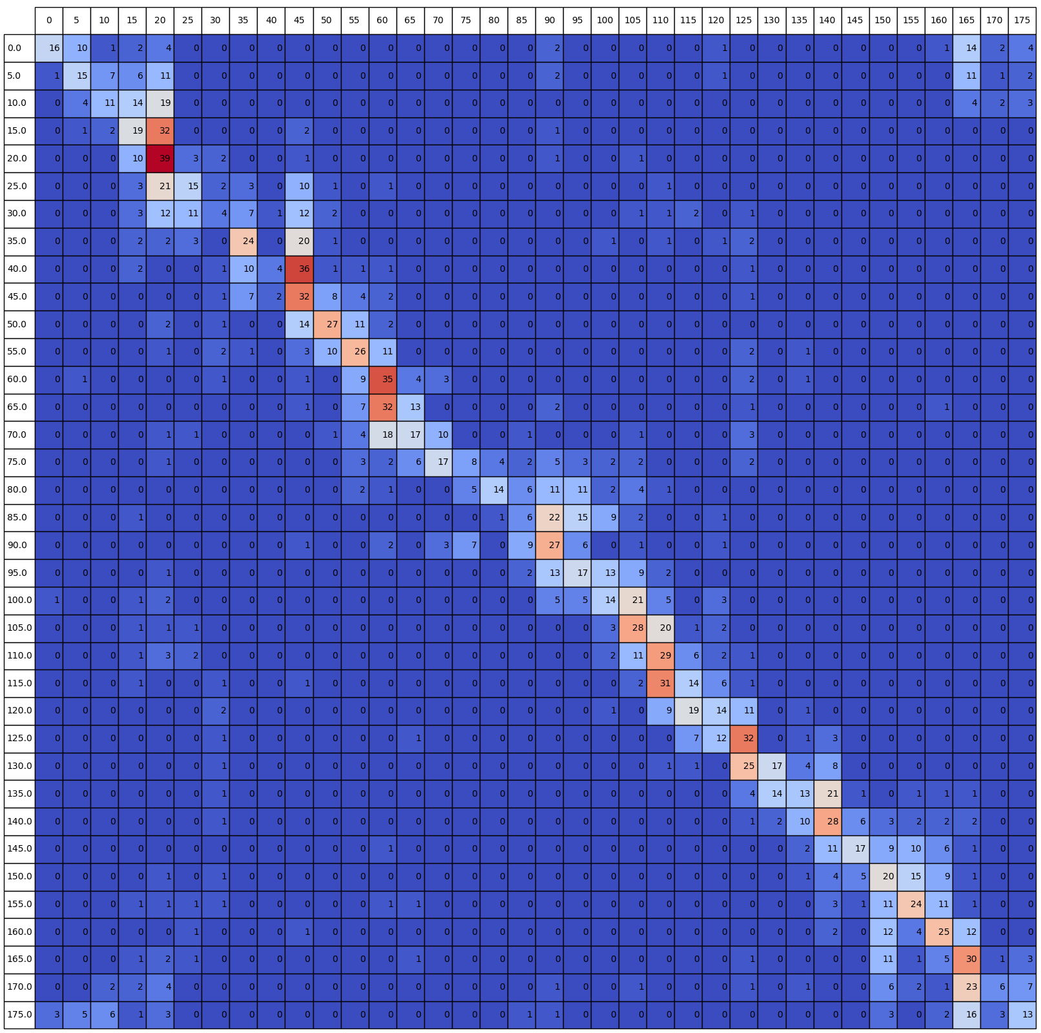
IncResNetV2
Allowed 200
Allowed 1000
Accuracy 0.299
Accuracy 0.334

