Slide 1

Mini Project 3 Mini Chess AI
Due: 6/20
Demo: 6/21 online

Slide 2
Outline
Introduction
Chess and Mini Chess
State Value Function
Minimax
Alpha-Beta Pruning
How To Design Your AI
Package
Requirements
Grading
Submission

Slide 3
Outline
Introduction
Chess and Mini Chess
State Value Function
Minimax
Alpha-Beta Pruning
How To Design Your AI
Package
Requirements
Grading
Submission

Slide 4
Introduction
Design and implement an AI which can play MiniChess
Read the current board and output the next move
Design a state value function to evaluate the score of the board
Determine the next move with a tree search algorithm

Slide 5
Outline
Introduction
Chess and Mini Chess
State Value Function
Minimax
Alpha-Beta Pruning
How To Design Your AI
Package
Requirements
Grading
Submission

Slide 6
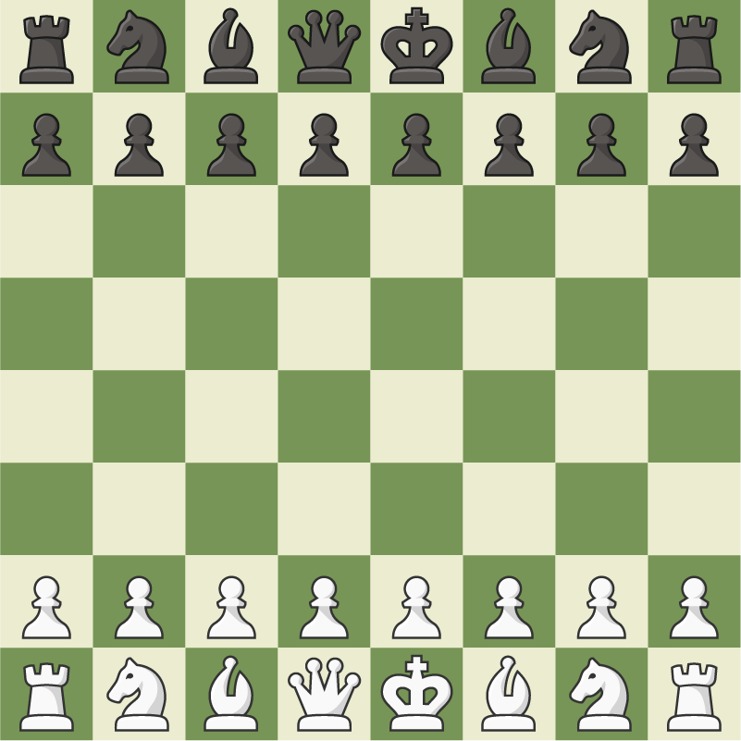
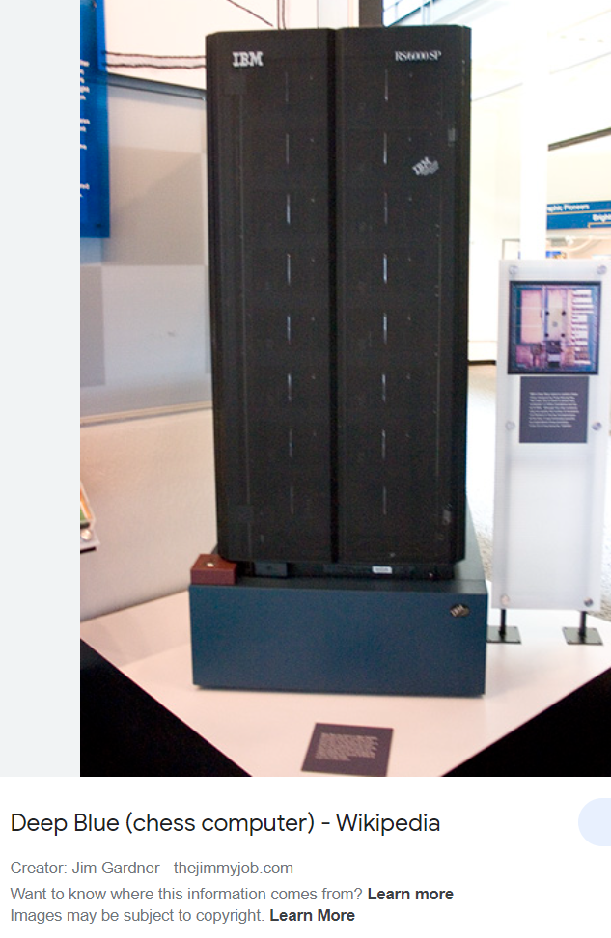
Chess

Slide 7
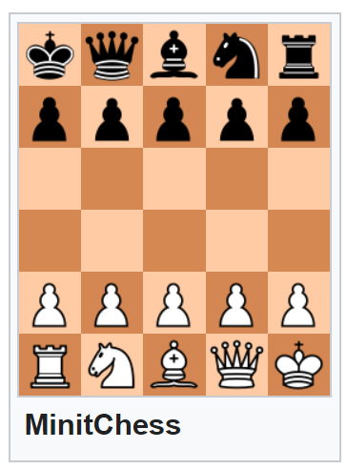
Mini Chess
Has lot of variance.
We use “MinitChess” in this project

Slide 8
Basic rules
We have 2 players: white and black. White plays first.
If the target place of your piece has the opponent’s piece, you can take it out (or, catch the piece), You cannot take your own piece.
If a player can catch the opponent’s king in its turn, it wins.
So a player can only win in he turn or lose in the opponent’s turn.
If a player makes an illegal move, he loses.
Our rule is simplified, any different rules will be marked as red one:
There is no castling
Pawn can only promote to Queen (detail in next section)

Slide 9
Basic rules
If 2 players have almost the same ability, it is very likely to get a draw and fall into an infinite loop. So we add these rules:
If it cost over 50 step(25 turn), we count the piece value. Queen=20, Bishop=8, Knight=7, Rook=6, Pawn=2. The player who has a higher piece value after 50 steps, wins.
If both sides have the same value, it is a draw.
The Queen who is promoted by Pawn, counts as queen.

Slide 10
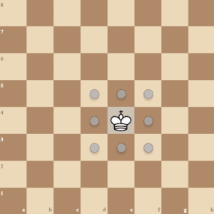
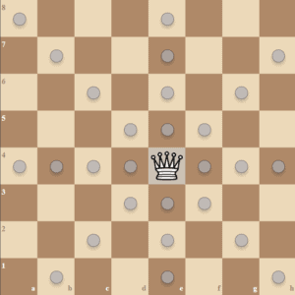
Piece Movement
King and Queen

Slide 11
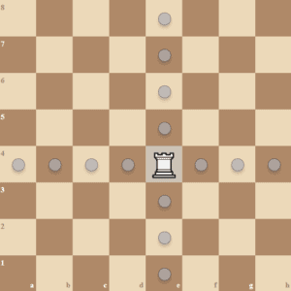
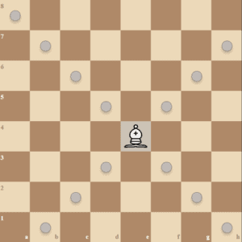
Piece Movement
Rook and Bishop

Slide 12

Piece Movement
Knight
Knight can “jump over pieces.”
It cannot be blocked

Slide 13
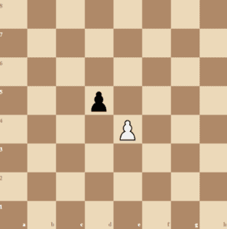
Piece Movement
Pawn
Every turn, the pawn can move forward one step.
Even in the first move of that pawn.
With ↑ this rule, there is no En passant.
If the left/right forward is the opponent’s piece, you can catch it.
When a pawn move to the last row (6 for white, 1 for black), it becomes Queen (promotion).
Promotion and Move to the Last Row will happen simultaneously.

Slide 14
Outline
Introduction
Chess and Mini Chess
State Value Function
Minimax
Alpha-Beta Pruning
How To Design Your AI
Package
Requirements
Grading
Submission

Slide 15
State Value Function
The program should decide which move is better
We can pick the move which leads to the board with the highest score
Thus, we need a function to evaluate the score of the board
It is the “state value function.”

Slide 16
State Value Function
State => the board
Value => how “good” the board is
Function => given a board, output the value

Slide 17
State Value Function
Super simple Example:
Give every piece a score (king=inf, queen=100, …)
Your pieces – Opponent’s pieces = value of the state.
Some upgrades:
A piece in a different place has a different value.

Slide 18
State Value Function
Keywords for a more complicated algorithm:
KP (King-Piece), PP (Piece-Piece), KPPT (King-Piece-Piece-Turn)
KKPT (King-King-Piece-Turn with King-Piece-Piece)
MCTS (Monte Carlos Tree Search)
AlphaZero
Leela Chess Zero
DLShogi
NNUE (Efficiently Updatable Neural Network)
This is the SOTA for Chess and Shogi
Stockfish (2022 TCEC 1st place, 2022 CCC 1st place)
水匠 (第3回世界将棋AI電竜戦優勝)

Slide 19
Use value function to pick the next move
Suppose we have three valid moves, A, B, and C:
Current
Move A
Move C
Move B
After
Move A
After
Move B
After
Move C

Slide 20
Use value function to pick the next move
After evaluating the state values, we have 20, -15, and 30
Current
Move A
Move C
Move B
Value
20
Value
-15
Value
30

Slide 21
Use value function to pick the next move
We pick move C to be our next step since it leads to the highest value
Current
Move C
Move A
Move B
Value
20
Value
-15
Value
30

Slide 22
Outline
Introduction
Chess and Mini Chess
State Value Function
Minimax
Alpha-Beta Pruning
How To Design Your AI
Package
Requirements
Grading
Submission

Slide 23
Minimax
In the previous example, we only look forward to one step
However, the opponent will try its best to defeat you
Greedy choice is not always the best
We should look forward to more steps and simulate how the opponent thinks to make the best choice with the least risk

Slide 24
Minimax
Player tries his best to win
Player picks the move with the highest score
Opponent tries its best to defeat the player
Opponent picks the move with the lowest “player’s value function” score
That is, the opponent tends to give the player the worst board
The Minimax algorithm is based on this player-opponent interaction

Slide 25
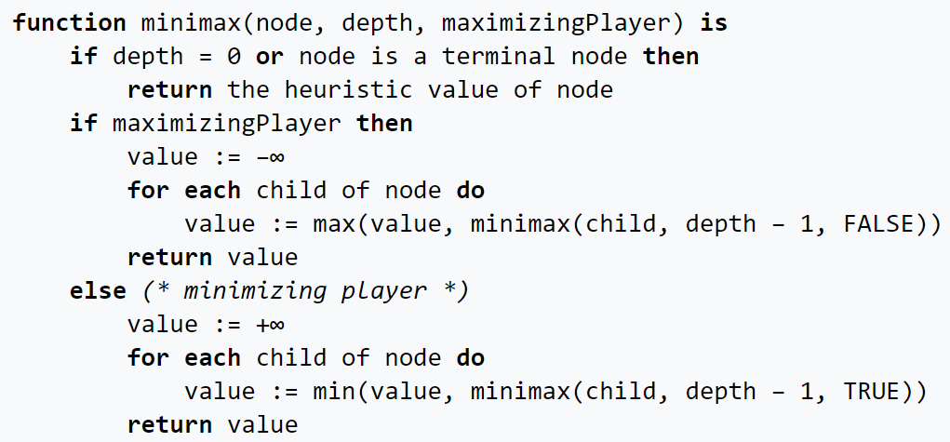
Minimax Pseudocode
Source: https://en.wikipedia.org/wiki/Minimax

Slide 26
Example
Now
:Player
:Opponent
A
B
C
D
E
F
G
H
I
J
K

Slide 27
Evaluate score at leaves
Now
:Player
:Opponent
A
B
C
D
E
F
G
H
I
J
K
5

Slide 28
Evaluate score at leaves
Now
:Player
:Opponent
A
B
C
D
E
F
G
H
I
J
K
5
6

Slide 29
Player picks the largest score
Now
:Player
:Opponent
A
B
C
D
E
6
F
G
H
I
J
K
5
6

Slide 30
Evaluate score at leaves
Now
:Player
:Opponent
A
B
C
D
E
6
F
G
H
I
J
K
5
6
7

Slide 31
Evaluate score at leaves
Now
:Player
:Opponent
A
B
C
D
E
6
F
G
H
I
J
K
5
6
7
4

Slide 32
Evaluate score at leaves
Now
:Player
:Opponent
A
B
C
D
E
6
F
G
H
I
J
K
5
6
7
4
5

Slide 33
Player picks the largest score
Now
:Player
:Opponent
A
B
C
D
E
6
7
F
G
H
I
J
K
5
6
7
4
5

Slide 34
Opponent picks the smallest score
Now
:Player
:Opponent
A
B
6
C
D
E
6
7
F
G
H
I
J
K
5
6
7
4
5

Slide 35
Evaluate score at leaves
Now
:Player
:Opponent
A
B
6
C
D
E
6
7
F
G
H
I
J
K
5
6
7
4
5
3

Slide 36
Player picks the largest score
Now
:Player
:Opponent
A
B
6
C
D
E
6
7
3
F
G
H
I
J
K
5
6
7
4
5
3

Slide 37
Opponent picks the smallest score
Now
:Player
:Opponent
A
B
6
3
C
D
E
6
7
3
F
G
H
I
J
K
5
6
7
4
5
3

Slide 38
Move A has the largest score
Now
:Player
:Opponent
A
B
6
3
C
D
E
6
7
3
F
G
H
I
J
K
5
6
7
4
5
3

Slide 39
Player picks move A to be the next move
Now
:Player
:Opponent
A
B
6
3
C
D
E
6
7
3
F
G
H
I
J
K
5
6
7
4
5
3

Slide 40
Outline
Introduction
Chess and Mini Chess
State Value Function
Minimax
Alpha-Beta Pruning
How To Design Your AI
Package
Requirements
Grading
Submission

Slide 41
Alpha-Beta Pruning
By Minimax, we can simulate our opponent’s moves and pick a move with minimum risk and maximum value
Looking forward to more steps that may improve the policy
However, the size of the search tree may drastically increase with the increase in search depth

Slide 42
Alpha-Beta Pruning
Since we only have limited time, if we hope to increase search depth, we must optimize the search process
There are many branches in the minimax process which are not related to the result
We can try to “prune” these branches to improve efficiency
The Alpha-Beta Pruning is the improved version of the Minimax method which eliminates some unnecessary branches

Slide 43
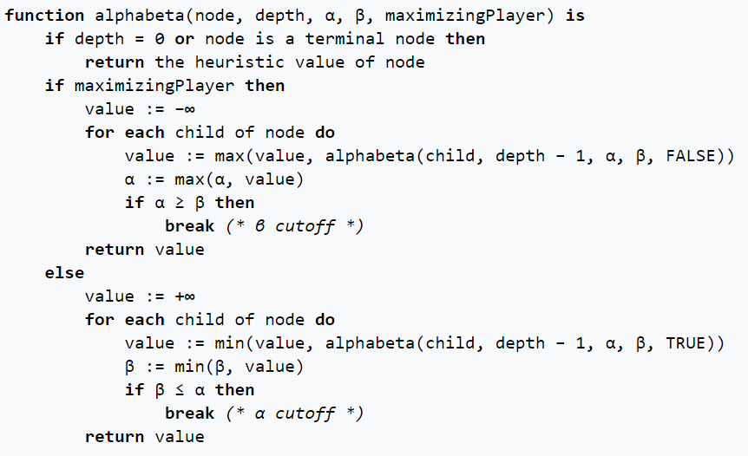
Alpha-Beta Pruning Pseudocode
Source: https://en.wikipedia.org/wiki/Alpha%E2%80%93beta_pruning

Slide 44
Alpha-Beta Pruning
Alpha: the maximum score that the player is assured of in the current search process
Beta: the minimum score that the opponent is assured of in the current search process

Slide 45
Alpha-Beta Pruning
If alpha >= beta on a player node, we can stop to search on this branch
In this situation, the player will return a value >= beta on this branch
However, the opponent already has a better choice (beta)
Thus, no matter the later discovered value on this branch, the opponent will not pick this branch
We can “prune” this branch since it will not affect the result
We can also stop to search if beta <= alpha on an opponent node

Slide 46
Example
Now
α: -INF
β: INF
:Player
:Opponent
A
B
α: -INF
β: INF
C
D
E
α: -INF
β: INF
F
G
H
I
J
K

Slide 47
Evaluate score at leaves
Now
α: -INF
β: INF
:Player
:Opponent
A
B
α: -INF
β: INF
C
D
E
α: -INF
β: INF
F
G
H
I
J
K
5

Slide 48
Update alpha
Now
α: -INF
β: INF
:Player
:Opponent
A
B
α: -INF
β: INF
C
D
E
α: 5
β: INF
F
G
H
I
J
K
5

Slide 49
Evaluate score at leaves
Now
α: -INF
β: INF
:Player
:Opponent
A
B
α: -INF
β: INF
C
D
E
α: 5
β: INF
F
G
H
I
J
K
5
6

Slide 50
Update alpha
Now
α: -INF
β: INF
:Player
:Opponent
A
B
α: -INF
β: INF
C
D
E
α: 6
β: INF
F
G
H
I
J
K
5
6

Slide 51
Player picks the largest score
Now
α: -INF
β: INF
:Player
:Opponent
A
B
α: -INF
β: INF
C
D
E
6
α: 6
β: INF
F
G
H
I
J
K
5
6

Slide 52
Update beta
Now
α: -INF
β: INF
:Player
:Opponent
A
B
α: -INF
β: 6
C
D
E
6
α: 6
β: INF
F
G
H
I
J
K
5
6

Slide 53
Propagate alpha and beta values
Now
α: -INF
β: INF
:Player
:Opponent
A
B
α: -INF
β: 6
C
D
E
6
α: 6
β: INF
α: -INF
β: 6
F
G
H
I
J
K
5
6

Slide 54
Evaluate score at leaves
Now
α: -INF
β: INF
:Player
:Opponent
A
B
α: -INF
β: 6
C
D
E
6
α: 6
β: INF
α: -INF
β: 6
F
G
H
I
J
K
5
6
7

Slide 55
Update alpha
Now
α: -INF
β: INF
:Player
:Opponent
A
B
α: -INF
β: 6
C
D
E
6
α: 6
β: INF
α: 7
β: 6
F
G
H
I
J
K
5
6
7

Slide 56
Alpha >= beta in a player node, stop searching
Now
α: -INF
β: INF
:Player
:Opponent
A
B
α: -INF
β: 6
C
D
E
6
α: 6
β: INF
7
α: 7
β: 6
F
G
H
I
J
K
5
6
7

Slide 57
Opponent picks the smallest score
Now
α: -INF
β: INF
:Player
:Opponent
A
B
6
α: -INF
β: 6
C
D
E
6
α: 6
β: INF
7
α: 7
β: 6
F
G
H
I
J
K
5
6
7

Slide 58
Alpha-Beta Pruning
In the example above, we use the same search tree as Minimax
By pruning, we eliminate branches I and J
However, we still get the same result on branch A
Alpha-Beta Pruning can effectively speed up the process while maintaining the same result

Slide 59
Outline
Introduction
Chess and Mini Chess
State Value Function
Minimax
Alpha-Beta Pruning
How To Design Your AI
Package
Requirements
Grading
Submission

Slide 60
How To Design Your AI
The game runner (main.cpp) executes the AIs of the player and the opponent in turns and communicates with them by files
Your game AI should read the board status from the file “state”
Your game AI should output your move to the file “action”

Slide 61
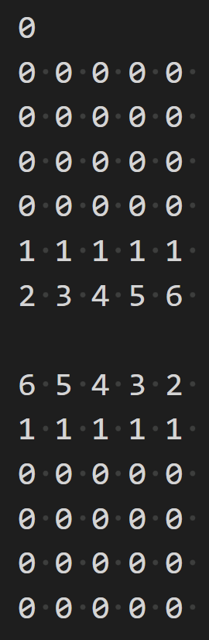
State file
3 part
First is the player (0 for white player, 1 for black player)
Second part is white player’s board (5*6)
Third part is black player’s board (5*6)
0=empty, 1=pawn, 2=rook, 3=knight, 4=bishop, 5=queen, 6=king

Slide 62
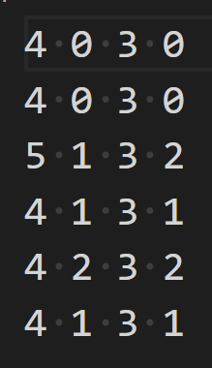
Action file
Your AI should output the next move to the action file
You can keep output moves within the time limit
Only the last complete output will be considered
In this case, on the right, 4 1 3 1 will be accepted by the game runner
You lose if you output an invalid move
Move format: from.y from.x to.y to.x
More details in the package introduction section

Slide 63
How to design your AI
You can refer to the random.cpp/hpp in the src/policy and src/player folders
Design your state value function in state.cpp to evaluate the board
Implement the Alpha-Beta Pruning method and use your value function in the search process
Run Alpha-Beta Pruning and decide which move to output

Slide 64
Outline
Introduction
Chess and Mini Chess
State Value Function
Minimax
Alpha-Beta Pruning
How To Design Your AI
Package
Requirements
Grading
Submission

Slide 65
Package
You don’t need to implement all the things by yourself, we will provide some useful utilities, and then you can focus on the state value function and the tree search algorithm.
You will get:
Game runner
State class
a native method to get all legal actions
Generate a new state based on action and state
You need to simply state value function by yourself
A example player (with random choose policy)

Slide 66

Package – How to run it
Despite the source files, you will also get some additional files:
Makefile – help you to compile the project
.gitignore – since you need to push your code to github, this can help you ignore some files when you push it
You can modify your Makefile, but you should make sure it can compile on TAs environment.
With Makefile and make utils (more details in environment setup document), you can compile your code with:

Slide 67
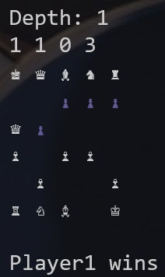
Package – How to run it
After running the make all command and compile your program successfully, you can use this command to run the game:
And it will start running!

Slide 68
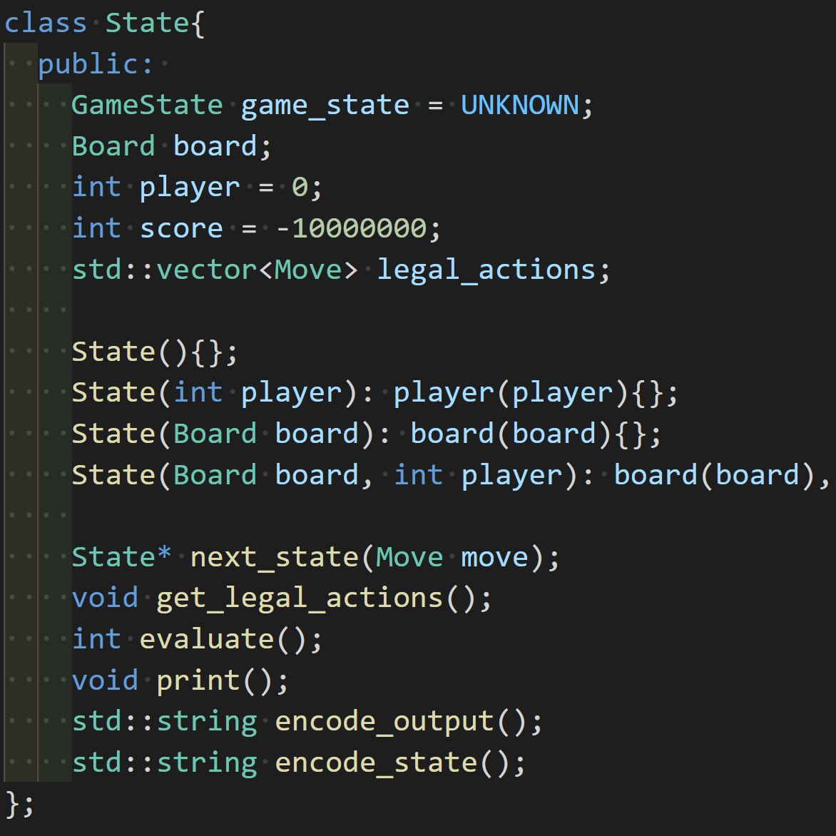
Package – State
And now, you should start your project.
I recommend you to check state class at first
next_state can generate new state based on a move
get_legal_actions will generate all legal actions of this state and store them in legal_actions.
evaluate is the state value function you need to implement

Slide 69
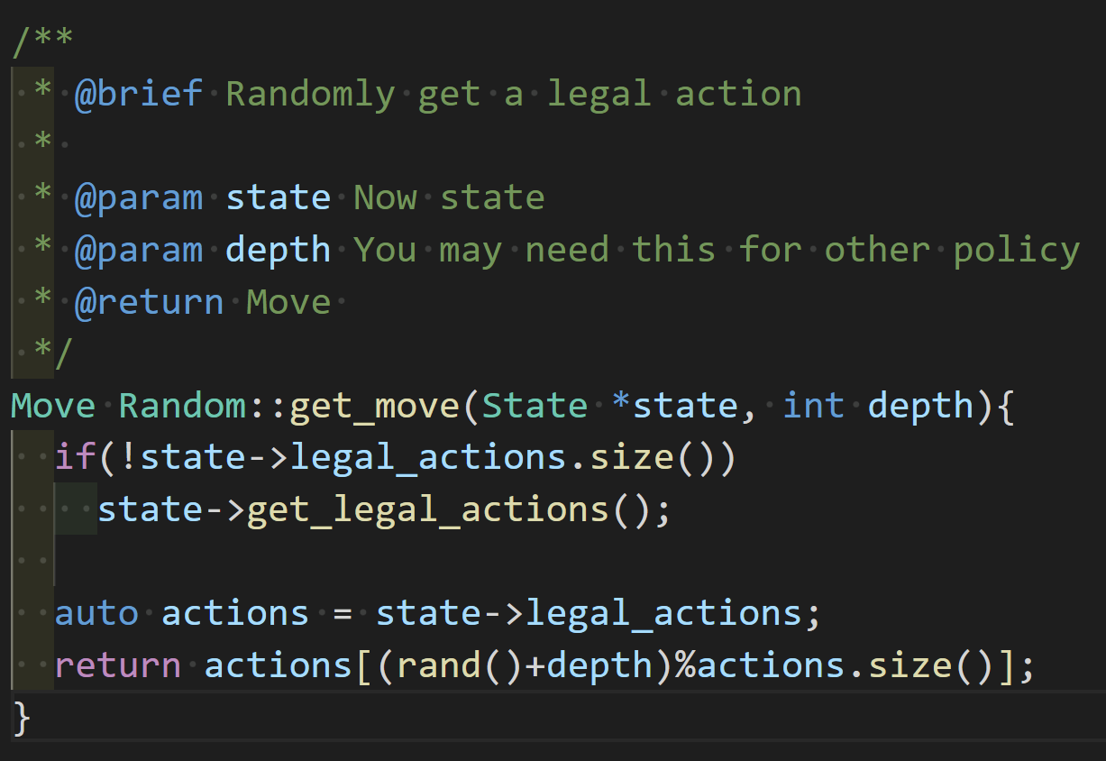
Package - Policy
If this project, you should implement your own MiniMax and AlphaBeta-pruning policy. And you will get a random policy player for example
Random policy: State in, random legal action out:

Slide 70
Package - player
There are some useful functions in example random player file:
read_board: read the board from state file
write_valid_sopt: in random player, it will output random point to action file, you can just modify this function to output the point you want.

Slide 71
Outline
Introduction
Chess and Mini Chess
State Value Function
Minimax
Alpha-Beta Pruning
How To Design Your AI
Package
Requirements
Grading
Submission

Slide 72
Requirements - code
In this project you should do these things:
1, design your own state value function
2, implement MiniMax and AlphaBeta pruning algorithm
3, utilize your algorithm and state value function to make a strong AI

Slide 73
Requirements - code
If you are not satisfied with the Alpha-Beta Pruning algorithm, you can try some more advanced methods (MCTS, NNUE). However, make sure you can explain how Minimax and Alpha-Beta Pruning works during the demo.
If you cannot complete the Alpha-Beta Pruning algorithm, implementing the basic Minimax algorithm also gives you some scores.

Slide 74
Requirements - code
You will lose immediately if your program outputs an invalid move
Time limit for each move is 10 seconds, and the memory limit is 4GB
You can keep output moves for a limited time. Only the last move is used by the game runner.

Slide 75
Requirements - code
You cannot use these things in your code:
Third party library (only standard library are acceptable)
Inline ASM
Multi thread/Multi process
Vectorize operation (Like AVX)

Slide 76
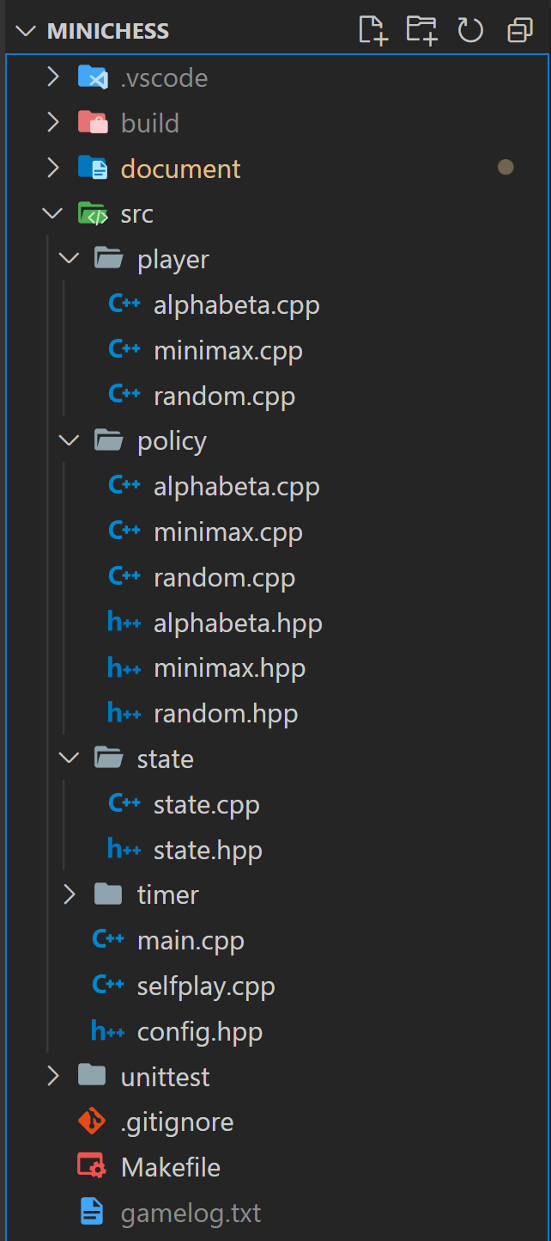
Requirements - structure
Please use C++ and write your program with the structure in the folder (basically as same as right side, but only has random policy).
Once you make player/xxx.cpp, policy/xxx.cpp, policy/xxx.hpp. You can use “make xxx” command to build the player with xxx policy. (For example, use “make alphabeta” with the structure on the right, will generate "build/player_alphabeta.exe file) Make sure you have implemented all needed method.

Slide 77
Requirements - structure
Make sure to make a copy of the player and policy you want to submit and rename them as “submission.cpp” for both player and policy.
For example, if I want to submit alphabeta player as my result. I should make a copy of player/alphabeta.cpp and a copy of policy/alphabeta.cpp. And then rename them to player/submission.cpp and policy/submission.cpp.
You should make sure “make submission” command can work!

Slide 78
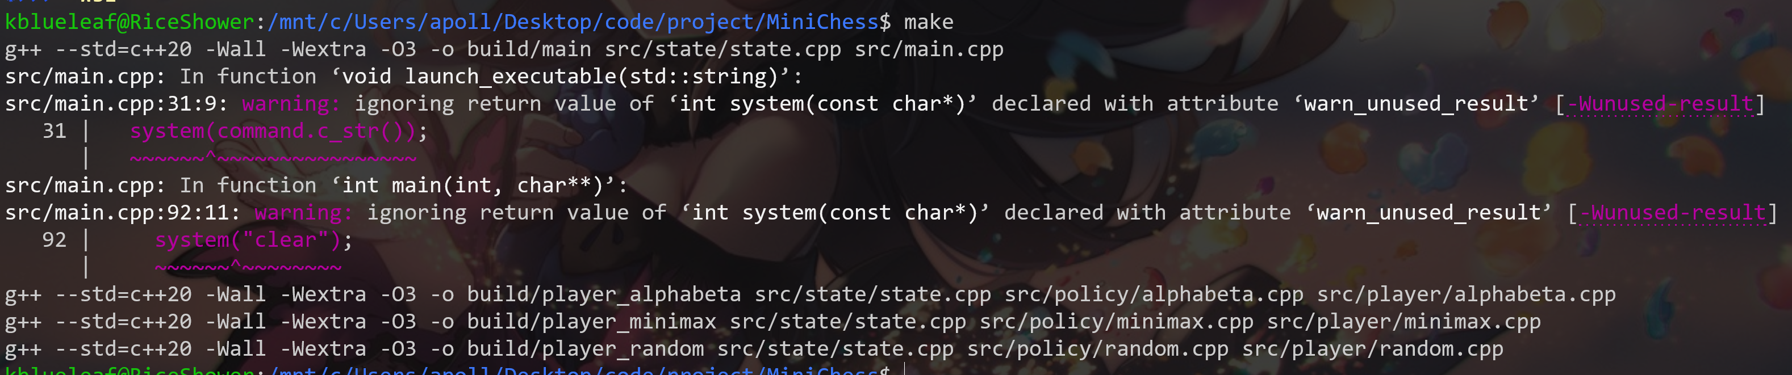
Requirements - structure
Your program will be compiled in a GNU/Linux environment by:
Please make sure your program can be compiled by the command above with no error. (If you don’t change the makefile, just use “make” command and see if there is any error.)

Slide 79
Requirements - Report and Demo
You should write a report to elaborate on how you design your AI
If you have implemented NNUE or MCTS, please provide a brief description in your report of how it was implemented, along with code explanations if possible.
The report is not directly graded, but is your only available reference through the TA demo (You cannot refer to your code in demo)
You must attend the demo and answer the questions from TA
The demo date and method will be announced soon

Slide 80
Outline
Introduction
Chess and Mini Chess
State Value Function
Minimax
Alpha-Beta Pruning
How To Design Your AI
Package
Requirements
Grading
Submission

Slide 81
Grading
The project accounts for 9 points of your total grade
Beat every baseline => +5 points (1 point for each 4 baselines, 1point if you beat all the baselines with both white and black)
Implement Tree search (Minimax) => +2 points
Design of your state value function => +1 point
Implement Alpha-Beta Pruning => +1 point

Slide 82
Grading - baselines
We have 4 baselines:
Random
Weak MiniMax
Strong MiniMax
Strong AlphaBeta
Your program will play with baselines for both white and black.
If you can get 1win + 1draw (or 2win), you can go to next baselines and get the score.
If you can beat all the baselines with 8wins, you get final 1 point.

Slide 83
Grading Bonus
(Bonus) Use version control software => +1 point
You need to push your code to github as submission. But if you also use github+git as version control software and have at least 3 commits, you will get this point.
(Bonus) Class ranking => At most +2 points
You can attend the class ranking if you beat all baselines (8wins).
Your AI will play against other Ais of your classmates and gain a bonus score according to your ranking.
(Bonus) Advanced algorithm => MCTS: +1points, NNUE: +2points
You get this bonus only if your advanced algorithm can beat the first 3 baselines and you can explain it well.

Slide 84
Grading Plagiarism
We will compare the code from both classes and previous years to detect plagiarism.
Please set your GitHub repository to private before the deadline to prevent your code from being plagiarized by others. Remember to reset it for the public after the deadline.
If plagiarism is still found, we will determine it based on the chronological order of commits on GitHub. The plagiarizer will receive 0 points, while the plagiarized person will receive a 50% deduction in score.

Slide 85
Outline
Introduction
Chess and Mini Chess
State Value Function
Minimax
Alpha-Beta Pruning
How To Design Your AI
Package
Requirements
Grading
Submission

Slide 86
Submission
Submit the report to Mini Project 3 繳交區on eeclass
File name: <student_id>_project3.pdf
Ex: 111000000_project3.pdf
Complete the following Google Form, which includes your GitHub Repo link and check of your bonus implementation
Link: https://forms.gle/V9CAMh3yMychxW8z7
Deadline: 6/20 (both report and google form)
Late submissions within 2 hours will receive a 40% deduction in score.(六折)
Late submissions more than 2 hours will receive a score of 0.

Slide 87
Happy Coding!

