Slide 1
MONTHLY REPORT
Vulkan Persistent Thread WorkGraph POC
May 2026 optimization evaluation: validating global atomic traffic as the queue bottleneck
30.75 ms
0.99 ms
31.0x
Baseline median
Final median
Median speedup
clean compute_ms
main integrated
same workload
Adopted path: Q1/Q2 queue sharding + Q1 lane-pop. Request batching is tested, documented, and not adopted for the current protocol/workload.
AMD RX 7900 XTX / RDNA 3

Slide 2
Vulkan Persistent Thread WorkGraph POC
02
Executive summary: hypothesis to validated bottleneck
HYPOTHESIS
EVIDENCE
ADOPTED PATH
RESULT
Hypothesis
Evidence
Adopted path
Result
The persistent-thread queue architecture is atomic-heavy, so global atomic traffic was suspected.
Clean timing plus counter-enabled runs identify queue contention, CAS failures, backlog, and ready-spin behavior.
Q1 sharding, Q2 sharding, and Q1 lane-pop reduce shared atomic hotspots.
Median clean compute drops from 30.75 ms to about 0.99 ms on the final integrated path.
Performance results come from clean timestamp runs; atomic counters are used to explain the bottleneck behavior.
2026-05-25
Optimization Evaluation v2

Slide 3
Vulkan Persistent Thread WorkGraph POC
03
Recap architecture: persistent workers and atomic queues
Node A
Q1
Node B
Q2
Node C
VB Render
Seed edges once
atomic count/head/tail ready flag
Subdivide work
atomic count/head/tail ready flag
Write vertices
Deterministic draw
Why atomic traffic is plausible
What v2 validates
- Cross-workgroup handoff uses atomics for correctness on RDNA 3.
- Queue state and ready flags are shared by many lanes and workgroups.
- Metrics confirm queue contention instead of treating it as an assumption.
- Optimizations that split or diversify queue access dominate the gains.
2026-05-25
Optimization Evaluation v2

Slide 4
Vulkan Persistent Thread WorkGraph POC
04
Prior hypothesis: suspected, not yet proven
PRIOR REPORT
THIS REPORT
Known state
Validation goal
- Correctness-first POC was working.
- The architecture depended heavily on atomics.
- Performance investigation was not complete.
- Build metrics that explain atomic behavior.
- Use controlled experiments to test the bottleneck hypothesis.
- Only adopt changes that improve clean timestamp runs.
This report turns the atomic-traffic hypothesis into an evidence-backed bottleneck diagnosis.
2026-05-25
Optimization Evaluation v2

Slide 5
Vulkan Persistent Thread WorkGraph POC
05
Measurement framework: separate timing from structure
Run type | Purpose | Primary readout | What it supports
Clean timestamp runs | Performance result | Median compute_ms after warmup | Duration and speedup
Counter-enabled runs | Bottleneck diagnosis | CAS fail ratio, backlog, ready-spin, empty-pop | Queue contention behavior
RGP occupancy | Profiler context | Wavefront view and event timing | Tool interpretation boundary
Timing
Counters
Profiler
Clean timestamp runs quantify performance.
Atomic counters explain queue pressure.
RGP provides context, not standalone proof.
This separation keeps duration numbers comparable while still exposing why each optimization changed the queue behavior.
2026-05-25
Optimization Evaluation v2

Slide 6
Vulkan Persistent Thread WorkGraph POC
06
Atomic metrics interpretation
Metric | Interpretation | Decision use
CAS fail per success | Many lanes or workgroups retry the same queue state. | High contention; sharding should reduce this.
Attempts vs success | Control path does repeated work without throughput. | Detects wasted polling.
Queue high-water | Producer/consumer balance and backlog. | Shows B/C balance and Q2 pressure.
Ready-spin / empty-pop | Consumers claimed or probed before useful work was ready. | Explains request batching regressions.
Clean vs counter runs | Timing and diagnosis are collected separately. | Keeps performance and cause analysis comparable.
The bottleneck diagnosis is strongest when clean duration and atomic metrics move in the same direction.
2026-05-25
Optimization Evaluation v2

Slide 7
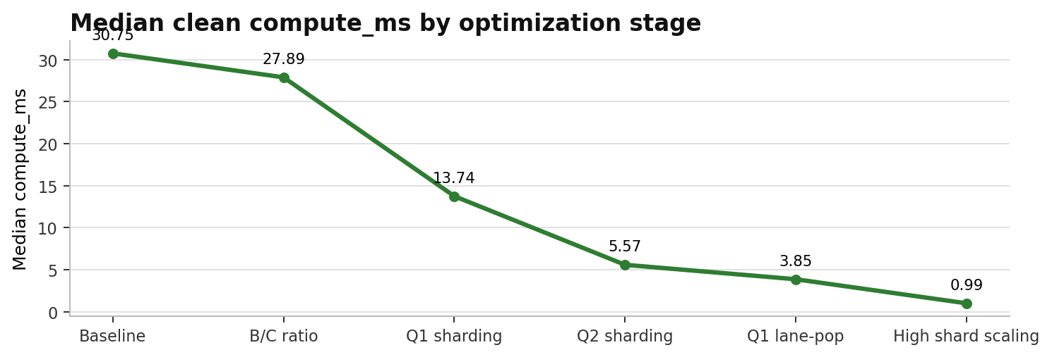
Vulkan Persistent Thread WorkGraph POC
07
Bottleneck timeline: median clean compute_ms
Stage | Config | Median ms
Baseline | Q1 batch on, Q2 scalar, C=24/B=72 | 30.7499
B/C ratio | C=40/B=56 | 27.8938
Q1 sharding | Q1s16/Q2s1, C=38/B=58 | 13.7416
Q2 sharding | Q1s16/Q2s16, C=16/B=80 | 5.5708
Q1 lane-pop | Q1s16/Q2s16, C=24/B=72 | 3.8509
High shard scaling | Q1s256/Q2s256, C=24/B=72 | 0.9868
Every major improvement corresponds to reducing or distributing queue atomic contention.
2026-05-25
Optimization Evaluation v2

Slide 8
Vulkan Persistent Thread WorkGraph POC
08
Optimization 1: B/C ratio
C/B | Median ms | Avg ms
24/72 | 30.7499 | 30.3533
32/64 | 28.5262 | 28.4431
40/56 | 27.8938 | 27.9742
48/48 | 28.5412 | 28.5873
64/32 | 30.2860 | 30.2509
EVIDENCE
What this stage proved
- Increasing Node C writers reduced Q2 backlog.
- C=40/B=56 improved median compute, but queue contention remained the larger bottleneck.
50k -> 9k
30.75 -> 27.89
Interpretation: writer balance matters, but it does not remove the single hot queue state.
Q2 high-water trend
Median ms
counter-enabled runs
clean runs
2026-05-25
Optimization Evaluation v2

Slide 9
Vulkan Persistent Thread WorkGraph POC
09
Optimization 2: Q1 sharding
Q1 shards | C/B | Median ms | Avg ms
4 | 40/56 | 23.3164 | 23.2366
8 | 40/56 | 17.9518 | 17.9043
16 | 36/60 | 13.9788 | 13.9523
16 | 38/58 | 13.7416 | 13.7046
16 | 40/56 | 14.1297 | 14.084
Before
After
Single Q1 queue hot count/head/tail
Q1 split across shards same queue protocol
- Q1 sharding turns one global atomic hotspot into multiple smaller hotspots.
- After Q1 pressure drops, Q2 queue pressure becomes the next clear bottleneck.
13.74 ms
The improvement stacks with B/C tuning, which supports the contention hypothesis.
Q1s16/Q2s1 median
2026-05-25
Optimization Evaluation v2

Slide 10
Vulkan Persistent Thread WorkGraph POC
10
Optimization 3: Q2 sharding
Q2 shards | Median ms | Avg ms | Speedup
1 | 16.9962 | 16.9529 | 1
2 | 10.2455 | 10.2431 | 1.655
4 | 8.3799 | 8.3824 | 2.022
8 | 6.8738 | 6.8656 | 2.469
16 | 6.0924 | 6.0839 | 2.787
READOUT
Second major structural optimization
- Q1 sharding exposed Q2 count/head/tail as the next global pressure point.
- Q2 sharding lowered median compute to about 5.57 ms after B/C rebalance.
5.57 ms
2.79x
The repeated pattern is not general compute optimization. It is queue hotspot removal.
Q1s16/Q2s16 median
vs Q2s1 in sweep
2026-05-25
Optimization Evaluation v2

Slide 11
Vulkan Persistent Thread WorkGraph POC
11
Optimization 4: Q1 lane-pop
Mode | Median ms | Avg ms | Min ms
lane-pop off, C=16/B=80 | 5.60 | 6.01 | 5.54
lane-pop on, C=16/B=80 | 4.00 | 4.39 | 3.90
lane-pop on, C=24/B=72 | 3.8509 | 3.8526 | 3.7292
Scan-start change
Old: wgId % Q1_QUEUE_SHARDS
New: (wgId * local_size_x + localId) % Q1_QUEUE_SHARDS
This is not request batching. It keeps the queue protocol but diversifies where lanes begin scanning, reducing avoidable local shard contention.
2026-05-25
Optimization Evaluation v2

Slide 12
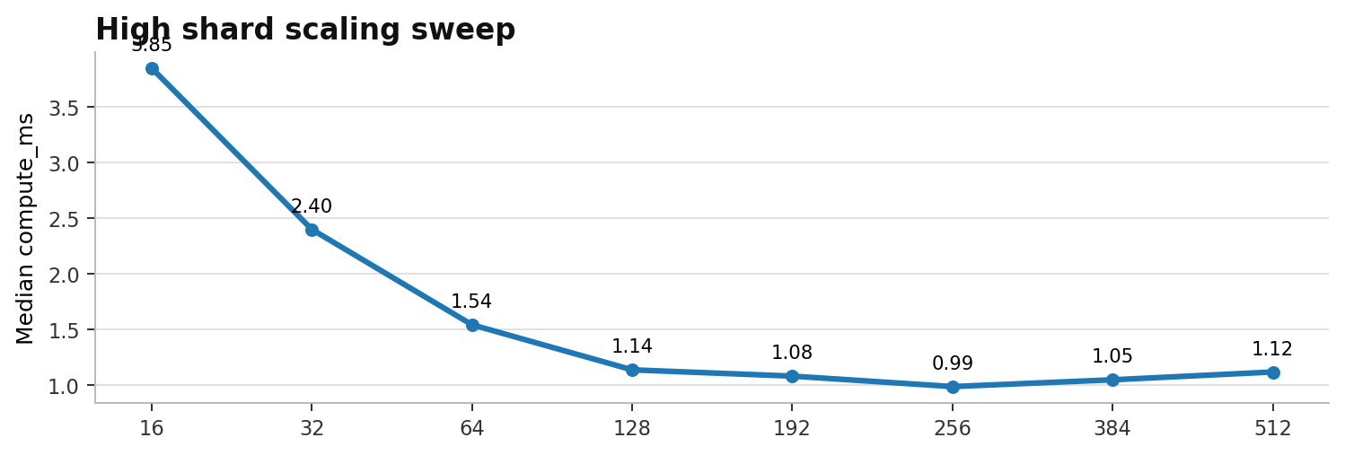
Vulkan Persistent Thread WorkGraph POC
12
Optimization 5: high shard scaling
Q1/Q2 | Median | P90
16 | 3.8509 | 3.8998
32 | 2.4002 | 2.4205
64 | 1.5427 | 1.5572
128 | 1.1372 | 1.1545
192 | 1.0808 | 1.0969
256 | 0.9868 | 1.0068
384 | 1.0478 | 1.0688
512 | 1.1178 | 1.1342
256 / 256
256 shards is the effective range in this architecture. Higher counts begin losing benefit to probing and indexing overhead.
Adopted default
2026-05-25
Optimization Evaluation v2

Slide 13
Vulkan Persistent Thread WorkGraph POC
13
Request batching: why the idea was plausible
Problem
Idea
Expected
Risk
Per-item dequeue CAS creates heavy retry traffic
One subgroup claim reserves multiple slots
Fewer CAS attempts per consumed item
More ready-spin or empty slots
Validation question
Does request batching improve clean median and P90 in the same controlled suite, or does it only move the cost into ready-spin and wasted polling?
2026-05-25
Optimization Evaluation v2

Slide 14
Vulkan Persistent Thread WorkGraph POC
14
Request batching controlled results
Default 256 suite | Samples | Median | P90
off | 354 | 1.9432 | 1.9691
l8 | 354 | 11.7109 | 11.7553
l16 | 354 | 11.4284 | 11.4658
l32 | 354 | 11.2778 | 11.3034
l1 | 0 | no samples | no samples
l2 | 0 | no samples | no samples
l4 | 0 | no samples | no samples
Stress 16 suite | Median | P90
off | 4.2442 | 4.9059
l4 | 4.2553 | 4.6734
l8 | 4.1737 | 5.1022
l16 | 4.2623 | 5.3898
l32 | 4.1165 | 5.2635
1.9432 ms
11 ms range
Conclusion: batching can help selected stress medians, but it does not generalize and can severely regress the default 256-shard setup.
Suite-local off baseline
Default 256 batching regression
2026-05-25
Optimization Evaluation v2

Slide 15
Vulkan Persistent Thread WorkGraph POC
15
Adopted default: current main path
256
256
ON
24 / 72
Q1 shards
Q2 shards
Q1 lane-pop
C/B workers
Setting | Value
MAX_QUEUE_SHARDS | 256
Q1_QUEUE_SHARDS_DEFAULT | 256
Q2_QUEUE_SHARDS_DEFAULT | 256
ENABLE_Q1_LANE_POP | default on
NODE_C_START | 72, so C=24/B=72
The main path is not a magic parameter. It is the endpoint of a sequence that repeatedly removed queue/global atomic contention.
2026-05-25
Optimization Evaluation v2

Slide 16
Vulkan Persistent Thread WorkGraph POC
16
Final confirmation: main integrated repeats
Run | Samples | Median | P10 | P90 | Min
repeat 1 | 1836 | 0.9904 | 0.9804 | 1.0036 | 0.9659
repeat 2 | 1867 | 0.9916 | 0.9819 | 1.0053 | 0.9657
repeat 3 | 1868 | 0.9907 | 0.9810 | 1.0042 | 0.9593
repeat 4 | 1866 | 0.9903 | 0.9807 | 1.0038 | 0.9615
~0.99 ms
~1.00 ms
Repeat runs show a stable median near 0.99 ms with P90 close to 1.00 ms.
Median band across repeats
P90 band across repeats
2026-05-25
Optimization Evaluation v2

Slide 17
Vulkan Persistent Thread WorkGraph POC
17
Key conclusion
Verified
Adopted
Rejected
Atomic traffic was validated as the bottleneck class.
Sharding plus lane-pop is the main optimization path.
Request batching is not adopted for this protocol/workload.
The current architecture can reach about 0.99 ms median, but the remaining design question is whether work can stay more local before spilling to global queues.
2026-05-25
Optimization Evaluation v2

Slide 18
Vulkan Persistent Thread WorkGraph POC
18
Next plan: wave-local work retention
Current baseline
Prototype
Compare
Global sharded queues Q1/Q2 = 256/256
Wave-local retention spill-to-global fallback
global atomic count spill ratio tail stability
- Keep 256-shard main path as the baseline.
- Measure global atomic count, wave-local handoff count, spill-to-global ratio, and compute duration.
- Revisit request batching only if the queue protocol changes.
- Keep timing and atomic-counter diagnosis separate in the next experiment.
2026-05-25
Optimization Evaluation v2

Slide 19
Vulkan Persistent Thread WorkGraph POC
19
Appendix: code snippets
SHARD PUSH
Q1 LANE-POP
Q2 BATCH CAS
Shard push / ready publish
Q1 lane-pop start shard
Request batching CAS claim
uint shard = mixHash(h) % Q1_QUEUE_SHARDS; if (atomicCompSwap(control.q1[shard].count, cur, cur + 1u) == cur) { uint localSlot = atomicAdd(control.q1[shard].tail, 1u) % capacity; atomicExchange(queue1.tasks[slot].payload[5], 1u); }
uint worker = wgId * local_size_x + localId; uint homeShard = (ENABLE_Q1_LANE_POP != 0u) ? (worker % Q1_QUEUE_SHARDS) : (wgId % Q1_QUEUE_SHARDS);
uint claim = min(available, Q2_DEQUEUE_BATCH_LIMIT); if (atomicCompSwap(control.q2[shard].count, cur, cur - claim) == cur) { baseHead = atomicAdd(control.q2[shard].head, claim); }
2026-05-25
Optimization Evaluation v2

Slide 20
Vulkan Persistent Thread WorkGraph POC
20
Appendix: numeric source files
Artifact | Path
Normalized measurements | reports/2026-05/metrics/monthly_v2_normalized_measurements_20260525.csv
Measurement notes | reports/2026-05/metrics/monthly_v2_measurement_notes_20260525.md
Main backbone | reports/2026-05/metrics/q2_shards_20260510/research_backbone_20260510.md
Request batching summary | reports/2026-05/metrics/request_batching_validation_20260525/request_batching_validation_summary.csv
Primary performance numbers are sourced from the normalized measurement table.
2026-05-25
Optimization Evaluation v2

