Slide 1
MONTHLY REPORT
Vulkan Persistent Thread WorkGraph POC
May 2026 evaluation: queue atomics set the bottleneck, and sharding removes it
30.75 ms
0.99 ms
31.0x
Starting median
Final repeat median
Median speedup
clean timestamp
main defaults
same workload
Adopt Q1/Q2 sharding and lane-based Q1 pop. Keep request batching out of the main path because the default 256-shard suite regresses.
AMD RX 7900 XTX / RDNA 3

Slide 2
Vulkan Persistent Thread WorkGraph POC
Queue atomics explain the measured gains
BOTTLENECK
BOUNDARY
ADOPT
REJECT
Bottleneck
Boundary
Adopt
Reject
Clean median falls when a change reduces shared Q1/Q2 queue pressure.
Timestamp-only runs carry duration. Counter runs explain CAS, backlog, and ready-spin.
Q1 shards, Q2 shards, and lane-based Q1 pop reach about 0.99 ms median.
Q2 request batching pushes the default 256-shard suite into the 11 ms band.
The adopted path moves 30.75 ms to 0.99 ms without using shader counters in the timing run.

Slide 3
Vulkan Persistent Thread WorkGraph POC
Only Q1/Q2 handoff points are shared global queue state
Node A
Q1
Node B
Q2
Node C
VB Render
Seed edges once
atomic count/head/tail ready flag
Subdivide work
atomic count/head/tail ready flag
Write vertices
Deterministic draw
Shared fields
Test question
- Q1/Q2 count, head, tail, and ready flags synchronize cross-workgroup handoff.
- Many lanes and workgroups touch the same fields before sharding.
- Candidate changes must reduce clean duration, queue contention, or both.
- Reject cost shifts into polling or ready-spin.

Slide 4
Vulkan Persistent Thread WorkGraph POC
Clean timing plus counters define the adoption rule
PRIOR REPORT
RULE
Before May 10
Decision rule
- The POC produced correct deterministic output.
- Persistent workers exchanged work through global atomic queues.
- Duration runs still carried diagnostic counters.
- Clean timestamp runs set the performance number.
- Counter-enabled runs diagnose CAS retries, backlog, and polling.
- Adopt clean-timing improvements.
The conclusion rests on a narrow rule: duration proves impact; counters explain the mechanism.

Slide 5
Vulkan Persistent Thread WorkGraph POC
Timing and counters answer different questions
Run type | Purpose | Primary readout | What it supports
Clean timestamp runs | Performance claim | Median compute_ms after warmup | Duration, speedup, adoption
Counter-enabled runs | Mechanism check | CAS fail ratio, backlog, ready-spin, empty-pop | Queue contention diagnosis
RGP occupancy | Context | Wavefront view and event timing | Profiler boundary
Adopt
Diagnose
Bound
Clean runs decide if a change stays.
Counters identify the queue failure mode.
RGP views set scope; timing carries proof.
Separating run types keeps counter instrumentation out of the performance result.

Slide 6
Vulkan Persistent Thread WorkGraph POC
Each atomic metric maps to a queue failure mode
Metric | Interpretation | Decision use
CAS fail per success | Lanes or workgroups retry the same queue state. | High contention; sharding should reduce the retry rate.
Attempts vs success | The control path burns operations without throughput. | Detects wasted polling.
Queue high-water | Backlog exposes producer/consumer imbalance. | Guides B/C balance and Q2 pressure checks.
Ready-spin / empty-pop | Consumers claim or probe before useful work is ready. | Explains request batching regressions.
Clean vs counter runs | The run type separates duration from diagnosis. | Keeps cause analysis out of headline timing.
A change earns confidence when clean duration improves and the relevant counter pressure moves in the same direction.

Slide 7
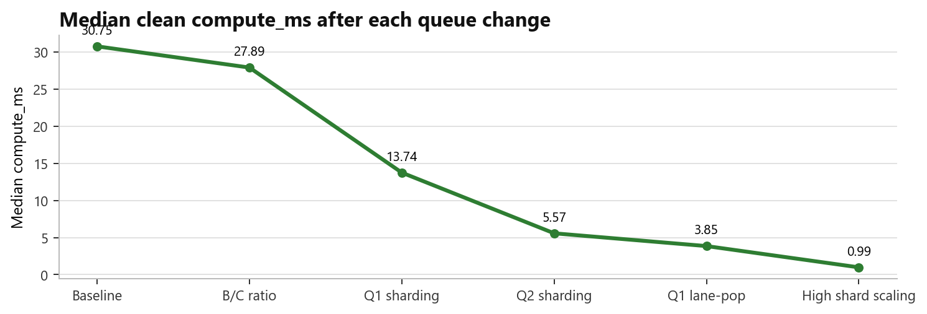
Vulkan Persistent Thread WorkGraph POC
Queue-locality changes drove a 31.0x median speedup
30.75 ms
0.99 ms
Starting median
Final repeat
clean timestamp
main defaults
31.0x
Median speedup
same workload
Baseline
B/C ratio
Q1 sharding
Q2 sharding
Q1 lane-pop
High shard scaling
30.7499 ms
27.8938 ms
13.7416 ms
5.5708 ms
3.8509 ms
0.9868 ms
Every large drop follows a queue split or scan-diversification step; request batching stays outside the adopted path.

Slide 8
Vulkan Persistent Thread WorkGraph POC
C/B tuning reduces backlog; sharding remains necessary
C/B | Median ms | Avg ms
24/72 | 30.7499 | 30.3533
32/64 | 28.5262 | 28.4431
40/56 | 27.8938 | 27.9742
48/48 | 28.5412 | 28.5873
64/32 | 30.2860 | 30.2509
READOUT
Writer balance is a setup fix
- C=40/B=56 lowers Q2 high-water from about 50k to about 9k.
- Median improves by 2.86 ms, but the queue remains a shared atomic hotspot.
50k -> 9k
30.75 -> 27.89
Set C=40/B=56 before testing structural queue changes.
Q2 high-water trend
Median ms
counter-enabled runs
clean runs

Slide 9
Vulkan Persistent Thread WorkGraph POC
Q1 sharding cuts median to 13.74 ms and exposes Q2
Q1 shards | C/B | Median ms | Avg ms
4 | 40/56 | 23.3164 | 23.2366
8 | 40/56 | 17.9518 | 17.9043
16 | 36/60 | 13.9788 | 13.9523
16 | 38/58 | 13.7416 | 13.7046
16 | 40/56 | 14.1297 | 14.084
Before
After
Single Q1 queue hot count/head/tail
Q1 split across shards same queue protocol
- Q1 sharding turns one global atomic queue into 16 smaller queues.
- After Q1 pressure drops, Q2 count/head/tail becomes the next bottleneck target.
13.74 ms
The result stacks with B/C tuning, so the gain tracks queue contention instead of an unrelated shader change.
Q1s16/Q2s1 median

Slide 10
Vulkan Persistent Thread WorkGraph POC
Q2 sharding removes the second global queue wall
Q2 shards | Median ms | Avg ms | Speedup
1 | 16.9962 | 16.9529 | 1
2 | 10.2455 | 10.2431 | 1.655
4 | 8.3799 | 8.3824 | 2.022
8 | 6.8738 | 6.8656 | 2.469
16 | 6.0924 | 6.0839 | 2.787
DECISION
Shard Q2 before batching it
- Q2 median improves from 1 to 16 shards.
- After B/C rebalance, Q1s16/Q2s16 reaches about 5.57 ms median.
5.57 ms
2.79x
The same pattern repeats: split the shared queue state, then retune worker balance.
Q1s16/Q2s16 median
vs Q2s1 in sweep

Slide 11
Vulkan Persistent Thread WorkGraph POC
Lane-pop removes same-shard starts inside a workgroup
Mode | Median ms | Avg ms | Min ms
lane-pop off, C=16/B=80 | 5.60 | 6.01 | 5.54
lane-pop on, C=16/B=80 | 4.00 | 4.39 | 3.90
lane-pop on, C=24/B=72 | 3.8509 | 3.8526 | 3.7292
Scan-start rule
Old: wgId % Q1_QUEUE_SHARDS
New: (wgId * local_size_x + localId) % Q1_QUEUE_SHARDS
Lane-pop keeps the queue protocol intact. It changes where each lane begins scanning, so the improvement isolates shard-selection pressure.

Slide 12
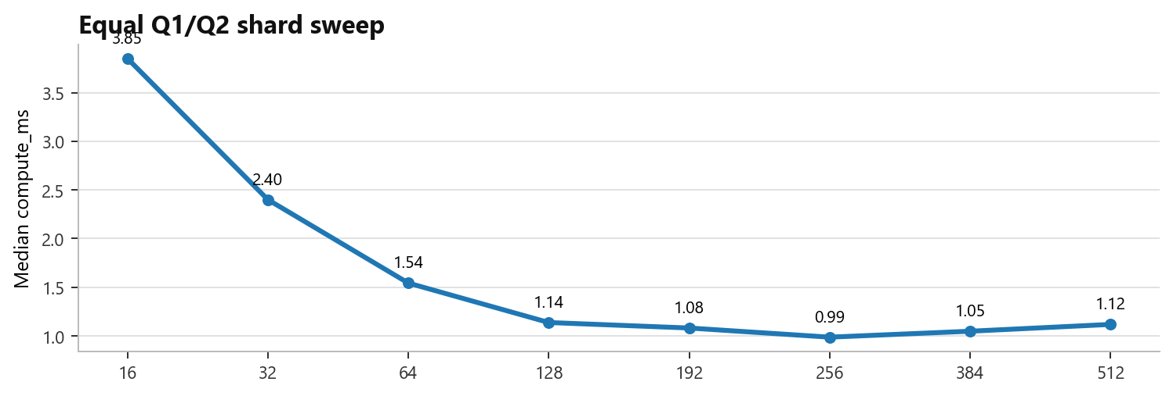
Vulkan Persistent Thread WorkGraph POC
256/256 is the measured knee of the shard-count tradeoff
Q1/Q2 | Median | P90
16 | 3.8509 | 3.8998
32 | 2.4002 | 2.4205
64 | 1.5427 | 1.5572
128 | 1.1372 | 1.1545
192 | 1.0808 | 1.0969
256 | 0.9868 | 1.0068
384 | 1.0478 | 1.0688
512 | 1.1178 | 1.1342
256 / 256
The 256-shard point has the best median in the sweep; 384 and 512 add probe/index cost without improving the tail.
Adopted default

Slide 13
Vulkan Persistent Thread WorkGraph POC
Request batching targets dequeue CAS first
Problem
Idea
Expected
Risk
Per-item dequeue CAS creates heavy retry traffic
One subgroup claim reserves multiple slots
Fewer CAS attempts per consumed item
More ready-spin or empty slots
Adoption test
A batch claim must lower clean median and P90 in the default 256-shard suite without moving cost into ready-spin or empty-slot work.

Slide 14
Vulkan Persistent Thread WorkGraph POC
Default 256-shard batching regresses, so it stays out
1.9432 ms
11 ms range
Stress cases can improve, but the default path moves from 1.94 ms off-baseline into the 11 ms band.
Default off baseline
Default batching result
suite-local
L8/L16/L32
Default 256 suite | Samples | Median | P90
off | 354 | 1.9432 | 1.9691
l8 | 354 | 11.7109 | 11.7553
l16 | 354 | 11.4284 | 11.4658
l32 | 354 | 11.2778 | 11.3034
l1 | 0 | no samples | no samples
l2 | 0 | no samples | no samples
l4 | 0 | no samples | no samples
Stress 16 suite | Median | P90
off | 4.2442 | 4.9059
l4 | 4.2553 | 4.6734
l8 | 4.1737 | 5.1022
l16 | 4.2623 | 5.3898
l32 | 4.1165 | 5.2635
Decision: reject batching for the current main protocol; revisit it only after the queue protocol changes.

Slide 15
Vulkan Persistent Thread WorkGraph POC
The main path encodes the proven queue changes
256
256
ON
24 / 72
Q1 shards
Q2 shards
Q1 lane-pop
C/B workers
Setting | Value
MAX_QUEUE_SHARDS | 256
Q1_QUEUE_SHARDS_DEFAULT | 256
Q2_QUEUE_SHARDS_DEFAULT | 256
ENABLE_Q1_LANE_POP | default on
NODE_C_START | 72, so C=24/B=72
The defaults preserve the measured mechanisms: split both queues, diversify Q1 scan starts, and keep the B/C mix from the best clean run.

Slide 16
Vulkan Persistent Thread WorkGraph POC
Four clean repeats keep median and P90 near 1 ms
Run | Samples | Median | P10 | P90 | Min
repeat 1 | 1836 | 0.9904 | 0.9804 | 1.0036 | 0.9659
repeat 2 | 1867 | 0.9916 | 0.9819 | 1.0053 | 0.9657
repeat 3 | 1868 | 0.9907 | 0.9810 | 1.0042 | 0.9593
repeat 4 | 1866 | 0.9903 | 0.9807 | 1.0038 | 0.9615
~0.99 ms
~1.00 ms
The confirmation set keeps median within a 0.0014 ms band and P90 near 1.00 ms across four runs.
Median band across repeats
P90 band across repeats

Slide 17
Vulkan Persistent Thread WorkGraph POC
Next experiment: reduce global spill
Proven
Kept
Dropped
Shared queue atomics drove the measured bottleneck.
Q1/Q2 sharding plus Q1 lane-pop stays in main.
Q2 request batching fails the default-suite test.
The current architecture reaches about 0.99 ms median. The next useful experiment should reduce trips to global queues before revisiting batch claims.

Slide 18
Vulkan Persistent Thread WorkGraph POC
Wave-local retention should measure global spill reduction
Current baseline
Prototype
Compare
Global sharded queues Q1/Q2 = 256/256
Wave-local retention spill fallback
global atomic count spill ratio P90/tail stability
- Use the 256-shard main path as the baseline.
- Measure global atomic count, wave-local handoff count, spill ratio, and clean duration.
- Bring request batching back after a queue-protocol change.
- Keep timing and atomic-counter diagnosis split in the next run.

Slide 19
Vulkan Persistent Thread WorkGraph POC
Appendix: code surfaces behind each decision
SHARD PUSH
Q1 LANE-POP
Q2 BATCH CAS
Adopted: shard selection plus ready publish
Adopted: lane-based Q1 scan start
Rejected: subgroup batch claim
uint shard = mixHash(h) % Q1_QUEUE_SHARDS; if (atomicCompSwap(control.q1[shard].count, cur, cur + 1u) == cur) { uint localSlot = atomicAdd(control.q1[shard].tail, 1u) % capacity; atomicExchange(queue1.tasks[slot].payload[5], 1u); }
uint worker = wgId * local_size_x + localId; uint homeShard = (ENABLE_Q1_LANE_POP != 0u) ? (worker % Q1_QUEUE_SHARDS) : (wgId % Q1_QUEUE_SHARDS);
uint claim = min(available, Q2_DEQUEUE_BATCH_LIMIT); if (atomicCompSwap(control.q2[shard].count, cur, cur - claim) == cur) { baseHead = atomicAdd(control.q2[shard].head, claim); }

Slide 20
Vulkan Persistent Thread WorkGraph POC
Appendix: numeric source table and provenance
Artifact | Path
Normalized measurements | reports/2026-05/metrics/monthly_v5_normalized_measurements_20260525.csv
Measurement notes | reports/2026-05/metrics/monthly_v5_measurement_notes_20260525.md
Main backbone | reports/2026-05/metrics/q2_shards_20260510/research_backbone_20260510.md
Request batching summary | reports/2026-05/metrics/request_batching_validation_20260525/request_batching_validation_summary.csv
Use the normalized table for headline numbers; use the notes file for warmup rules and source-file mapping.

