Slide 1
Vulkan Persistent Thread
Producer-Consumer Network POC
D3D Work Graphs Monthly Progress Report
2026 / 0424

Slide 2
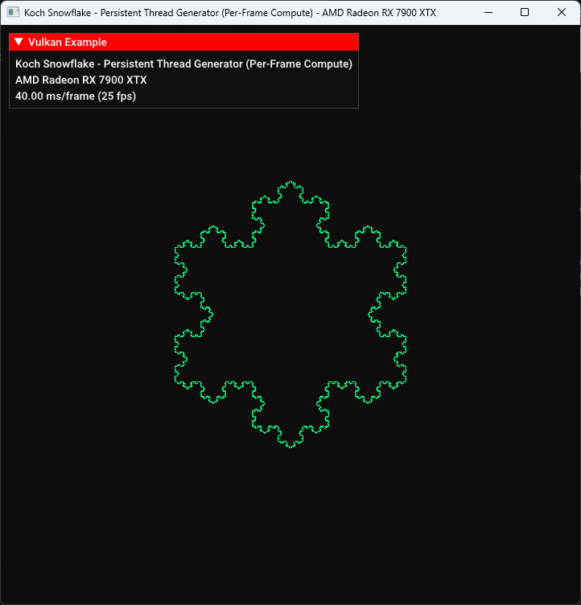
Overview
Goal
Implement a D3D12 Work Graph analogue on Vulkan using persistent compute shaders
Why
Find key considerations during design
Make basic evaluation
Test Case
Koch Snowflake fractal generation + real-time rendering Recursive branching workload: 1 edge → 4 sub-edges per level

Slide 3
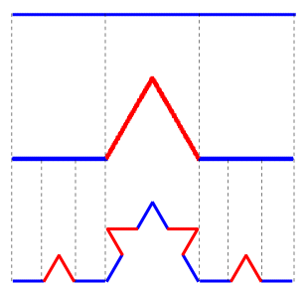
System Architecture
HOST (CPU)
↓
↺ feedback (depth < MAX)
Node A
(Seed)
Q1
Node B
(Subdivide)
Q2
Node C
(Write VB)
→
→
→
→
↓
Graphics Pipeline
→ Display
←
Vertex Buffer
Per-Frame Command Buffer Flow:
// buildCommandBuffers() - per frame
vkCmdFillBuffer(cmd, controlBuf, ...); // 1. GPU Reset
vkCmdFillBuffer(cmd, q1Buf/q2Buf, ...);
vkCmdPipelineBarrier(...TRANSFER → COMPUTE); // 2. Barrier
vkCmdDispatch(cmd, 96, 1, 1); // 3. Compute (3072 threads)
vkCmdPipelineBarrier(...COMPUTE → VERTEX); // 4. Barrier
vkCmdDraw(cmd, 24576, 1, 0, 0); // 5. Render

Slide 4
Persistent Thread Model
Workgroup | Role | Queue | Action
WG 0 | Node A / B | Seed → Q1 | Thread 0 seeds 3 edges, then all do Node B
WG 1–71 | Node B | Q1 → Q1 / Q2 | Pop Q1, subdivide, push back Q1 or forward Q2
WG 72–95 | Node C | Q2 → VB | Pop Q2, write vertices, count → stopFlag
Single dispatch: vkCmdDispatch(96, 1, 1) = 96 WG × 32 threads = 3,072 persistent threads
Shader Main Loop Structure:
void main() {
uint wgId = gl_WorkGroupID.x;
uint localId = gl_LocalInvocationID.x;
if (wgId == 0 && localId == 0) {
if (atomicCompSwap(control.seedDone, 0, 1) == 0) {
pushQ1( /* ...*/); pushQ1( /* ...*/); pushQ1( /* ...*/);
}
}
/* ...*/
while (control.stopFlag == 0) {
if (wgId < NODE_C_START) { /* Node B */ }
else { /* Node C */ }
}
}

Slide 5
Atomic Queue Mechanism (mutex-free)
Ring Buffer Structure
pushQ1() Implementation:
QueueControl: head / tail / count
Task: payload[6] (4×float + depth + ready)
Push Protocol:
1. CAS count (reserve slot) 2. atomicAdd tail (get slot index)
3. Write payload[0–4]
4. memoryBarrierBuffer()
5. atomicExchange(ready, 1)
Pop Protocol:
1. CAS count (claim item)
2. atomicAdd head (get slot)
3. Spin: atomicCompSwap(ready,1,0)
4. Read payload
bool pushQ1(uint p0, uint p1, uint p2,
uint p3, uint p4) {
while (control.stopFlag == 0) {
uint cur = control.q1.count;
if (cur < QUEUE_SIZE) {
// CAS: reserve a slot
if (atomicCompSwap(control.q1.count, cur, cur+1) == cur) {
uint slot = atomicAdd(control.q1.tail, 1) % QUEUE_SIZE;
// Write payload
queue1.tasks[slot].payload[0] = p0;
queue1.tasks[slot].payload[1] = p1;
queue1.tasks[slot].payload[2] = p2;
queue1.tasks[slot].payload[3] = p3;
queue1.tasks[slot].payload[4] = p4;
memoryBarrierBuffer();
// Signal ready (atomic!)
atomicExchange(queue1.tasks[slot].payload[5], 1u);
return true;
}
}
}
return false;
}

Slide 6
Cross-Workgroup Memory Sync
1
Producer-consumer data race
Fix: Added per-slot payload[5] ready flag protocol
Producer increments count then writes data; consumer reads uninitialized
2
Plain store cross-CU unreliable
Fix: All ready flags use atomicExchange / atomicCompSwap
Plain store of ready flag not visible across CUs
Memory Visibility:
Method | Same WF | Same CU | Cross-CU
Plain load/store | ✔ | ~ | ~
coherent | ✔ | ✔ | ~
Atomic (CAS/Exch) | ✔ | ✔ | ✔

Slide 7
Koch Snowflake Algorithm
Subdivision Rule:
Node B: Subdivision Core:
Each edge P1->P2 splits into 4 sub-edges:
P1 -> A -> C -> B -> P2
A, B = 1/3, 2/3 points along P1P2
C = apex point, rotated +60 deg from A
Growth: 3 x 4^depth edges
depth=4: 768 edges (1,536 vertices)
depth=6: 12,288 edges (24,576 vertices)
depth=8: 196,608 edges (393,216 vertices)
// Koch subdivision: 1 edge -> 4 sub-edges
float dx = (x2 - x1) / 3.0;
float dy = (y2 - y1) / 3.0;
// A = 1/3 point, B = 2/3 point
float kax = x1 + dx, kay = y1 + dy;
float kbx = x1 + 2.0 * dx, kby = y1 + 2.0 * dy;
// C = apex (shader orientation)
float cos60 = 0.5;
float sin60 = 0.8660254037844387;
float kcx = kax + dx * cos60 + dy * sin60;
float kcy = kay - dx * sin60 + dy * cos60;
// Push 4 sub-edges (depth+1)
pushQ1(P1->A); pushQ1(A->C);
pushQ1(C->B); pushQ1(B->P2);
GPU Self-Termination:
// Node C: auto-shutdown when all edges processed
uint processed = atomicAdd(control.totalProcessed, 1) + 1;
if (processed >= MAX_DEPTH_EDGES) {
atomicExchange(control.stopFlag, 1u); // all threads exit
}

Slide 8
Risk & Mitigation
GPU-side termination
Completion is decided by Node C using a global processed-edge counter.
headless.comp:153-160
What it does
The GPU terminates itself after the expected number of output edges.
uint base = atomicAdd(control.vertexCount, 2);
output_vb.vertices[base] = vec2(x1, y1);
output_vb.vertices[base + 1] = vec2(x2, y2);
uint processed = atomicAdd(control.totalProcessed, 1) + 1;
if (processed >= MAX_DEPTH_EDGES) {
atomicExchange(control.stopFlag, 1u);
}
Risk
Fail if MAX_DEPTH_EDGES or workload shape is wrong.
Possible fix
Add queue-drain or in-flight accounting as a second termination condition.

Slide 9
Risk & Mitigation
Static role mapping
Workgroup ID hard-partitions producer and consumer roles.
workgraph_poc.cpp:12-13, headless.comp:92-138
What it does
Current role split is fixed: 72 workgroups for subdivision, 24 for output writes.
#define NUM_WORKGROUPS 96
#define NODE_C_START 72
while (control.stopFlag == 0) {
if (wgId < NODE_C_START) {
// NODE B: Subdivider
} else {
// NODE C: Writer
}
}
Risk
Fixed B/C ratio can become imbalanced when queue pressure changes.
Role switching ←→ Cache Utilization
Possible fix
Pressure-driven role switching;
Working item dependencies sensitive role switching.

Slide 10
Risk & Mitigation
Spin wait risk
Consumers busy-spin on ready flags; cost is identified but not measured in this report.
headless.comp:99-101, 143-145
What it does
Busy-spin is part of the current correctness-first design.
// Q1 consumer waits for producer publish
while (atomicCompSwap(
queue1.tasks[slot].payload[5], 1u, 0u) != 1u) {
if (control.stopFlag != 0u) return;
}
// Q2 uses the same ready-flag spin protocol
while (atomicCompSwap(
queue2.tasks[slot].payload[5], 1u, 0u) != 1u) {
if (control.stopFlag != 0u) return;
}
Risk
Under producer-consumer imbalance, retries may reduce effective throughput before arithmetic saturates.
Possible fix
Wave sleep instructions.

Slide 11
Risk & Mitigation
Fixed-size backing queues
Queue capacity is fixed and producers spin when no slot is available.
workgraph_poc.cpp:9-11, headless.comp:29-45
What it does
A global ring buffer backs cross-workgroup producer-consumer handoff.
#define EXPECTED_EDGES (3u * (1u << (2u * MAX_DEPTH)))
#define QUEUE_SIZE EXPECTED_EDGES
bool pushQ1(...) {
while (control.stopFlag == 0) {
uint cur = control.q1.count;
if (cur < QUEUE_SIZE) {
if (atomicCompSwap(
control.q1.count, cur, cur + 1)== cur) {
uint slot = atomicAdd( control.q1.tail, 1) % QUEUE_SIZE;
...
}
}
}
}
Risk
Too small increases retries and progress risk;
Too large increases memory footprint.
Possible fix
Define sizing from worst-case frontier growth.

Slide 12
Risk & Mitigation
Atomic queue handoff
Ready flag publishes a slot only after payload writes are visible.
headless.comp:33-41, 97-101
What it does
Correctness relies on atomics plus per-slot publish/consume protocol.
// Producer
if (atomicCompSwap(control.q1.count, cur, cur + 1) == cur) {
uint slot = atomicAdd(
control.q1.tail, 1) % QUEUE_SIZE;
queue1.tasks[slot].payload[0] = p0;
...
memoryBarrierBuffer();
atomicExchange(queue1.tasks[slot].payload[5], 1u);
}
// Consumer
while (atomicCompSwap(
queue1.tasks[slot].payload[5], 1u, 0u) != 1u) { ... }
Risk
Global counters and ready flags can become contention hotspots as worker count scales.
Possible fix
Reduce global atomic pressure with batching, per-WG staging, or LDS/local queues.

Slide 13
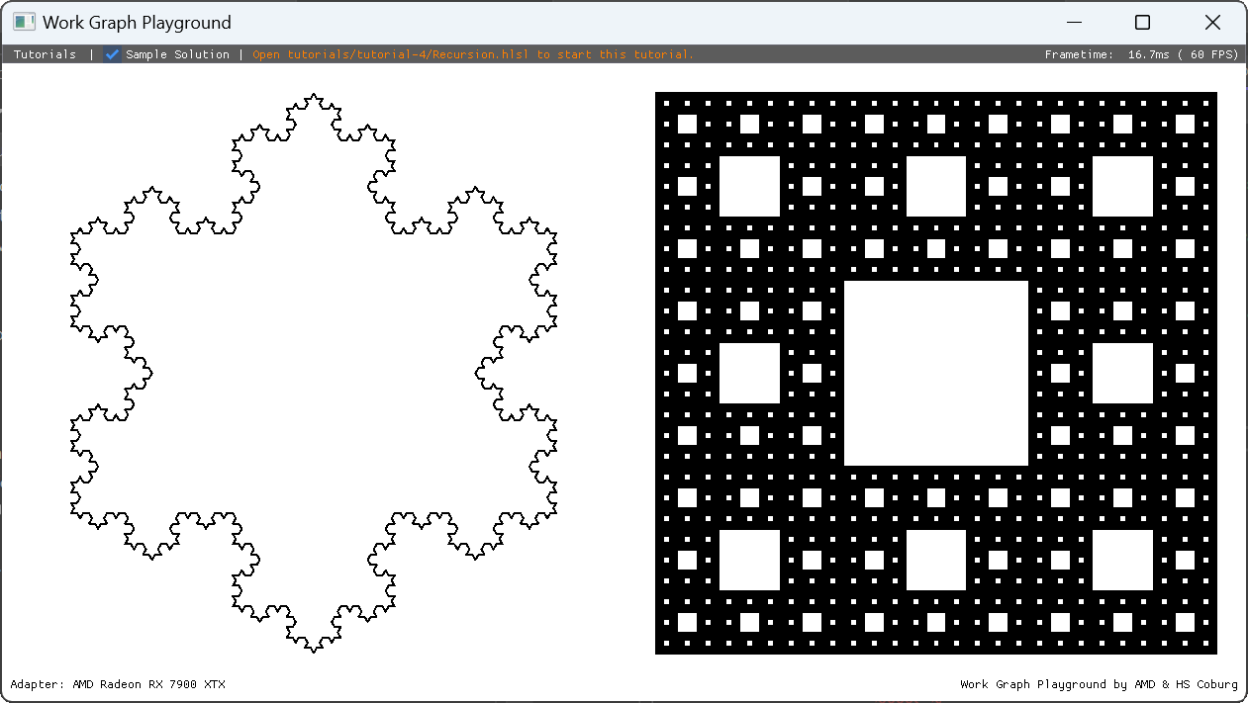
Evaluation - Baseline
D3D12 provenance aligned locally to the same Koch snowflake recursion workload.
GPUOpen WorkGraphPlayground
github.com/GPUOpen-LibrariesAndSDKs/WorkGraphPlayground
Local Alignment
Adjusted to match the snowflake evaluation workload before comparison.
Aligned snowflake capture from the local WorkGraphPlayground clone.
Notes:
Baseline provenance and alignment context.
Sources:
- https://github.com/GPUOpen-LibrariesAndSDKs/WorkGraphPlayground
- C:\CGV\Projects\D3DWorkgraph\workgraph_snowflake
- tutorials/tutorial-4/Recursion.hlsl

Slide 14
Evaluation - Profile
Summary from monthly_report_0424_profile_result.md with FPS kept as secondary callouts.
Config | FPS (Hz) | Frame duration (us) | Compute duration (us)
wg | 6,920.1 Hz | 144.507 us | 34.791 us
pt-96 | 298.6 Hz | 3,349.001 us | 3,174.813 us
wg8 | 6,157.8 Hz | 162.397 us | 50.183 us
pt8-96 | 19.5 Hz | 51,407.951 us | 51,078.034 us
pt8-96x32 | 6.5 Hz | 153,038.548 us | N/A
pt8-96x32-reverse-worker | 6.3 Hz | 157,964.844 us | N/A
Frame duration (us)
Notes:
Profile comparison data used on this slide.
Source:
- C:\CGV\Projects\D3DWorkgraph\workgraph_vulkan_poc\monthly_report_0424_profile_result.md
Compute duration is unavailable for pt8-96x32 and pt8-96x32-reverse-worker.

Slide 15
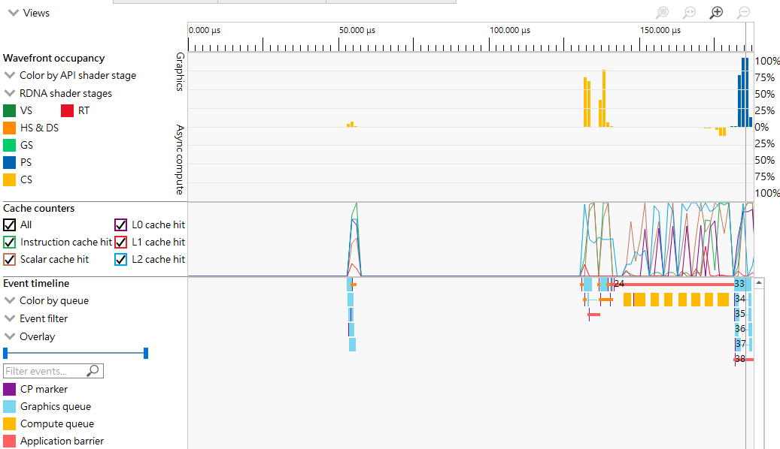
Wavefront – Work Graph / Depth 6
Notes:
Evaluation - Wavefront (WorkGraphPlayground)
Image: C:\CGV\Projects\D3DWorkgraph\workgraph_vulkan_poc\image-16.png
Matched crop and scale, image-16.png: wavefront - depth 8.

Slide 16
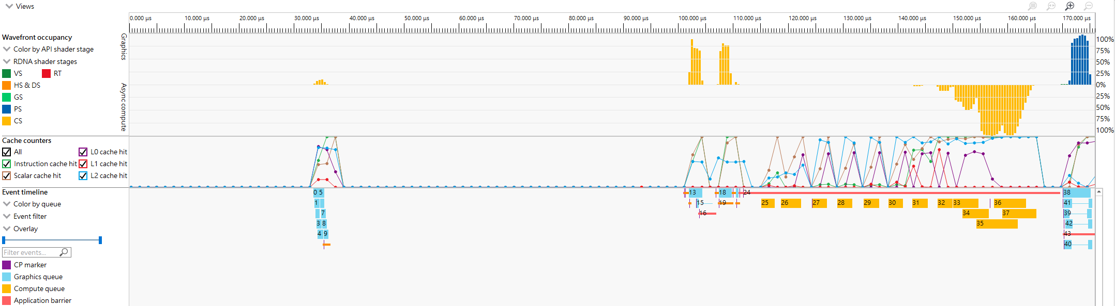
Wavefront - Work Graph / Depth 8
Notes:
Evaluation - Wavefront (WorkGraphPlayground)
Image: C:\CGV\Projects\D3DWorkgraph\workgraph_vulkan_poc\image-16.png
Matched crop and scale, image-16.png: wavefront - depth 8.

Slide 17
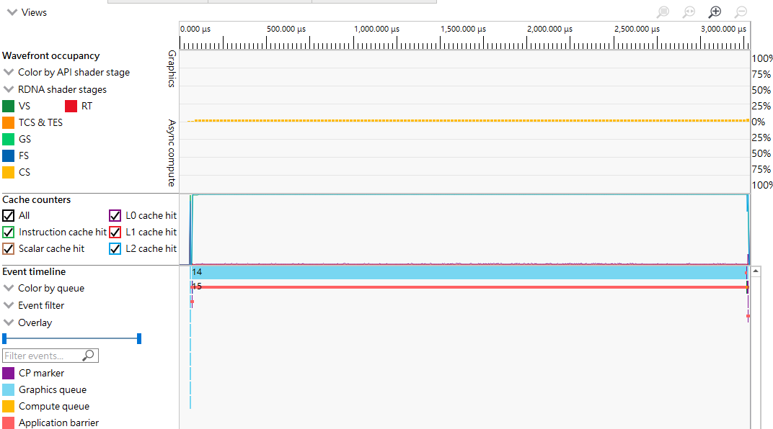
Wavefront – Persistent Thread /Depth 6
Notes:
Evaluation - Wavefront (WorkGraphPlayground)
Image: C:\CGV\Projects\D3DWorkgraph\workgraph_vulkan_poc\image-16.png
Matched crop and scale, image-16.png: wavefront - depth 8.

Slide 18
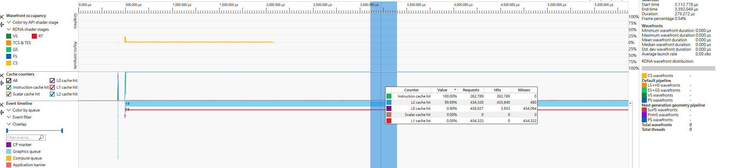
Wavefront – Persistent Thread /Depth 8
Notes:
Evaluation - Wavefront (WorkGraphPlayground)
Image: C:\CGV\Projects\D3DWorkgraph\workgraph_vulkan_poc\image-16.png
Matched crop and scale, image-16.png: wavefront - depth 8.

Slide 19
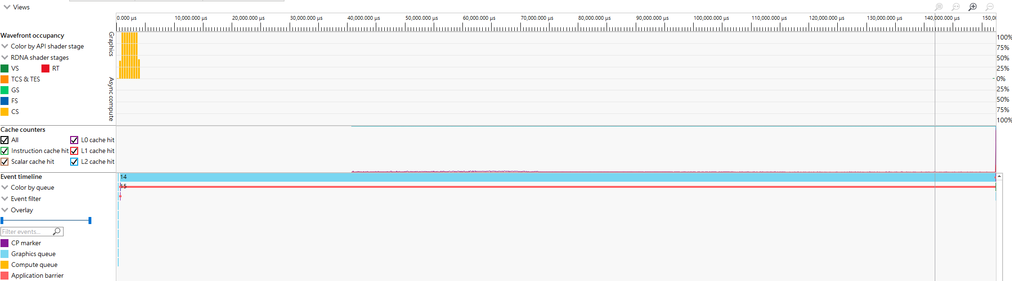
Wavefront – Persistent Thread / Depth 8 / MaxWave
Notes:
Evaluation - Wavefront (WorkGraphPlayground)
Image: C:\CGV\Projects\D3DWorkgraph\workgraph_vulkan_poc\image-16.png
Matched crop and scale, image-16.png: wavefront - depth 8.

Slide 20
Conclusion
We validated a Vulkan persistent-thread producer-consumer network as a D3D12 Work Graph analogue on RDNA 3.
The POC runs end-to-end for a recursive branching workload with deterministic output.
Performance is still under investigation.
Highlights design considerations in synchronization, queue sizing, role partitioning, and spin-based handoff cost.

