Slide 1
Vulkan Persistent Thread
Producer-Consumer Network POC
Monthly Progress Report
2026 / 04
LUO-WEN-CHIEN
AMD RX 7900 XTX | RDNA 3 | Vulkan 1.4
1 / 12

Slide 2
Research Goal & Motivation
Goal
Implement a D3D12 Work Graph analogue on Vulkan using persistent compute shaders
Why
Find key considerations during design
Measure scheduling overhead & on-chip memory utilization
Target: AMD RX 7900 XTX (RDNA 3, 96 CUs, 24GB VRAM)
Test Case
Koch Snowflake fractal generation + real-time rendering
Recursive branching workload: 1 edge → 4 sub-edges per level
2 / 12

Slide 3
System Architecture
HOST (CPU)
▼
↺ feedback (depth < MAX)
Node A
(Seed)
Q1
Node B
(Subdivide)
Q2
Node C
(Write VB)
▶
▶
▶
▶
▼
Graphics Pipeline
→ Display
◀
Vertex Buffer
(SSBO + VB)
Per-Frame Command Buffer Flow:
// buildCommandBuffers() - per frame
vkCmdFillBuffer(cmd, controlBuf, ...); // 1. GPU Reset
vkCmdFillBuffer(cmd, q1Buf/q2Buf, ...);
vkCmdPipelineBarrier(...TRANSFER → COMPUTE); // 2. Barrier
vkCmdDispatch(cmd, 96, 1, 1); // 3. Compute (3072 threads)
vkCmdPipelineBarrier(...COMPUTE → VERTEX);// 4. Barrier
vkCmdDraw(cmd, 24576, 1, 0, 0); // 5. Render
3 / 12

Slide 4
Persistent Thread Model
Workgroup | Role | Queue | Action
WG 0 | Node A + B | Seed → Q1 | Thread 0 seeds 3 edges, then all do Node B
WG 1–71 | Node B | Q1 → Q1 / Q2 | Pop Q1, subdivide, push back Q1 or forward Q2
WG 72–95 | Node C | Q2 → VB | Pop Q2, write vertices, count → stopFlag
Single dispatch: vkCmdDispatch(96, 1, 1) = 96 WG × 32 threads = 3,072 persistent threads
Shader Main Loop Structure:
void main() {
uint wgId = gl_WorkGroupID.x;
uint localId = gl_LocalInvocationID.x;
// Node A: WG 0, Thread 0 seeds 3 edges (once)
if (wgId == 0 && localId == 0) {
if (atomicCompSwap(control.seedDone, 0, 1) == 0)
pushQ1(edge_AB); pushQ1(edge_BC); pushQ1(edge_CA);
}
barrier(); memoryBarrierBuffer();
// Main persistent loop
while (control.stopFlag == 0) {
if (wgId < NODE_C_START) { /* Node B */ }
else { /* Node C */ }
}
}
4 / 12

Slide 5
Atomic Queue Mechanism
Ring Buffer Structure
pushQ1() Implementation:
QueueControl: head / tail / count
Task: payload[6] (4×float + depth + ready)
Push Protocol:
1. CAS count (reserve slot)
2. atomicAdd tail (get slot index)
3. Write payload[0–4]
4. memoryBarrierBuffer()
5. atomicExchange(ready, 1)
Pop Protocol:
1. CAS count (claim item)
2. atomicAdd head (get slot)
3. Spin: atomicCompSwap(ready,1,0)
4. Read payload
bool pushQ1(uint p0, uint p1, uint p2,
uint p3, uint p4) {
while (control.stopFlag == 0) {
uint cur = control.q1.count;
if (cur < QUEUE_SIZE) {
// CAS: reserve a slot
if (atomicCompSwap(control.q1.count,
cur, cur+1) == cur) {
uint slot = atomicAdd(
control.q1.tail, 1) % QUEUE_SIZE;
// Write payload
queue1.tasks[slot].payload[0] = p0;
queue1.tasks[slot].payload[1] = p1;
queue1.tasks[slot].payload[2] = p2;
queue1.tasks[slot].payload[3] = p3;
queue1.tasks[slot].payload[4] = p4;
memoryBarrierBuffer();
// Signal ready (atomic!)
atomicExchange(
queue1.tasks[slot].payload[5], 1u);
return true;
}
}
}
return false;
}
5 / 12

Slide 6
Cross-Workgroup Memory Sync
Bug 1
Missing coherent modifier
Fix: Added coherent to all SSBO declarations
Node C read stale count from L0/L1 cache → no task consumption
Bug 2
Producer-consumer data race
Fix: Added per-slot payload[5] ready flag protocol
Producer increments count then writes data; consumer reads uninitialized
Bug 3
Plain store cross-CU unreliable
Fix: All ready flags use atomicExchange / atomicCompSwap
Plain store of ready flag not visible across CUs
Memory Visibility:
Method | Same WF | Same CU | Cross-CU
Plain load/store | ✔ | ~ | ✘
coherent | ✔ | ✔ | ~
Atomic (CAS/Exch) | ✔ | ✔ | ✔
6 / 12

Slide 7
Koch Snowflake Algorithm
Subdivision Rule:
Node B: Subdivision Core:
Each edge P1→P2 splits into 4 sub-edges:
P1 → A → C → B → P2
A, B = 1/3, 2/3 points along P1P2
C = apex point, rotated +60° from A
Growth: 3 × 4^depth edges
depth=4: 768 edges (1,536 vertices)
depth=6: 12,288 edges (24,576 vertices)
// Koch subdivision: 1 edge -> 4 sub-edges
float dx = (x2 - x1) / 3.0;
float dy = (y2 - y1) / 3.0;
// A = 1/3 point, B = 2/3 point
float kax = x1 + dx, kay = y1 + dy;
float kbx = x1 + 2*dx, kby = y1 + 2*dy;
// C = apex (rotate +60° from A)
float cos60 = 0.5;
float sin60 = 0.8660254037844387;
float kcx = kax + dx*cos60 - dy*sin60;
float kcy = kay + dx*sin60 + dy*cos60;
// Push 4 sub-edges (depth+1)
pushQ1(P1→A); pushQ1(A→C);
pushQ1(C→B); pushQ1(B→P2);
GPU Self-Termination:
// Node C: auto-shutdown when all edges processed
uint processed = atomicAdd(control.totalProcessed, 1) + 1;
if (processed >= MAX_DEPTH_EDGES) {
atomicExchange(control.stopFlag, 1u); // all threads exit
}
Current Config (depth=6)
12,288 edges
24,576 vertices
7 / 12

Slide 8
Progress & Next Steps
Completed
Next: Phase 4.2
✔ Phase 1-2
GPU Timestamp Queries
Persistent threading, CAS-based queue, CPU monitoring
vkCmdWriteTimestamp for compute timing measurement
✔ Phase 3
Node A→B→C pipeline, feedback loop, workgroup roles
CAS Failure Counters
✔ Phase 4.1
Quantify atomic contention & scheduling overhead
GPU self-termination, per-frame compute+render, windowed display
LDS Queues
Key Achievements:
Intra-workgroup shared memory (10-100× latency reduction)
• Cross-CU atomic sync validated on RDNA 3
• Zero CPU intervention (GPU self-scheduling)
• Single dispatch replaces multi-pass pipeline
• Koch snowflake: deterministic output verified
Subgroup Optimization
ballot/shuffle for RDNA3 occupancy tuning
8 / 12

Slide 9
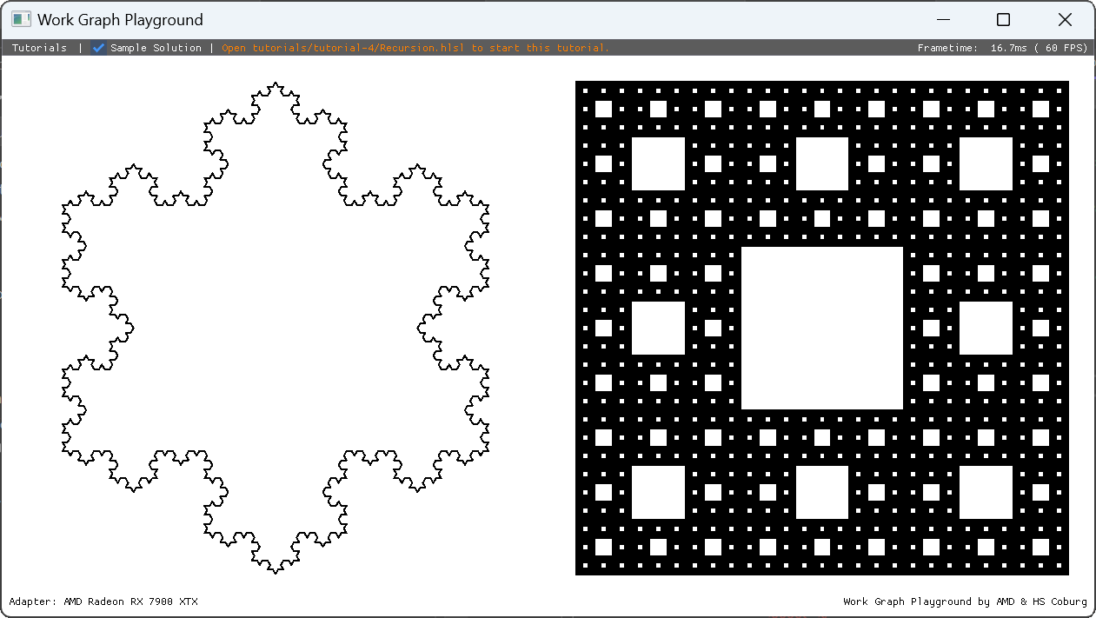
Evaluation - Baseline
D3D12 provenance aligned locally to the same Koch snowflake recursion workload.
Baseline Source
GPUOpen WorkGraphPlayground
https://github.com/GPUOpen-LibrariesAndSDKs/WorkGraphPlayground
Local Alignment
Local clone: C:\CGV\Projects\D3DWorkgraph\workgraph_snowflake
Adjusted to match the snowflake evaluation workload before comparison.
Reference Shader
tutorials/tutorial-4/Recursion.hlsl
Used as the aligned recursion / snowflake baseline inside the local clone.
Aligned tutorial-4 snowflake capture from the local WorkGraphPlayground clone.
9 / 12
Notes:
Baseline provenance and alignment context.
Sources:
- https://github.com/GPUOpen-LibrariesAndSDKs/WorkGraphPlayground
- C:\CGV\Projects\D3DWorkgraph\workgraph_snowflake
- tutorials/tutorial-4/Recursion.hlsl

Slide 10
Evaluation - Profile
Summary from monthly_report_0424_profile_result.md with FPS kept as secondary callouts.
Config | FPS (Hz) | Frame duration (us) | Compute duration (us)
wg | 6,920.1 Hz | 144.507 us | 34.791 us
pt-96 | 298.6 Hz | 3,349.001 us | 3,174.813 us
wg8 | 6,157.8 Hz | 162.397 us | 50.183 us
pt8-96 | 19.5 Hz | 51,407.951 us | 51,078.034 us
pt8-96x32 | 6.5 Hz | 153,038.548 us | N/A
pt8-96x32-reverse-worker | 6.3 Hz | 157,964.844 us | N/A
Frame vs compute duration (us)
FPS reference
wg
pt-96
6,920.1 Hz
298.6 Hz
wg8
pt8-96
6,157.8 Hz
19.5 Hz
pt8-96x32
pt8-96x32-rw
6.5 Hz
6.3 Hz
Compute duration comes from the selected-compute Duration field.
pt8-96x32 and pt8-96x32-reverse-worker have no compute-duration entry in monthly_report_0424_profile_result.md.
10 / 12
Notes:
Profile comparison data used on this slide.
Source:
- C:\CGV\Projects\D3DWorkgraph\workgraph_vulkan_poc\monthly_report_0424_profile_result.md
Compute duration is unavailable for pt8-96x32 and pt8-96x32-reverse-worker.

Slide 11
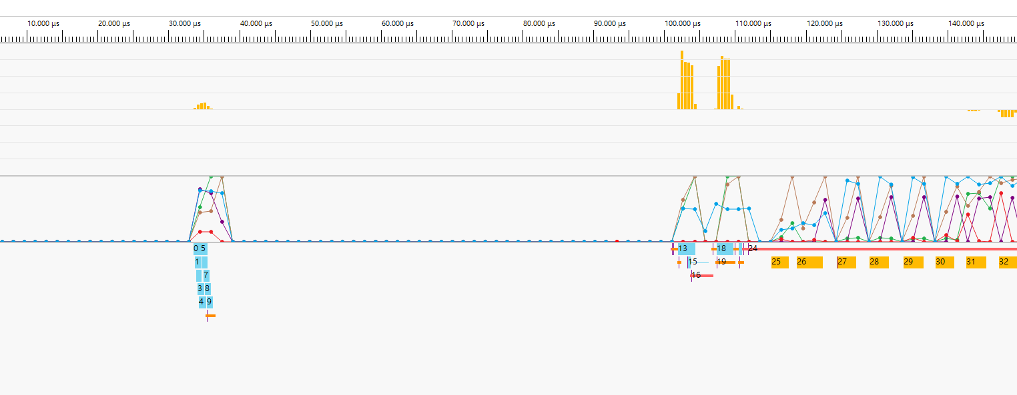
Evaluation - Wavefront (WorkGraphPlayground)
Depth 8 wavefront capture from the aligned D3D12 baseline path.
Matched crop and scale, image-16.png: wavefront - depth 8.
11 / 12
Notes:
Evaluation - Wavefront (WorkGraphPlayground)
Image: C:\CGV\Projects\D3DWorkgraph\workgraph_vulkan_poc\image-16.png
Matched crop and scale, image-16.png: wavefront - depth 8.

Slide 12
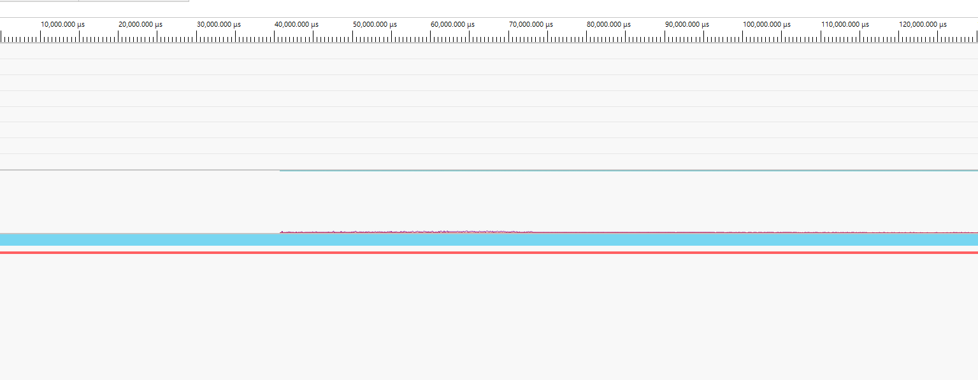
Evaluation - Wavefront (Vulkan Persistent Thread)
Depth 8 / 3072-group wavefront capture from the Vulkan persistent-thread path.
Matched crop and scale, image-18.png: depth 8, 3072 group, wavefront.
12 / 12
Notes:
Evaluation - Wavefront (Vulkan Persistent Thread)
Image: C:\CGV\Projects\D3DWorkgraph\workgraph_vulkan_poc\image-18.png
Matched crop and scale, image-18.png: depth 8, 3072 group, wavefront.

