Slide 1
MONTHLY REPORT
Vulkan Persistent Thread WorkGraph POC
May 2026 evaluation: queue atomics set the bottleneck, and sharding removes it
30.75 ms
0.99 ms
31.0x
Starting median
Final repeat median
Median speedup
clean timestamp
main defaults
same workload
Adopt Q1/Q2 sharding and lane-based Q1 pop. Keep request batching out of the main path because the default 256-shard suite regresses.
AMD RX 7900 XTX / RDNA 3

Slide 2
Vulkan Persistent Thread WorkGraph POC
02
Queue atomics explain the measured gains
BOTTLENECK
BOUNDARY
ADOPT
REJECT
Bottleneck
Boundary
Adopt
Reject
Clean median falls when a change reduces shared Q1/Q2 queue pressure.
Timestamp-only runs carry duration. Counter runs explain CAS, backlog, and ready-spin.
Q1 shards, Q2 shards, and lane-based Q1 pop reach about 0.99 ms median.
Q2 request batching pushes the default 256-shard suite into the 11 ms band.
The adopted path moves 30.75 ms to 0.99 ms without using shader counters in the timing run.
2026-05-25
Optimization Evaluation v3

Slide 3
Vulkan Persistent Thread WorkGraph POC
03
Only Q1/Q2 handoff points are shared global queue state
Node A
Q1
Node B
Q2
Node C
VB Render
Seed edges once
atomic count/head/tail ready flag
Subdivide work
atomic count/head/tail ready flag
Write vertices
Deterministic draw
Shared fields
Test question
- Q1/Q2 count, head, tail, and ready flags synchronize cross-workgroup handoff.
- Many lanes and workgroups touch the same fields before sharding.
- Candidate changes must reduce clean duration, queue contention, or both.
- Changes that move cost into polling or ready-spin are rejected.
2026-05-25
Optimization Evaluation v3

Slide 4
Vulkan Persistent Thread WorkGraph POC
04
Clean timing plus counters define the adoption rule
PRIOR REPORT
RULE
Before May 10
Decision rule
- The POC produced correct deterministic output.
- Persistent workers exchanged work through global atomic queues.
- Duration runs still carried diagnostic counters.
- Clean timestamp runs set the performance number.
- Counter-enabled runs diagnose CAS retries, backlog, and polling.
- Adopt changes that improve clean timing.
The conclusion rests on a narrow rule: duration proves impact; counters explain the mechanism.
2026-05-25
Optimization Evaluation v3

Slide 5
Vulkan Persistent Thread WorkGraph POC
05
Timing and counters answer different questions
Run type | Purpose | Primary readout | What it supports
Clean timestamp runs | Performance claim | Median compute_ms after warmup | Duration, speedup, adoption
Counter-enabled runs | Mechanism check | CAS fail ratio, backlog, ready-spin, empty-pop | Queue contention diagnosis
RGP occupancy | Context | Wavefront view and event timing | Profiler boundary
Adopt
Diagnose
Bound
Clean runs decide if a change stays.
Counters identify the queue failure mode.
RGP views set scope; timing carries proof.
Separating these runs keeps counter instrumentation out of the performance result.
2026-05-25
Optimization Evaluation v3

Slide 6
Vulkan Persistent Thread WorkGraph POC
06
Each atomic metric maps to a queue failure mode
Metric | Interpretation | Decision use
CAS fail per success | Lanes or workgroups retry the same queue state. | High contention; sharding should reduce this.
Attempts vs success | The control path burns operations without throughput. | Detects wasted polling.
Queue high-water | Backlog exposes producer/consumer imbalance. | Guides B/C balance and Q2 pressure checks.
Ready-spin / empty-pop | Consumers claim or probe before useful work is ready. | Explains request batching regressions.
Clean vs counter runs | The run type separates duration from diagnosis. | Keeps cause analysis out of headline timing.
A change earns confidence when clean duration improves and the relevant counter pressure moves in the same direction.
2026-05-25
Optimization Evaluation v3

Slide 7
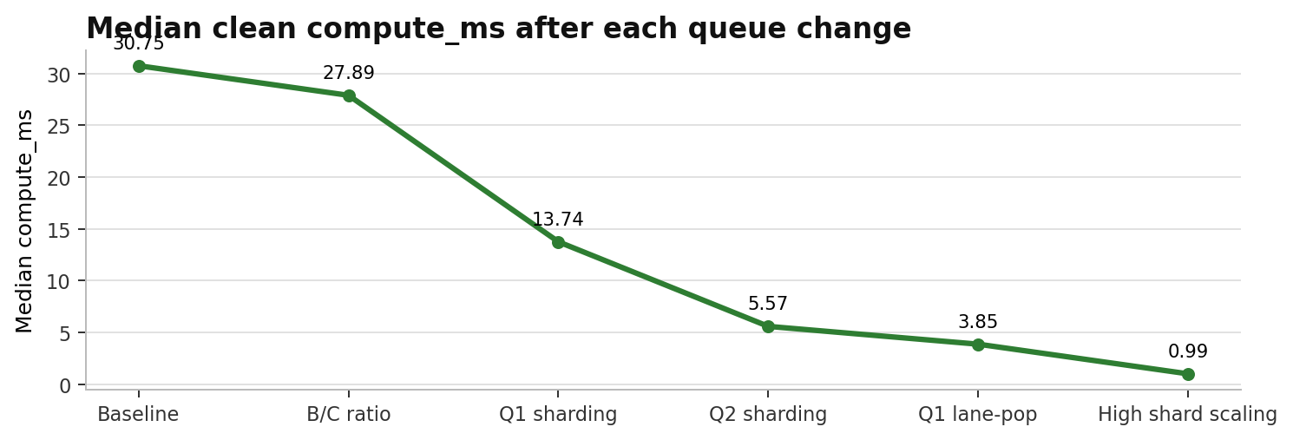
Vulkan Persistent Thread WorkGraph POC
07
Queue-locality changes drove a 31.0x median speedup
Stage | Config | Median ms
Baseline | Q1 batch on, Q2 scalar, C=24/B=72 | 30.7499
B/C ratio | C=40/B=56 | 27.8938
Q1 sharding | Q1s16/Q2s1, C=38/B=58 | 13.7416
Q2 sharding | Q1s16/Q2s16, C=16/B=80 | 5.5708
Q1 lane-pop | Q1s16/Q2s16, C=24/B=72 | 3.8509
High shard scaling | Q1s256/Q2s256, C=24/B=72 | 0.9868
The curve drops at queue split or scan-diversification steps; the adopted path excludes request batching.
2026-05-25
Optimization Evaluation v3

Slide 8
Vulkan Persistent Thread WorkGraph POC
08
C/B tuning reduces backlog; sharding remains necessary
C/B | Median ms | Avg ms
24/72 | 30.7499 | 30.3533
32/64 | 28.5262 | 28.4431
40/56 | 27.8938 | 27.9742
48/48 | 28.5412 | 28.5873
64/32 | 30.2860 | 30.2509
READOUT
Writer balance is a setup fix
- C=40/B=56 lowers Q2 high-water from about 50k to about 9k.
- Median improves by 2.86 ms, but the queue remains a shared atomic hotspot.
50k -> 9k
30.75 -> 27.89
Set the worker mix with this result before testing structural queue changes.
Q2 high-water trend
Median ms
counter-enabled runs
clean runs
2026-05-25
Optimization Evaluation v3

Slide 9
Vulkan Persistent Thread WorkGraph POC
09
Q1 sharding cuts median to 13.74 ms and exposes Q2
Q1 shards | C/B | Median ms | Avg ms
4 | 40/56 | 23.3164 | 23.2366
8 | 40/56 | 17.9518 | 17.9043
16 | 36/60 | 13.9788 | 13.9523
16 | 38/58 | 13.7416 | 13.7046
16 | 40/56 | 14.1297 | 14.084
Before
After
Single Q1 queue hot count/head/tail
Q1 split across shards same queue protocol
- Q1 sharding turns one global atomic queue into 16 smaller queues.
- After Q1 pressure drops, Q2 count/head/tail becomes the next bottleneck target.
13.74 ms
The result stacks with B/C tuning, so the gain tracks queue contention instead of an unrelated shader change.
Q1s16/Q2s1 median
2026-05-25
Optimization Evaluation v3

Slide 10
Vulkan Persistent Thread WorkGraph POC
10
Q2 sharding removes the second global queue wall
Q2 shards | Median ms | Avg ms | Speedup
1 | 16.9962 | 16.9529 | 1
2 | 10.2455 | 10.2431 | 1.655
4 | 8.3799 | 8.3824 | 2.022
8 | 6.8738 | 6.8656 | 2.469
16 | 6.0924 | 6.0839 | 2.787
DECISION
Shard Q2 before batching it
- The Q2 sweep improves through 16 shards in this stage.
- After B/C rebalance, Q1s16/Q2s16 reaches about 5.57 ms median.
5.57 ms
2.79x
The same pattern repeats: split the shared queue state, then retune worker balance.
Q1s16/Q2s16 median
vs Q2s1 in sweep
2026-05-25
Optimization Evaluation v3

Slide 11
Vulkan Persistent Thread WorkGraph POC
11
Lane-pop removes same-shard starts inside a workgroup
Mode | Median ms | Avg ms | Min ms
lane-pop off, C=16/B=80 | 5.60 | 6.01 | 5.54
lane-pop on, C=16/B=80 | 4.00 | 4.39 | 3.90
lane-pop on, C=24/B=72 | 3.8509 | 3.8526 | 3.7292
Scan-start rule
Old: wgId % Q1_QUEUE_SHARDS
New: (wgId * local_size_x + localId) % Q1_QUEUE_SHARDS
Lane-pop keeps the queue protocol intact. It changes where each lane begins scanning, so the improvement isolates shard-selection pressure.
2026-05-25
Optimization Evaluation v3

Slide 12
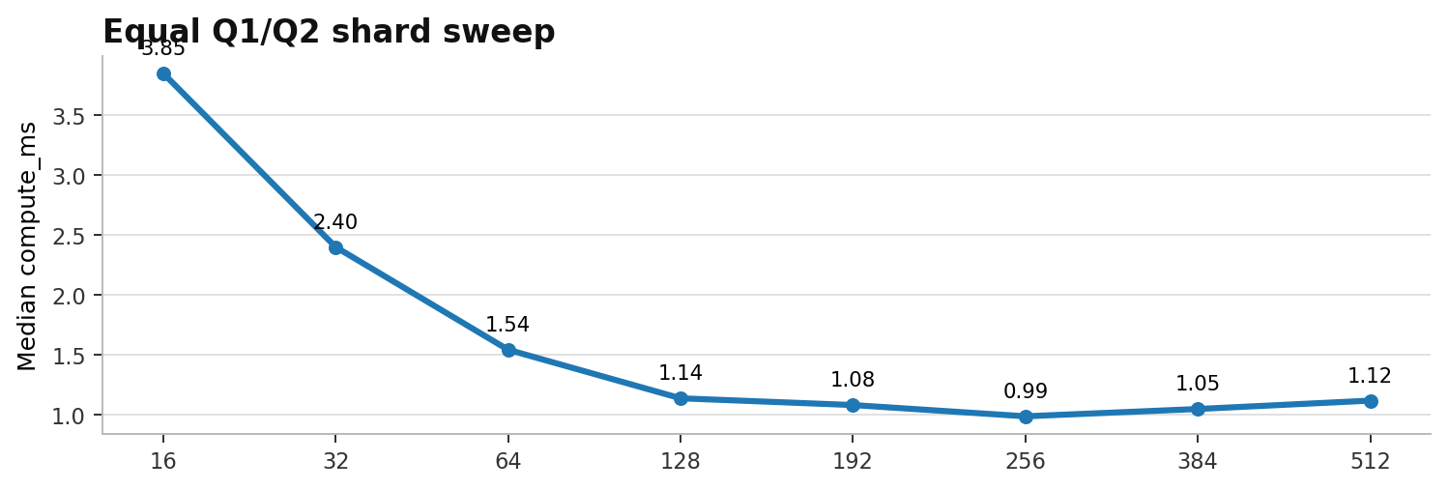
Vulkan Persistent Thread WorkGraph POC
12
256/256 is the measured knee of the shard-count tradeoff
Q1/Q2 | Median | P90
16 | 3.8509 | 3.8998
32 | 2.4002 | 2.4205
64 | 1.5427 | 1.5572
128 | 1.1372 | 1.1545
192 | 1.0808 | 1.0969
256 | 0.9868 | 1.0068
384 | 1.0478 | 1.0688
512 | 1.1178 | 1.1342
256 / 256
The 256-shard point has the best median in the sweep; 384 and 512 add probe/index cost without improving the tail.
Adopted default
2026-05-25
Optimization Evaluation v3

Slide 13
Vulkan Persistent Thread WorkGraph POC
13
Request batching targets dequeue CAS first
Problem
Idea
Expected
Risk
Per-item dequeue CAS creates heavy retry traffic
One subgroup claim reserves multiple slots
Fewer CAS attempts per consumed item
More ready-spin or empty slots
Adoption test
A batch claim must lower clean median and P90 in the default 256-shard suite without moving cost into ready-spin or empty-slot work.
2026-05-25
Optimization Evaluation v3

Slide 14
Vulkan Persistent Thread WorkGraph POC
14
Default 256-shard batching regresses, so it stays out
Default 256 suite | Samples | Median | P90
off | 354 | 1.9432 | 1.9691
l8 | 354 | 11.7109 | 11.7553
l16 | 354 | 11.4284 | 11.4658
l32 | 354 | 11.2778 | 11.3034
l1 | 0 | no samples | no samples
l2 | 0 | no samples | no samples
l4 | 0 | no samples | no samples
Stress 16 suite | Median | P90
off | 4.2442 | 4.9059
l4 | 4.2553 | 4.6734
l8 | 4.1737 | 5.1022
l16 | 4.2623 | 5.3898
l32 | 4.1165 | 5.2635
1.9432 ms
11 ms range
Stress cases can improve, but the default path moves from 1.94 ms off-baseline into the 11 ms band. That fails the adoption test.
Suite-local off baseline
Default 256 batching regression
2026-05-25
Optimization Evaluation v3

Slide 15
Vulkan Persistent Thread WorkGraph POC
15
The main path encodes the proven queue changes
256
256
ON
24 / 72
Q1 shards
Q2 shards
Q1 lane-pop
C/B workers
Setting | Value
MAX_QUEUE_SHARDS | 256
Q1_QUEUE_SHARDS_DEFAULT | 256
Q2_QUEUE_SHARDS_DEFAULT | 256
ENABLE_Q1_LANE_POP | default on
NODE_C_START | 72, so C=24/B=72
These defaults preserve the winning mechanisms: split both queues, diversify Q1 scan starts, and keep the B/C mix from the best clean run.
2026-05-25
Optimization Evaluation v3

Slide 16
Vulkan Persistent Thread WorkGraph POC
16
Four clean repeats keep median and P90 near 1 ms
Run | Samples | Median | P10 | P90 | Min
repeat 1 | 1836 | 0.9904 | 0.9804 | 1.0036 | 0.9659
repeat 2 | 1867 | 0.9916 | 0.9819 | 1.0053 | 0.9657
repeat 3 | 1868 | 0.9907 | 0.9810 | 1.0042 | 0.9593
repeat 4 | 1866 | 0.9903 | 0.9807 | 1.0038 | 0.9615
~0.99 ms
~1.00 ms
The confirmation set keeps median within a 0.0014 ms band and P90 near 1.00 ms across four runs.
Median band across repeats
P90 band across repeats
2026-05-25
Optimization Evaluation v3

Slide 17
Vulkan Persistent Thread WorkGraph POC
17
Next experiment: reduce global spill
Proven
Kept
Dropped
Shared queue atomics drove the measured bottleneck.
Q1/Q2 sharding plus Q1 lane-pop stays in main.
Q2 request batching fails the default-suite test.
The current architecture reaches about 0.99 ms median. The next useful experiment should reduce trips to global queues before revisiting batch claims.
2026-05-25
Optimization Evaluation v3

Slide 18
Vulkan Persistent Thread WorkGraph POC
18
Wave-local retention should measure global spill reduction
Current baseline
Prototype
Compare
Global sharded queues Q1/Q2 = 256/256
Wave-local retention spill fallback
global atomic count spill ratio P90/tail stability
- Use the 256-shard main path as the baseline.
- Measure global atomic count, wave-local handoff count, spill ratio, and clean duration.
- Bring request batching back after a queue-protocol change.
- Keep timing and atomic-counter diagnosis split in the next run.
2026-05-25
Optimization Evaluation v3

Slide 19
Vulkan Persistent Thread WorkGraph POC
19
Appendix: code surfaces behind each decision
SHARD PUSH
Q1 LANE-POP
Q2 BATCH CAS
Adopted: shard selection plus ready publish
Adopted: lane-based Q1 scan start
Rejected: subgroup batch claim
uint shard = mixHash(h) % Q1_QUEUE_SHARDS; if (atomicCompSwap(control.q1[shard].count, cur, cur + 1u) == cur) { uint localSlot = atomicAdd(control.q1[shard].tail, 1u) % capacity; atomicExchange(queue1.tasks[slot].payload[5], 1u); }
uint worker = wgId * local_size_x + localId; uint homeShard = (ENABLE_Q1_LANE_POP != 0u) ? (worker % Q1_QUEUE_SHARDS) : (wgId % Q1_QUEUE_SHARDS);
uint claim = min(available, Q2_DEQUEUE_BATCH_LIMIT); if (atomicCompSwap(control.q2[shard].count, cur, cur - claim) == cur) { baseHead = atomicAdd(control.q2[shard].head, claim); }
2026-05-25
Optimization Evaluation v3

Slide 20
Vulkan Persistent Thread WorkGraph POC
20
Appendix: numeric source table and provenance
Artifact | Path
Normalized measurements | reports/2026-05/metrics/monthly_v3_normalized_measurements_20260525.csv
Measurement notes | reports/2026-05/metrics/monthly_v3_measurement_notes_20260525.md
Main backbone | reports/2026-05/metrics/q2_shards_20260510/research_backbone_20260510.md
Request batching summary | reports/2026-05/metrics/request_batching_validation_20260525/request_batching_validation_summary.csv
Use the normalized table for headline numbers; use the notes file for warmup rules and source-file mapping.
2026-05-25
Optimization Evaluation v3

