Slide 1
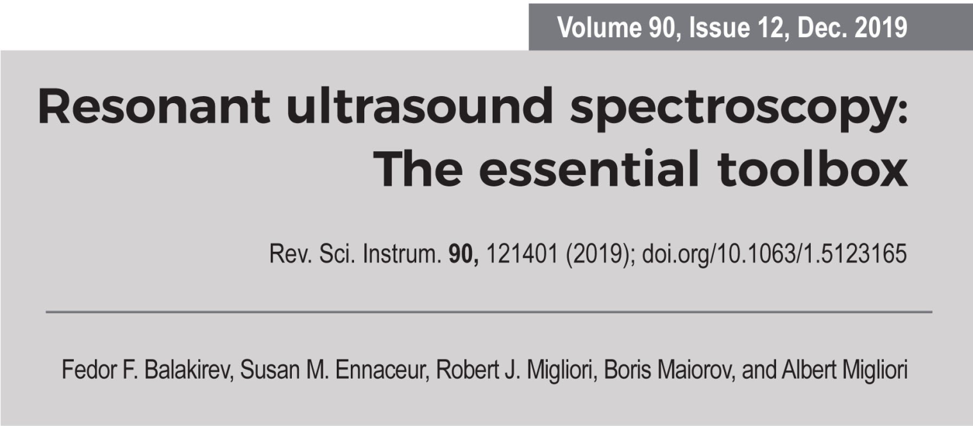
RUSpy ver 0.01
copyright(c) Albert Migliori
Alamo Creek Engineering
www.rusalamocreek.com
6 March 2022
3/6/22

