Slide 1
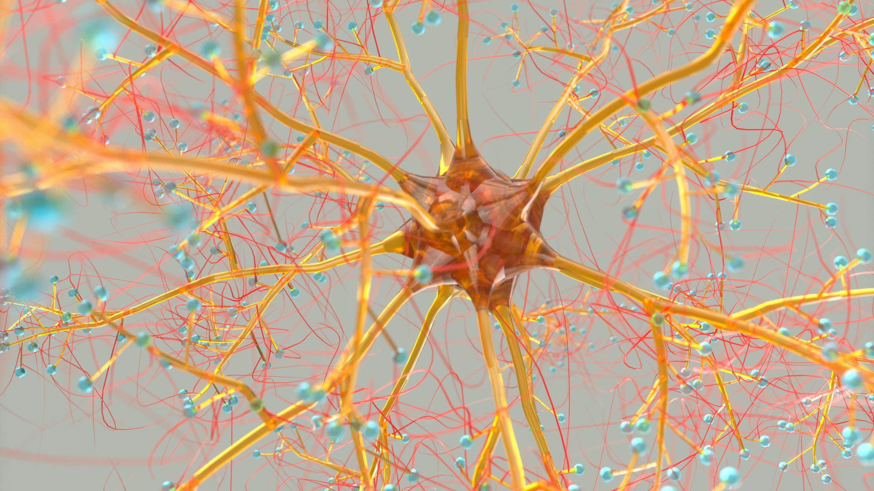
Neural Networks Recommendation System
on Amazon Reviews Dataset

Slide 2

OBJECTIVE: Explore Neural Networks by using TensorFlow Recommenders to address Cold Start problem.
PROJECTED OUTCOME:
Test Retrieval, Ranking, and Sequential models
Test efficient serving (ScaNN)

Slide 3
Outline
BUSINESS PROBLEM
DATA AND METHODS
RESULTS
CONCLUSIONS

Slide 4
Business Problem
Stakeholder: Marketing team
Low user penetration in US (20% at 2022)
Cold Start Problem

Slide 5
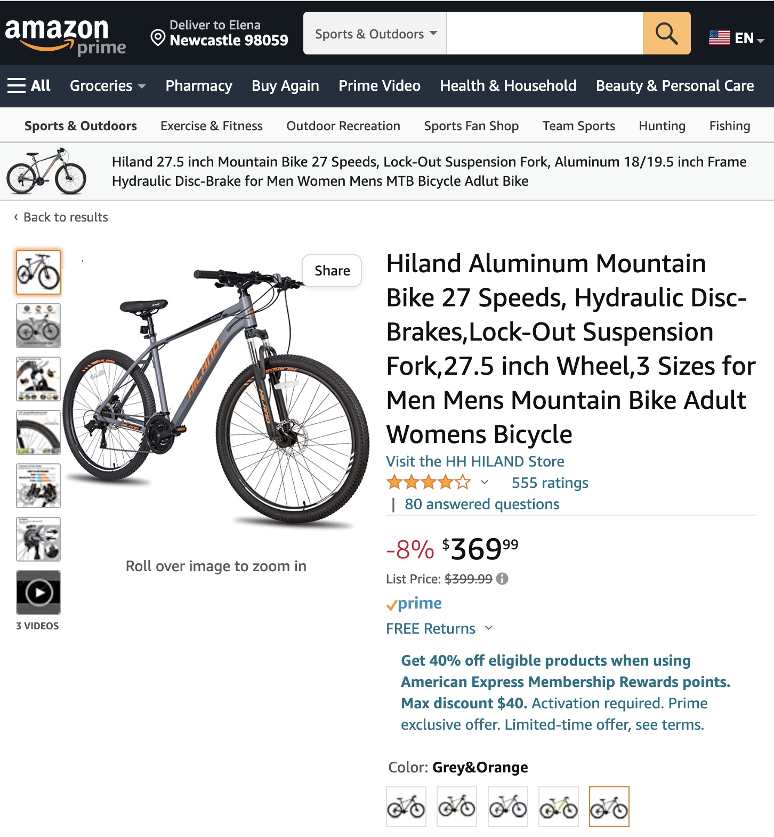
DATA & METHODS
DATA:
2.3M Outdoor product reviews (2000 – 2015)
FEATURES:
Product title, review title, review, review date, votes
DATA SOURCE:
Amazon Reviews dataset
RECOMMENDATION SYSTEMS:
Retrieval
Ranking
Sequential
Combined Features

Slide 6
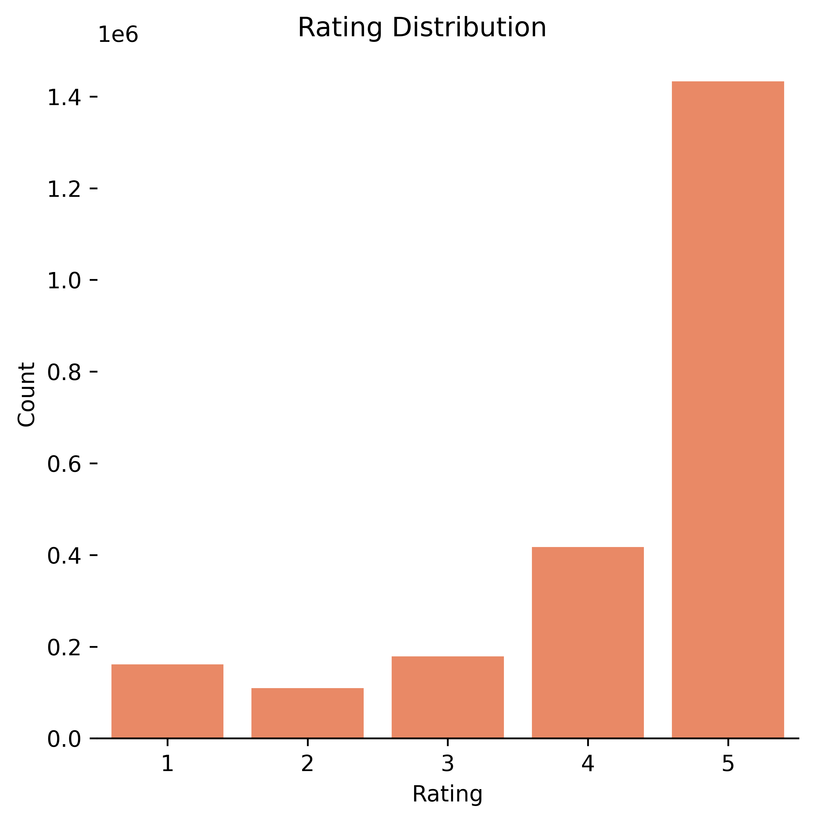
Star Rating Distribution:
62.4% - 5 star
18.1% - 4 star
7.6% - 3 star
4.7% - 2 star
7.1% - 1 star
Rating distribution is skewed left indicating that customers tend to leave positive ratings.
Notes:
Add KDE
Get rid 1e6

Slide 7
Since 2008 the number of reviews has been progressively increasing each year with more than doubling in 2013.

Slide 8
SoundAsleep Dream Series Air Mattress
Intex Pillow Rest Raised Airbed
Hydro Flask Insulated Water Bottle
Intex Raised Downy Airbed
LifeStraw Personal Water Filter for Camping
Notes:
Ticks large – use white space

Slide 9
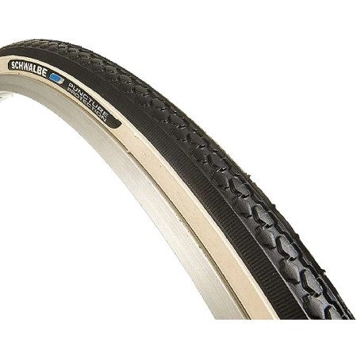
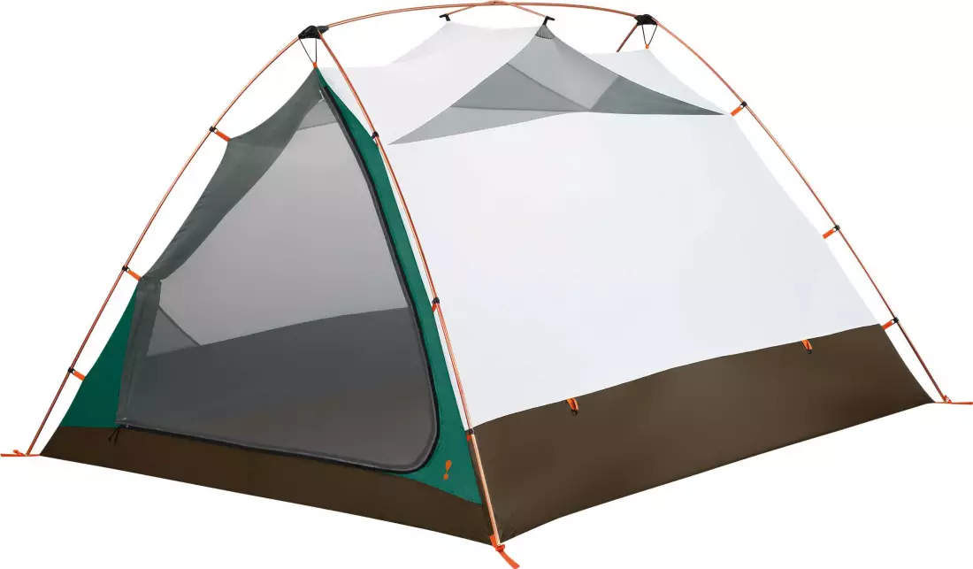
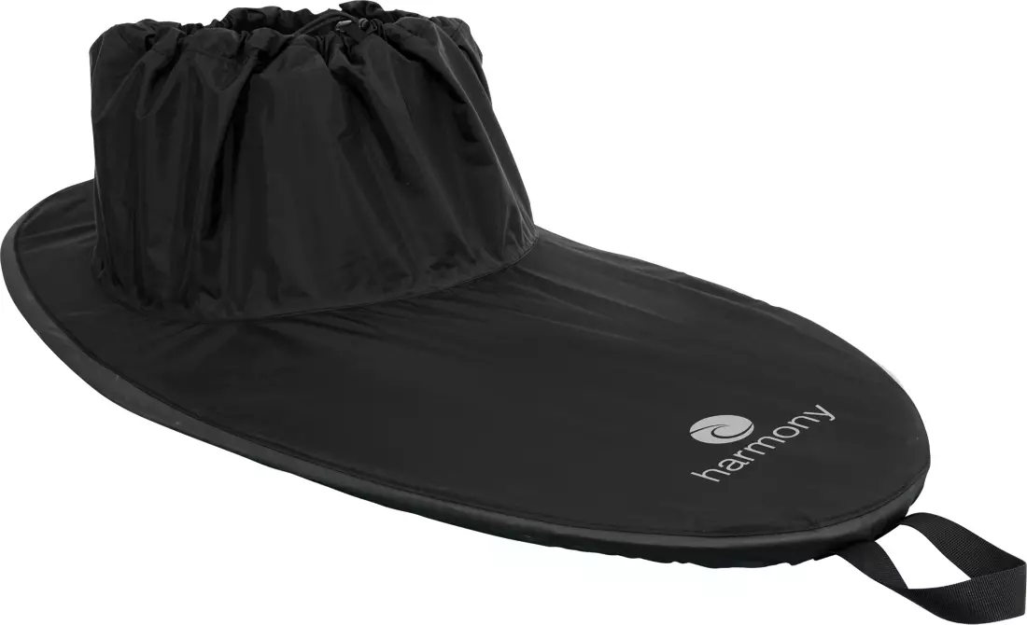
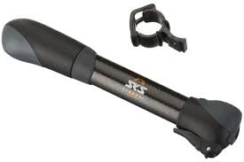
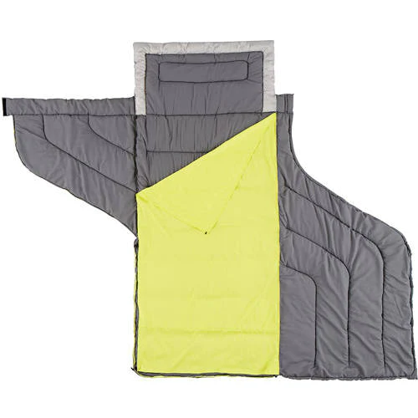
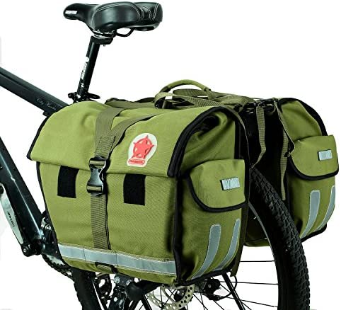
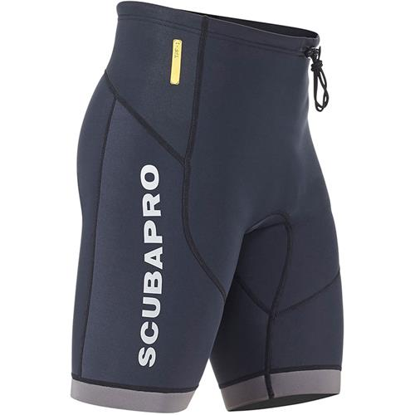
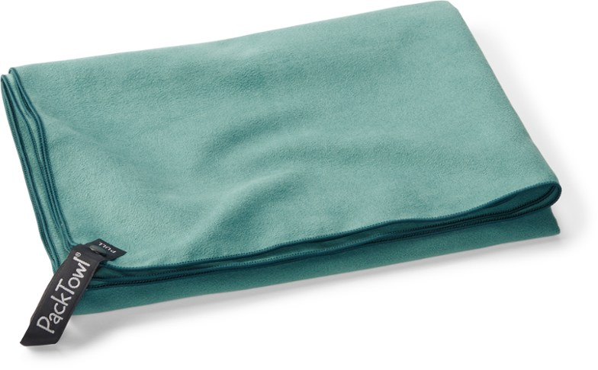
Item-to-item Retrieval Model
Accuracy rate of Top-10 recommendations is 63.26%
Notes:
Three porducts with visualizations

Slide 10
BUSINESS RECOMMENDATIONS
A/B test item-to-item Retrieval TensorFlow model on the website.
Implement ScaNN for efficient and fast serving.

Slide 11
NEXT STEPS
Scrub
Scrub current data from Amazon.com to run the models on the up-to-date dataset.
Explore
Further explore TensorFlow Recommenders to build advanced machine learning models.
Incorporate
Incorporate time series data to fine tune Sequential models (RNN: Recurrent Neural Networks).
Run
Run Convolutional Neural Networks (CNN) on image and video data.

Slide 12

Thank you
Link to Notebook

