Slide 1

Movie analysis
For Microsoft

Slide 2

summary
Microsoft seeing success of other big tech companies in the movie industry is starting its own movie studio.
The objective of this analysis is to provide a high-level overview of movie industry with insights and actionable suggestions in four categories:
Releases
Popularity
Rating
Gross Income and ROI

Slide 3
outline
Business Problem
Data & Methods
Results
Conclusions

Slide 4

Business problem
Entering an industry that it doesn’t have experience in.
Relying on data from other sources due to the lack of its own data.
Established and recently emerged competitors.

Slide 5
Data & methods
Data Sources:
Box Office Mojo
IMDB
The Numbers
Over 140K data entries for movie titles, genres, and release dates from 2010-2020.
Over 73K data entries for average ratings and number of votes.
Over 2,800 data entries for movie budgets, domestic/foreign/worldwide gross.

Slide 6
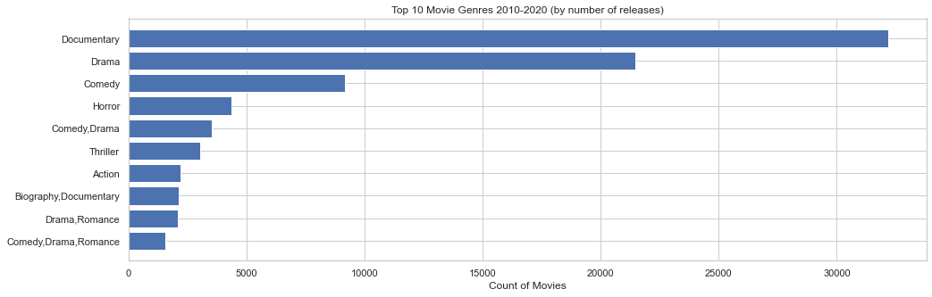
Results: releases
For this analysis we used data of over 140,736 movies.
Documentary and Drama have been the most released movie genres in the past decade.

Slide 7
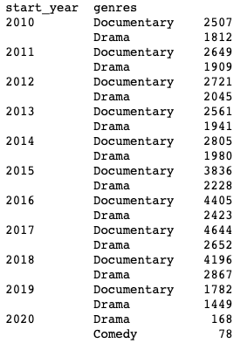
Results: releases

Slide 8
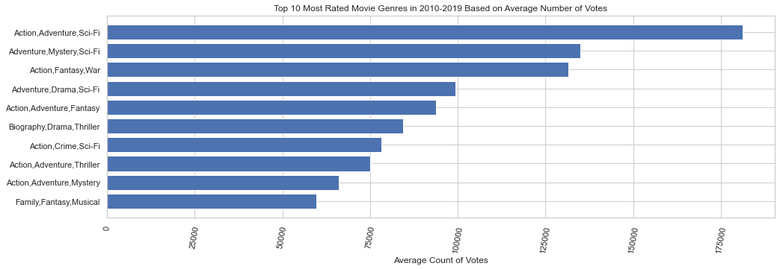
Results: popularity
For this analysis we used data of 73,052 movies.
Action, Adventure, Sci-Fi, Fantasy, Mystery, and War have been the most popular movie genres in the past decade.

Slide 9
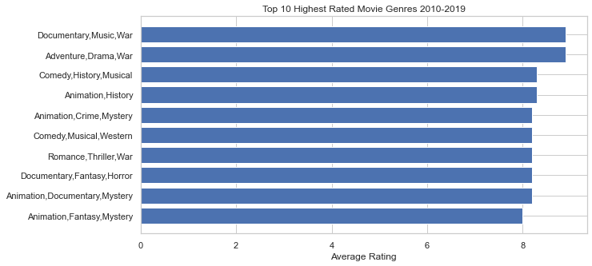
Results: rating
For this analysis we used data of 28,628 movies with over 100 votes.
Documentary, Music, War, Adventure, and Drama have been the highest rated movie genres in the past decade. Their average rating is 8.9. However other 10 genres are not far behind and rated around 8.

Slide 10
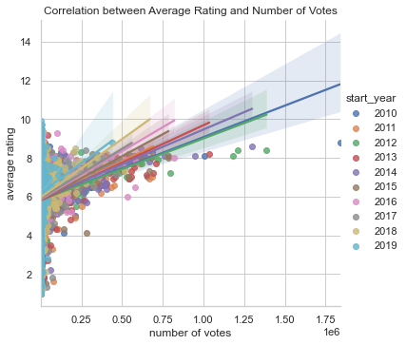
Correlation between rating and popularity
0.13
There is a little positive correlation between rating and population indicating that these two variables have to be considered independently.

Slide 11
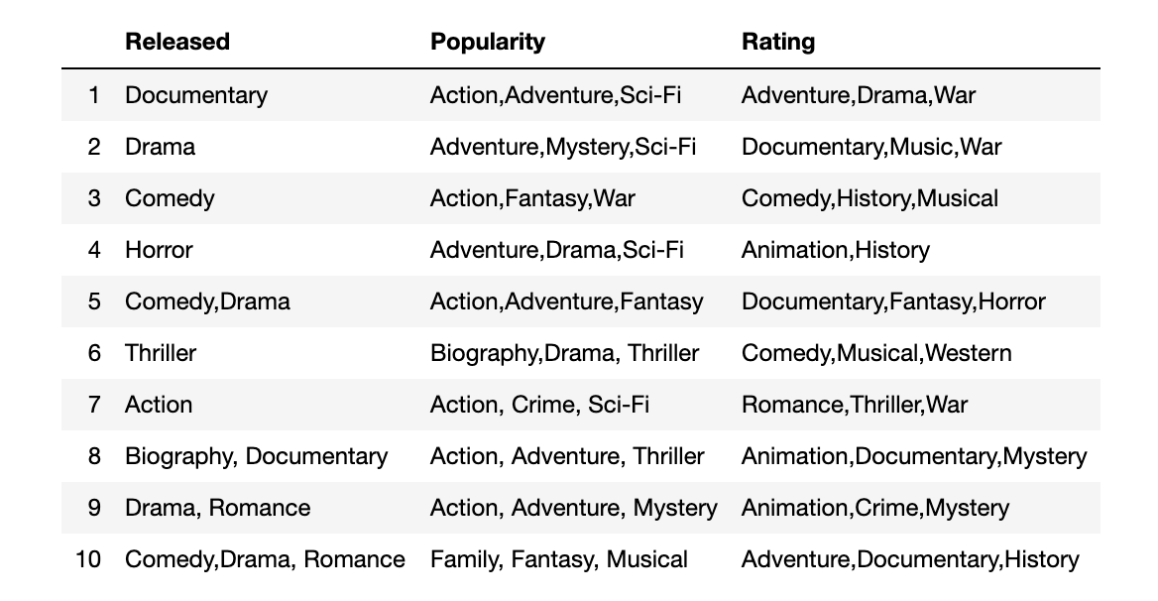
Comparison
Documentary and Drama overlap in the most Released and Highest Rated genres.

Slide 12
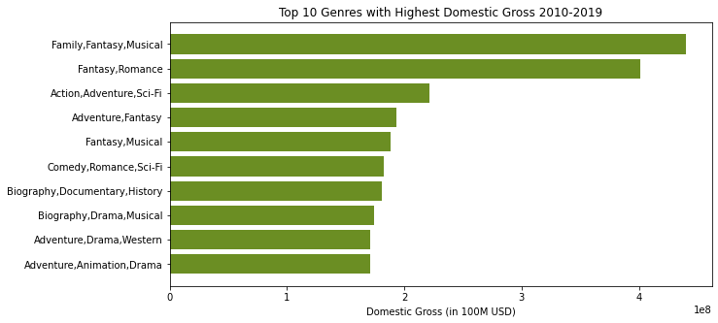
Results: domestic gross
Family, Fantasy, Musical, and Romance are performing best financially in domestic market with at or over $400M gross.

Slide 13
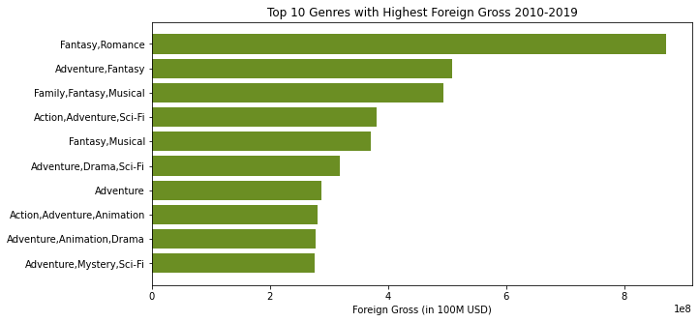
Results: foreign gross
Fantasy, Romance are performing best financially with over $800M foreign gross. Adventure, Fantasy, Musical, Family are the next highest performing genres with about $500M in foreign gross.

Slide 14
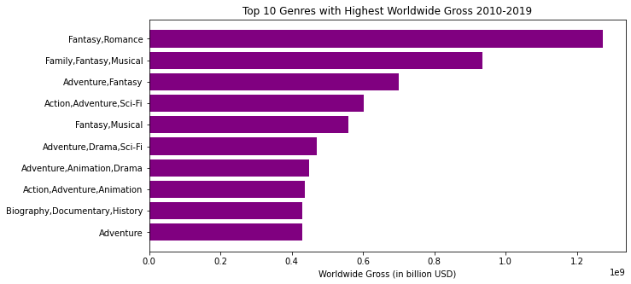
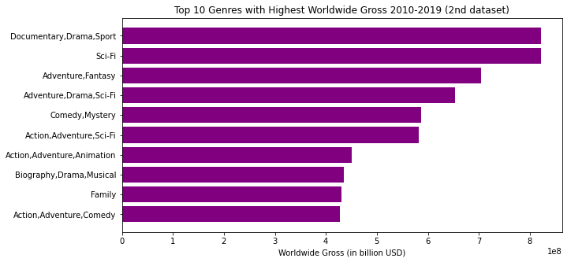
results: worldwide gross
For this analysis we used data two datasets: Box Office Mojo and The Numbers. We are getting very similar results per genre or a combination of genres even though some data per genre is missing in one dataset or the other.
Fantasy & Romance genres have over $1.2B worldwide gross. Family, Fantasy, Musical are close to $1B. Documentary, Drama, Sport, and Sci-Fi are producing over $0.8B in worldwide gross.

Slide 15
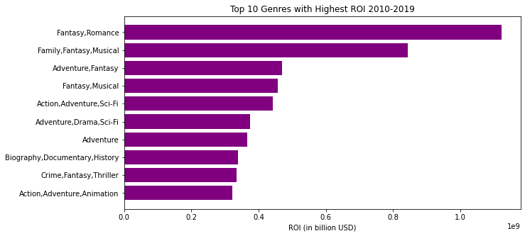
Results: ROI
Fantasy and Romance (aka ’Frozen’) are by far the most profitable genres. On average a combination of these genres is responsible for over $1B in ROI. Family, Fantasy, Musical are the second on the list with ROI over $0.8B.

Slide 16
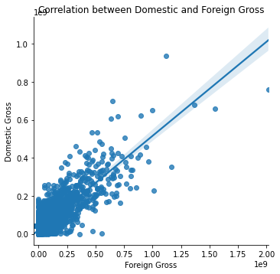
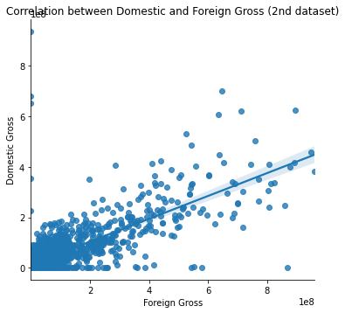
Correlation between domestic and foreign gross
0.76 - 0.83
After analyzing two dataset with financial data: The Numbers and Box Office Mojo,
we discovered that there is a strong positive correlation between domestic and foreign gross.
Domestic gross is responsible for 47% of worldwide gross when Foreign gross is responsible for 53%.

Slide 17
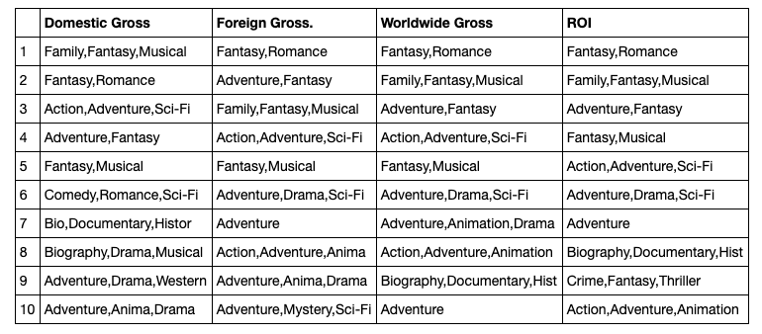
comparison

Slide 18
Suggestions/conclusions
Action, Adventure, Sci-Fi, Fantasy, Mystery, and War are the most popular.
Gross Release a movie in both domestic and foreign markets to get the maximum gross. Foreign gross is responsible for over half of worldwide income (~53%).
ROI Fantasy and Romance are the most profitable genre combo followed by Family/Fantasy/Musical and Action/Adventure/Sci-Fi.
To analyze the trends in genres over the years.
To get more recent data through APIs to see how pandemic has shaped a movie industry.
To perform more in-depth analysis on ROI per genre.
To look into a cast and directors whose movies are the most popular and profitable.
Next steps:

