Slide 1



Quantum Asset
Selection
OPTIMIZING PORTFOLIOS ON A QUANTUM COMPUTER
FRAMING THE BASKET AS A QUBO — ASSETS AS NODES,
COUPLINGS AS EDGES — THEN RACING CLASSICAL
AND QUANTUM SOLVERS FOR THE BEST ALLOCATION
QUIP NETWORK
YOUR NAME @YOURHANDLE NAME@POSTQUANT.XYZ

Slide 2
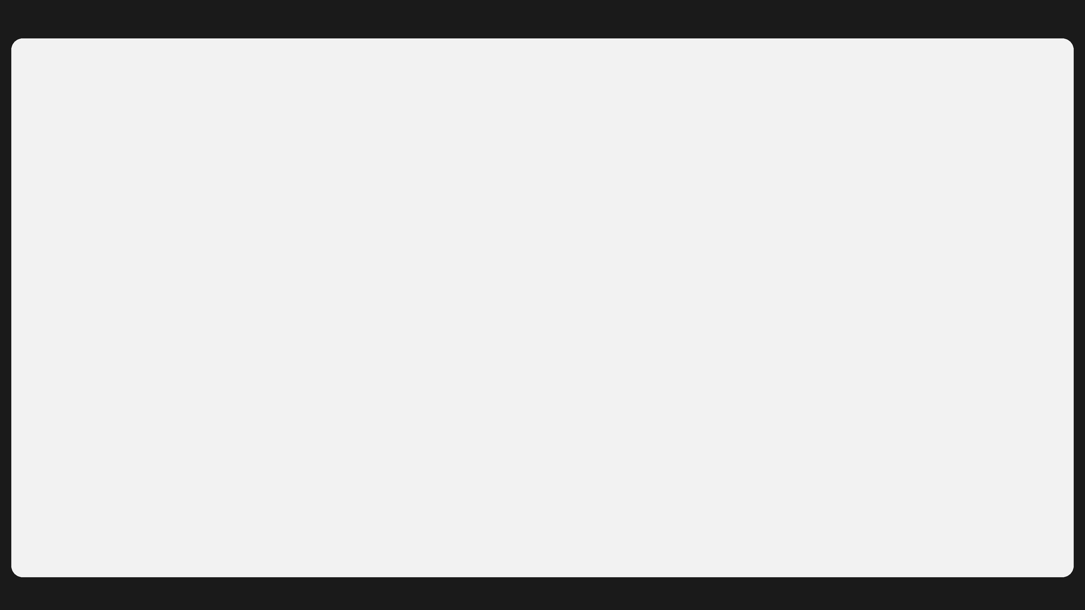

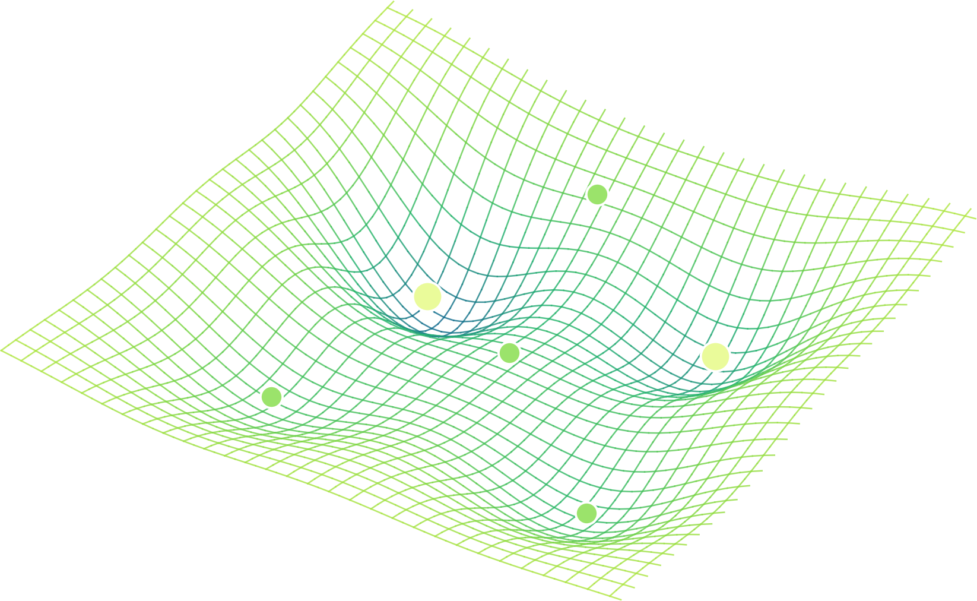
ASSET SELECTION AS AN OPTIMIZATION LANDSCAPE
Find the lowest point
on the cost surface
Every basket is a point on a surface shaped by expected return, risk, and market conditions. The optimizer descends toward the deepest wells — the allocations that cost the least to hold and trade.
DEEPER WELL = MORE OPTIMAL ALLOCATION

Slide 3
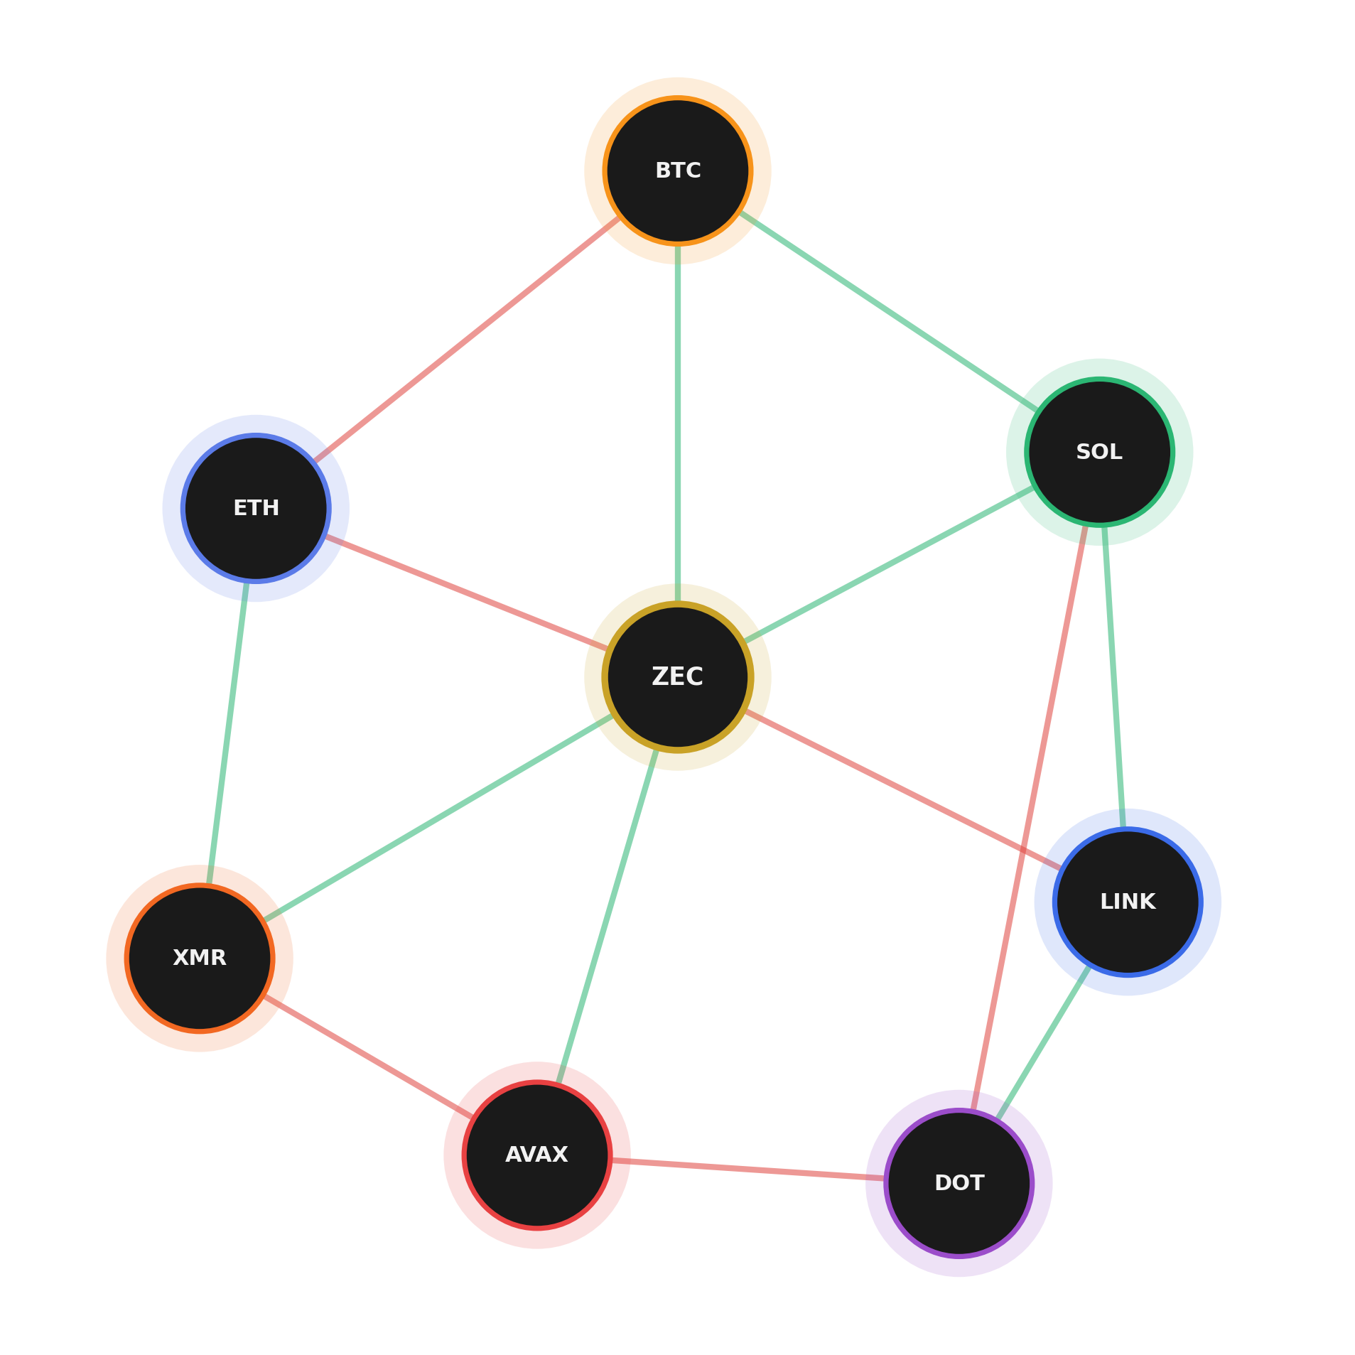
FORMULATING THE QUBO
A graph of assets
and their couplings
Nodes are assets; each carries a weight h (its standalone appeal). Edges are the J couplings between assets — how holding one affects another.
POSITIVE J — REINFORCING
NEGATIVE J — OPPOSING
Topology is irregular — a node can couple to many others, not just four.

Slide 4
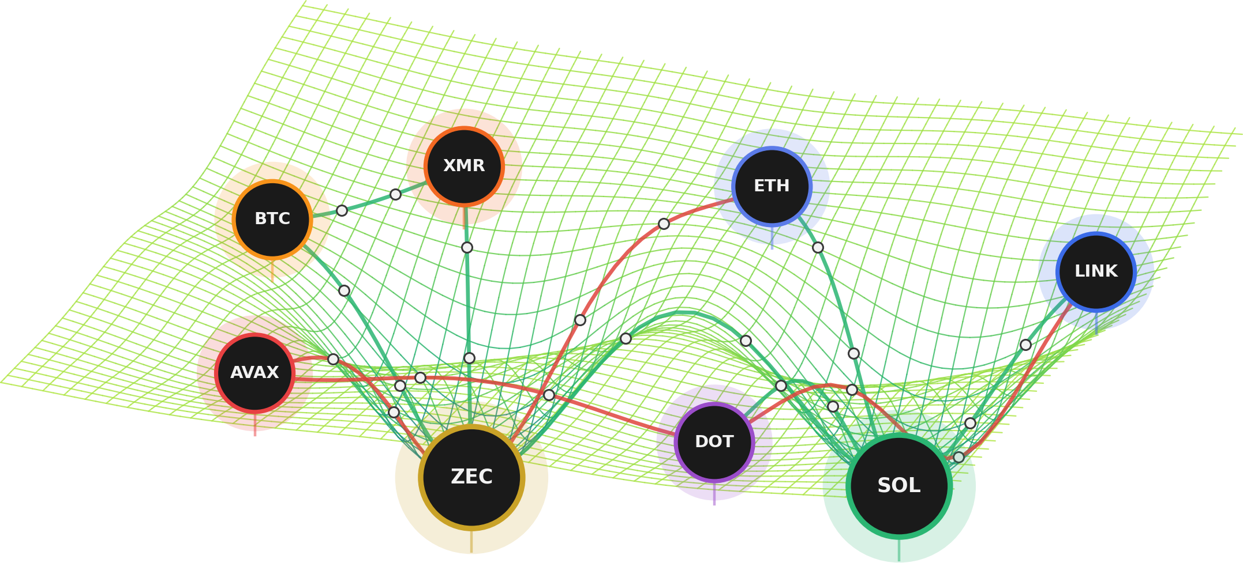
ASSETS AS WELLS, CONSTRAINTS AS NODES
The optimizer settles
into the deepest wells
Each asset bends the cost surface into a well; couplings (green = reinforcing, red = opposing) and the constraint nodes between them shape it. The search settles into ZEC and SOL — the two deepest wells.

Slide 5
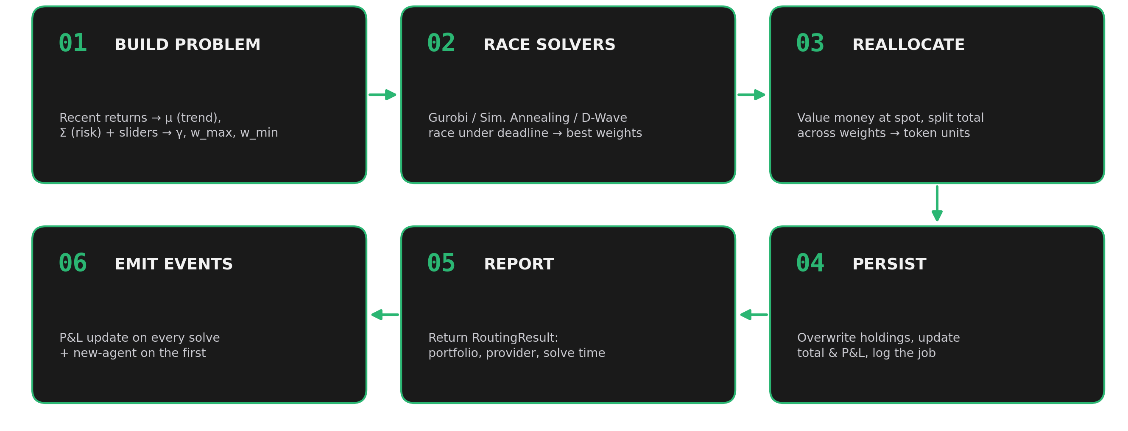
FROM PROBLEM TO PERSISTED PORTFOLIO
One straight line:
estimate → solve → report
Build a PortfolioProblem from recent returns (μ = trend, Σ = risk) and the slider knobs (γ, w_max, w_min); race the solvers for the best feasible weights; value money at spot, split it into token units, save, and report.

Slide 6
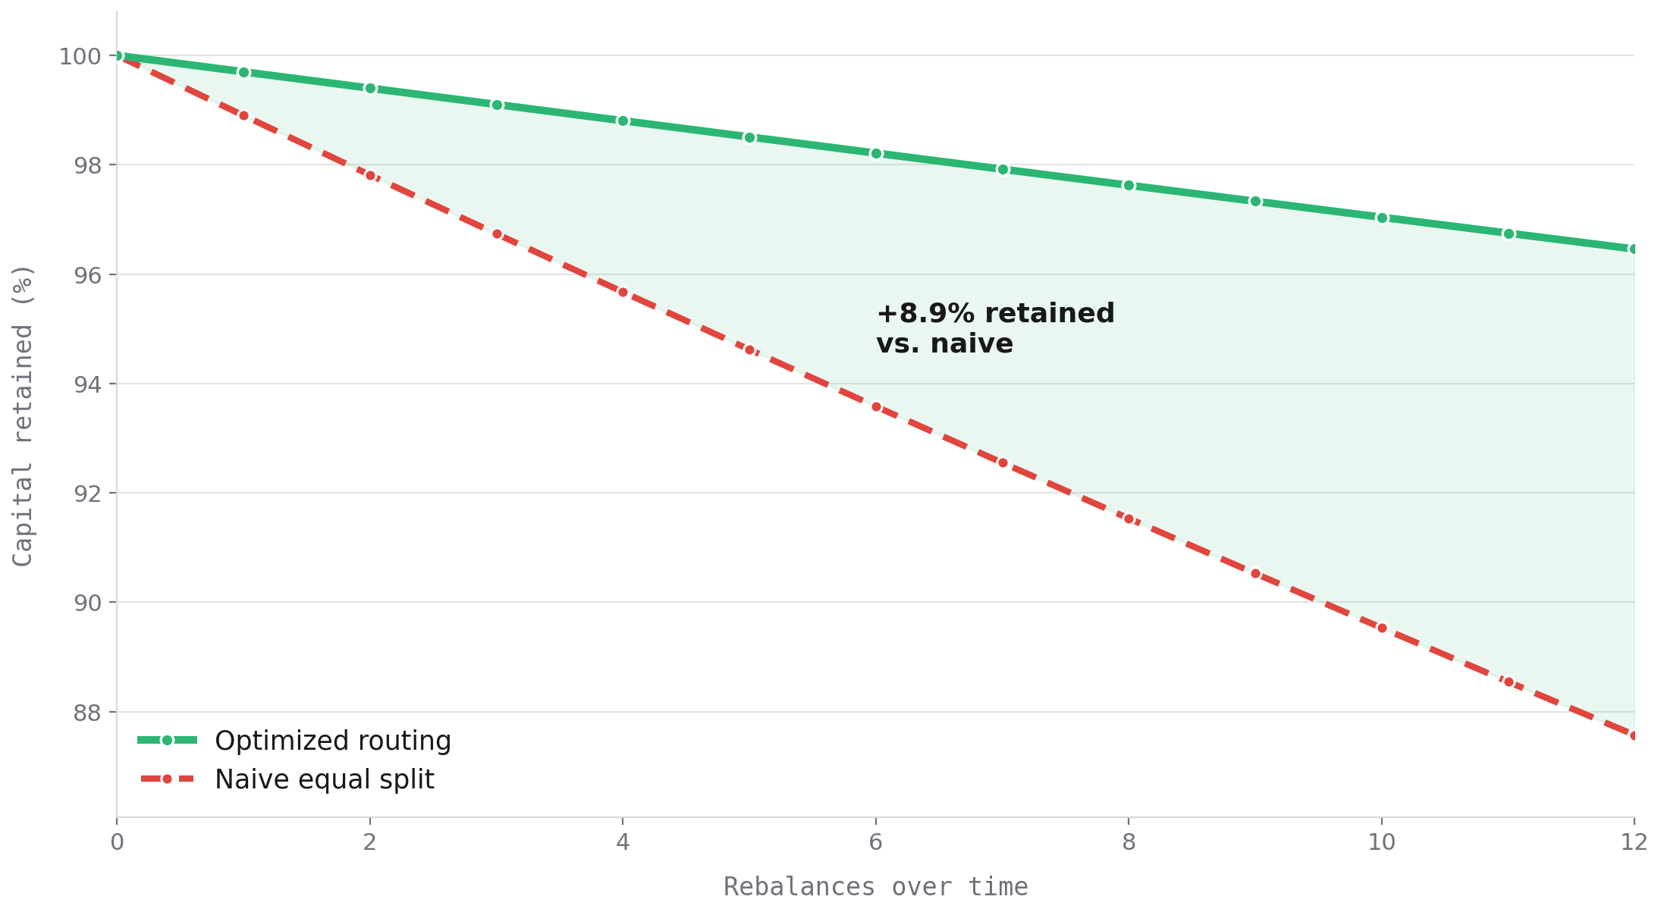
WHY POOL OPTIMIZATION PAYS OFF
Less slippage now,
more capital later
Optimizing across the pool routes weight toward the assets that are cheapest to trade under current conditions — so each rebalance loses less to slippage.
That edge compounds: you still buy the least-weighted assets, but you keep more of every dollar over the long run.

