Slide 1
CAPSTONE PROJECT PROPOSAL · PROPOSAL HEARING
Human Resource
Information System
WEB PORTAL
React.js · HR, Engineers, Executives
An offline-capable, tamper-evident attendance and payroll system for construction field operations
MOBILE APP
React Native · Foremen, offline
for Arcenas Development Corporation
CRYPTO ENGINE
HMAC chain · TEE signing
PRESENTED BY
Jay Mark A. Reños · Liza Mae C. Sugala · Rusel R. Portes
Efren S. Cabudbud Jr. · CarlVey Sente · Rayla G. Lanaza
Title Reviewer / Adviser: Engr. Clark Kevin V. Villamor
Notes:
Good morning. We are presenting the Human Resource Information System for Arcenas Development Corporation, a construction company. In the next hour we will cover the problem, our objectives, the proposed solution, our methodology, the core features, and our timeline.

Slide 2
SECTION 1 · PROJECT TITLE
Project at a Glance
01
PROJECT TITLE
02
CLIENT
Human Resource Information System (HRIS) for Arcenas Development Corporation
Arcenas Development Corporation
A centralized HR and payroll platform built around offline, tamper-evident construction site attendance.
A construction firm running multiple active project sites, several of them outside cellular coverage.
03
TARGET USERS
04
PROJECT TYPE
Seven defined roles, five with system access
Web-based Information System with a companion mobile application
HR Personnel, Site Foremen, Site Engineers / Construction Managers, System Administrator and Executives. Workers and Operators are record-only classifications.
A React.js web portal on a Laravel API, paired with an offline-capable Android app (iOS secondary) for field use.
Jay Mark A. Reños · Project Manager
02
Notes:
Two minutes here. Title, client, users, type. Note the two-part delivery: a web portal for the office and a mobile app for the field. The mobile app is the part that has to work with no internet at all.

Slide 3
02
SECTION 2
Statement of the Problem
What attendance and payroll look like today at Arcenas Development Corporation, and why the current process does not hold up.
5 minutes
Presented by
Liza Mae C. Sugala — Systems Analyst
Liza Mae C. Sugala · Systems Analyst
03

Slide 4
STATEMENT OF THE PROBLEM
The Current Process
Attendance today is captured on paper at the site and re-encoded in the office days later.
1
2
3
4
5
Paper roll call
Sheet travels
Re-encoding
Manual payroll
Payslip release
The foreman writes crew attendance on a sheet at the site.
Sheets are hand-carried to the office at end of day or end of week.
HR keys the same records a second time into a spreadsheet.
Overtime, night, rest day and holiday pay computed by hand.
Corrections and disputes are settled after the fact, from memory.
WHAT THIS PROCESS QUIETLY ASSUMES
That the handwritten time on the sheet is the time the record was actually made. Nothing proves it.
That a sheet written at a remote site survives the trip to the office intact and unaltered.
That the foreman is present and on time every single shift, at every single site.
That HR has the hours to recompute Labor Code premium rates by hand, for every worker, every cutoff.
Liza Mae C. Sugala · Systems Analyst
04
Notes:
Walk the panel left to right. The key point is the gap between step 1 and step 3: days can pass, and during that gap the record is a piece of paper nobody can verify.

Slide 5
STATEMENT OF THE PROBLEM
Existing Problems and Limitations
01
No signal at remote sites
02
Timestamps can be altered
03
Late, duplicated encoding
Several sites have no cellular or internet coverage, so nothing can be recorded or transmitted live.
A device clock can be rolled back and a paper sheet rewritten. Nothing proves when a record was really made.
Records reach HR days late and are keyed a second time, introducing transcription errors.
04
Manual payroll computation
05
Field edge cases unhandled
06
No audit trail
Overtime, night differential, rest day and holiday premiums are calculated by hand, worker by worker.
A late foreman, an absent foreman, or a day nobody logged has no defined procedure at all.
Overrides and corrections leave no record, so compliance review after the fact is not possible.
All six trace back to one root cause: the attendance record is not trustworthy at the moment it is created.
Liza Mae C. Sugala · Systems Analyst
05
Notes:
Five minutes for the whole problem section, so keep this to about two. Do not read all six. Highlight 01, 02 and 06, which are the ones the rest of the system is built to answer.

Slide 6
STATEMENT OF THE PROBLEM
Who Is Affected, and Why It Matters Now
WHO IS AFFECTED
WHY IT MUST BE ADDRESSED
1
Site Foremen
Carry the entire burden of proof on paper, with no way to defend a disputed entry.
Legal exposure
Payroll must comply with the Philippine Labor Code (RA 442). Unverifiable attendance is not a defensible basis for it.
2
Field Workers
Pay depends on a sheet they never see, computed by hand days after the shift.
Wage cost leakage
Hand-computed premiums and unverifiable hours produce errors in both directions: underpaid workers and overpaid hours.
3
HR Personnel
Encode the same records twice, then recompute premium rates manually each cutoff.
No evidence in a dispute
Site Engineers
When a worker contests a day's pay, neither side has anything better than a recollection.
4
Cannot see who is actually deployed and present across sites in any timely way.
It worsens with growth
5
Executives and the firm
Each new site multiplies the paper, the travel time and the manual computation. The process does not scale.
Carry the legal and financial exposure of records that cannot be substantiated.
Liza Mae C. Sugala · Systems Analyst
06
Notes:
Land on the last two points: no evidence in a dispute, and it gets worse as the company takes on more sites. That is the argument for doing this now rather than later.

Slide 7
SECTION 3
Objectives
GENERAL OBJECTIVE
To design and develop a centralized Human Resource Information System for Arcenas Development Corporation that records construction site attendance reliably without internet connectivity, protects that record from tampering using hardware-backed cryptography, and automates payroll computation in compliance with the Philippine Labor Code.
SPECIFIC OBJECTIVES
01
Centralize HR operations
02
Capture attendance offline
03
Make records tamper-evident
Digitize employee records, crew deployment, attendance, leave and payroll into one system of record.
Let foremen log crew attendance at sites with no cellular or internet signal, and sync it automatically later.
Prevent and detect timestamp manipulation through monotonic clock capture, hash chaining and hardware signing.
04
Handle real field edge cases
05
Automate Labor Code payroll
06
Make compliance reviewable
Automate the late foreman, absent foreman and unlogged-day scenarios instead of leaving them to memory.
Compute overtime 1.25x, night differential 1.10x, rest day 1.30x and holiday 2.0x from verified attendance only.
Log every override and correction, and surface labor cost and punctuality analytics to management.
Liza Mae C. Sugala · Systems Analyst
07
Notes:
Three minutes. Read the general objective once, slowly. Then name the six specific objectives without reading their descriptions.

Slide 8
04
SECTION 4
Overview of the Solution
What we are proposing to build, how it works end to end, and how each part answers a problem we just described.
5 minutes
Presented by
Liza Mae C. Sugala — Systems Analyst
Liza Mae C. Sugala · Systems Analyst
08

Slide 9
OVERVIEW OF THE SOLUTION
What the Proposed System Is
HRIS is a centralized web-based information system for HR and payroll, with a companion mobile application that records crew attendance at the site itself, with or without a connection.
HOW IT GENERALLY WORKS
Site Foreman - Mobile App
React Native. Taps Present / Late / Absent. Writes to encrypted SQLite on the device.
THE IDEA IN ONE LINE
Capture attendance once, at the source, in a form that can later be proven unaltered, and let everything downstream compute itself from that single verified record.
Laravel API - Verification
Re-computes the hash chain and checks the ECDSA signature before anything is accepted.
THREE THINGS THAT MAKE IT WORK
MySQL 8.0 - Central Records
Offline-first: the mobile app writes to an encrypted local database, never to the network.
Tamper-evident: each record is time-anchored, hash-chained and signed inside the phone's security chip.
Single source of truth: payroll, leave, analytics and audit all read the same verified attendance rows.
Thirteen-table schema: employees, crews, attendance, signatures, payroll, audit log.
React Web Portal
HR, Site Engineers, Administrators and Executives work from the verified record.
Data only ever moves upward after it has been signed on the device.
Liza Mae C. Sugala · Systems Analyst
09
Notes:
Point at the right-hand stack while you talk. Stress that the arrow from the mobile app to the API only fires after signing, and that the API rejects anything whose chain or signature does not verify.

Slide 10
OVERVIEW OF THE SOLUTION
Who Uses It, and How They Interact
1
Site Foreman
MOBILE
Opens the app at the site, taps Present / Late / Absent for each worker on the crew roster, then closes it. No typing, no signal needed.
2
HR Personnel
WEB
Maintains employee records, reviews synced attendance, processes leave and runs payroll for the cutoff.
3
Site Engineer / Construction Manager
WEB
Forms crews, deploys them to sites, designates foremen, and signs off on retroactive attendance recovery.
4
System Administrator
WEB
Manages accounts, role permissions and system configuration.
5
Executive
WEB
Reviews labor cost analytics, site punctuality and the audit trail. Read-only access.
Worker and Operator are record-only classifications. They appear on rosters and payroll but have no system login of their own.
Liza Mae C. Sugala · Systems Analyst
10
Notes:
The important contrast is row 1 against the rest: the foreman's entire interaction is tapping a list on a phone. Everyone else works in a browser, on data the foreman produced.

Slide 11
OVERVIEW OF THE SOLUTION
Major Components and Modules
01
Employee & Workforce Management
02
Crew Assignment & Site Deployment
03
Offline Mobile Attendance Checklist
Profiles, trade skills, certifications, pay rates, emergency contacts, employment status.
Crew formation, deployment to project sites, foreman designation.
Tap-based roll call on React Native, writing to encrypted local storage.
04
Cryptographic Integrity Engine
05
Automated Background Sync Engine
06
Foreman Edge Case Handling
Four layers: monotonic clock, HMAC-SHA256 chain, TEE signing, server verification.
Detects reconnection and pushes the queued batch with retry and backoff.
Late override, one-click re-assignment, retroactive recovery sign-off.
07
Philippine Labor Code Payroll Engine
08
Leave & Overtime Filing Workflow
09
Compliance & Analytics
Regular, overtime, night differential, rest day and holiday pay, plus deductions.
Multi-tier filing and approval for leave and overtime requests.
Labor cost breakdowns, site punctuality, and a reviewable audit event log.
Modules 3 to 6 are the field side of the system. Modules 1, 2 and 7 to 9 run in the web portal.
Efren S. Cabudbud Jr. · Database & QA Lead
11
Notes:
Nine modules. Do not read them all. Group them: one and two are the office setup, three through six are the field, seven through nine are what management gets out of it.

Slide 12
OVERVIEW OF THE SOLUTION
General System Workflow
1
2
3
4
Deploy the crew
Open the app on site
Tap the roll call
Sign and chain
A Site Engineer forms a crew, assigns it to a site and designates the foreman.
The foreman opens the mobile app. The crew roster is already cached on the device.
Present, Late or Absent for each worker. Written straight to encrypted local storage.
Each record is time-anchored, linked to the previous one and signed in the phone's security chip.
5
6
7
THE KEY PROPERTY
Steps 2, 3 and 4 need no internet at all. Step 5 happens by itself, whenever signal returns.
Sync and verify
Compute payroll
Review and audit
On reconnection the queued batch is sent. The server re-computes the chain and checks the signature.
Only verified attendance feeds the Labor Code payroll engine for the cutoff.
HR reviews, management sees labor cost and punctuality, and every override is in the audit log.
Liza Mae C. Sugala · Systems Analyst
12
Notes:
Trace the whole path with your finger: office, site, phone, back to server, payroll. Then say the line on the dark card. That is the sentence the workflow exists to support.

Slide 13
OVERVIEW OF THE SOLUTION
How the Solution Addresses Each Problem
PROBLEM
HOW HRIS ADDRESSES IT
No signal at remote sites
Offline-first mobile app on encrypted SQLite, plus an automatic background sync engine on reconnection.
Timestamps can be altered
Monotonic hardware clock, HMAC-SHA256 hash chaining and ECDSA P-256 signing inside the device security chip.
Late, duplicated encoding
The record is created once, digitally, at the site. HR never re-keys it.
Manual payroll computation
A payroll engine that applies Labor Code premium rates automatically to verified attendance.
Field edge cases unhandled
Late foreman override, one-click absent foreman re-assignment and retroactive recovery sign-off.
No audit trail
Every override, re-assignment and correction writes an audit log entry with actor, time and reason.
Liza Mae C. Sugala · Systems Analyst
13
Notes:
This slide closes the problem loop. If the panel challenges any single problem later, come back here. Every row on the right becomes a core feature in section six.

Slide 14
05
SECTION 5
Methodology
How the system will be built: the development model, the fixed technology stack, and the resources the project requires.
8 minutes
Presented by
Rayla G. Lanaza — Documentation Lead
Rayla G. Lanaza · Documentation Lead
14

Slide 15
METHODOLOGY
Development Methodology
An Agile-Waterfall hybrid: documentation is sequential and approved in order, development runs in two-week sprints.
WATERFALL
AGILE
For the documentation phases
For the development phases
Each document is reviewed and approved before the next begins, so development starts from a settled specification.
Web, mobile and cryptographic modules are built in two-week sprints with a review at the end of each one.
SRS - Software Requirements Specification
1
Plan
2
Build
Pick the sprint's use cases from the SRS and the WBS.
Implement against the SDD design and the coding standards.
SDD - Software Design Description
SPMP - Software Project Management Plan
3
Test
4
Review
Unit tests, then the relevant STD test cases.
Demo, adviser feedback, re-prioritise the next sprint.
STD - Software Test Document
Reference: SPMP Section 4.1 Process Model. Weekly Friday stand-ups; any delay beyond five days escalates to the Project Manager.
Rayla G. Lanaza · Documentation Lead
15
Notes:
Expect a question on why not pure Agile. Answer: the capstone requires approved documents in sequence, but the crypto and payroll work genuinely needs iteration, so we split the model by phase type.

Slide 16
METHODOLOGY
Technology Stack
The stack is fixed by the SPMP and is not changed without team sign-off.
01
Backend / API
02
Web Frontend
03
Mobile
Laravel (PHP 8.x)
RESTful API
Role-based access control
PSR-12 coding standard
React.js
TailwindCSS
Vite build tooling
Airbnb style guide
React Native
Android primary
iOS secondary
Tap-based offline UI
04
Data
05
Security and Cryptography
MySQL 8.0 - central database, 13-table schema
SQLite with SQLCipher (AES-256) - encrypted on-device storage
Eloquent ORM and Laravel migrations
HMAC-SHA256 hash chaining across attendance records
ECDSA P-256 signing of synced batches
Android Keystore TEE / iOS Secure Enclave key storage
Monotonic clock: elapsedRealtime / mach_continuous_time
Rusel R. Portes · Lead Developer
16
Notes:
Say plainly that nothing here is exotic or paid. The only unusual item is the hardware security chip, and every Android phone from version 10 onward already has one.

Slide 17
METHODOLOGY
Development Resources and Requirements
01
Hardware
02
Software and Tools
03
Environments and Hosting
Five developer workstations, one per team member
Android test smartphone, Android 10 or higher with a hardware-backed keystore
Local development server for the Laravel API and MySQL
Minimum client spec: dual-core 2.0 GHz, 4 GB RAM for the web portal
Node.js and npm for the React and React Native builds
PHP 8.x and Composer for Laravel
MySQL 8.0 and SQLite
Git with GitHub for version control
VS Code, Postman, Figma, draw.io
Local development on XAMPP or Docker
Staging on a local network server for integration testing
Production cloud hosting after the capstone, to be selected with the client
No paid third-party APIs required
ESTIMATED BUDGET
PHP 1,000 - 2,500
All tooling is open-source or free tier, test devices are team-owned, and the defense runs on a local environment. The cost is documentation printing and team coordination.
Jay Mark A. Reños · Project Manager
17
Notes:
The budget line usually draws a question. The honest answer is that the cryptography runs on hardware the phones already have, so there is no security vendor to pay.

Slide 18
06
SECTION 6
Core Features and Prototype
The ten features that do the actual work of solving the problem, then the interface prototype for each part of the system.
25 minutes · 16 for the features, 9 for the prototype
Presented by
Rusel R. Portes — Lead Developer
Rusel R. Portes · Lead Developer
18

Slide 19
CORE FEATURES
The Ten Core Features
Each one exists to close a specific gap in the current process. We will take them in the order the work happens.
01
Crew Assignment and Site Deployment
02
Offline-First Mobile Roll-Call Checklist
Who is on which crew, at which site, under which foreman.
Tap-based attendance that needs no connection at all.
03
Cryptographic Attendance Integrity Engine
04
Automated Background Sync Engine
Four layers that make a record provably unaltered.
Queued records reach the server the moment signal returns.
05
Late Foreman Override and Shift-Start Credit
06
One-Click Absent Foreman Re-assignment
Workers are not penalised for a foreman's lateness.
A crew never loses a day because one person did not report.
07
Retroactive Crew Recovery Sign-off
08
Philippine Labor Code Payroll Engine
A controlled, approved path for days nobody logged.
Premium rates applied automatically to verified attendance.
09
Leave and Overtime Filing and Approval
10
Audit Trail and Compliance Review
Multi-tier approval that reaches payroll before the cutoff.
Every override and correction on record, and reviewable.
Rusel R. Portes · Lead Developer
19
Notes:
Sixteen minutes for ten features is roughly ninety seconds each, with the prototype walkthrough taking the remaining nine. Announce that split here so the panel knows you are pacing deliberately, then move.

Slide 20
CORE FEATURE 01 OF 10
Crew Assignment and Site Deployment
WHAT IT DOES
Site Engineers build crews from the worker registry and deploy each crew to a project site.
Every crew has exactly one designated foreman, and only that foreman can log its attendance.
Deployment state lives on the crew record itself: current status and the date it was deployed.
The crew roster is cached to the foreman's device in advance, so it is readable at the site with no signal.
DEPLOYMENT CHAIN
Site
Tower 3 Project Site
Crew
Crew A - 12 workers
Foreman
One designated, device-bound
Roster cached to the device before deployment
Mason
Welder
Operator
Helper
THE PROBLEM IT SOLVES
The roster the foreman taps through at the site is the same roster the office deployed. Nobody works from a hand-copied list.
Rusel R. Portes · Lead Developer
20

Slide 21
CORE FEATURE 02 OF 10
Offline-First Mobile Roll-Call Checklist
WHAT IT DOES
The foreman taps one of three choices for each worker: Present, Late or Absent. No typing and no time entry.
Every tap writes straight to an encrypted SQLite database on the phone. The write path never touches the network.
An Undo action corrects a mistaken tap before the record is finalised.
The screen shows whether the device is online and how many records are still waiting to sync.
Crew A · Tower 3 Site
OFFLINE
R. Delos Santos
PRESENT
LATE
ABSENT
M. Abanto
PRESENT
LATE
ABSENT
J. Villaruel
PRESENT
LATE
ABSENT
A. Carpio
PRESENT
LATE
ABSENT
4 of 12 recorded · 4 queued for sync
Written to encrypted local storage, with no network call
THE PROBLEM IT SOLVES
Attendance is recorded at sites with no cellular or internet coverage, at the moment the crew actually assembles.
Rusel R. Portes · Lead Developer
21

Slide 22
CORE FEATURE 03 OF 10
Cryptographic Attendance Integrity Engine
WHAT IT DOES
Four independent layers, each one defeating a different way of faking an attendance record.
All four are applied on the device as the record is written, not bolted on at the server afterwards.
The server refuses any batch whose hash chain or signature does not verify. It is never stored as attendance.
Tested against three deliberate attacks: clock rollback, direct database edits, and forged signatures.
FOUR LAYERS, APPLIED IN ORDER
L1
Monotonic clock capture
Anchors when the record was made
L2
HMAC-SHA256 hash chain
Links every record to the one before it
L3
ECDSA P-256 signing in the TEE
Proves which device produced the batch
L4
Server-side verification
Rejects anything that does not re-compute
THE PROBLEM IT SOLVES
A record's time and content can be proven unaltered, so attendance becomes evidence rather than a claim.
Rusel R. Portes · Lead Developer
22

Slide 23
CORE FEATURE 03 · INTEGRITY ENGINE
Layers 1 and 2: Anchoring Time, Linking Records
L1
Monotonic Clock Capture
L2
HMAC-SHA256 Hash Chaining
Attack it defeats: the foreman sets the phone's clock back and logs a late arrival as on time.
Attack it defeats: someone opens the local database and edits a record after the fact.
HOW IT WORKS
HOW IT WORKS
Every record stores two readings: the wall-clock time and the device's monotonic counter.
The monotonic counter (elapsedRealtime on Android, mach_continuous_time on iOS) counts from boot and cannot be edited from settings.
If the clock is moved, the two readings stop agreeing with each other, and the discrepancy is detectable on the server.
Each record's hash is computed over its own contents plus the hash of the record before it.
Changing any single record breaks its own hash and every hash that follows it.
The server re-computes the whole chain on receipt and compares. A single altered field is enough to fail it.
Rusel R. Portes · Lead Developer
23
Notes:
This is the slide the panel is most likely to probe. The one-line version: layer one proves when, layer two proves what. Neither can be undone by editing the phone.

Slide 24
CORE FEATURE 03 · INTEGRITY ENGINE
Layers 3 and 4: Proving the Device, Verifying the Batch
L3
ECDSA P-256 Signing in the TEE
L4
Server-Side Verification
Attack it defeats: a forged batch submitted from somewhere other than the bound device.
Attack it defeats: anything that got past the first three, or was altered in transit.
HOW IT WORKS
HOW IT WORKS
A private key is generated inside the phone's hardware security chip (Android Keystore TEE or iOS Secure Enclave).
The key cannot be exported from that chip, even on a rooted device. Signing happens inside it.
Each batch of attendance records is signed there before it leaves the phone.
The Laravel API checks the signature against the public key registered to that foreman's device.
It re-computes the hash chain and compares the monotonic and wall-clock readings.
The outcome of every check is written to the Crypto Signature Ledger. A batch that fails is quarantined, never stored as payable attendance.
Rusel R. Portes · Lead Developer
24
Notes:
Layer three proves which device. Layer four is the gate: nothing becomes payable attendance until the server has re-derived it independently.

Slide 25
CORE FEATURE 04 OF 10
Automated Background Sync Engine
WHAT IT DOES
A background service detects the return of connectivity without the foreman doing anything at all.
Queued records are transmitted as a signed batch, oldest first, so the hash chain arrives in order.
A failed transmission retries with exponential backoff rather than being dropped or duplicated.
A sync queue screen shows what is pending, what has synced and what failed, with the reason.
QUEUE AND DELIVERY
Batch 001 · 12 records
SYNCED
Batch 002 · 12 records
SENDING
Batch 003 · 9 records
QUEUED
Laravel API
Verifies the signature and chain, then accepts or quarantines
THE PROBLEM IT SOLVES
Records reach the office the moment signal returns, instead of waiting for someone to carry the paper in.
Rusel R. Portes · Lead Developer
25

Slide 26
CORE FEATURE 05 OF 10
Late Foreman Override and Shift-Start Credit
WHAT IT DOES
If the foreman opens the app after shift start, the crew is credited from the standard 7:00 AM shift start, not from the tap time.
The record carries a FOREMAN_LATE_OVERRIDE flag, so the credit is never invisible to anyone reviewing it.
An audit log entry records the actual tap time, the credited time and the foreman responsible.
Site Engineers can filter for flagged days in the web portal and follow up on the pattern.
WHAT GETS CREDITED
Standard shift start
7:00 AM
Foreman opened the app
8:42 AM
Credited to the crew
7:00 AM
Flagged: FOREMAN_LATE_OVERRIDE · written to the audit log
THE PROBLEM IT SOLVES
Workers who arrived on time are not penalised for their foreman's lateness, and the adjustment stays on the record.
Rusel R. Portes · Lead Developer
26

Slide 27
CORE FEATURE 06 OF 10
One-Click Absent Foreman Re-assignment
WHAT IT DOES
When a foreman does not report, a Site Engineer re-assigns the crew to an acting foreman in a single action.
The crew roster and the authority to log that day's attendance move to the acting foreman's device.
The original foreman, the acting foreman, the reason and the timestamp all go to the audit log.
Nothing already recorded is deleted or rewritten. The re-assignment is added, not substituted.
TRANSFER OF ATTENDANCE AUTHORITY
Designated foreman · did not report
Crew of 12 standing at the site with nobody able to log them
ONE ACTION
Acting foreman · roster on device
Roll call proceeds, signed by the acting foreman's device key
THE PROBLEM IT SOLVES
A crew never loses a day of attendance because one person did not show up.
Rusel R. Portes · Lead Developer
27

Slide 28
CORE FEATURE 07 OF 10
Retroactive Crew Recovery Sign-off
WHAT IT DOES
For a day where no attendance was logged at all, the crew's record can be reconstructed and submitted for sign-off.
The submission is explicitly marked retroactive. It can never be mistaken for a same-day record.
A Site Engineer must approve it before it becomes attendance that payroll will pay on.
The approver, the approval time and the stated reason are written to the audit log.
RECOVERY WORKFLOW
Gap detected
A shift day with no attendance records for a deployed crew
Foreman submits
Reconstructed roll call, marked RETROACTIVE with a reason
Engineer reviews
Approves, rejects, or returns it for correction
Becomes payable
Approved record enters payroll, with the audit entry attached
THE PROBLEM IT SOLVES
Missed days get a controlled, reviewable recovery path instead of a quiet edit to the record.
Rusel R. Portes · Lead Developer
28

Slide 29
CORE FEATURE 08 OF 10
Philippine Labor Code Payroll Engine
WHAT IT DOES
Computes pay for a cutoff directly from verified attendance. Records that failed verification are not payable.
Applies the premium rates set by RA 442, Articles 83, 86, 87, 93 and 94, without manual intervention.
Produces a payroll header plus a per-employee detail line showing how every figure was derived.
Verified against manual calculations for each premium scenario as test case TC-06.
PREMIUM RATE MULTIPLIERS APPLIED
Applied to the daily rate on the employee record, per RA 442.
THE PROBLEM IT SOLVES
Removes hand computation of premium rates, the single largest source of payroll error and wage dispute.
Rusel R. Portes · Lead Developer
29
Notes:
If asked about stacking, for example overtime worked on a holiday: the engine applies the premiums in the order the Labor Code specifies, and the payroll detail line shows the derivation for each worker.

Slide 30
CORE FEATURE 09 OF 10
Leave and Overtime Filing and Approval
WHAT IT DOES
Leave and overtime requests are filed in the web portal and routed through a multi-tier approval chain.
Approved overtime is reconciled against actual recorded attendance before any premium is paid on it.
Approved leave is reflected in attendance, so a lawful absence is never read as an unexcused one.
Every decision in the chain is stored with the approver, the date and any remarks.
APPROVAL CHAIN
1
Filed
Employee or HR files the leave or overtime request
2
Tier 1 review
Site Engineer or Construction Manager endorses it
3
Tier 2 approval
HR Personnel gives the final approval
4
Reflected in payroll
Applied to the cutoff and reconciled against attendance
THE PROBLEM IT SOLVES
Replaces verbal and paper approvals that routinely fail to reach payroll before the cutoff closes.
Rusel R. Portes · Lead Developer
30

Slide 31
CORE FEATURE 10 OF 10
Audit Trail and Compliance Review
WHAT IT DOES
Every override, re-assignment, retroactive approval and record correction writes an audit log entry.
Each entry records who acted, what changed, when it changed and which record it touched.
The Crypto Signature Ledger separately keeps the verification outcome of every synced batch.
Management reviews labor cost, site punctuality and override frequency from the same verified data.
AUDIT LOG
FOREMAN_LATE_OVERRIDE
R. Delos Santos
07:00 credited
CREW_REASSIGNED
Engr. M. Lopez
Crew A to acting
RETROACTIVE_APPROVED
Engr. M. Lopez
12 records
SIGNATURE_VERIFIED
Device FRM-004
Batch 002 valid
SIGNATURE_FAILED
Device FRM-009
Quarantined
Entries are append-only. Nothing in the trail can be edited or removed.
THE PROBLEM IT SOLVES
Compliance review becomes possible after the fact, for DOLE, for the client, and for internal dispute resolution.
Efren S. Cabudbud Jr. · Database & QA Lead
31

Slide 32
CORE FEATURES · 6.2 PROTOTYPE DESIGN
Interface Prototype
DESIGN APPROACH
Thirteen screens drawn against one shared design system, so the web portal and the mobile app read as a single product.
Every screen is tied to a use case. Nothing was designed that UC-01 to UC-10 does not call for.
Mobile screens assume gloved hands, direct sunlight and one-handed use while standing at a site.
Field screens always state connection status and what is still held on the phone, in plain language rather than system terms.
WEB PORTAL · 7 SCREENS
Login and Role Shell
Employee Records
Crew Builder — Manpower Allocation
Payroll Run
Executive Dashboard
Late Override Audit
Attendance Recovery Sign-off
MOBILE · 6 SCREENS
Foreman Home
Roll Call
Sync Queue
These are working HTML prototypes, not static mock-ups. The web screens and the mobile screens shown next are the ones being built against.
Device Binding
Request Form — Overtime and Leave
Acting Foreman Re-assignment
CarlVey Sente · UI/UX Designer
32
Notes:
Nine minutes for the prototype walkthrough. Say up front that these are real HTML prototypes you can click through, then move to the screens themselves.

Slide 33
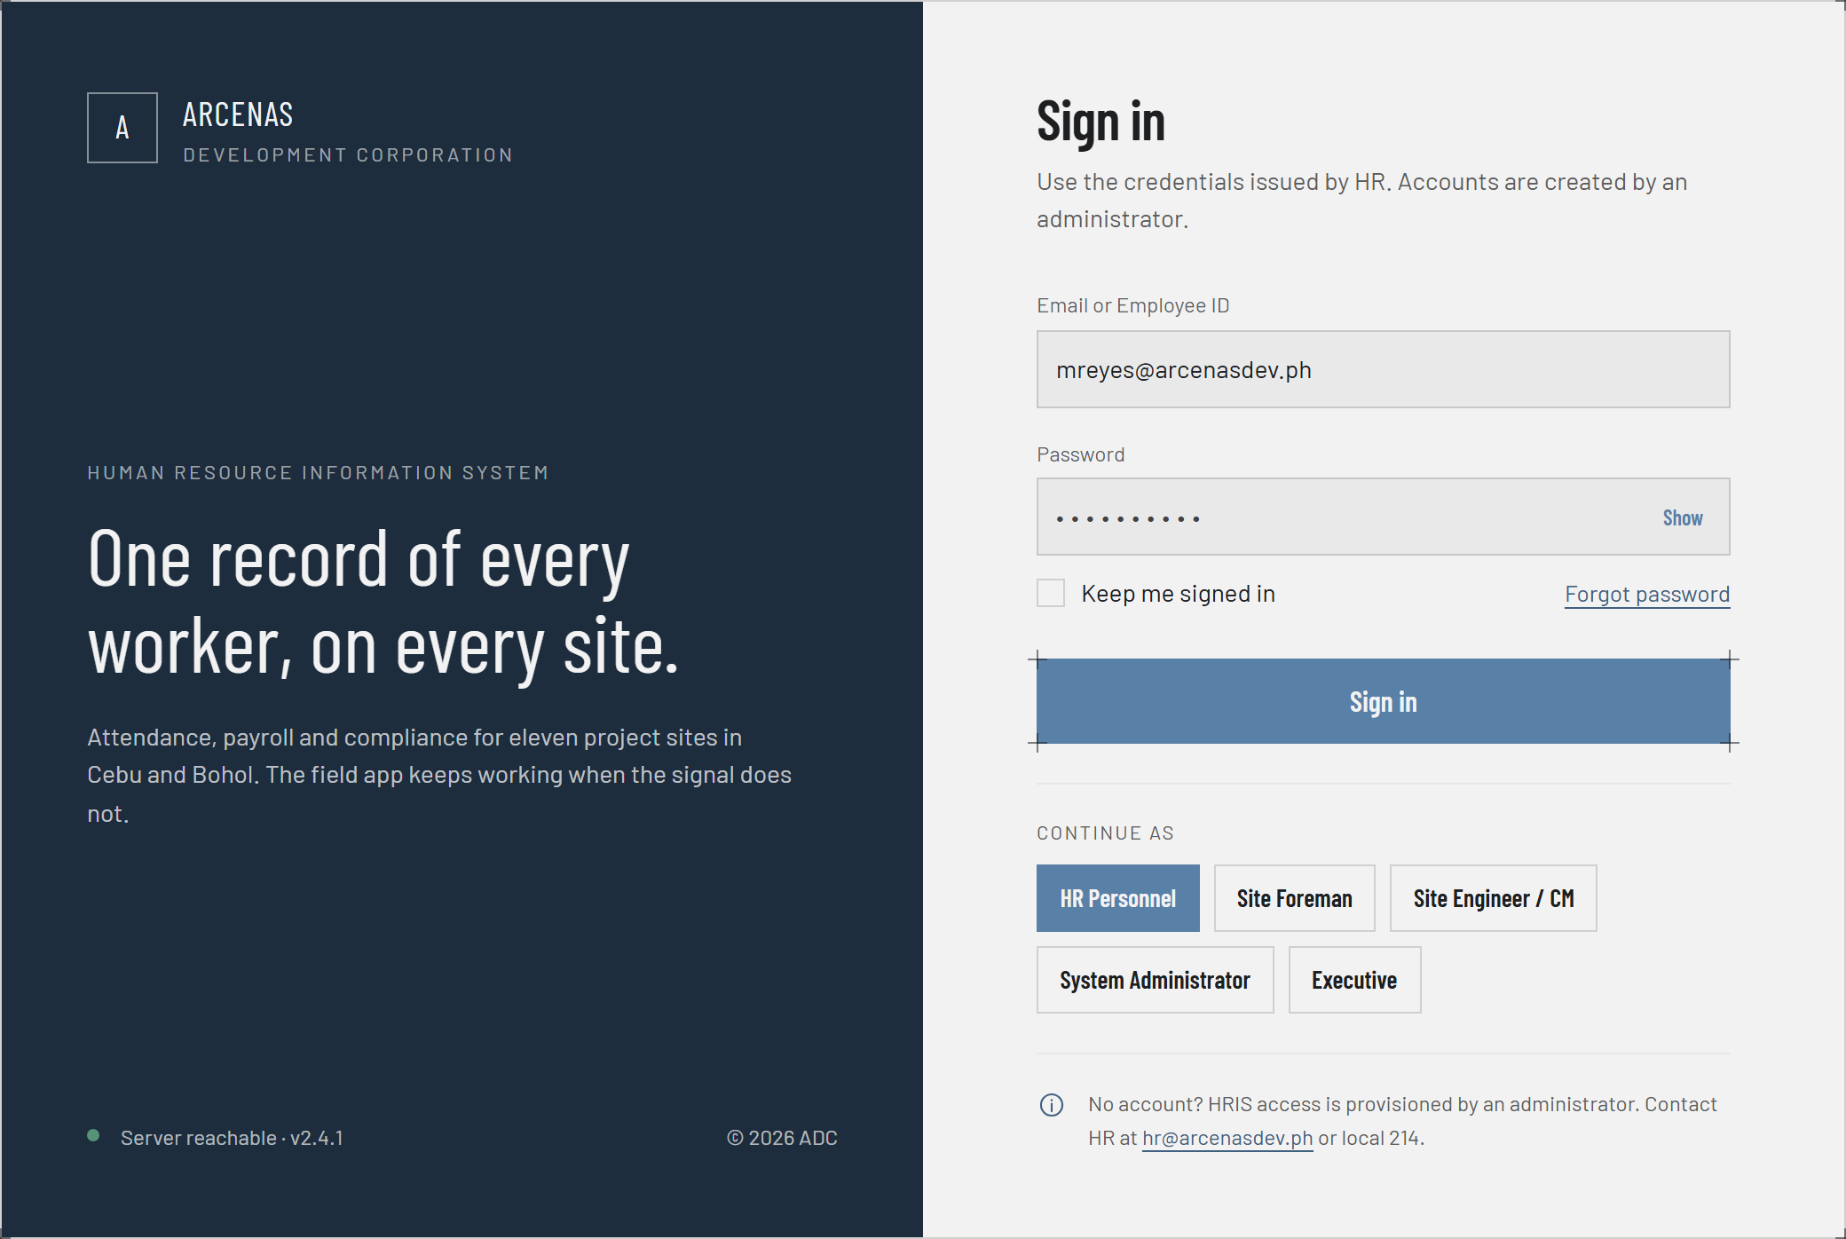
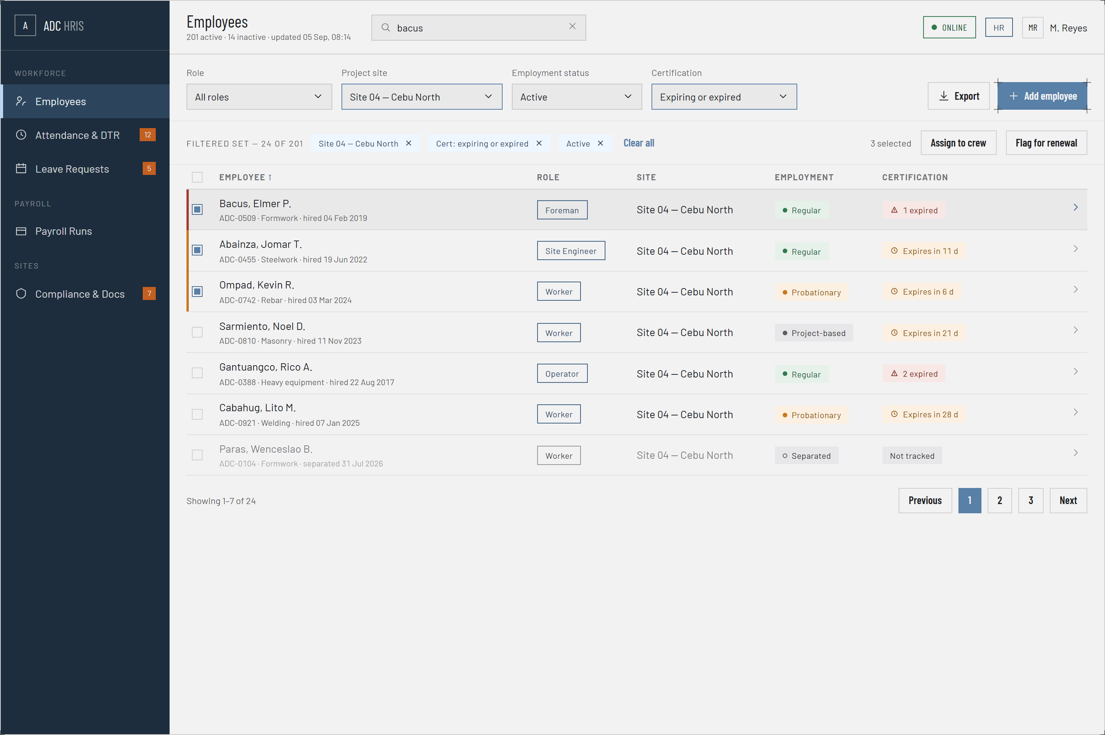
PROTOTYPE · WEB PORTAL
Sign-in, Role Shell and Employee Records
Login and Role Shell
Employee Records
One entry point for all five login-capable roles. What loads after sign-in is decided by the role, not by a separate app per role. Server reachability is shown before the user even tries to sign in.
201 active workers, filtered by role, project site, employment status and certification expiry. Certification state is a first-class filter because an expired certificate blocks crew assignment.
CarlVey Sente · UI/UX Designer
33
Notes:
The point to make on the left screen is RBAC: one sign-in, five different portals behind it. On the right, that certification expiry is a filter rather than a note buried in a profile.

Slide 34
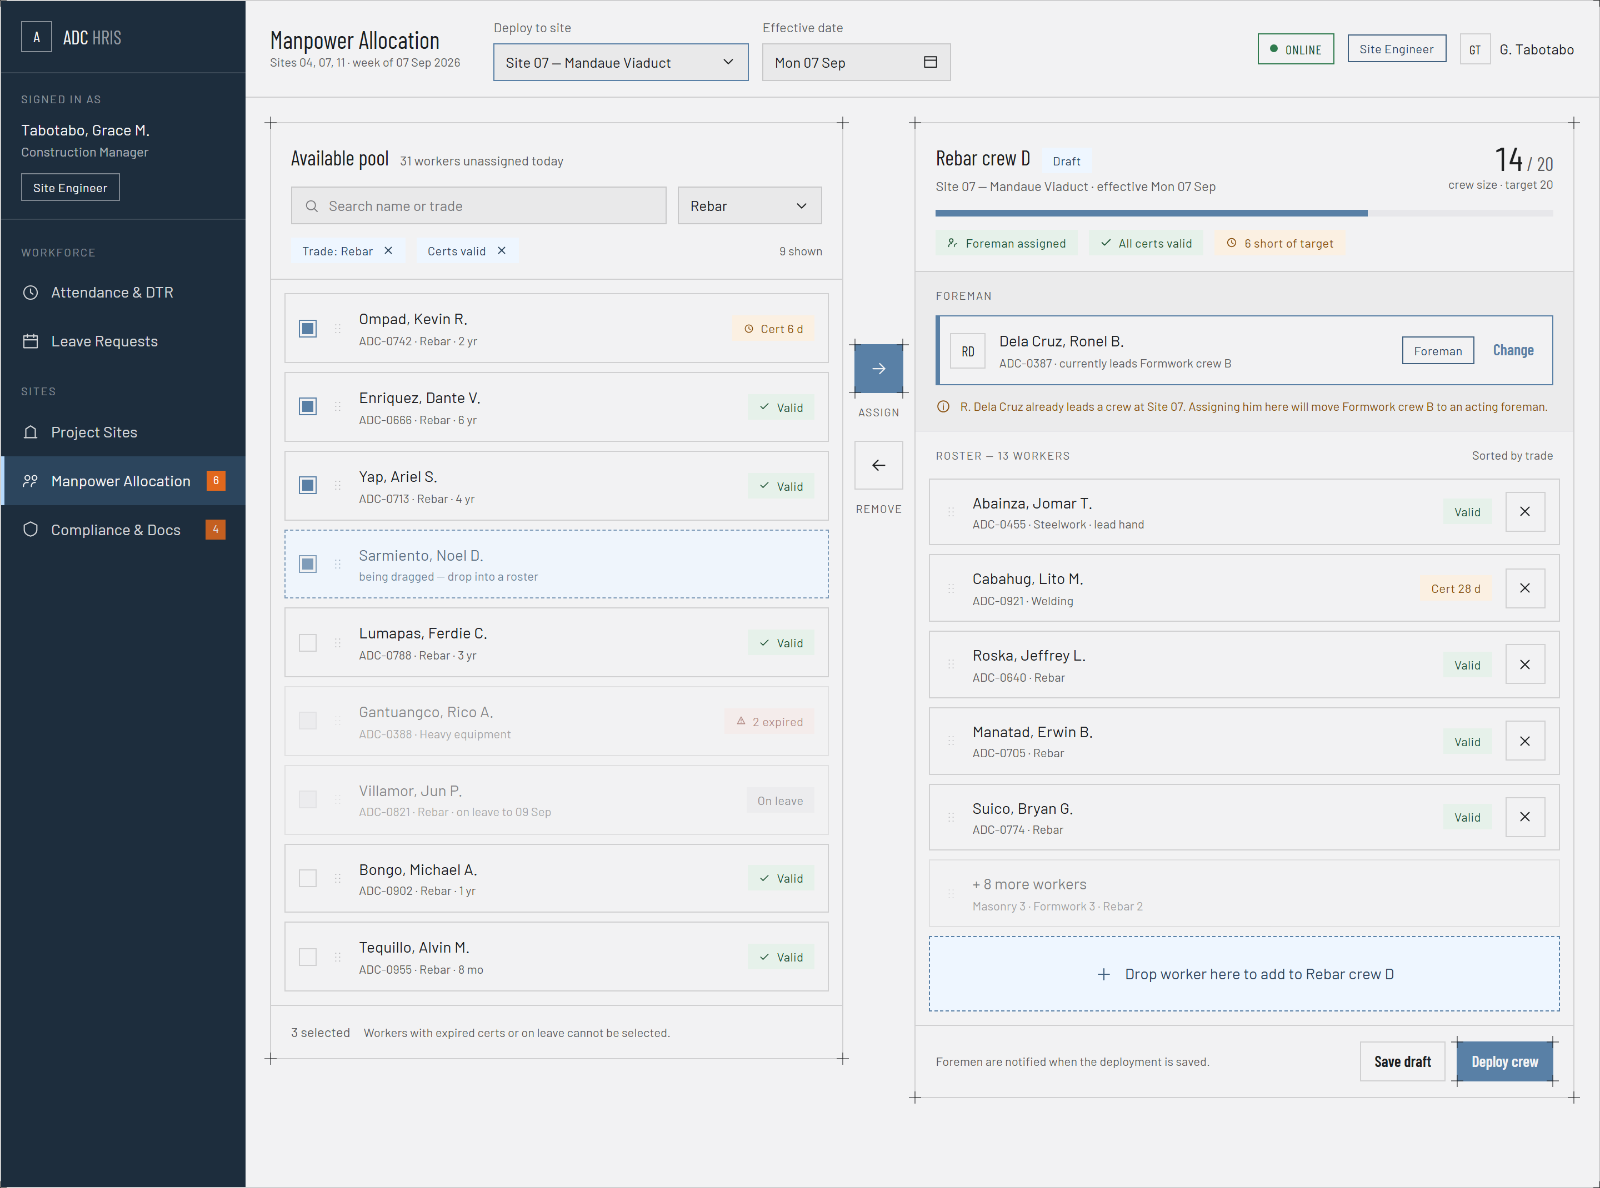
PROTOTYPE · WEB PORTAL
Crew Builder — Manpower Allocation
WHAT THE SCREEN ENFORCES
The available pool sits on the left, the crew being built on the right, with assign and remove between them.
Workers with expired certificates or on approved leave cannot be selected. The rule is enforced in the interface, not only on save.
Naming a foreman who already leads another crew warns that the other crew will drop to an acting foreman.
Crew size is tracked against a target, so an under-manned deployment is visible before it is saved.
Deploying the crew notifies the assigned foreman, which is the step that pushes the roster onto the phone.
CarlVey Sente · UI/UX Designer
34
Notes:
This is Core Feature 01 in interface form. The warning about an already-assigned foreman is worth pointing at: it is where crew assignment and the absent-foreman feature meet.

Slide 35
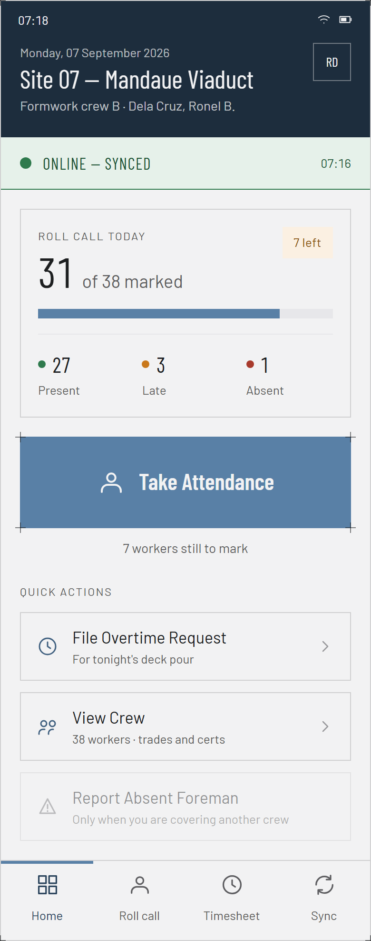
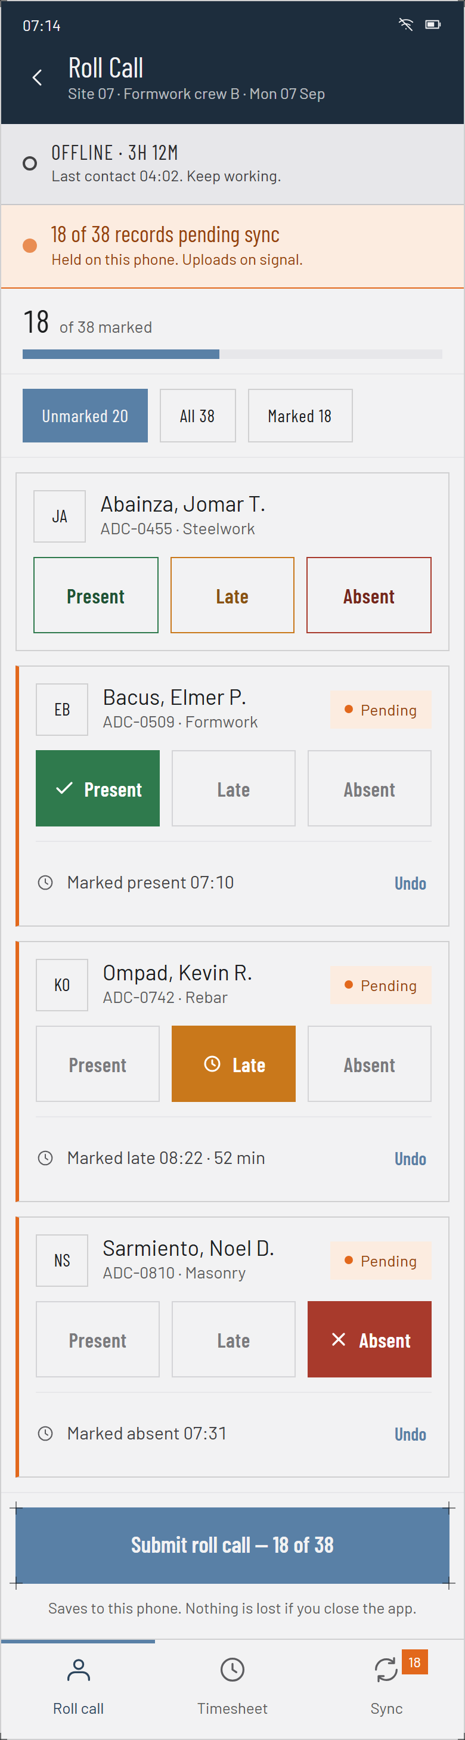
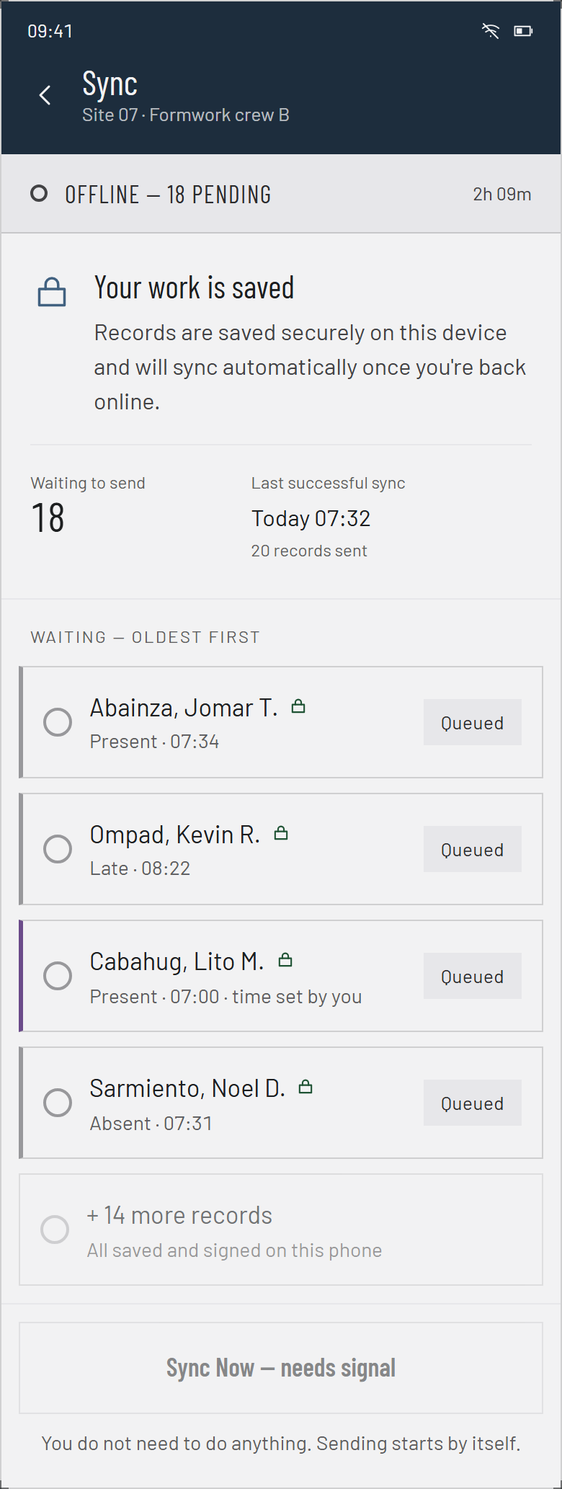
PROTOTYPE · MOBILE APP
The Foreman's Daily Screens
DESIGNED FOR THE SITE, NOT THE OFFICE
Home opens on today's roll call: 31 of 38 marked, 27 present, 3 late, 1 absent, and one button to continue.
Roll call is the three-choice tap list, with Undo on every marked worker and the offline duration shown at the top.
Sync lists what is still held on the phone, oldest first, and states plainly that sending starts by itself.
Every screen says whether the device is online and how many records are pending, in words a foreman can act on.
“Saves to this phone. Nothing is lost if you close the app.” — wording from the actual screen.
Home
Roll Call
Sync Queue
CarlVey Sente · UI/UX Designer
35
Notes:
Hold on the middle screen. That three-button row is the entire data-entry surface of the system for a foreman. Everything cryptographic happens behind it with no UI at all.

Slide 36
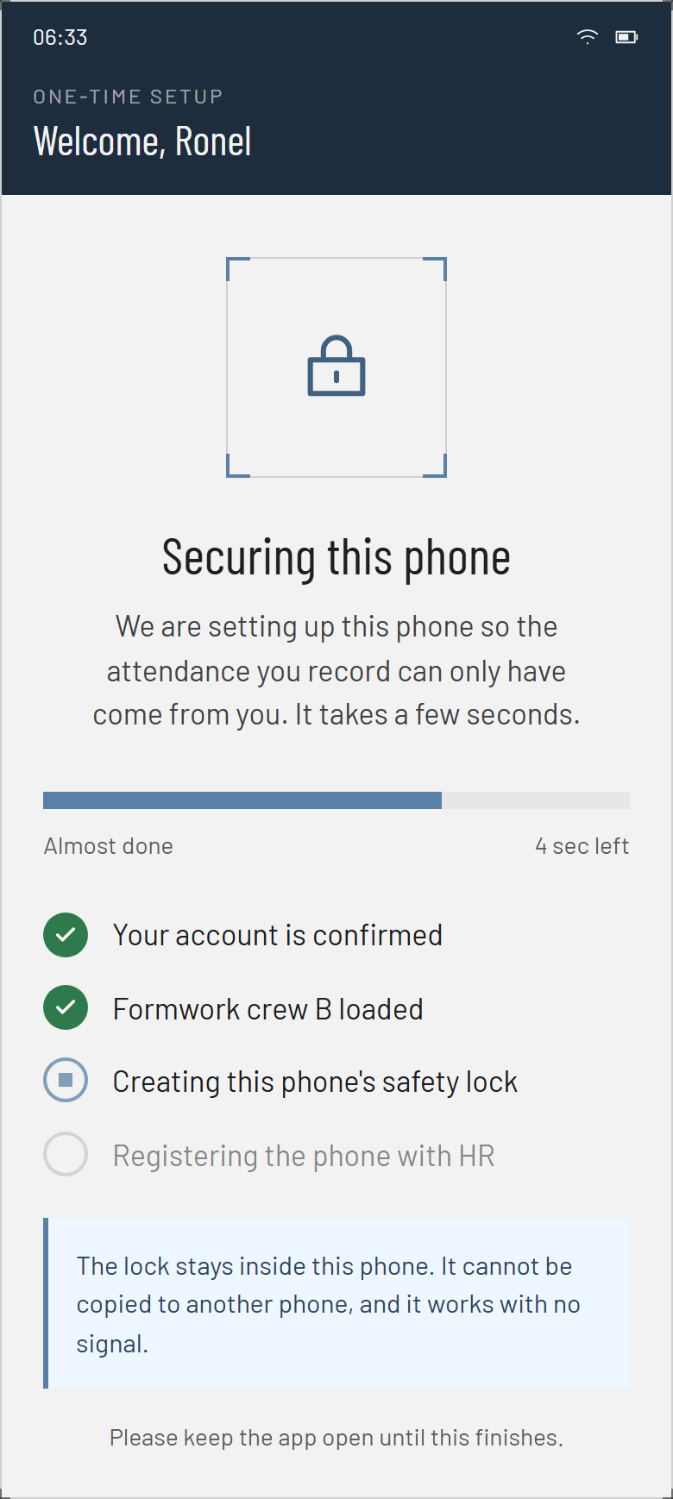
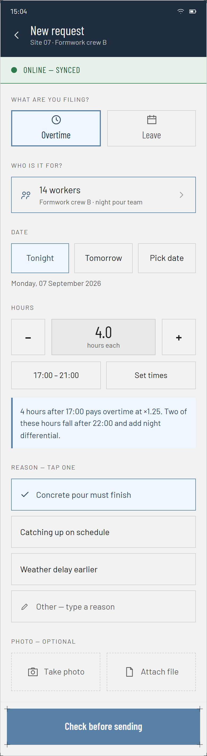
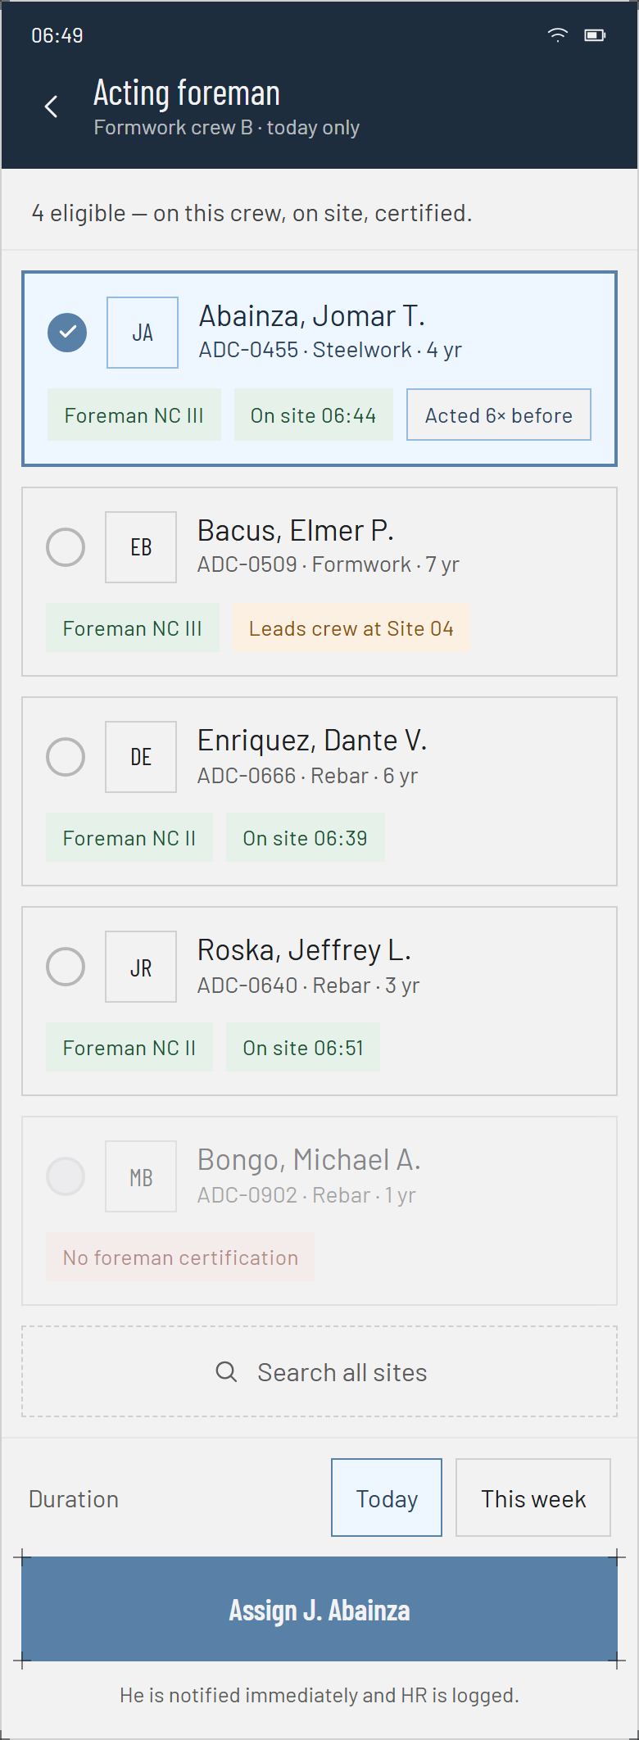
PROTOTYPE · MOBILE APP
Setup, Requests and Covering an Absent Foreman
THE SCREENS BEHIND THE EDGE CASES
Device binding is a one-time setup that creates the phone's key in hardware and registers it with HR, described as a safety lock rather than in cryptographic terms.
The request form files overtime or leave for a whole crew in a few taps, with preset reasons and an optional photo.
Acting foreman re-assignment lists only eligible workers: on this crew, on site, and holding a foreman certification.
The chosen acting foreman is notified immediately, and HR is logged.
Ineligible workers are shown greyed with the reason, so the foreman sees why, not just what.
Device Binding
Request Form
Acting Foreman
CarlVey Sente · UI/UX Designer
36
Notes:
Device binding is the screen that makes layer 3 of the crypto engine real. Note that the foreman never sees the word key, certificate or signature anywhere in the app.

Slide 37
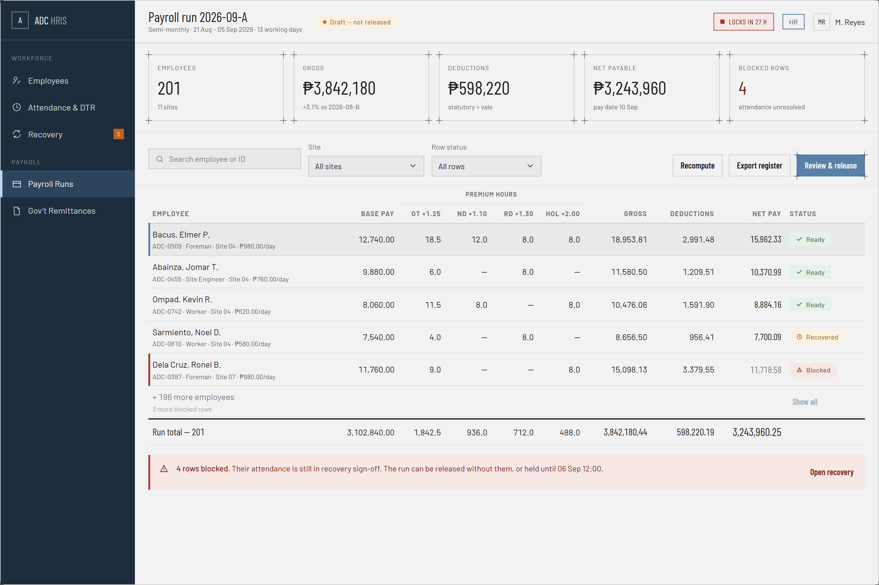
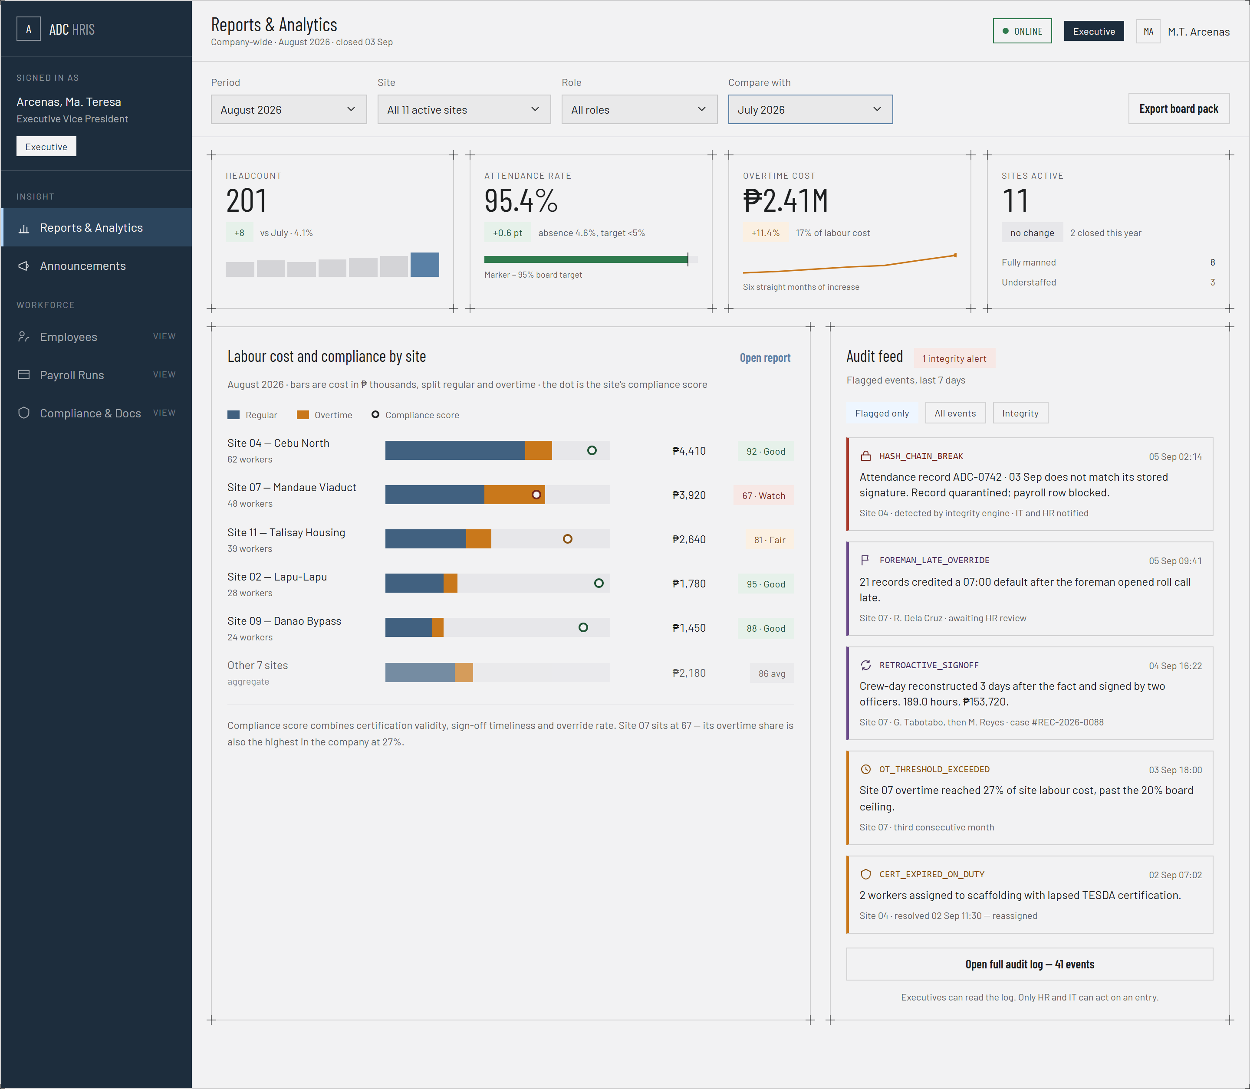
PROTOTYPE · WEB PORTAL
Payroll Run and the Executive View
Payroll Run 2026-09-A
Executive Dashboard
Semi-monthly, 13 working days: gross, deductions, net payable and pay date. Four rows are blocked because their attendance is unresolved, and the run carries a lock countdown.
Company-wide August 2026 across all 11 active sites: headcount, attendance rate and a comparison against the prior period. Read-only.
CarlVey Sente · UI/UX Designer
37
Notes:
The four blocked rows on the payroll screen are the whole argument of this project in one detail: payroll will not release over attendance that did not verify.

Slide 38
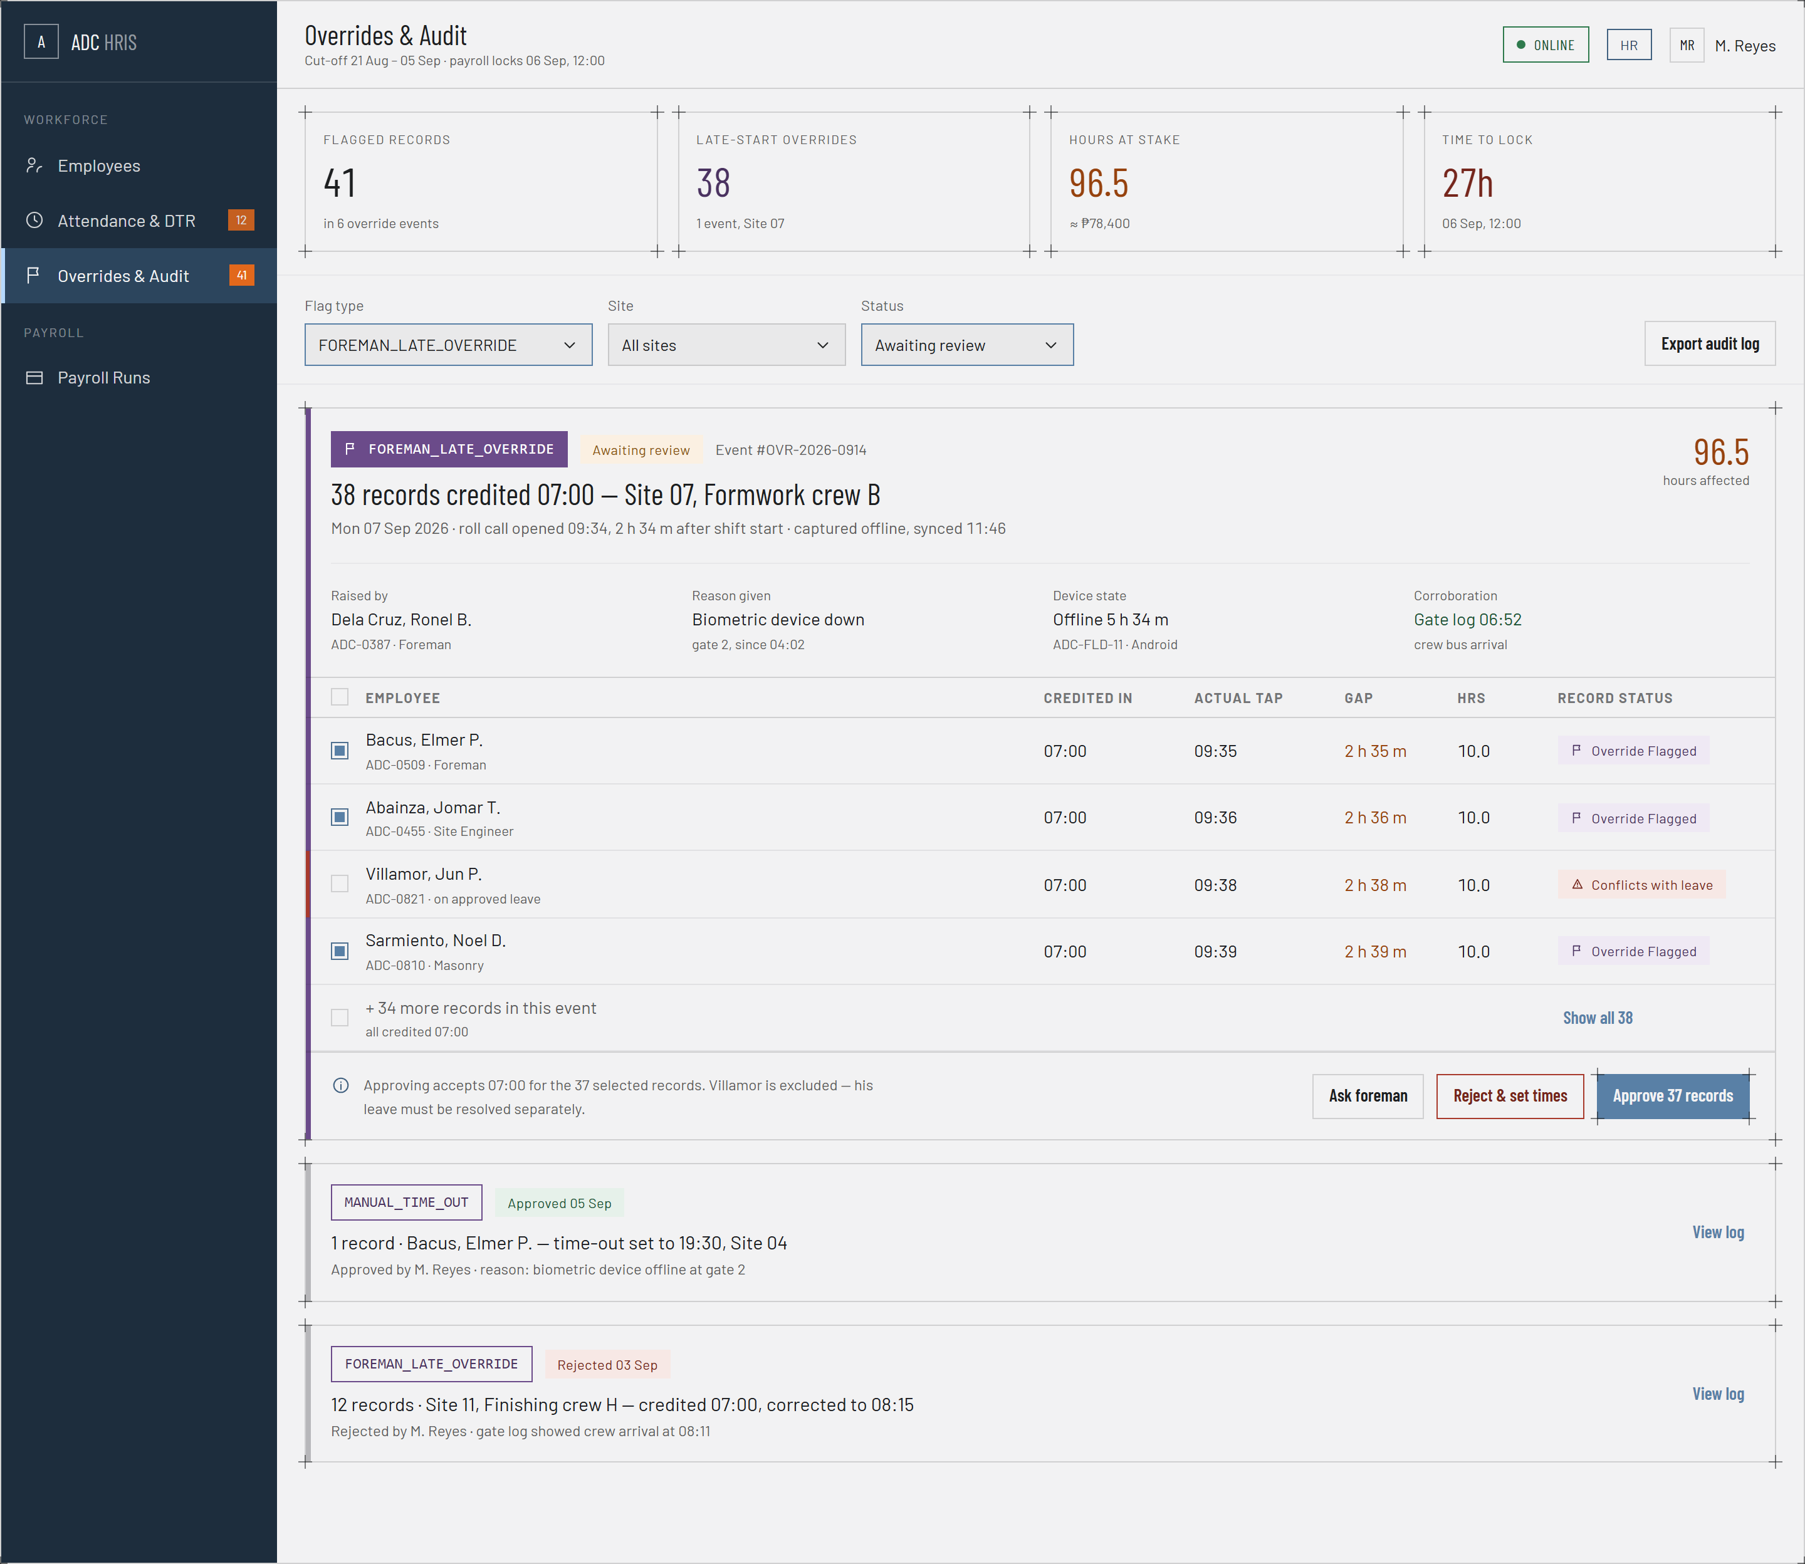
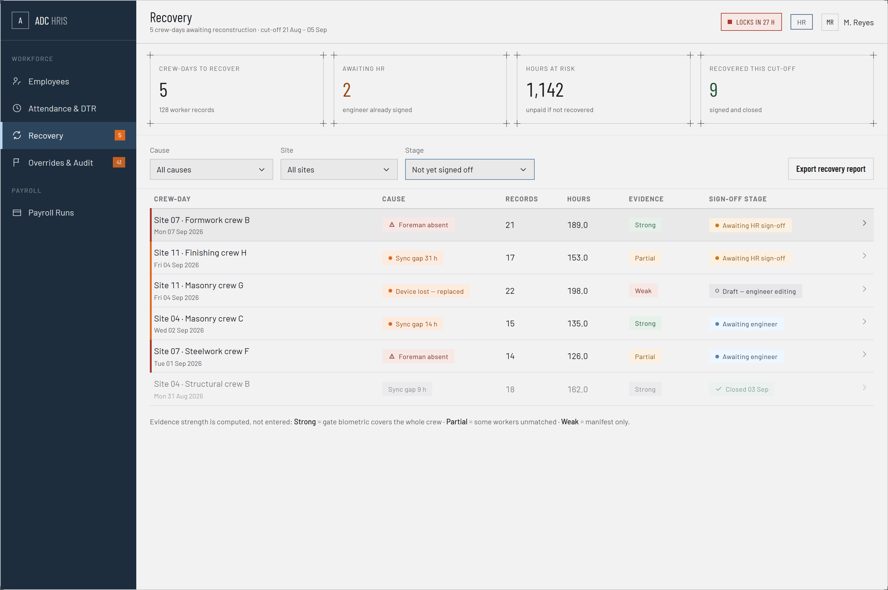
PROTOTYPE · WEB PORTAL
Override Audit and Attendance Recovery
Late Override Audit
Attendance Recovery Sign-off
41 flagged records across 6 override events, with the hours and the peso value at stake and a hard lock time. FOREMAN_LATE_OVERRIDE is a filter, not a footnote.
5 crew-days awaiting reconstruction covering 128 worker records and 1,142 hours that go unpaid if they are not recovered before the cut-off locks.
CarlVey Sente · UI/UX Designer
38
Notes:
Both screens quantify the exposure rather than just listing records. That framing is deliberate: it is what turns an audit log into something management will actually open.

Slide 39
07
SECTION 7
Development Milestones and Timeline
Eighteen weeks, eight phases, and the milestone that closes each one.
5 minutes
Presented by
Jay Mark A. Reños — Project Manager
Jay Mark A. Reños · Project Manager
39

Slide 40
MILESTONES AND TIMELINE
Eighteen-Week Development Schedule
PHASE
WEEK
1
2
3
4
5
6
7
8
9
10
11
12
13
14
15
16
17
18
Requirements Gathering
W1–W3
System Design
W4–W6
Web Portal Development
W7–W11
Mobile App Development
W10–W13
Crypto Engine Integration
W12–W14
Integration and Testing
W14–W16
Documentation Finalisation
W15–W17
Capstone Defense
W18
Mobile development overlaps web development from week 10, and crypto integration overlaps testing from week 14. Those two overlaps are the critical path.
Jay Mark A. Reños · Project Manager
40
Notes:
Point out the two overlaps rather than reading eighteen weeks aloud. If asked what happens if crypto slips: testing in weeks 14 to 16 absorbs a one-week slip, beyond that documentation week 15 to 17 is the buffer.

Slide 41
MILESTONES AND TIMELINE
Milestone Deliverables
W3
W6
W11
W13
Approved SRS
Approved SDD and prototypes
Functional web HRIS
Functional mobile app
Requirements confirmed with the client and signed off by the adviser.
Architecture, thirteen-table schema and screen designs settled.
Laravel API and React portal running the office-side modules.
Android build performing offline roll call on encrypted local storage.
W14
W16
W17
W18
Crypto engine complete
All test cases passed
Documents submitted
Defense completed
All four integrity layers working end to end, device through server.
TC-01 to TC-06 executed, including the three attack simulations.
SPMP, SRS, SDD and STD finalised and packaged.
Live demonstration, question and answer, project handoff.
Progress is reported to the Project Manager every Friday, and a written milestone report goes to the adviser at each phase close.
Rayla G. Lanaza · Documentation Lead
41
Notes:
Eight milestones, one per phase. The two the panel will care about are week 14, the crypto engine, and week 16, the test cases, because those are where the claims in this proposal get proven.

Slide 42
SECTION 8
Proposal Summary
The problem
Attendance at remote construction sites is written on paper, cannot be verified, and is re-encoded days later. Payroll premiums are computed by hand.
18
10
The proposal
weeks to defense
core features
A centralized web-based HRIS with a companion mobile application that records crew attendance at the site itself, with or without a connection.
What makes it work
4
13
Four cryptographic layers, running on hardware the phones already have, make each record's time and content provably unaltered.
integrity layers
database tables
The scope
Nine modules, ten core features, ten use cases, a thirteen-table schema, and seven roles of which five have system access.
WHAT WE ARE ASKING FOR
The delivery
Approval of the project title and the scope as presented, so development can begin on the schedule shown.
Eighteen weeks on an Agile-Waterfall hybrid, a fixed open-source stack, and an estimated budget under PHP 2,500.
Jay Mark A. Reños · Project Manager
42
Notes:
Three minutes. This is the slide you leave on screen while the panel deliberates on questions. Say the ask out loud at the end; do not let it sit only on the slide.

Slide 43
Thank you
SUPPORTING DOCUMENTS
Software Project Management Plan
Software Requirements Specification
Software Design Description
Software Test Document
Entity-Relationship Diagram
We welcome your questions.
PROJECT TEAM
Jay Mark A. Reños
Project Manager
Liza Mae C. Sugala
Systems Analyst
Rusel R. Portes
Lead Developer / Programmer
Efren S. Cabudbud Jr.
Database and QA Lead
Title Reviewer: Engr. Clark Kevin V. Villamor
CarlVey Sente
UI/UX Designer
Rayla G. Lanaza
Documentation Lead
Notes:
Hold here for questions. If a question needs a diagram, the workflow slide and the two integrity-layer slides are the ones to jump back to.

