Slide 1
Troposphere

Slide 2
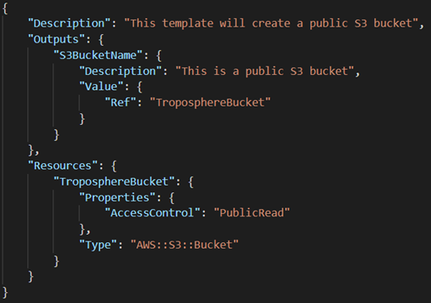
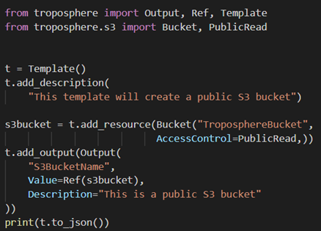
From Python to CloudFormation
>pip install troposphere
>python template.py > template.json
Notes:
Python examples: https://github.com/cloudtools/troposphere/tree/master/examples

Slide 3
Concepts: Terraform vs Troposhere
Terraform as "Describe your complete infrastructure as code”
With Terraform, you describe your complete infrastructure as code, even as it spans multiple service providers
VS
Troposphere is detailed as "Library to create AWS CloudFormation descriptions“
AWS CloudFormation JSON by writing Python code to describe the AWS resources
Notes:
Terraform vs troposphere: What are the differences?
Developers describe Terraform as "Describe your complete infrastructure as code and build resources across providers". With Terraform, you describe your complete infrastructure as code, even as it spans multiple service providers. Your servers may come from AWS, your DNS may come from CloudFlare, and your database may come from Heroku. Terraform will build all these resources across all these providers in parallel. On the other hand, troposphere is detailed as "Library to create AWS CloudFormation descriptions". The troposphere library allows for easier creation of the AWS CloudFormation JSON by writing Python code to describe the AWS resources. troposphere also includes some basic support for OpenStack resources via Heat.
Terraform can be classified as a tool in the "Infrastructure Build Tools" category, while troposphere is grouped under "AWS Tools"

Slide 4
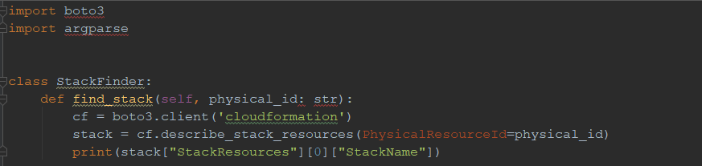
Python and AWS Boto3
AWS-provided Boto3 library to execute AWS API
python vpc_stack.py > vpc_stack.json
Notes:
Boto is the Amazon Web Services (AWS) SDK for Python. It enables Python developers to create, configure, and manage AWS services, such as EC2 and S3. Boto provides an easy to use, object-oriented API, as well as low-level access to AWS services.

