Slide 1

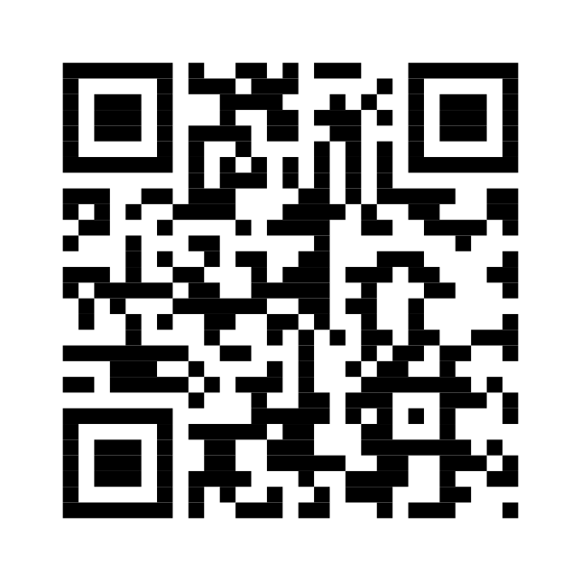
rippl
everyday actions, visible impact
a personal space for everyday progress
small actions.
lasting ripples.
log sustainable choices, verify them with photos,
and see what your habits add up to.
your impact
illustrative demo profile
1,280
12 days
32
points earned
current streak
actions logged
carbon avoided
water saved
kg co₂
litres of water
demo figures · estimated savings from approved actions
a simple loop that turns a choice into a record.
01
02
03
log an action
add evidence
see your impact
choose a sustainable habit.
attach a photo for review.
follow estimated savings over time.
start your ripple.
open rippl ↗
rippl.aarush-uae.workers.dev/app
Notes:
A1 portrait display poster. The impact figures are illustrative demo values, not live user data. The dotted headings and maker credit are separate transparent PNG images; matching SVG files are included. The QR code opens https://rippl.aarush-uae.workers.dev/app. All other copy, impact dots, cards and gradients are native editable PowerPoint objects.

