Slide 1
Human resources slide 1
Data Analytics On Road Accidents in the US
Capstone Part 4: Non-Technical Presentation
Prepared & Presented By:
Priyanka Maurya
07th April 2025

Slide 2
Human resources slide 2
AGENDA
1
Project Introduction
2
Data Cleaning
3
Data Analysis & Visualization
4
Prediction & Forecasting Model
5
Conclusion & Q/A

Slide 3

Human resources slide 4
Purpose
This presentation will analyze accidents trend, severity, hotspots, and Forecast daily accident counts and predict accident severity using Machine Learning models, aiming to provide insights for improving road safety.
3. Data Analysis & Visualization
Create dashboards & Reports in Tableau.
2. Data Cleaning and Processing
4. Prediction and Forecasting
Identify dataset, perform data clearing & processing in Python.
Create Machine Learning Models in Python.
Project Stages
A journey from Raw Data to Data Insights
1. Project Introduction
5. Conclusion & Next Step
Create slides to share findings & next step in MS PowerPoint.
Create Persona & Project Objective

Slide 4
Human resources slide 2
1
Project Introduction
2
Data Cleaning
3
Data Analysis & Visualization
4
Prediction & Forecasting Model
5
Conclusion & Q/A

Slide 5

Human resources slide 8
Facts & Figures
According to the World Health Organization (WHO), road traffic injuries are a leading global health issue, causing 1.3 million deaths each year worldwide. In the United States, road traffic fatalities remain a serious concern, with nearly 39,000 deaths each year.
1.19 million deaths annually from crashes
Leading cause of death for ages 5-29
92% of fatalities occur in low-income countries
Over half of deaths are vulnerable road users
Road traffic costs 3% of GDP globally
Source: WHO [Link]

Slide 6


Human resources slide 3
Objective
Persona#1: Government City Planners
Persona#2: Traffic & Ambulance Services
This analysis aims to provide insights for City Planners and Emergency Services such as Ambulance & Traffic Authorities; by identifying accident hotspots, peak times, and predicting severity. This will enhance road infrastructure, optimize traffic management, and improve resource allocation and emergency response efficiency.
Pain Point
Pain Point
Limited insight into accident hotspots
Unpredictable accident surges, especially severe ones.
Difficulty in efficient resource allocation for emergencies.
Key Performance Indicator
Identify top accident-prone state, city, and hotspots
Determine peak accident periods (month, day, time)
Analyze the impact of weather (humidity & temp) on accidents
Key Performance Indicator
Forecast daily accident counts and severity for optimized resource planning.
Benefits
Benefits
Analyze accident hotspots and peak times to improve safety and optimize traffic management
Better resource allocation for emergencies.
Enhanced response efficiency and optimized traffic management.

Slide 7
Human resources slide 2
1
Project Introduction
2
Data Cleaning and Processing
3
Data Analysis & Visualization
4
Prediction & Forecasting Model
5
Conclusion & Q/A

Slide 8

Human resources slide 9
This project began with a massive dataset of over 5 million US road accident records spanning 2016 to 2023. Dataset had 46 columns; covering everything from accident time and location to weather and road conditions.
The raw data had inconsistencies like missing timestamps, outliers in distance/weather values, and nulls in key columns.
I performed:
⏱ Converted time – Datetime conversion helped break accident timestamps into useful parts (like hour, day, and month)
📉 Handled odd values – Outlier capping using IQR removed extreme values so they don't confuse the model.
🧩 Filled in the blanks – Imputation added reasonable values where data was missing (both numbers and categories).
➖ Fixed impossible values – Negative value correction ensured fields like distance or temperature didn’t have invalid negatives.
📌 Why it was crucial: Without this, models would be misled by noise or invalid values, resulting in unreliable predictions.
Step # 1
Data Cleaning: Bringing Order to Chaos

Slide 9

Human resources slide 9
This project began with a massive dataset of over 5 million US road accident records spanning 2016 to 2023. Dataset had 46 columns; covering everything from accident time and location to weather and road conditions.
I explored how accident severity relates to factors like weather, temperature, and time of day, then engineered meaningful features for the models.
📊 Spotted patterns – Explored trends, correlations (how things relate), and category distributions.
🧠 Figured out what matters most – Ranked features using Random Forest Importance.
🕒 Broke down time – Extracted Hour, DayOfWeek, and Month from Start_Time.
🔤 Gave categories a number – Encoded categorical variables into numeric format for the model.
🧹 Removed extra baggage – Dropped redundant or low-impact columns (like Wind_Chill(F) when Temperature(F) was kept).
📍 Prepared Zipcodes – Created Zipcode_5 for easier regional analysis.
📌 Why it was crucial: This process reduced noise, highlighted impactful variables, and ensured the model had cleaner, more meaningful input, leading to better performance.
Step # 2
EDA & Feature Engineering: Understanding the Story Behind the Data

Slide 10
Human resources slide 9
This project began with a massive dataset of over 5 million US road accident records spanning 2016 to 2023. Dataset had 46 columns; covering everything from accident time and location to weather and road conditions.
Two paths were taken:
Time Series (SARIMAX): Forecasted daily accident volume
Classification Models (Random Forest, XGBoost): Predicted severity levels
Enhanced using:
⭐ Prioritized smart inputs – Feature importance ranking helped identify which inputs were most useful.
🔧 Tuned for better results – Hyperparameter tuning adjusted the model settings for improved accuracy.
🔁 Double-checked reliability – Cross-validation tested the model multiple times to ensure it's not just lucky.
⚖️ Handled imbalance fairly – Class balancing with weights made sure rare accident types weren’t ignored.
📌 Why it was crucial:
Proper model building and tuning improved accuracy and made the results actionable and trustworthy.
Step # 3
Model Creation & Refinement: Training Smart Models for Smarter Decisions

Slide 11
Human resources slide 2
1
Project Introduction
2
Data Cleaning and Processing
3
Data Analysis & Visualization
4
Prediction & Forecasting Model
5
Conclusion & Q/A

Slide 12
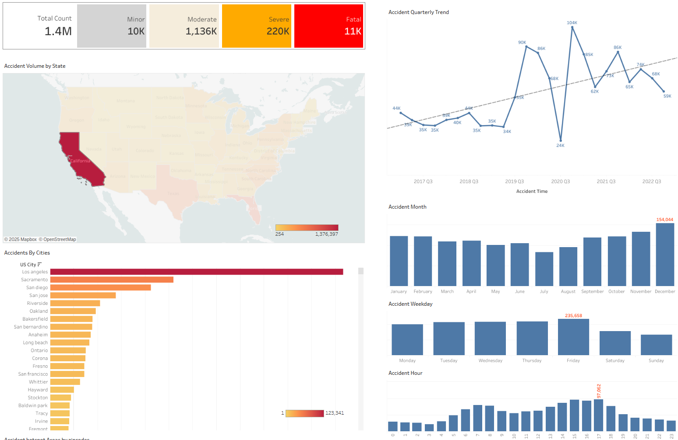
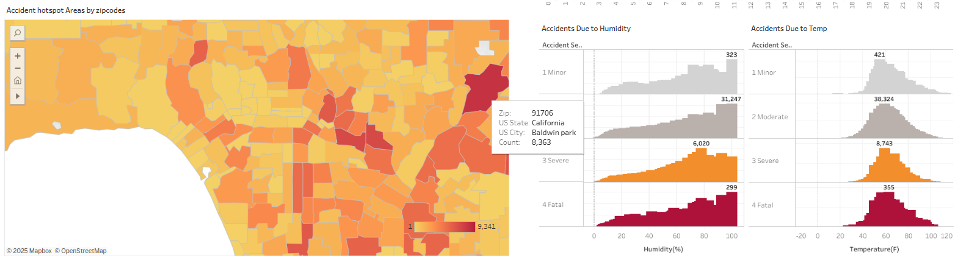
Human resources slide 5
KPIs
Identify top accident-prone state, city, and hotspots
Determine peak accident periods (month, day, time)
Analyze the impact of weather (humidity & temp) on accidents
Findings
01
California is the most accident-prone state
Los Angeles is the most accident-prone city in California
91706 is the top accident hotspot in California, Baldwin Park
02
Peak accident month is December
Peak accident day is Friday
Peak accident hour is 1700 Hours.
03
Higher fatal accidents when Humidity is between 93% - 100%
Higher Severe accidents when Humidity is between 75% - 80%
Higher accidents when Temp is between 59° – 65° Fahrenheit
Refer Tableau Dashboard for Detailed Analysis - Link

Slide 13
Human resources slide 2
1
Project Introduction
2
Data Cleaning and Processing
3
Data Analysis & Visualization
4
Prediction & Forecasting Model
5
Conclusion & Q/A

Slide 14
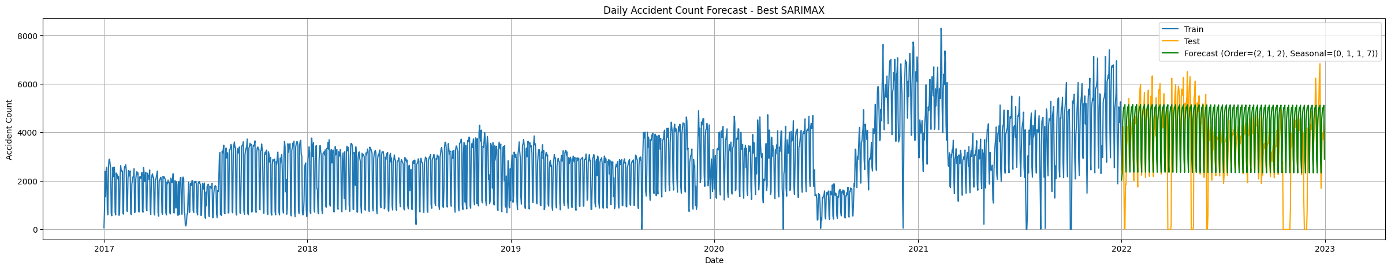
Human resources slide 3
Time Series Forecasting - SARIMAX Model
What this model does: The SARIMAX model is a forecasting tool used to predict future accident counts by learning from past patterns in the data. It takes into account seasonal trends (like weekly or monthly cycles) and other time-based behaviors to give accurate short-term forecasts.
Why was this model was chosen: SARIMAX is well-suited for time series data with seasonal effects. Unlike basic models like ARIMA, it can handle more complexity such as recurring weekly patterns in accident trends — which are common in real-world traffic scenarios.
How it performed: The model was trained on several years of accident data. Initially, ARIMA was used as a baseline but didn’t capture seasonality well. After tuning, SARIMAX with configuration (2,1,2)(0,1,1,7) delivered a better result.
RMSE
1597
What we did to improve it:
Explored multiple SARIMAX configurations
Identified and adjusted seasonal cycles (7-day weekly pattern)
Removed irregular spikes (outliers) that confused the model
Ensured clean datetime formatting to help detect patterns
What the result means: An RMSE of 1597 means the model predicts the number of daily accidents with a reasonably small error margin, given the size and spread of the data. This forecasting can be used by traffic authorities or emergency planners to prepare for high-risk days 🚦📅.
(Root Mean Squared Error – lower is better)

Slide 15
Human resources slide 3
What these models does: Predict the severity level (1 to 4) of an accident using inputs like time, weather, location, and road features.
Why I used these models:
Random Forest is a simple and reliable model giving a good baseline accuracy and is simple to interpret.
XGBoost is a more advanced version, performs better with large datasets, handles imbalanced data better and improves performance on rare classes.
Both are classification models, useful when predicting categories (like severity levels 1 to 4).
How the models performed:
The baseline Random Forest model predicted Severity 2 (most common class) with high accuracy, but struggled to detect less frequent severities (like 1 and 4).
After tuning and using class weights (to give more importance to underrepresented classes), performance improved slightly.
Final accuracy was around 80%, but detection of Severity 1 remained weak due to its rarity in the dataset.
What was done to improve the results:
✅ Applied class weights: This told the model to pay more attention to less frequent severity levels.
🔍 Performed Grid Search: to fine-tune model settings/finding the best model settings (hyperparameters).
🔁 Applied Cross-Validation: to validate model stability across different data samples.
⚡ Trained XGBoost: which improved performance for Severity 3 but still faced challenges with Severity 1.
⚠️ Class imbalance: remained a key challenge despite these efforts.
What the result means: The model is very effective for predicting the most common severity levels (Accuracy: 80%), which are important for traffic planning and emergency services. However, it still misses rare and severe cases, which is a known challenge in imbalanced datasets.
Severity Prediction Models: Random Forest & XGBoost
83%
Overall Accuracy

Slide 16
Human resources slide 2
1
Project Introduction
2
Data Cleaning and Processing
3
Data Analysis & Visualization
4
Prediction & Forecasting Model
5
Conclusion & Q/A

Slide 17

Human resources slide 7
Limitations & Future Steps
What challenges were faced: Class imbalance made it harder to predict rare accident severities like level 1 or 4. Most records were of severity 2, so models tended to focus on that.
💡
🌍
⚠️
🚀
Use SMOTE
Bring in external data
More feature tuning
Deploy as a tool
A technique that creates synthetic examples of rare classes to balance the dataset better.
like traffic flow, weather alerts, or holidays to provide more context to the model.
can help uncover patterns that are currently missed.
Which could help local authorities predict both the count and severity of upcoming road incidents.

Slide 18
Human resources slide 5
Conclusion
What was built:
⚠️ I developed two powerful models — SARIMAX for predicting how many accidents may happen, and Random Forest/XGBoost for predicting how serious they might be.
What worked well:
✅ SARIMAX gave strong forecasting accuracy (RMSE ≈ 1597) for daily accident counts.
✅ Random Forest achieved ~80% accuracy and did especially well with Severity 2 (the most common class).
Where there’s room to grow:
🔍 Less common severity levels were harder to detect due to limited examples.
🕒 Some improvements (like deeper tuning or external data usage) were limited by time, but could unlock much more accuracy in the future.

Slide 19
Human resources slide 10
Thank You
Let’s Begin The Q/A…

