Slide 1

GreyAtom Hackathon
Team 3
Rushabh Mehta
Shardul Janaskar
Sanket Takle
Ritwik Yadav
Sagar Gomase

Slide 2
Problem Statement
Indian Start Funding: Predicting how much funds does a startup generally get in India.

Slide 3
Features in the Dataset
Date : Categorical
Startup Name : Categorical
Industry Vertical : Categorical
Sub Vertical: Categorical
City : Categorical
Investors Name: Categorical
Investment type : Categorical
Amount in USD : Continuous (Target variable)

Slide 4
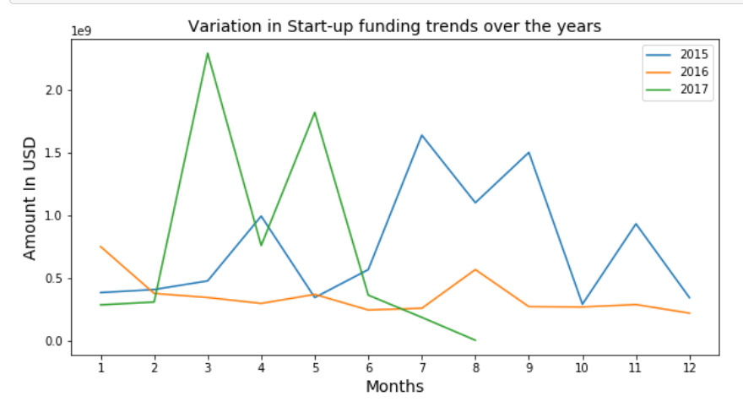
How the startup funding ecosystem has varied over the years?

Slide 5
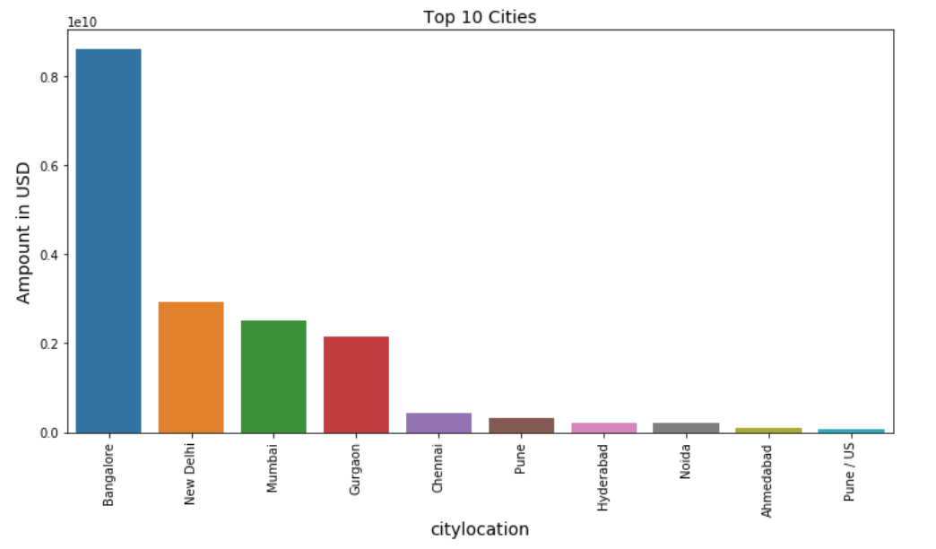
Do cities play a major role in funding?

Slide 6
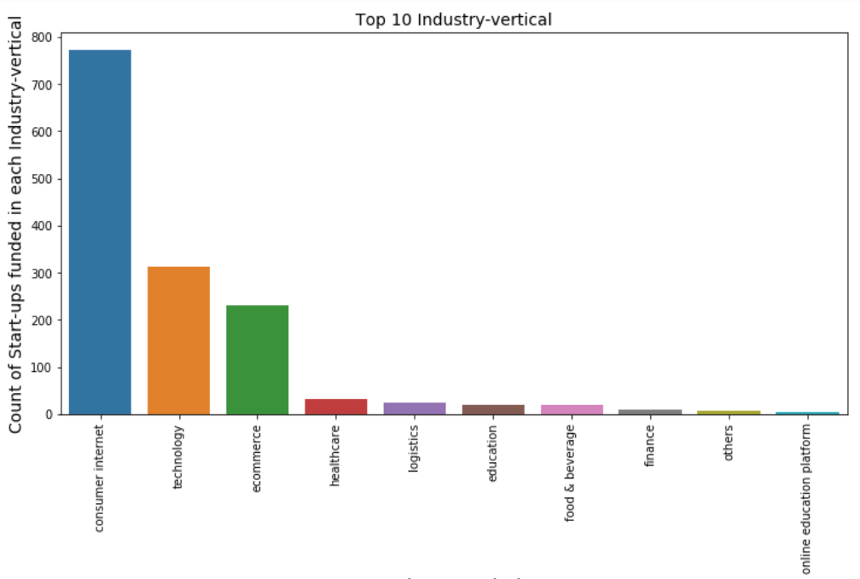
Which industries are favored by investors for funding?

Slide 7
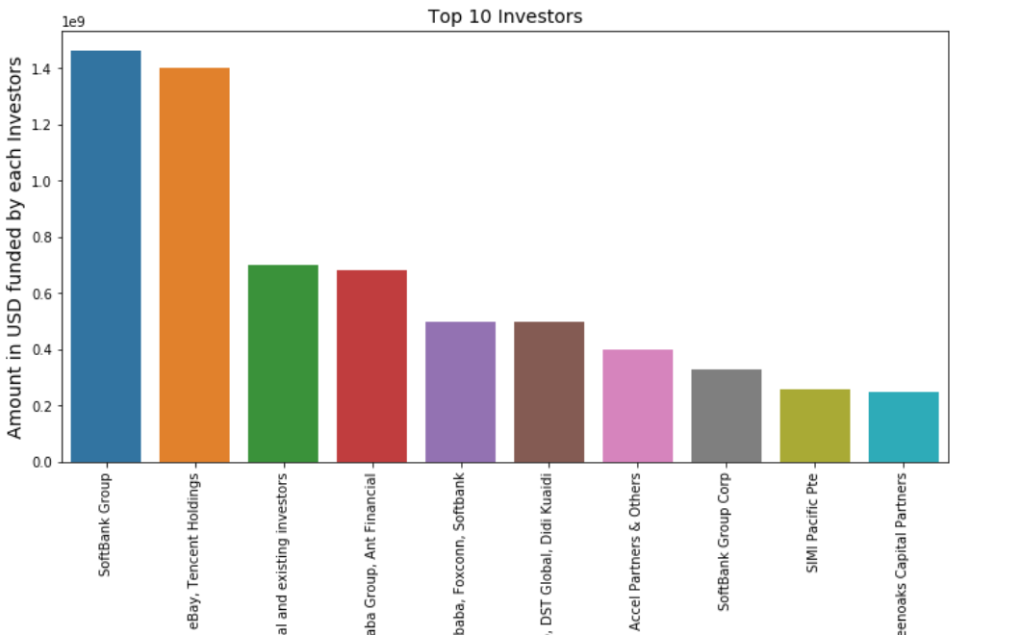
Who are the important investors in the Indian Ecosystem?

Slide 8
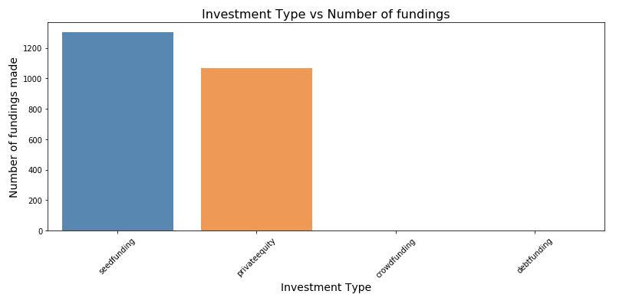
What is the Preferred Investment type?

Slide 9
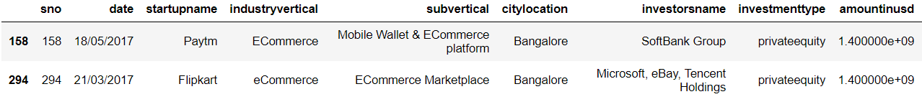
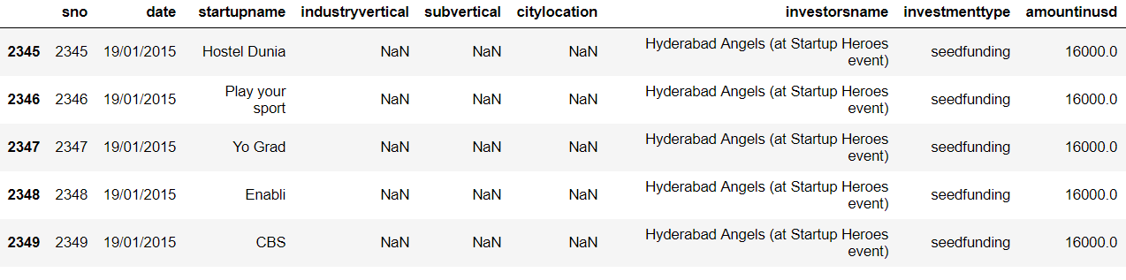
What is the minimum and maximum funding companies got in India?
Maximum funding: 140000000
Minimum funding: 16000

Slide 10
How much funds do start-ups generally get in India?
Average funding given to start-ups : $8117064
95% of the start-ups get funding between $6039317 and $10194810

Slide 11
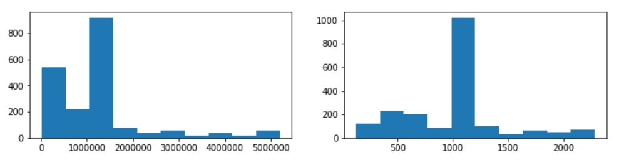
Skewness in the Target Variable
Right Skewed
Center Aligned
Solution: Use Square Root transformation!

Slide 12
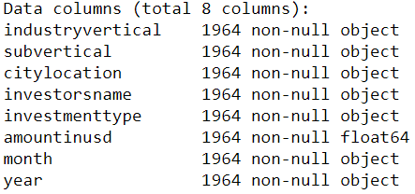
Predicting the funds a startup will receive! Model : Decision Tree Regressor
Dataset :
Result :
R2 score of just 38%!

Slide 13
Thank You!

