Slide 1

Skin Disease Detection

Slide 2
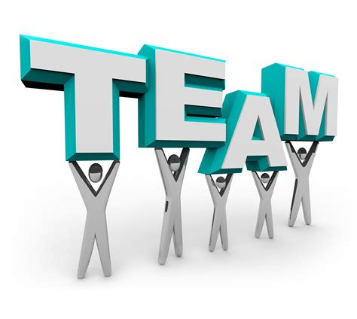
Team Details
Team Name: Technophiles
Team Members:
Rushabh Thakkar ( rushabh.tict18@sot.pdpu.ac.in)
Divy Patel
Denish Kalariya
Yug Thakkar
Shubham Vyas
College name: Pandit Deendayal Energy University

Slide 3
Problem Definition
Dermatological Issues/disorders are most commonly spread worldwide. This can be caused by various fungal, bacterial, or skin allergies. Effective use of Emerging technologies like AI/ML can recognize such diseases. Computer Vision is one such platform that made the possibility of detecting the cause accurately through Images.The problem here is to develop an Application Programming Interface which can be easily integrated with Android and IOS to detect the skin disease without any physical interaction with a Dermatologist.

Slide 4
Current state-of-the-art System
Skin diseases are common, but it is not always easy to visit a dermatologist quickly or distinguish malignant from benign conditions. "Recently, there have been remarkable advances in the use of AI in medicine. For specific problems, such as distinguishing between melanoma and nevi, AI has shown results comparable to those of human dermatologists. However, for these systems to be practically useful, their performance needs to be tested in an environment similar to real practice, which requires not only classifying malignant versus benign lesion, but also distinguishing skin cancer from numerous other skin disorders including inflammatory and infectious conditions.
Many foreign AI teams and research institutes have participated in the research and development of dermatological AI products, and have achieved remarkable results. A joint research team at Stanford University used a single CNN trained on general skin lesion classification to develop an AI system that is comparable to human physicians in the diagnosis of skin cancer. A team of German, American, and French researchers trained an AI system to identify dangerous skin lesions and benign lesions.
At the same time, some companies focus on AI research and development. For example, DeepMind, which was established in 2010, has conducted a series of researches in the field of medical AI, including AI eye disease detection, AI recognition of breast cancer, and prediction of kidney damage. SkinVision was founded in 2011 by researchers and dermatologists. It serves as a health-prevention medium to help every subject understand their own skin health. SkinVision makes early detection of skin cancer possible, treating it as early as possible and reducing treatment costs. The subjects take a picture of the skin lesion through the mobile phone. After about 30 s, they will receive a low-risk or high-risk indication, and the next step to take the relevant advice, and set the next time to check.

Slide 5

Our Approach
We made an application which classifies the skin diseases into these given types healthy, lupus, ringworm and scalp_infections.
How?
The data given was analysed first. We came to conclusion that the data given was not enough so we searched for new datasets.
We got the datasets from various sources and segregated the datasets of harvard. We combined all the datasets and trained the tensorflow image classification model multiple times. The accuracy was not satisfying. Augmented the data to unbais the model and the dataset would be balanced.
Data Augmentation was done on the data given . We generated 800 images per disease.Again we had trained the model and the accuracy was good. After which, we exported the .tflite and label.txt file.We imported the files into android studio and made an application which is working properly.

Slide 6
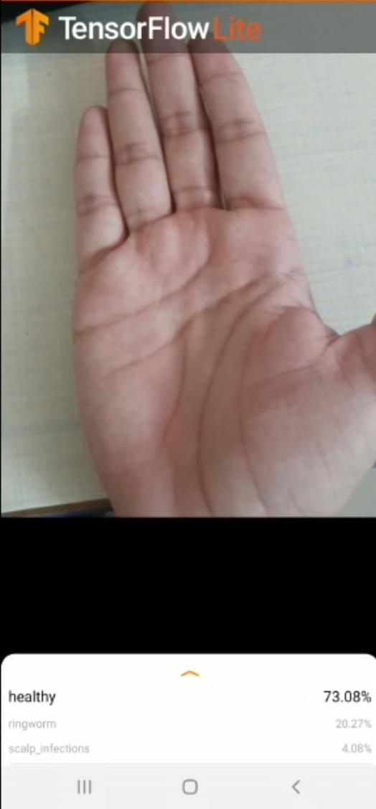
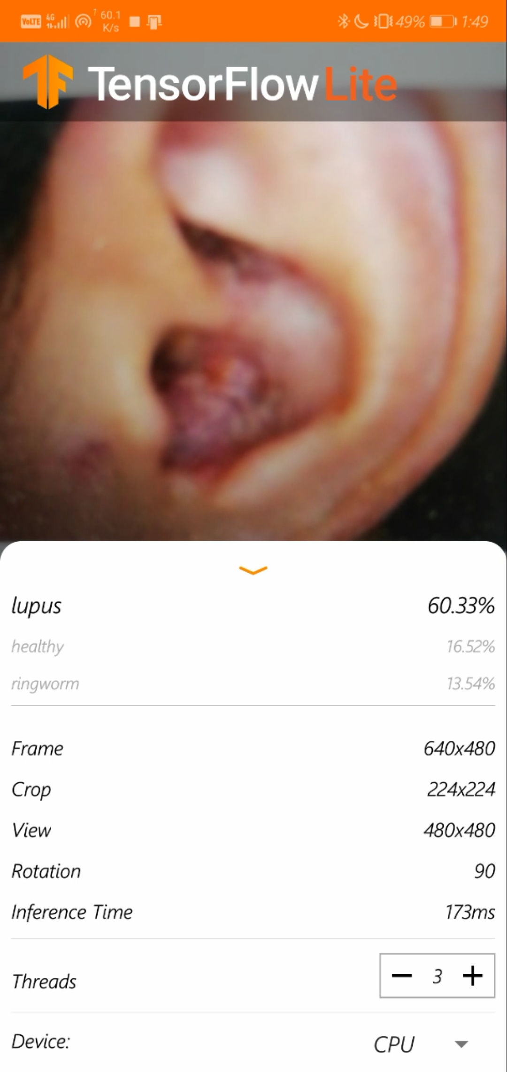
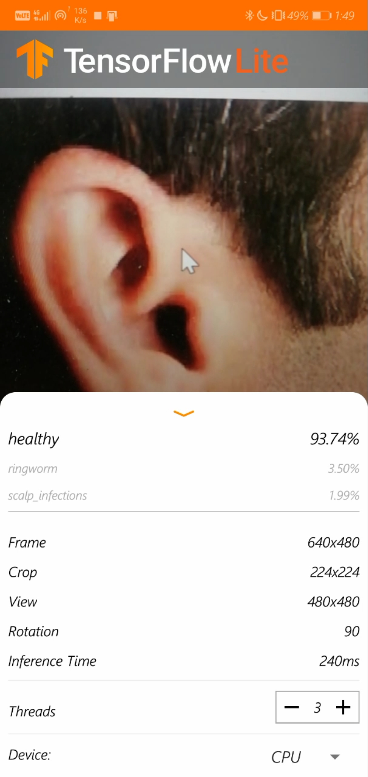
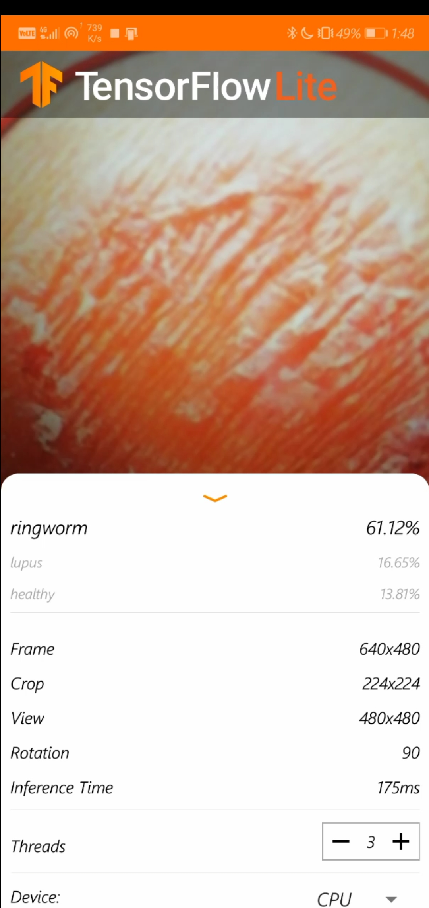
Working Prototype
Our application is working perfectly as shown here:

Slide 7
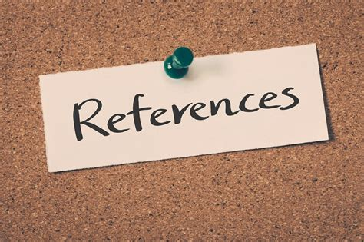
References
1. Patel VL, Shortliffe EH, Stefanelli M, Szolovits P, Berthold MR, Bellazzi R, et al. The coming of age of artificial intelligence in medicine. Artif Intell Med 2009; 46:5–17. doi: 10.1016/j.artmed.2008.07.017. [PMC free article] [PubMed] [Google Scholar]
2. Shaffie A, Soliman A, Fraiwan L, Ghazal M, Taher F, Dunlap N, et al. A generalized deep learning-based diagnostic system for early diagnosis of various types of pulmonary nodules. Technol Cancer Res Treat 2018; 17:1180783544.doi: 10.1177/1533033818798800. [PMC free article] [PubMed] [Google Scholar]
3. Perryman AL, Stratton TP, Ekins S, Freundlich JS. Predicting mouse liver microsomal stability with “pruned” machine learning models and public data. Pharm Res 2016; 33:433–449. doi: 10.1007/s11095-015-1800-5. [PMC free article] [PubMed] [Google Scholar]
4. Choi H, Kang H, Chung K, Park H. Development and application of a comprehensive machine learning program for predicting molecular biochemical and pharmacological properties. Phys Chem Chem Phys 2019; 21:5189–5199. doi: 10.1039/C8CP07002D. [PubMed] [Google Scholar]
5. https://www.ncbi.nlm.nih.gov/pmc/articles/PMC6793782/
6. https://www.tensorflow.org/lite/tutorials/model_maker_image_classification
7. https://codelabs.developers.google.com/codelabs/recognize-flowers-with-tensorflow-on-android/#4
8. https://blog.tensorflow.org/2020/03/higher-accuracy-on-vision-models-with-efficientnet-lite.html

Slide 8
Possible Future Expansion
Although dermatological AI has developed rapidly in recent years, it has encountered bottlenecks in the clinic, and there are many problems that need to be solved urgently: First, the current scale of skin disease image data is still insufficient, the degree of information sharing between hospitals is low, and the standard and quality of skin images are not uniform. It is difficult to obtain high-quality image data, which will lead to the unreliability of research results. Second, the combination of medical and AI complex talents is extremely scarce. It is indispensable to cooperate closely with multi-disciplinary personnel in computer science, biomedical and medical.

Slide 9

Thank you!

