Slide 1


“E-commerce And Inventory Management”
Database Management and Database Design
Team 12
Adarsh Havalad
Hardik Radadiya
Prajakta Sawant
Rutuja Kale
Rushabh Patel

Slide 2





DB Objectives
& Design rules
Inventory Management
Customer Service Experience
Customer Order Details
Product Return and Refund

Slide 3
Entity Relationship Diagram

Slide 4
DDL – Create
Total 18 DB Entities created and 3 Associative entities.
For the below example Seller Product is an Associative table. The Associative Tables are used for Normalizing a many to many relationship between the seller and the Product entity.
CREATE TABLE Seller (
SellerId INT PRIMARY KEY,
OrganizationName VARCHAR(255) NOT NULL,
Email VARCHAR(255) NOT NULL,
PhoneNumber BIGINT NOT NULL,
SellerAddressId INT NOT NULL FOREIGN KEY REFERENCES SellerAddress(AddressId));
CREATE TABLE Product(
ProductID INT IDENTITY PRIMARY KEY,
ProductName VARCHAR(255) NOT NULL,
UnitPrice MONEY NOT NULL,
Quantity INT NOT NULL ProductCategoryID INT NOT NULL
FOREIGN KEY(ProductCategoryId)
REFERENCES ProductCategory (ProductCategoryID));
CREATE TABLE SellerProduct(
SellerID INT,
ProductID INT,
PRIMARY KEY(SellerID, ProductID),
FOREIGN KEY(SellerID) REFERENCES Seller(SellerID),
FOREIGN KEY(ProductID) REFERENCES Product(ProductID));

Slide 5
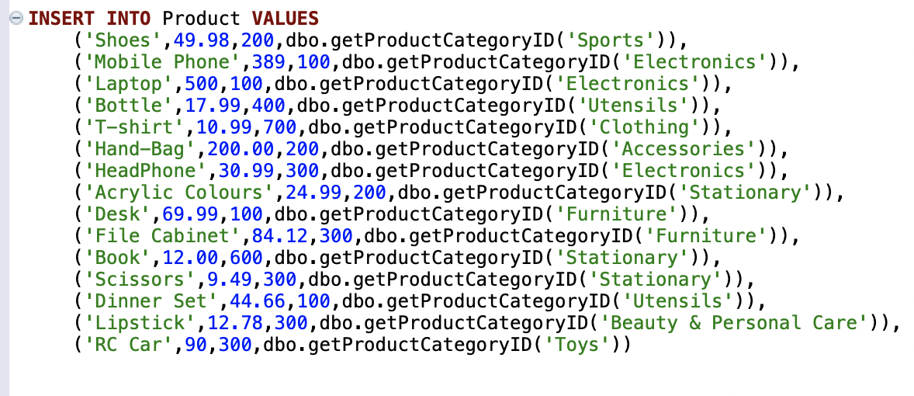
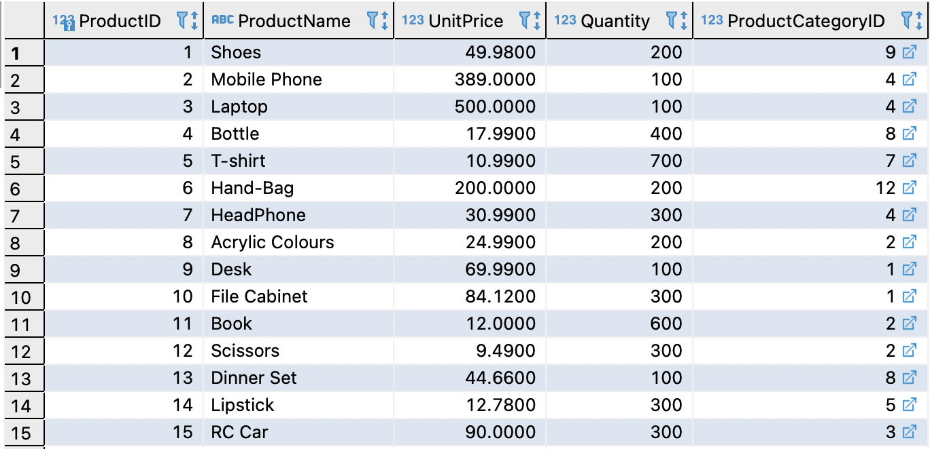
DML – Insert

Slide 6
User Defined Function
getOrderAmount function calculate the Order Amount using quantity, unit price and Discount.
getBillingAmount function calculates total billing amount for the respective order.
CREATE FUNCTION dbo.getOrderAmount(@orderID INT) RETURNS MONEY
BEGIN
RETURN(
SELECT SUM(op.QUANTITY * (1-(pm.Discount/100.0)) * p.UnitPrice) [OrderAmount]
FROM ORDERPRODUCT op
JOIN Product p
ON op.PRODUCTID = p.ProductID
JOIN Promotion pm
ON p.ProductID = pm.ProductID
WHERE op.ORDERID = @orderID
GROUP BY op.ORDERID);
CREATE FUNCTION dbo.getBillingAmount(@orderID INT) RETURNS MONEY
BEGIN
RETURN(
SELECT SUM(op.QUANTITY * (1-(pm.Discount/100)) * p.UnitPrice * (1+(pt.TaxAmount/100))) [OrderAmount]
FROM ORDERPRODUCT op
JOIN Product p
ON op.PRODUCTID = p.ProductID
JOIN Promotion pm
ON p.ProductID = pm.ProductID
JOIN ProductTax pt
ON p.ProductID = pt.ProductID
WHERE op.ORDERID = @orderID
GROUP BY op.ORDERID);

Slide 7
Computed Column
Getdisbursementamount function calculates the Disbursement amount to be transferred to the Seller using unitprice of each product and the product Quantity .
CREATE FUNCTION dbo.getdisbursementamount(@sellid INT)
RETURNS MONEY
BEGIN
RETURN(
SELECT SUM(p.unitprice * op.quantity * 0.30) [DisbursementAmount]
FROM ORDERPRODUCT op
JOIN Product p
ON op.PRODUCTID = p.ProductID
JOIN SellerProduct sp
ON p.ProductID = sp.ProductID
WHERE sp.sellerid= @sellid
GROUP BY sp.SellerID)
END;

Slide 8

Data Encryption
BEGIN TRY
Create Master Key
Encryption By Password = 'P@ssword';
Create Certificate ProjectCertificate
With Subject = 'Project Certificate',
Expiry_Date = '2021-12-31';
Create Symmetric Key ProjectSymmetricKey
With Algorithm = AES_128
Encryption by Certificate ProjectCertificate;
END TRY
BEGIN CATCH
PRINT 'Master key and certificates already exists';
END CATCH
OPEN SYMMETRIC KEY ProjectSymmetricKey
DECRYPTION BY CERTIFICATE ProjectCertificate;
DECLARE @cnt INT = 1
WHILE @cnt <= (SELECT MAX(c.CustomerID) FROM Customer c)
BEGIN
UPDATE Customer
SET PhoneNumber = (EncryptByKey(Key_GUID(N'ProjectSymmetricKey'),
convert(varbinary, 'Pass'+CAST(@cnt AS VARCHAR)))) Where CustomerID = 1000 + @cnt;
SET @cnt += 1;
END;
Data Encrption is done on Customer Phone numbers to keep the customer personal details secure.

Slide 9

Stored Procedure
TotalSalesPerDay calculate total revenue for the specific date.
Drop PROCEDURE IF EXISTS TotalSalesPerDay;
GO
CREATE PROCEDURE TotalSalesPerDay
@OrderDate DATE,
@totalSales Money OUTPUT
AS BEGIN
SET @totalSales = (SELECT sum(pm.BillingAmount) as TotalSale
FROM [Order] o
INNER JOIN Payment pm
ON pm.OrderId = o.OrderId
WHERE o.OrderDate = @OrderDate
GROUP BY o.OrderDate )
END;
GO
DECLARE @date DATE = '2021-07-02';
DECLARE @totalSales MONEY;
EXEC TotalSalesPerDay @date, @totalSales OUTPUT;
SELECT @totalSales AS [TotalSales];

Slide 10

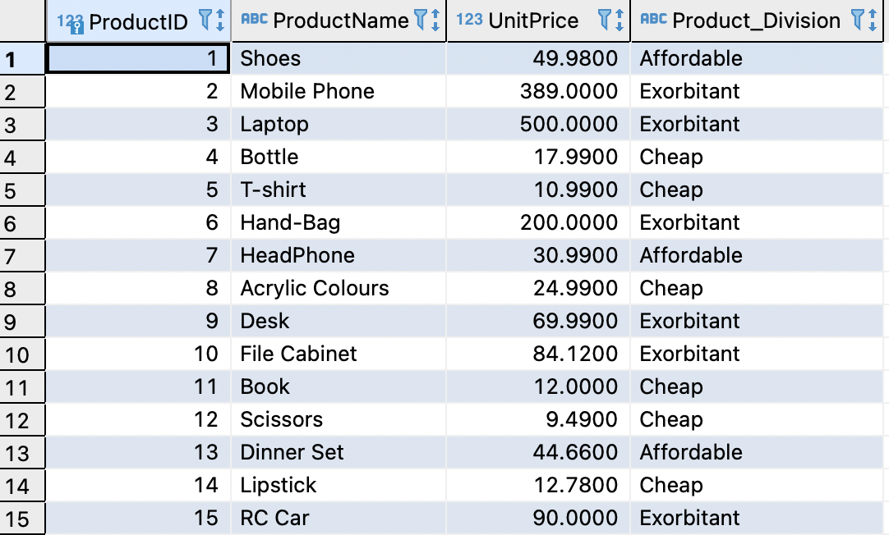
Views
ProductDivision view assigns product division based on their unit price.
CREATE VIEW Product_Division AS
SELECT ProductID,ProductName,UnitPrice,
CASE
WHEN UnitPrice < 25 THEN 'Cheap'
WHEN UnitPrice > 50 THEN 'Exorbitant'
ELSE 'Affordable'
END AS Product_Division
FROM Product;

Slide 11
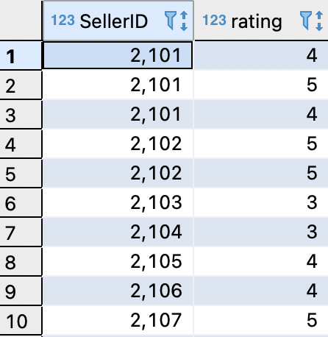
The Seller Rating view assigns rating to seller based on their performance.
Create view SellerRating As
select s.SellerID, f.rating
from Seller s
inner join Feedback f
on s.SellerID = f.SellerID
Where rating >= 3

Slide 12

Data Reports in Tableau

Slide 13
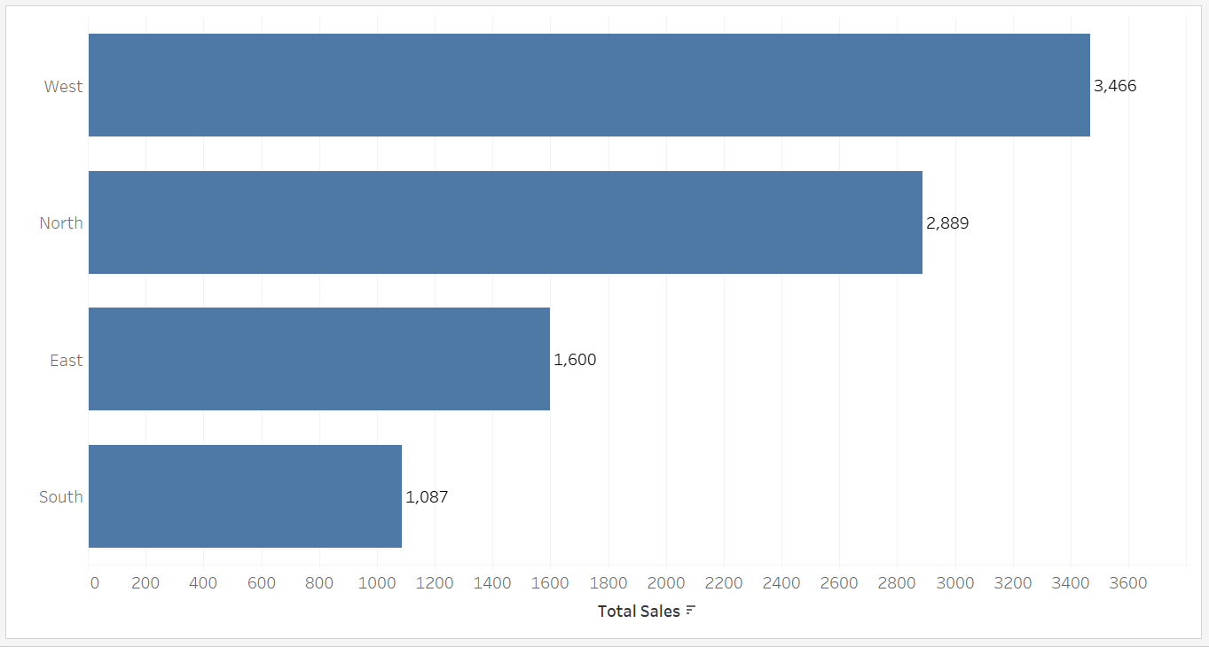
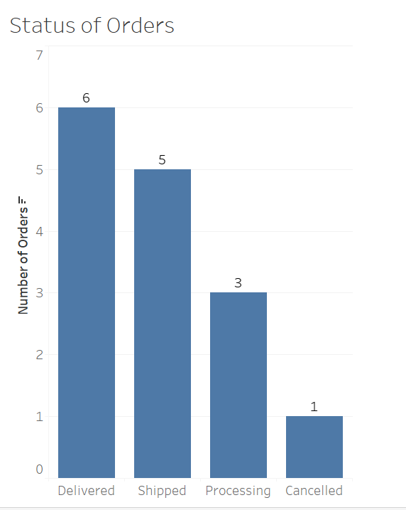
Report For Region wise Sales
Report For Region wise Sales

Slide 14
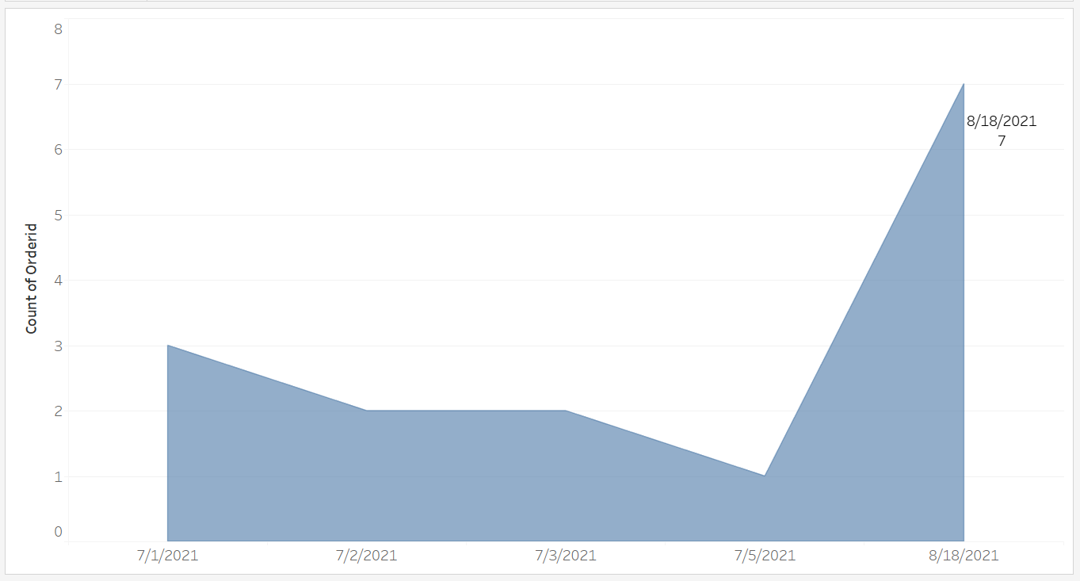
Report for Orders By Order dates
Report for Orders By Order dates
Number of orders

Slide 15
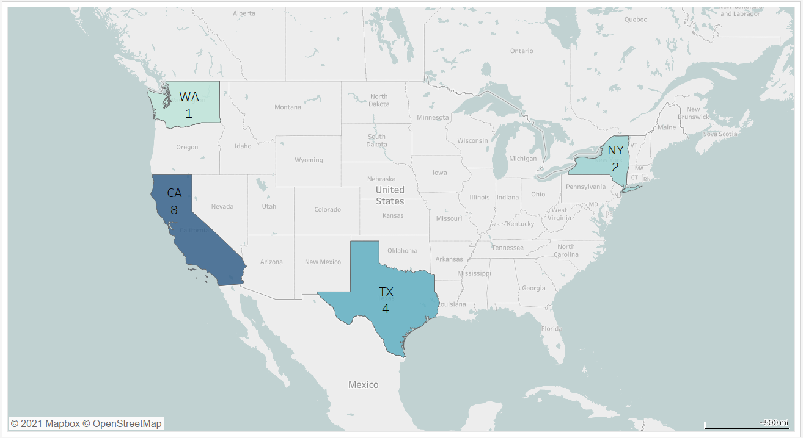
Report For State wise Orders
Report For State wise Orders

Slide 16
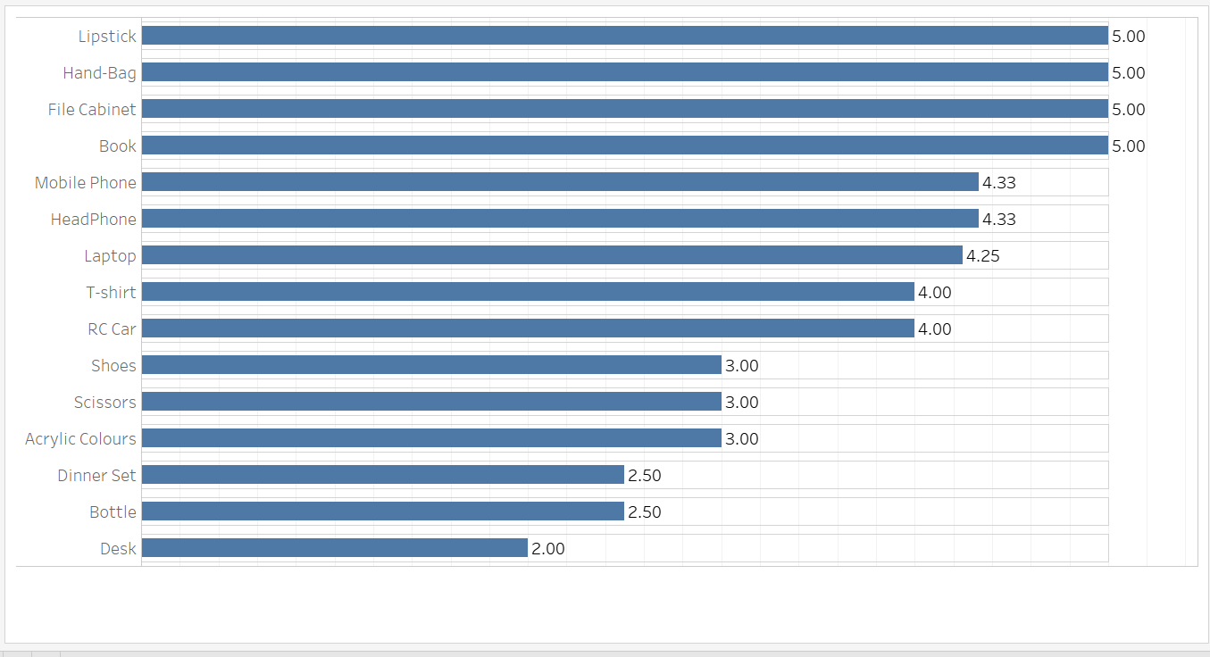
Report for Product Rating
Report for Product Rating

Slide 17
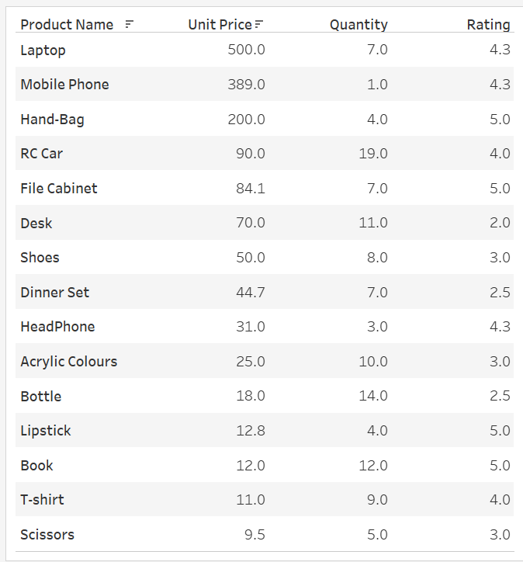
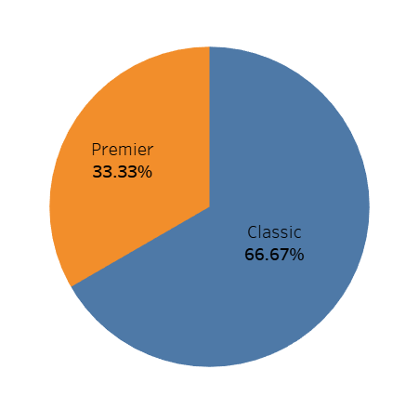
Report for Product Performance and Membership chart
Report for Product Performance and Membership chart

Slide 18
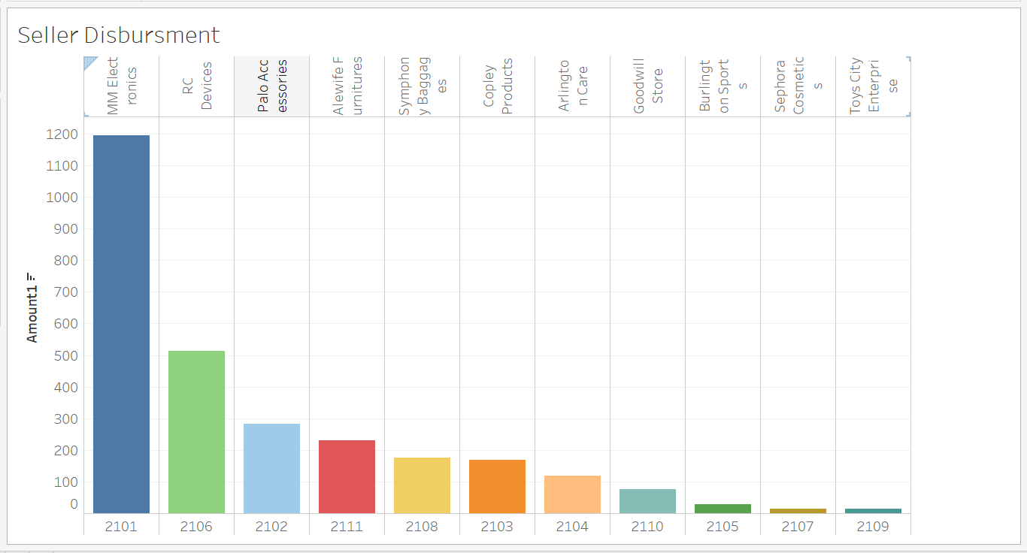
Report for Seller Disbursement
Report for Seller Disbursement

Slide 19
Thank You

