Slide 1
CQL SHELL
CASSANDRA QUERY LANGUAGE

Slide 2
Installation
http://downloads.datastax.com/community/datastax-community-32bit_2.2.8.msi

Slide 3
First to Check the status
Nodetool status

Slide 4
CQLSH
Cqlsh – the command to enter Cassandra shell

Slide 5
help
Help command gives you the list of cassandra shell commands available
You can try giving any command with help
Help describe [here describe is the name of the command]
At time even you can press TAB button multiple times and it will show you the help available

Slide 6
CQL COMMANDS::
DESC
DESCRIBE KEYSPACEs;
Help CREATE_KEYSPACE; (PRESS TAB MULTIPLE TIMES)

Slide 7
CREATE KEYSPACE::
CREATE KEYSPACE cassdemo WITH replication = {‘class’: ‘SimpleStrategy’, ‘replication_factor’: 1};
Select * from system_schema.keyspaces;
DESCIRBE KEYSPACEs;
Use cassdemo;

Slide 8
CREATE TABLE:
CREATE TABLE users (email_id text, first_name text, last_name text, primary key (email_id));
DESCRIBE TABLE users;
DESC TABLE users;

Slide 9
INSERT DATA
INSERT INTO cassdemo.users (email_id, first_name, last_name) values (‘king@gmail.com’,’king’,’smith’);
Select * from cassdemo.users;
INSERT INTO cassdemo.users (email_id, first_name) VALUES (‘queen@yahoo.com’, NULL);
SELECT *FROM cassdemo.users;
INSERT INTO cassdemo.users (email_id,first_name) VALUES ( ‘queen@yahoo.com’, ‘Queen’);
SELECT *FROM cassdemo.users;

Slide 10
Caution!!!
Where clause can be applied only on primary key
Do the search based on primary key

Slide 11
UPDATE::
UPDATE users SET last_name = ‘JONES’ WHERE email_id = ‘queen@yahoo.com’;

Slide 12
UPSERT
Update the key if it already exists or else insert a new record
Update users set last_name = ‘JONES’ WHERE email_id = ‘QUEEN@yahoo.com’;
Select *from users;

Slide 13
DELETE
DELETE last_name FROM users WHERE email_id = ‘QUEEN@yahoo.com’;
Select *from users;

Slide 14
TRUNCATE
TRUNCATE users;
You cannot undo this

Slide 15
INSERT::
INSERT INTO users (email_id, first_name, last_name) values (‘king@gmail.com’,’King’,’Smith’);
INSERT INTO users (email_id, last_name) values (‘queen@yahoo.com’,’Jones’);
Select *from users;

Slide 16
ALTER
ALTER TABLE users ADD year_of_birth smallint;
DESCRIBE TABLE users;

Slide 17
INSERT MORE
INSERT INTO users (email_id, year_of_birth) values (‘king@gmail.com’, 1967);
INSERT INTO users (email_id, year_of_birth) values (‘queen@yahoo.com’,1985);

Slide 18
ALTER WITH DROP:
ALTER TABLE users DROP year_of_birth;
Select *from users;

Slide 19
DESCRIBE TABLE WITH COMMENTS::
DESCRIBE TABLE users;
ALTER TABLE users WITH comment = ‘this table contains user information.’;
DESCRIBE TABLE users;
Select *from users;

Slide 20
ALTER WITH COLLECTIONS ::
ALTER TABLE users ADD fraud_alerts set<text>;
DESCRIBE TABLE users;

Slide 21
INSERT INTO TABLE
INSERT INTO users (email_id , fraud_alerts ) VALUES (‘king@gmail.com’, {‘zone@gmail.com’,’aone@yahoo.com’});
Select *from users;
SET WILL SORT THE ITEMS
UPDATE users SET fraud_alerts = fraud_alerts + {‘cone@email.net’,’bone@contact.net’} where email_id = ‘king@gmail.com’;
Select *from users;
UPDATE users SET fraud_alerts = fraud_alerts – {‘zone@gmail.com’} where email_id = ‘king@gmail.com’ ;
Select *from users;
UPDATE users SET fraud_alerts = {} WHERE email_id = ‘king@gmail.com’;
Select *from users;
This will delete all fraud alerts

Slide 22
ALTER TABLE users DROP fraud_alerts;
Select *from users;

Slide 23
ALTER WITH LIST ::
ALTER TABLE users ADD phone_numbers list<text>;
Select *from users;
Describe table users;
INSERT INTO users (email_id, phone_numbers) VALUES (‘queen@yahoo.com’, [‘987-654-3219’,’123-456-7890’] );
Select * FROM users;
Update users SET phone_numbers = [‘756-987-6543’] + phone_numbers where email_id = ‘queen@yahoo.com’ ;
Select *from users;
Update users set phone_numbers[2] = ‘999-999-9999’ where email_id = ‘queen@yahoo.com’ ;
Select *from users;

Slide 24
ALTER
ALTER TABLE users DROP phone_numbers;
Select *from users;

Slide 25
ALTER MAP:
ALTER TABLE users ADD secret_questions map<text,text> ;
Select *from users;
Describe table users;
Insert into users (email_id,secret_questions) values (‘king@gmail.com’, {‘Favorite Alphabet’:’T’,’Favorite Number’:’8’});
Select *from users;

Slide 26
ALTER
ALTER TABLE users ADD contact_numbers tuple<text,text,text>;
INSERT INTO users (email_id,contact_numbers) VALUES (‘queen@yahoo.com’,(‘Home’,’987-654-3210’,’Primary Contact’));
Select *from users;

Slide 27
FROZEN ☺
FROZEN keyword is used as a serialization package in Cassandra
ALTER TABLE users DROP contact_numbers;
ALTER TABLE users ADD contact_numbers frozen<set<tuple<text,text,text>>>;
Desc users;

Slide 28
INSERT
Insert into users (email_id,contact_numbers) values (‘queen@yahoo.com’, {
(‘Home’,’987-654-3210’,’Primary Contact’),
(‘Mobile’,’654-321-0987’,’Secondary Contact’),
(‘Alerts’,’900-765-4321’,’SMS Alerts’)
}
);

Slide 29
Select *from users;

Slide 30
ALTER TABLE users DROP contact_numbers;
ALTER TABLE users ADD contact_numbers frozen<set<tuple<tinyint,text,text,text>>> ;
Desc users;

Slide 31
Insert into users (email_id,contact_numbers) values (‘queen@yahoo.com’, {
(1,‘Home’,’987-654-3210’,’Primary Contact’),
(2,‘Mobile’,’654-321-0987’,’Secondary Contact’),
(3,‘Alerts’,’900-765-4321’,’SMS Alerts’)
}
);

Slide 32
ALTER TABLE users DROP contact_numbers;

Slide 33
USER DEFINED TYPE
Create type postal_address (
street1 text,
street2 text,
city text,
state text,
country text,
zipcode text
);

Slide 34
Desc types;

Slide 35
ALTER TABLE users ADD address frozen<postal_address>;
Desc users;

Slide 36
INSERT into users (email_id, address ) values (‘queen@yahoo.com’,
{ street1:’1 Main Street’,city: ‘Orlando’,state:’FL’,country:’USA’,zipcode:’54321’} );

Slide 37
Select *from users;
ALTER TABLE users DROP address;

Slide 38
Counter column
Create table webpage_stats (
webpage text PRIMARY KEY,
webpage_views counter,
unique_visitors counter,
likes counter,
dislikes counter
);

Slide 39
Update webpage_stats SET webpage_views = webpage_views + 0 where webpage = ‘homepage.php’;
Select *from webpage_stats;

Slide 40
Update webpage_stats SET webpage_views = webpage_views + 0 where webpage = ‘products.php’;
Update webpage_stats SET webpage_views = webpage_views + 0 where webpage = ‘sales.php’;

Slide 41
INCREMENT THE COUNTER
Update webpage_stats SET webpage_views = webpage_views + 1, unique_visitors = unique_visitors + 1, likes = likes + 1 where webpage = ‘products.php’;
Select *from webpage_stats;
Update webpage_stats SET webpage_views = webpage_views + 1, unique_visitors = unique_visitors + 1, likes = likes + 30 where webpage = ‘sales.php’;
Select *from webpage_stats;

Slide 42
PLAYING WITH JSON
Select json * from users;
Select JSON first_name,last_name from users where email_id = ‘king@gmail.com’;
Insert into users json ‘{“email_id”:json@gmail.com”, “last_name”:”Jason”}’;
Select *from users;

Slide 43
TTL → TIME TO LIVE → EXPIRING CELL
Select *from users;
Insert into users (email_id,first_name,last_name) values (
‘ttl@test.com’,’test’,’ttl’) using TTL 120;
AND YOU WILL OBSERVE IN 120 SECONDS THAT DATA DISAPPEARS

Slide 44
ALTER TABLE users with default_time_to_live = 120;
Desc users;
With the above query the old data will not be impacted, only the new data gets impacted
ALTER TABLE users with default_time_to_live = 0;

Slide 45
LightWeight Transactions (CAS – COMPARE AND SET)
INSERT INTO users (email_id,first_name,last_name) values (‘king@gmail.com’,’king2’,’smith2’) IF NOT EXISTS;
INSERT INTO users (email_id,first_name,last_name) values (‘king2@gmail.com’,’king2’,’smith2’) IF NOT EXISTS;
Update users set first_name= ‘King Jr’ where email_id = ‘king2@gmail.com’ if first_name = ‘king2’;

Slide 46
COPY A CSV
Create table tablename
(
Col1 text , col2 text,
Col3 smallint, month tinyint,
Col4 decimal ….)
;

Slide 47
Copy command
Copy db.tablename (list of columns)
FROM ‘path’ with DELIMITER = ‘,’ AND HEADER = TRUE AND
NULL = ‘-99’;

Slide 48
APPLY LIMITS::
Select * from tablename LIMIT 2;

Slide 49
CHANGE FROM TO TO::
Copy cassdemo.tablename (columnnames …)
TO ‘/home/cass/emps.out’
WITH DELIMITER = ‘~’ AND HEADER = true AND NULL = ‘NULL’;

Slide 50
System Keyspaces:
Desc keyspaces;
Use system;
Describe tables;
Desc table peers;
Select peer, host_id from peers;
Use system_schema;
Select keyspace_name, table_name from system_schema.tables where keyspace_name= ‘cassdemo’;
Desc tables;
Desc system_schema.tables;

Slide 51
INDEXES::
Create index idx_employees_jobpos on employees (emp_job_position);
Select emp_id , emp_name, emp_job_position from cassdemo.employees where emp_job_position = ‘Programmer’;
Drop index idx_employees_jobpos;

Slide 52
MAKE ALL DISAPPEAR
DROP INDEX <index_name>;
DROP TABLE <table_name>;
DROP KEYSPACE <keyspace_name>;

Slide 53
STATIC COLUMNS
For a particular column if you need a constant value across all rows you anounce that column as static for eg:
Create table courses (id varchar, name varchar STATIC, module_id int, module_name varchar, PRIMARY KEY (id,module_id));
Insert into courses (id,name,author,audience,duration,cc,released) values (‘node-intro’,’Introduction to Node.js’,’Rushabh Doshi’,2,10080,true,’2012-12-19’);
Select *from courses where id = ‘node-intro’;

Slide 54
Insert into courses (id,module_id,module_name,module_duration) values (‘node-intro’,1,’Getting started with Node.js’,2174);
Insert into courses (id,module_id,module_name,module_duration) values (‘node-intro’,2,’Modules, require() and NPM’,1063);
SELECT *FROM courses;

Slide 55
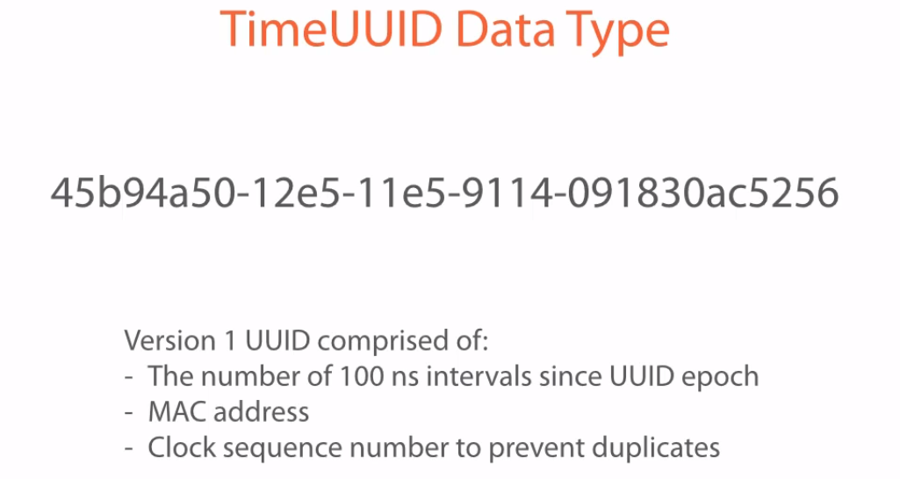

Slide 56
Below link for reference::
https://mashable.com/2015/06/24/flamingo-prosthetic-leg/#AldcaISQAsqw

Slide 57
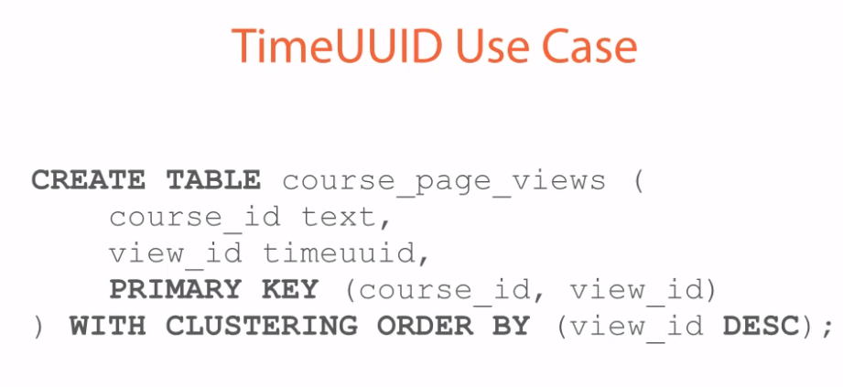

Slide 58
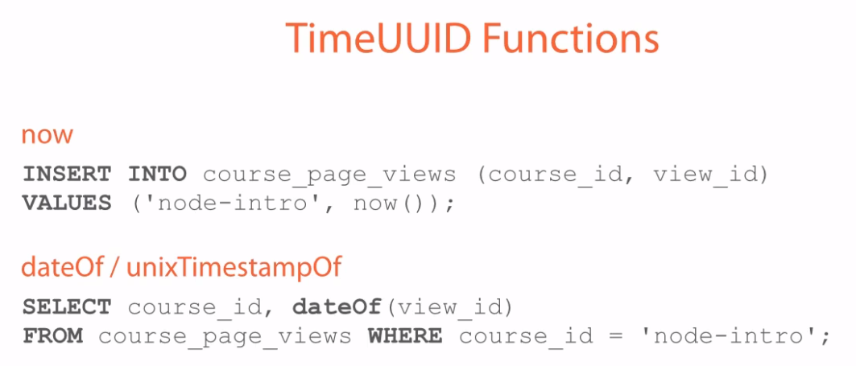

Slide 59
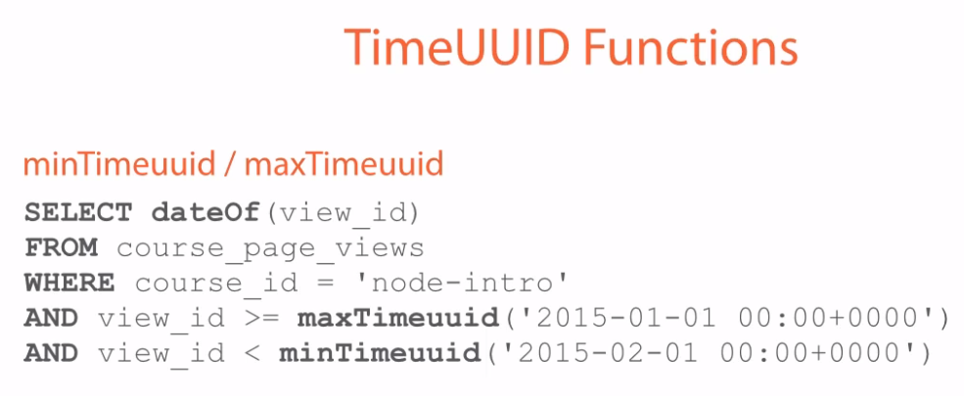

Slide 60
NODETOOL
Nodetool status
Nodetool help
Nodetool version
Nodetool describecluster
Nodetool info
Nodetool cfstats cassdemo.users

