Slide 1
Data Conversion from Traditional Relational Database to MongoDB using XAMPP and NoSQL
-Piyush Maheshwari
-Maninder Jeet Kaur
-Insha Mearaj
RDBMS – IA1
Rushabh Gandhi-1911012

Slide 2
Introduction
MongoDB is a NoSQL database written in C++ language.
MongoDB is a document-oriented database which helps us group data more logically.
MongoDB has lots of extensive built-in-features and is highly compatible with other software systems.
This paper demonstrates the conversion of data from a native tabular form to unstructured documents.

Slide 3
NoSQL characteristics
Can handle large data volume.
Scalable: servers without requiring application assistance. Servers can be added or removed from the data layer without application downtime.
Schema-less : Data can be inserted in a NoSQL database without first defining a rigid database schema.
Open Source development

Slide 4
Difference between SQL & NoSQL database
SQL | NoSQL
RELATIONAL DATABASE MANAGEMENT SYSTEM (RDBMS) | Non-relational or distributed database system.
These databases have fixed or static or predefined schema | They have have dynamic schema
These databases are not suited for hierarchical data storage. | These databases are best suited for hierarchical data storage.
These databases are best suited for complex queries | These databases are not so good for complex queries
Vertically Scalable | Horizontally scalable

Slide 5
Hadoop framework
Hadoop - the main frame technology being a Java based framework that supports the processing and storage of tremendously large data sets in a distributed computing environment.
Even though as we all know that Hadoop is written in Java programming language, programs for Hadoop can be written in other languages like Python.
Hadoop uses map reduce technology

Slide 6
What is MapReduce?
MapReduce is a processing technique and a program model for distributed computing based on java.
MapReduce program executes in three stages, namely map stage, shuffle stage, and reduce stage.
Map stage − The map or mapper’s job is to process the input data. Generally the input data is in the form of file or directory and is stored in the Hadoop file system (HDFS). The input file is passed to the mapper function line by line. The mapper processes the data and creates several small chunks of data.

Slide 7
Reduce stage − This stage is the combination of the Shuffle stage and the Reduce stage. The Reducer’s job is to process the data that comes from the mapper. After processing, it produces a new set of output, which will be stored in the HDFS.
During a MapReduce job, Hadoop sends the Map and Reduce tasks to the appropriate servers in the cluster.
The framework manages all the details of data-passing such as issuing tasks, verifying task completion, and copying data around the cluster between the nodes.
After completion of the given tasks, the cluster collects and reduces the data to form an appropriate result, and sends it back to the Hadoop server.

Slide 8
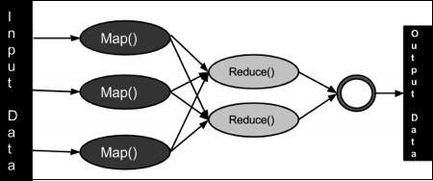

Slide 9
Authors have used XAMPP which is apache distribution web server solution for creating a local web server, after setting the environment the database was tested. JSON enabled the transferring data between the master server and the web application in human readable form. This improved the overall efficiency.

Slide 10
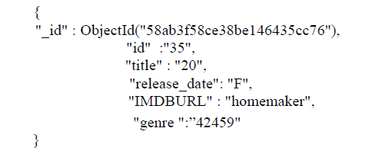
Proposed work
Defining data model-Authors have created three collections in our projects. They are movies, ratings and users
The data model used in Movies is as

Slide 11
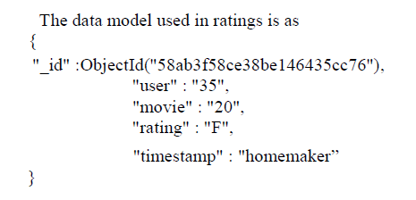
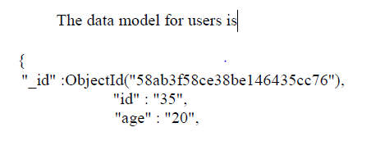
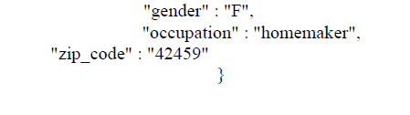

Slide 12
Process to be followed for data conversion
INPUT: The input for this project is a sql file, which we extracted to zipped form using WinRAR file compressor and later imported the same into XAMPP phpMyAdmin.
CONVERSION: The first tool we used was XAMPP.
Using XAMPP we will take the compressed input file movie. Normalized and convert it to JSON file
Before it we will create a view of genres and movies, the view is named as moviefile.

Slide 13
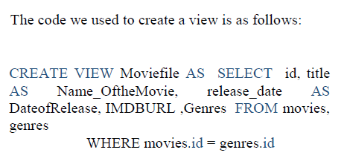
Once the View is created we export this view along with other two tables to NoSQL manager for MongoDB hence therefore Ratings, users and moviefile is exported to NoSQL manager for MongoDB.
But before we export the file we are supposed to convert the view created and the SQL files users and ratings to JSON File which is later imported into NoSQL manager for MongoDB.

Slide 14
The steps for exporting the JSON files are illustrated as below:
Turn on the exe files in MongoDb for the NoSQL ManagerDb Professional to work. Once both the exe console terminals are open go to NoSQL manager for MongoDB and start importing the JSON we got from XAMPP.
Select the JSON file type and enter the file name path, will be the first foremost step.
Next to it, we have to select and adjust the JSON option, File encoding methodology is to be selected in this step.

Slide 15
The Third step is to specify the import option, we in this step highlight the new collection option and specify the name of the collection we want to use, so the JSON is imported in the new the new collection.
Once we name the collection click on the Execution button to make it run.
This takes the code conversion to a different level.
The Fourth step is to check the import process status.

Slide 16
Result
We were successfully able to convert the JSON files to MongoDB format and consequently now our database is ready for interactions.

Slide 17
Conclusion
In this paper JSON enabled the transferring data between the master server and the web application in human readable form.
It was concluded from the results that MongoDB provides high performance on data persistence, support for embedded data models reduces I/O activity on database high speed interactions can include keys from embedded documents and arrays.
The resultant data repository will be in document format.
The JSON document we have can be very easily parsed with ease directly by JavaScript.

Slide 18
Strategy of implementation
Converting the MySQL query result to JSON.
Using Python and MySql connector.
Connecting the database to python using the connector.
Python MySQL Select Table to fetch a particular table and then fetch the stored data in the form of a dictionary.
Using json module to convert the object into the JSON object.
JSON object as the output.

Slide 19
References
K. Berg, T. Seymour and R. Coel, "History of Databases", International Journal of Management and Information Services, pp. 17, 2013.
Michael Stonebraker, "SQL databases v. NoSQL databases", Commun. ACM, vol. 53, no. 4, pp. 10-11, 2010.
Zhu Wei-Ping, Li Ming-Xin and Chen Huan, Using MongoDB to Implement Textbook Management System instead of MySQL, IEEE, 2011.
W. Naheman and Jianxin Wei, "Review of NoSQL databases and performance testing on HBase", Proceedings of International Conference on Mechatronic Sciences Electric Engineering and Computer (MEC), pp. 2304-2309, Dec. 2013.
R. Lawrence, "Integration and Virtualization of Relational SQL and NoSQL Systems Including MySQL and MongoDB", Proceedings of International Conference on Computational Science and Computational Intelligence (CSCI), pp. 285-290, Mar. 2014.
H. M. L Dharmasiri and M. D. J. S. Goonetillake, "A federated approach on heterogeneous NoSQL data stores", IEEE International Conference on Advances in ICT for Emerging Regions (ICTer), December 2013.

Slide 20


