Slide 1
Railway Reservation System
Rushabh Gandhi-1911012
Nayan Mandliya-1911027
Hussein Motiwala-1911031

Slide 2
Problem Statement
Implementation of railway management system using queue data structure with various facilities.
Our system is mainly divided into two parts the ADMIN part and the USER part.
The admin being in control of the railway reservation system can view and manipulate data according to his needs and can also create notices as per requirements which will then be displayed on the users ticket.
Coming to the users part, the users are capable of booking, cancelling and viewing their booked ticket.

Slide 3
Assumptions
Only for single train
Number of coaches = 2
Number of seats in each coach=2
Total number of seats in train = 4
Only special reservation for senior citizen (age>=60 years) not for any others like children women etc.
Password for the admin is directly provided(password=1234)
Not given rights to the admin change passwords.
Note – the number of tickets and the number of coaches are taken very small only for the sake of ease of explanation.

Slide 4
Implementation code- Header files and global variables
#include <string>
#include<cstdio>
#include <iostream>
#include <time.h>
#include <unistd.h>
#include <ctime>
//max number of coaches=2 and maximum number of seats in a coach=2
//Max number of normal customers=2 Number of senior citizens=2
using namespace std;
long int reg_no=202000,extra;

Slide 5
Implementation code-Structure
struct node{
string name;
string notice;
long int aadhaar_no;
long int phone_no;
int age;
string gender;
int seat_no;
int coach_no;
int reg_no;
string status;
struct node *link;
};

Slide 6
Implementation code-Insert Ticket
void ins_tic(struct node **front,struct node **rear,string fname,int age,long int ad_no,long int ph_no,int seat_no,int co_no,int reg_no,string gender,string status)
{
struct node *temp;
temp=(struct node *)malloc(sizeof(struct node));
temp->name=fname;
temp->age=age;
temp->aadhaar_no=ad_no;
temp->phone_no=ph_no;
temp->seat_no=seat_no;
temp->coach_no=co_no;
temp->reg_no=reg_no;
temp->gender=gender;
temp->status=status;
temp->notice=" ";
if(*front == NULL && *rear == NULL)
{
*rear = temp;
*front = *rear;
}
else
{
(*rear)->link = temp;
*rear = temp;
(*rear)->link = NULL;
}
}

Slide 7
Implementation code-Display ticket List
void display_list(struct node **front,struct node **wfront)
{
system("clear");
struct node *temp,*temp1;
temp=*front;
temp1=*wfront;
cout<<"\n\n-----------------------------------------------------------------------------\n";
cout<<"\t\t\t\tRESERVED TICKETS\n";
cout<<"-----------------------------------------------------------------------------\n";
cout<<"\t NAME\t\tAGE\t\tGENDER\t\tPHONE NO.\t\tREG_NO\t\tSTATUS\n";
cout<<"-----------------------------------------------------------------------------\n";
while(temp != NULL)
{
cout<<"\t"<<temp->name;
cout<<"\t\t"<<temp->age;
cout<<"\t\t"<<temp->gender;
cout<<"\t\t"<<temp->phone_no;
cout<<"\t\t\t"<<temp->reg_no;
cout<<"\t\t"<<temp->status;
cout<<endl;
temp = temp->link;
}
cout<<"\n\n-----------------------------------------------------------------------------\n";
cout<<"\t\t\t\tWAITING LIST\n";
cout<<"-----------------------------------------------------------------------------\n";
cout<<"\t NAME\t\tAGE\t\tGENDER\t\tPHONE NO.\t\tREG_NO\t\tSTATUS\n";
cout<<"-----------------------------------------------------------------------------\n";
while(temp1 != NULL)
{
cout<<"\t"<<temp1->name;
cout<<"\t\t"<<temp1->age;
cout<<"\t\t"<<temp1->gender;
cout<<"\t\t"<<temp1->phone_no;
cout<<"\t\t\t"<<temp1->reg_no;
cout<<"\t\t"<<temp1->status;
cout<<endl;
temp1 = temp1->link;
}
cout<<"\n\t\tPLEASE ENTER ANY NUMBER TO CONTINUE : ";
cin>>extra;
system("clear");
}

Slide 8
Implementation code-Cancel Ticket
void Cancel_Ticket(struct node** front,struct node** rear,int reg_num,struct node** wfront,struct node** wrear)
{
struct node *temp = NULL;
temp = *front;
while(temp != *rear)
{
if(temp->reg_no == reg_num)
{
break;
}
temp = temp->link;
}
temp->status="CANCELLED";
cout<<"\t\tNAME : "<<temp->name<<"\t\t"<<"CONTACT : "<<temp->phone_no<<endl;
cout<<"\n\t\t---------------------------------------------------------------\n";
cout<<"\t\tYOUR TICKET HAS BEEN CANCELLED"<<endl;
cout<<"\n\t\t---------------------------------------------------------------\n";
cout<<"\t\tPLEASE ENTER ANY NUMBER TO CONTINUE : ";
cin>>timepass;
(*rear)->link=(*wfront);
(*rear)=(*wfront);
(*wfront)=(*wfront)->link;
(*rear)->link=NULL;
(*rear)->coach_no=temp->coach_no;
(*rear)->seat_no=temp->seat_no;
(*rear)->status="CONFIRMED";
}

Slide 9
Implementation code- Notice For Cancellation
void notice(struct node** front,struct node** rear,string note1,struct node** wfront,struct node** wrear){
struct node *temp = NULL;
temp = *front;
while(temp != NULL)
{ temp->status="CANCELLED";
temp->notice=note1;
temp = temp->link;
}
if(*wfront!=NULL){
temp = *wfront;
while(temp != NULL)
{ temp->status="CANCELLED";
temp->notice=note1;
temp = temp->link;
}
}
}

Slide 10
Implementation code- Display Ticket
void display_ticket(struct node** front,struct node** rear,struct node** wfront,struct node** wrear,int reg_no)
{
int t,id=0;
struct node *temp = NULL,*temp1 = NULL;
temp = *front;
temp1 = *wfront;
while(temp != NULL)
{
if(temp->reg_no == reg_no)
{
id = 1;
break;
}
temp = temp->link;
}
if(id == 0)
{
while(temp1 != NULL)
{
if(temp1->reg_no == reg_no)
{
id = 2;
break;
}
temp1 = temp1->link;
}
}
if(id == 0)
{
cout<<"\n\t\tREGISTRATION NUMBER NOT FOUND !"<<endl;
cout<<"\n\t\t--------------------------------------------------------\n";
cout<<"\t\tPLEASE ENTER ANY NUMBER TO CONTINUE : ";
cin>>extra;
}

Slide 11
Implementation code- Display Ticket
else if(id == 1)
{
id = 0;
cout<<"---------------------------------------------------------------------------------"<<endl;
cout<<" "<<temp->notice<<endl;
cout<<"NAME : "<<temp->name<<"\t\t\t"<<"CONTACT : "<<temp->phone_no<<endl<<endl;
cout<<"AGE : "<<temp->age<<"\t\t"<<"REG_NO : "<<temp->reg_no<<"\t\t"<<"GENDER : "<<temp->gender<<endl<<endl;
cout<<"AADHAAR_NO : "<<temp->aadhaar_no<<endl<<endl;
cout<<"SEAT NUMBER : "<<temp->seat_no<<"\t\t"<<"COACH_NO : "<<temp->coach_no<<endl<<endl;
cout<<"CURRENT STATUS : "<<temp->status<<endl;
cout<<"---------------------------------------------------------------------------------"<<endl;
cout<<"\n\n\nENTER ANY NUMBER TO CONTINUE : ";
cin>>t;
}

Slide 12
Implementation code- Display Ticket
else if(id == 2)
{
id = 0;
cout<<"---------------------------------------------------------------------------------"<<endl;
cout<<" "<<temp1->notice<<endl;
cout<<"NAME : "<<temp1->name<<"\t\t\t"<<"CONTACT : "<<temp1->phone_no<<endl<<endl;
cout<<"AGE : "<<temp1->age<<"\t\t"<<"REG_NO : "<<temp1->reg_no<<"\t\t"<<"GENDER : "<<temp1->gender<<endl<<endl;
cout<<"AADHAAR_NO : "<<temp1->aadhaar_no<<endl<<endl;
cout<<"SEAT_NUMBER : NA\t\tCOACH_NO : NA"<<endl<<endl;
cout<<"CURRENT STATUS : "<<temp1->status<<endl;
cout<<"---------------------------------------------------------------------------------"<<endl;
cout<<"\n\n\nENTER ANY NUMBER TO CONTINUE : ";
cin>>t;
}
}

Slide 13
Implementation code- Main Function
Link to our code-
https://repl.it/@RushabhGandhi/railWayReservationFinal#main.cpp

Slide 14
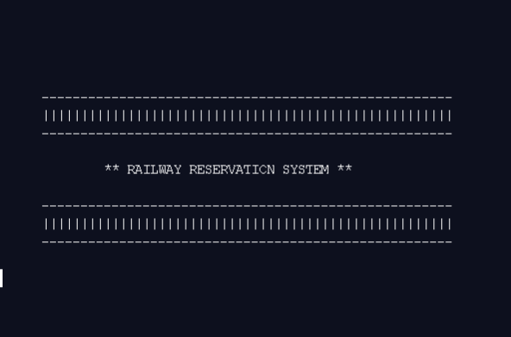
Output Screenshots

Slide 15
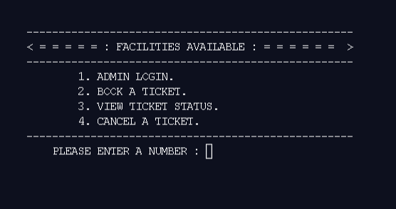
Output Screenshots

Slide 16
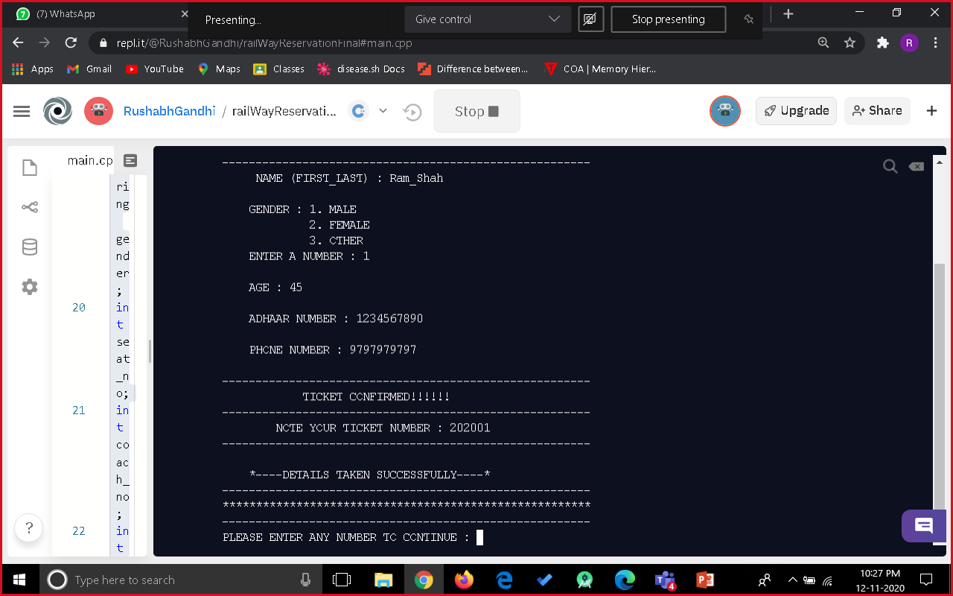
Output Screenshots

Slide 17
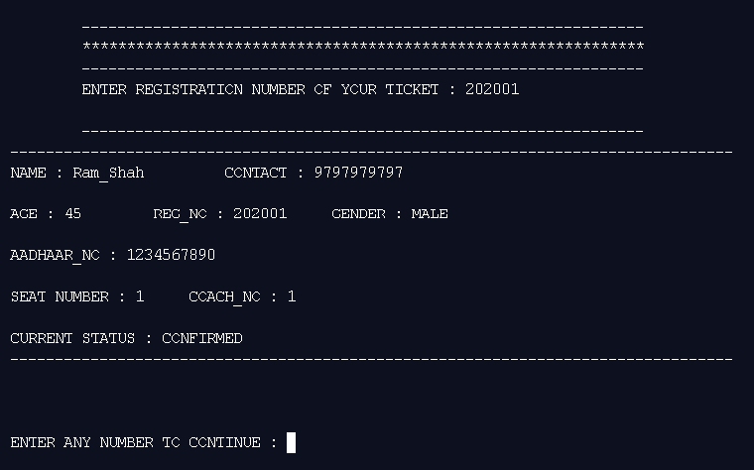
Output Screenshots

Slide 18
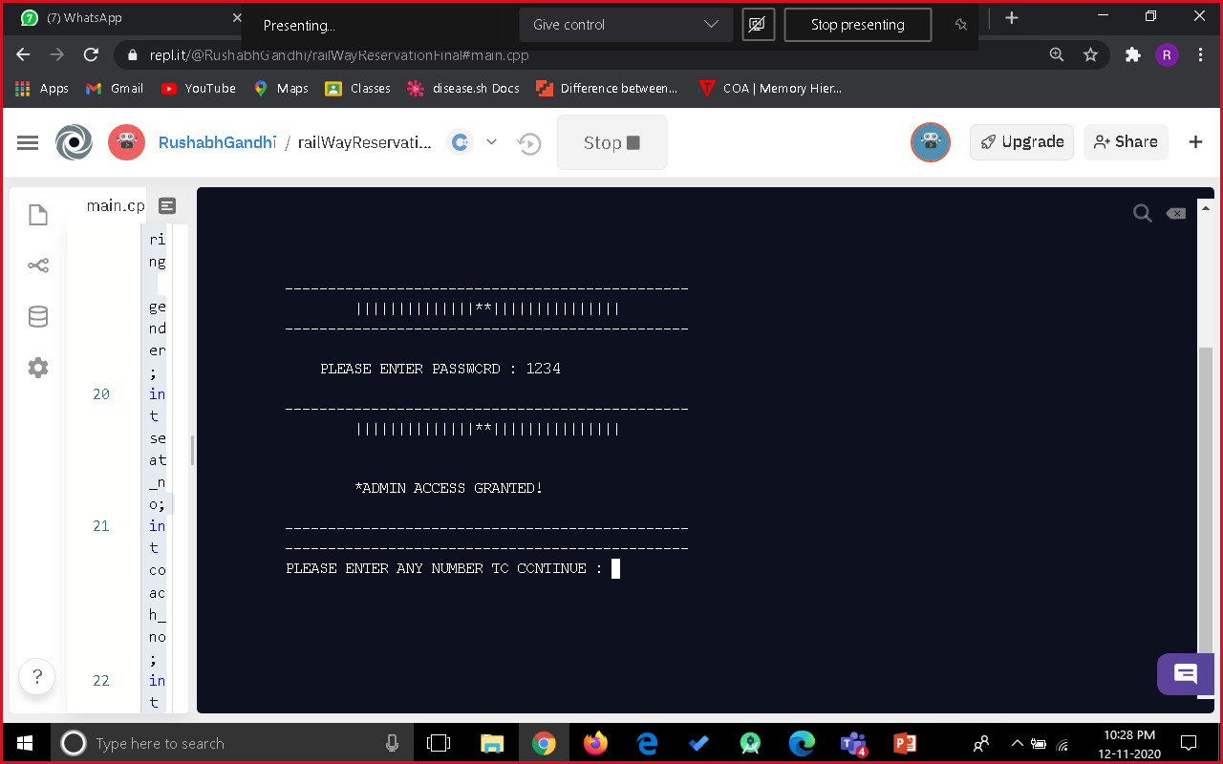
Output Screenshots

Slide 19

Output Screenshots

Slide 20

Output Screenshots

Slide 21
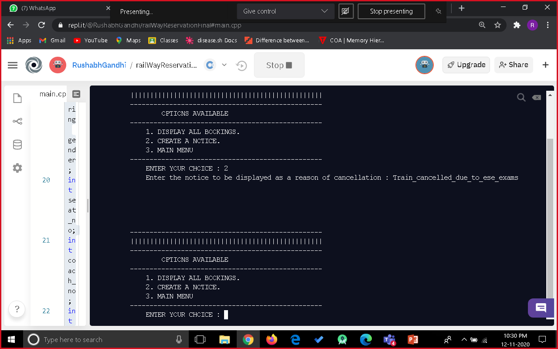
Output Screenshots

Slide 22
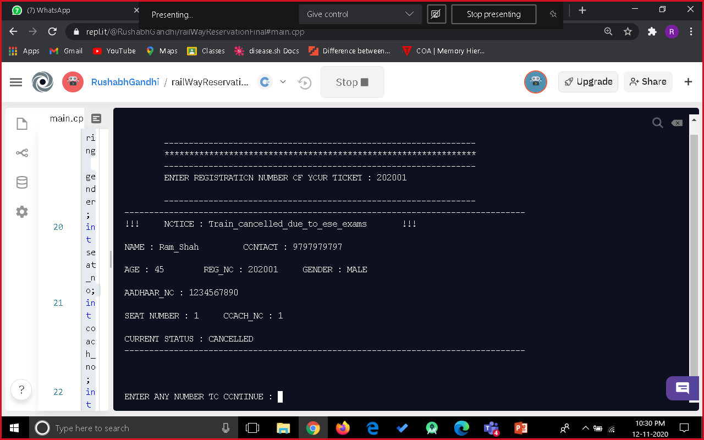
Output Screenshots

Slide 23

Output Screenshots

Slide 24
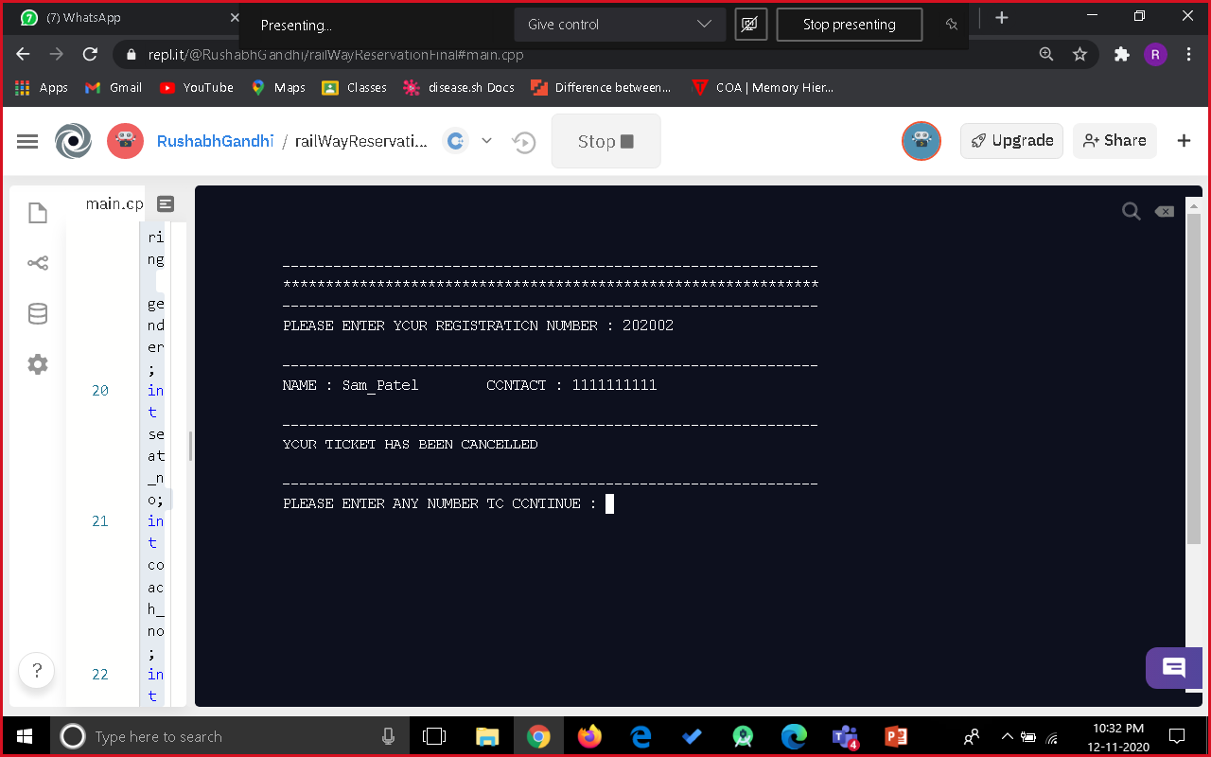
Output Screenshots

Slide 25

Output Screenshots

Slide 26

Output Screenshots

Slide 27
THANK YOU
Rushabh Gandhi-1911012
Nayan Mandliya-1911027
Hussein Motiwala-1911031

