Slide 1

How To Do Well In Professor Moody’s Class
Rushabh Jhaveri
RUID: 171008850

Slide 2
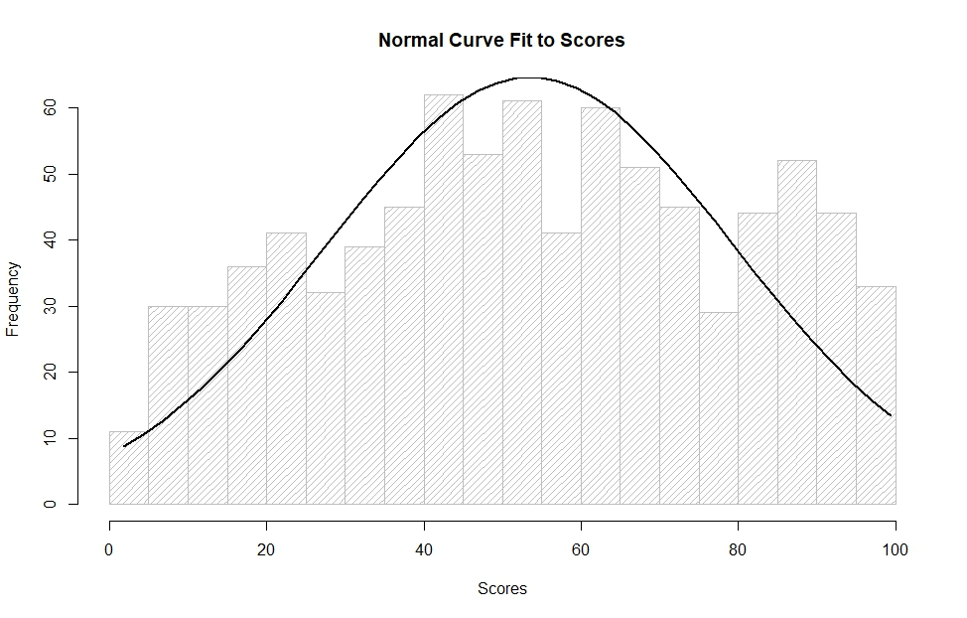
The Most Important Factor..
I feel the most important factor was obviously the scores.
To the right is a histogram of students’ scores and their frequency.
A normal curve was then superimposed on this histogram, fit to the scores.

Slide 3
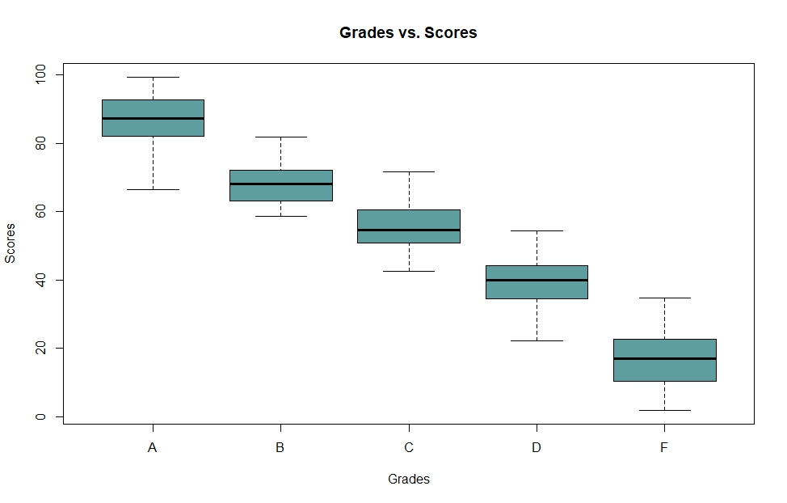
Scores
While there was considerable overlap, by taking the maximum score achieved for each grade, I was able to determine what score guaranteed a particular grade. For example, the max score for B grade was 81.93, which means anything above 81.93 guaranteed an A. Similarly, a 71.57 guaranteed a B, 54.47 a C, and 34.65 a D.

Slide 4
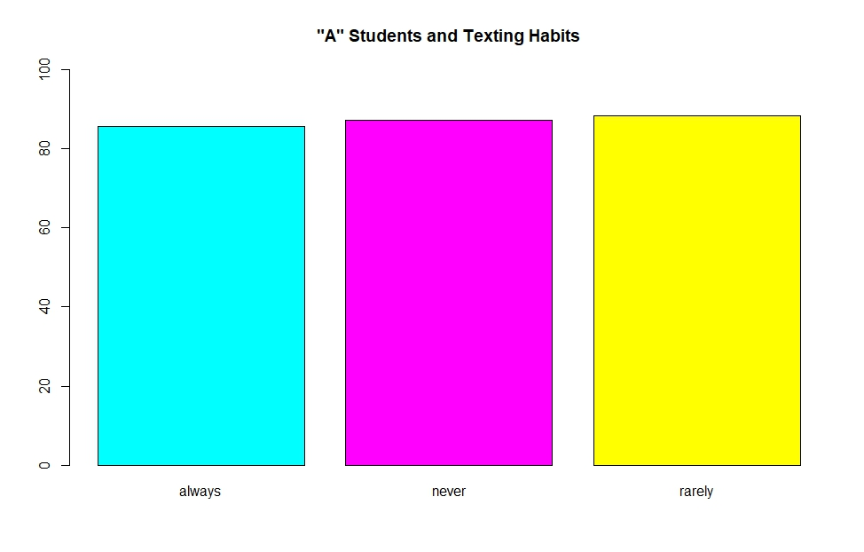
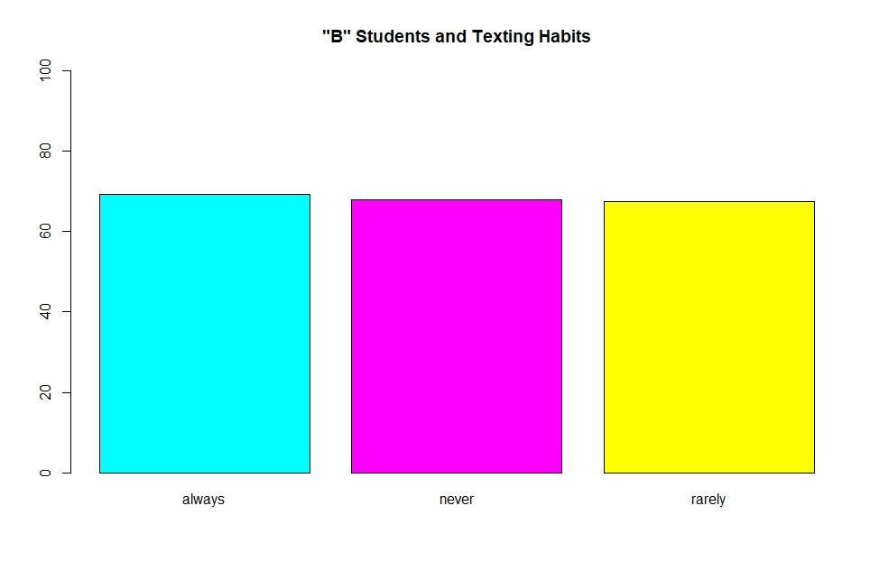
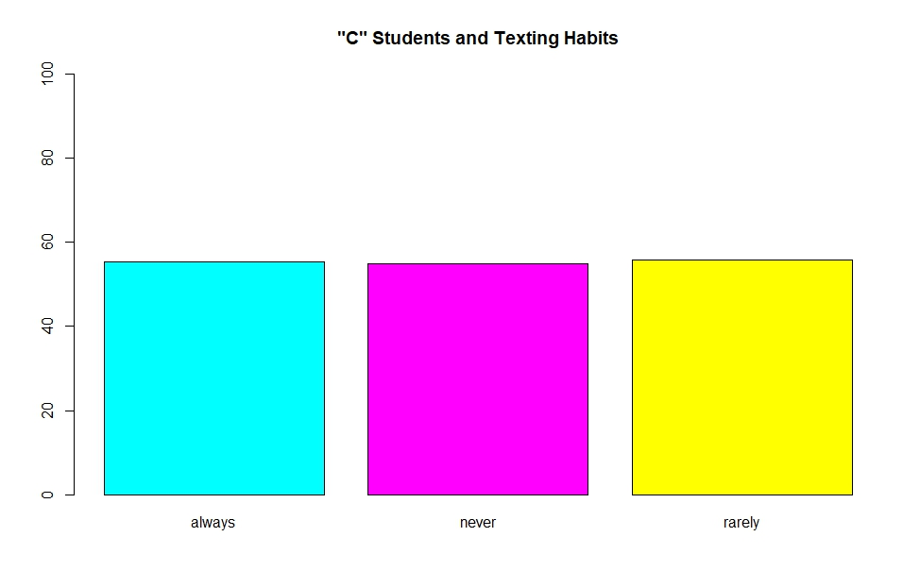
Texting Habits
I made bar plots of students who got an A and their texting habits (whether they always / never / rarely texted in class).
I made similar bar plots for students who got B’s, C’s, and so forth.
All the plots had an (almost) even distribution of students between the three categories (always, never, rarely).
This led me to an interesting conclusion – texting in class is not a factor in determining the overall grade.
Reasoning: if there are equal number of students who always text, or never / rarely text in class, and they all get the same grade, then it must follow that texting in class has no effect on the final grade.

Slide 5
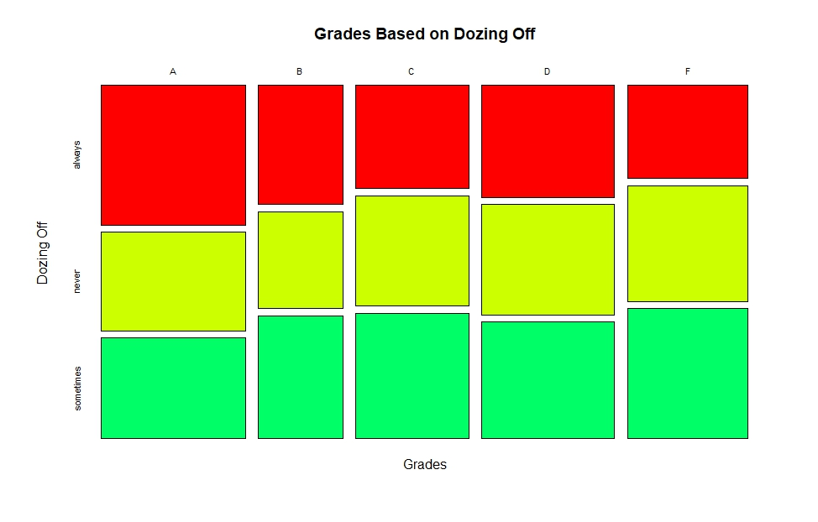
Dozing Off in Class…
When plotting a mosaic plot between grades and how often students doze off in class, I felt there was no clear correlation.
Which meant, I needed to make more plots!

Slide 6
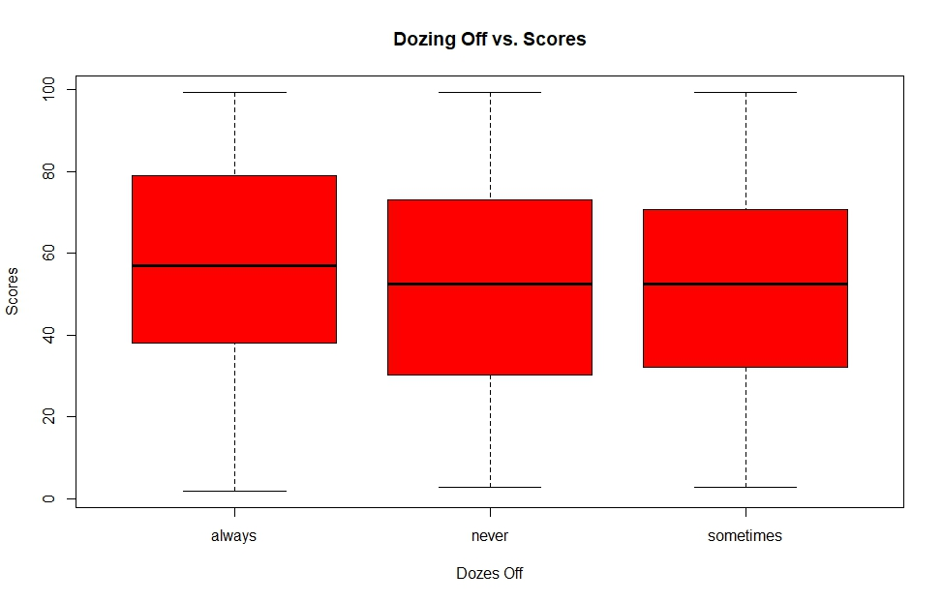
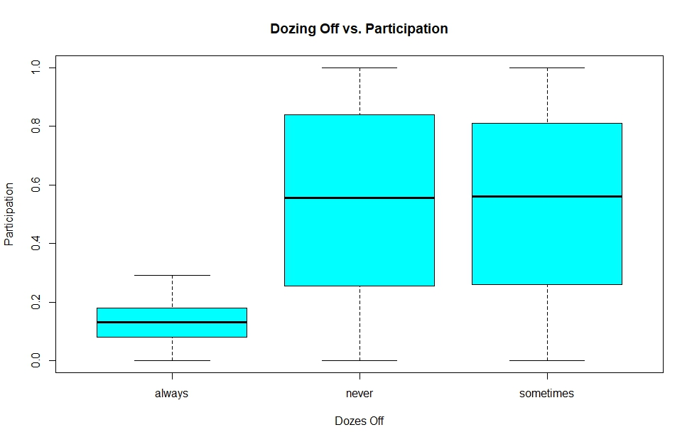
Dozing Off in Class…
So then, I made bar plots of dozing off versus scores, and dozing off versus participation, and noticed several correlations.
Dozing off is the primary factor in determining participation. Those who always dozed off received low participation scores, and while those who never/sometimes dozed off had roughly the same range of participation scores, those who never dozed off definitely had the highest participation scores.

Slide 7
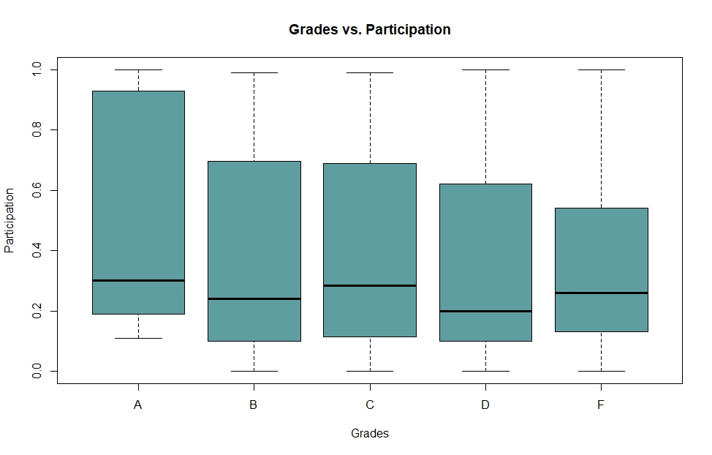
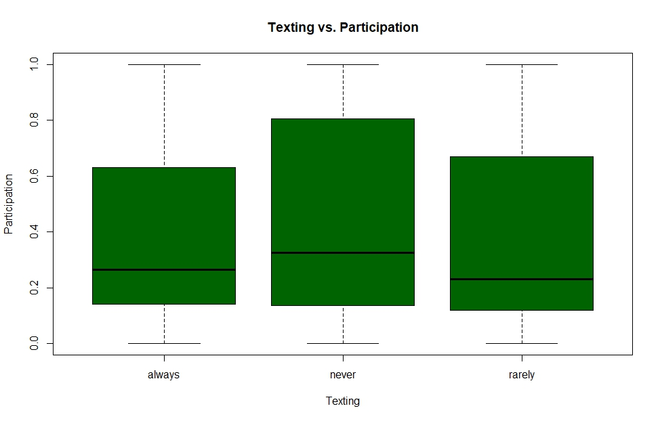
Participation
That got me thinking – what else influences participation?
The answer – texting. Those who always/rarely texted also received lower participation scores, but those who always texted received the lowest scores.
How much does participation affect the final grade?
Participation does hold some significance over the final grade, but the range of scores is too vast to be able to make a solid correlation.

Slide 8
Final Advice
Your score is the singular most important factor in determining your grade. Do well on all aspects that affect your score. It almost guarantees the grade you want.
Do not doze off in class. It heavily affects your participation score.
Keep texting to a minimum, if you must text at all. Always texting also affects your participation, even though texting does not directly affect final grade.
Participation is like a wild card – it has a very wide range for each grade, but in the end, might be what gets you a B even though your scores put you at the C / B border.

