Slide 1

Rushabh Jhaveri
RUID: 171008850

Slide 2
Quarterly Earnings Per Johnson and Johnson Share
The dataset I used was a CSV file containing quarterly earnings per J&J share for each quarter from the beginning of 1960 to the last quarter of 1980.
Source: https://vincentarelbundock.github.io/Rdatasets/datasets.html

Slide 3
Why Is This Information Useful?
Earnings per share is an important indicator of a company’s profitability.
Earnings per share is considered to be the single most important variable in determining a stock’s price.
Earnings per share is also considered to be an important indicator of a company’s value.

Slide 4
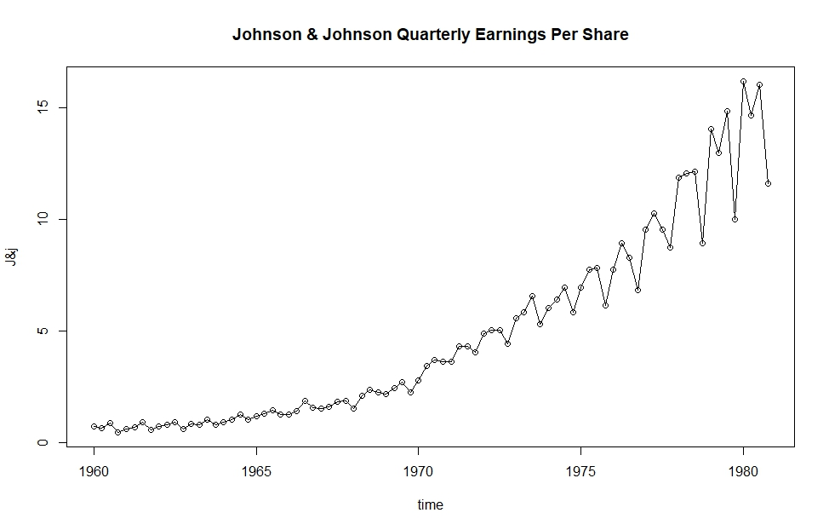
Quarterly Earnings
Overall, the quarterly earnings per share increased from 1960 through the end of 1980.
However, quarter on quarter, there have been marked dips in earnings per share, as evidently seen by the steep downward slopes in the graph.

Slide 5
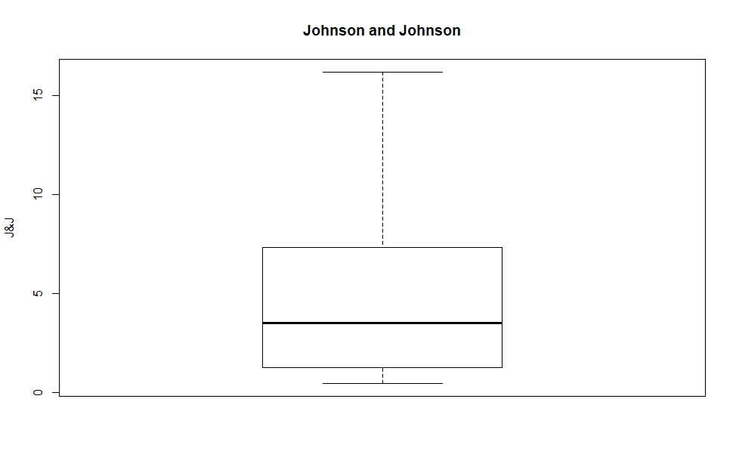
A Box Plot of the Quarterly Earnings

Slide 6
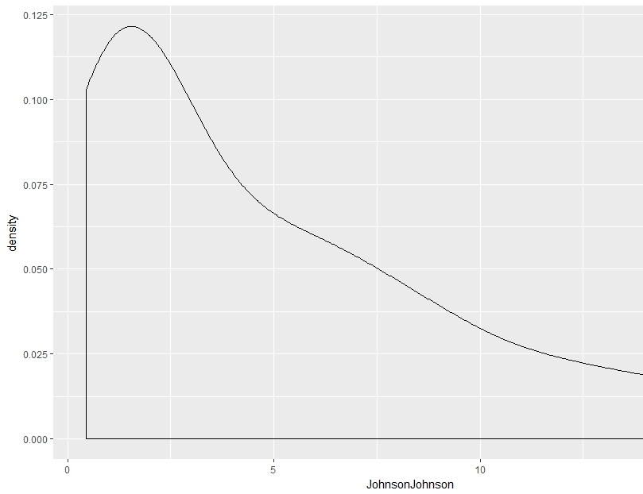
Density Plot
This is a density plot of J&J’s earnings per share.
Upon looking at the density plot, it seems like the quarterly earnings per share keep sliding lower.
HOWEVER, THIS IS A WRONG INFERENCE.
The purpose of a density plot is to show the PROBABILITY of the quarterly earning lying around a given point, assuming it is a continuous variable.

Slide 7
Conclusion
This information is especially useful in predicting trends in J&J’s stock, and making investment decisions.
The plots are also useful in determining important factors like risk, general direction in which the stock is heading, and how valuable the company was in that quarter.
The dataset is also important to the company’s board as it indicates whether decisions made are reaping rewards or whether they need to rethink their strategy.

