Slide 1
Athletes Have a Higher GPA Than Non-Athletes
Rushabh Jhaveri
RUID: 171008850

Slide 2



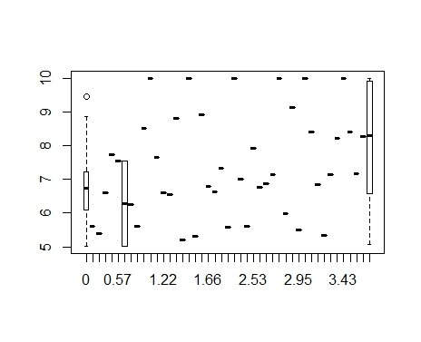
Do Athletes Have a Higher GPA?
z
A preliminary box-plot shows us that most of the athlete’s GPAs are concentrated closer to 4.0, which suggests they have higher GPA.
However, more conclusive testing must be done.

Slide 3


The Z - Test
z
The Z-Test is a very accurate way of determining whether a given hypothesis is correct.
The Z-Test returned a p value of $3∗{10}^{−9},$ which is very, very close to zero.
This indicates very strong evidence against the null hypothesis, which indicates athletes have higher GPA than non-athletes.

Slide 4
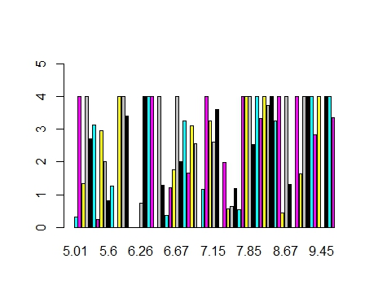
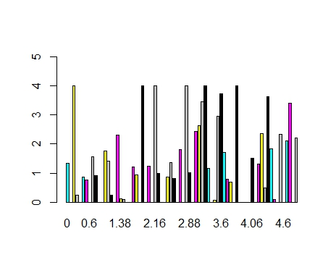
A Few Plots to Further Support The Claim
z
The bar plot on the top shows the GPA received by athletes [those with athletic ability > 5], whereas the bar plot on the bottom shows the GPA of non-athletes [athletic ability < 5].
Clearly, the athletes (who have higher athletic ability) have more number of students getting high GPA, when compared to the non-athletes, where the number of students getting high GPA is sparse.

Slide 5
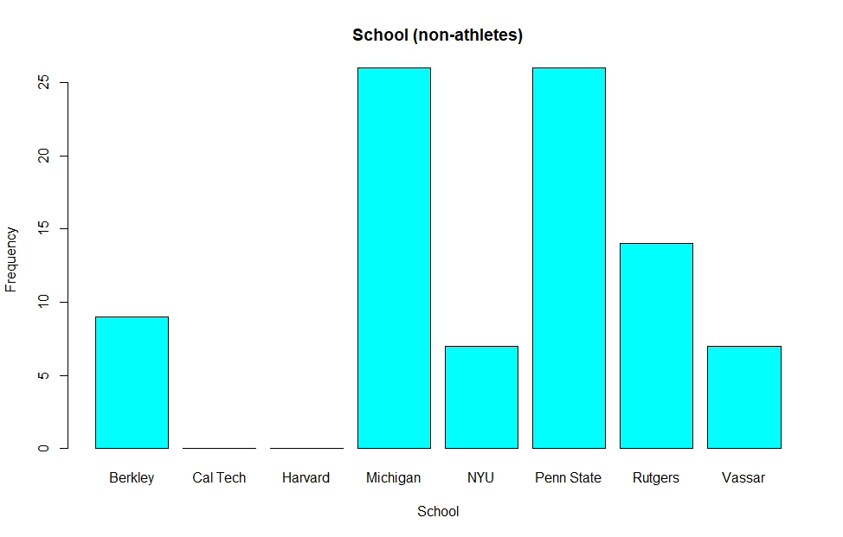
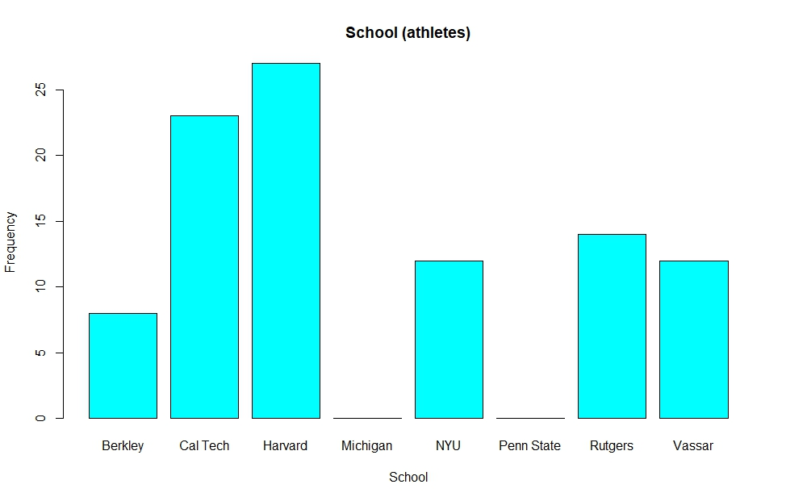
Schools and Students
z
From the bar plots on the right, we observe that most non-athletes go to state schools like Berkeley, Michigan, Rutgers, and Penn State, whereas athletes go to schools like Cal Tech and Harvard, which are schools with much lower acceptance rates and higher GPA and performance requirements for admission.
Since most of the athletes go to these highly selective schools and not the state schools, we can infer that the athletes must be better students with higher GPA than the non-athletes.

Slide 6
Conclusion
From the Z-Test, it is clear that there is strong evidence to indicate that the hypothesis that athletes have a higher GPA is correct.
From the various plots comparing athletes and non-athletes, the schools they have been admitted into, their GPA, it also supports that athletes have a higher GPA.
Thus, we can say that athletes are better students.

