Slide 1
Decision Trees

Slide 2
OK, now back to PREDICTION. training vs testing
How to create predictors which work for the new data?
OVERFITTING: working for the current data but NOT for new data

Slide 3
Simplest classifier
Simplest classifier – give everyone the most frequent grade
Best choice if no more information

Slide 4
But what if you can ask more questions?
Have you been late in class and how often?
Often? Select the most frequent grade for students who were often late
Never? Select the most frequent grade for students who were never late

Slide 5
More questions
How often did you ask questions?
Frequently? Select the most frequent grade for students who ask questions frequently
Never: Select the most frequent grade for students who never asked any questions

Slide 6
More questions
What was your score?
What was your participation index?

Slide 7
What is the order we should ask these questions?
DECISION TREE

Slide 8
ASTRO BANK DATA
ZODIAC FIVEELEMENTS MOON LOAN 1 Scorpio Water 0.00 NO 2 Leo Fire 0.25 YES 3 Scorpio Wood 1.00 YES 4 Gemini Metal 1.00 YES 5 Libra Watr 0.50 YES
ZODIAC | 5ELEMENTS | MOON | LOAN
Virgo | Fire | 1.00 | Yes
Scorpio | Water | 0.50 | No
Leo | Earth | 0.25 | No

Slide 9
How to get rpart and rpart.plot in Rstudio
install.packages(“rpart”)
install.packages(“rpart.plot”)
Then import the library using:
library(rpart)
library(rpart.plot)
library(rpart)
library(rpart.plot)

Slide 10
Recursive Partitioning (rpart) – regression tree
loan.tree <- rpart(LOAN ~ ZODIAC + FIVEELEMENTS + MOON,data=train)

Slide 11
So simple….thanks to R
loan.tree <- rpart(LOAN ~ FIVEELEMENTS + MOON+ZODIAC,data=train)
loan.tree
rpart.plot(loan.tree)

Slide 12
Prediction
pred.tree <- predict(loan.tree,newdata=test, type=“class”)

Slide 13
Error Calculation on Testing Data
test <- read.csv("LOANS_TESTING.csv",header=T)
loan <- test$LOAN
error.tree <- mean(pred.tree != loan)

Slide 14
Very simple decision tree
A | B | Class
1 | 0 | YES
0 | 1 | YES
0 | 0 | NO
1 | 1 | NO

Slide 15
Tree representation in R
A=1 -> Class=Yes/No (50%)
B=1 -> Class = No (100%)*
B=0 -> Class = Yes (100%)*
A=0 -> Class = Yes/No (50%)
B=1 -> Class = Yes (100%)*
B=0 -> Class = No (100%)*

Slide 16
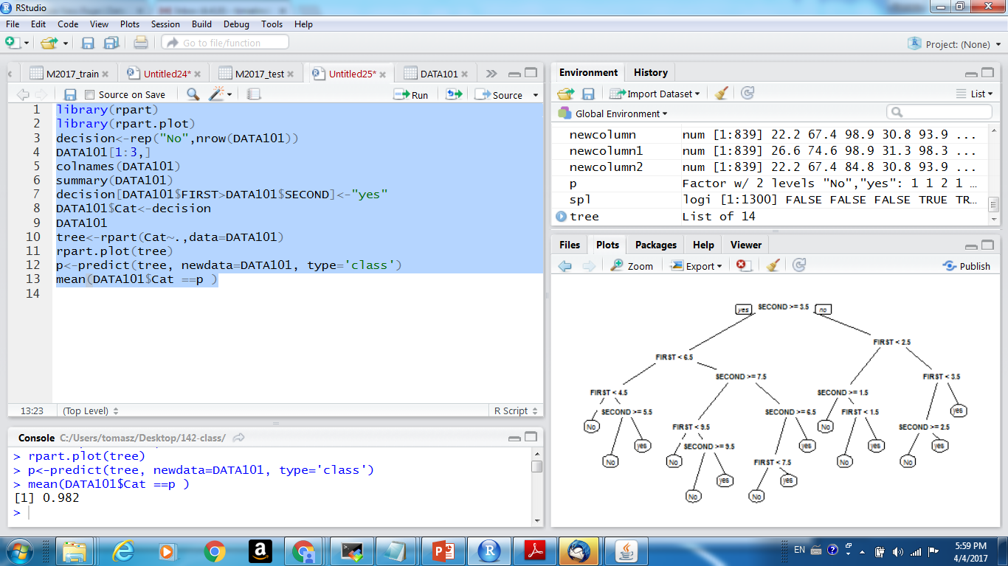

Slide 17
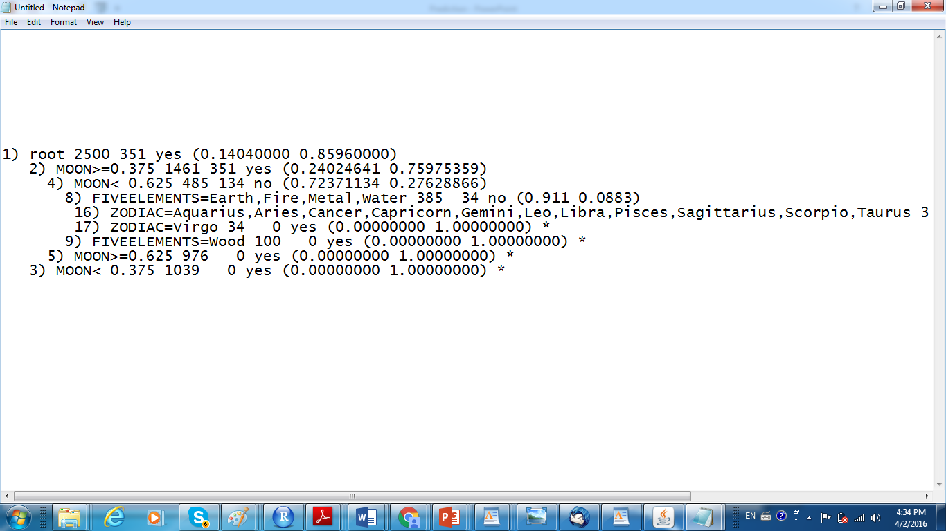

Slide 18
Minimum Description Principle
Basically – smaller models have better predictive chance….
Smaller the tree – more chance to predict well on new data
This is why we need to control the SIZE of the tree

Slide 19
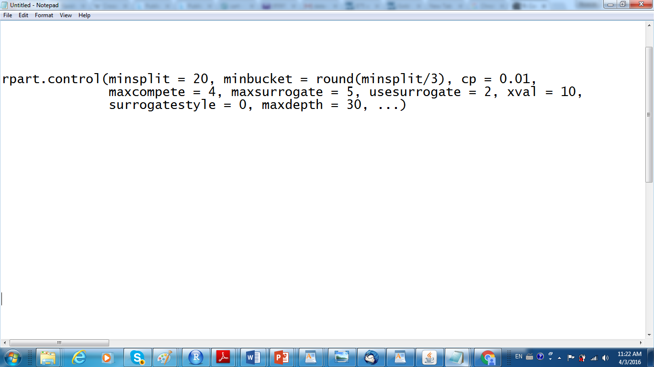
Parameters to control the tree size

Slide 20
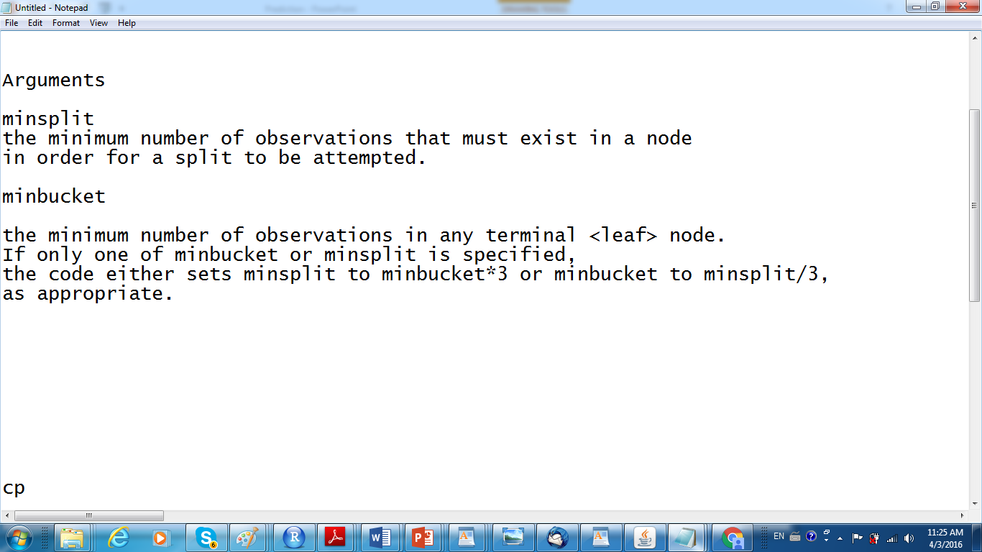
Parameters to control tree size

Slide 21
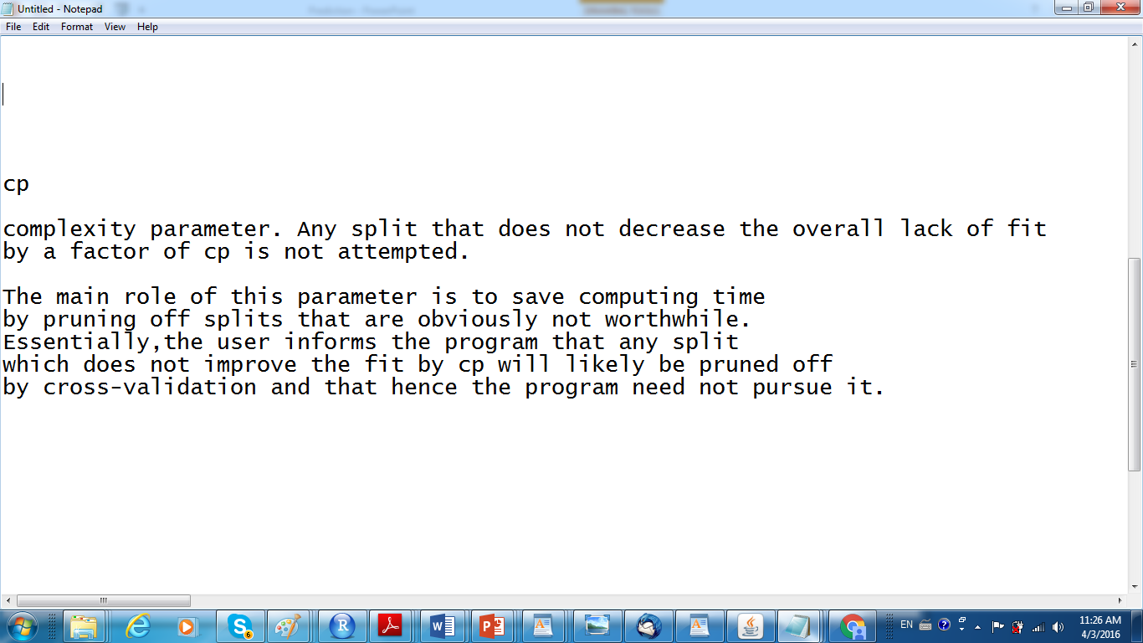
Parameters to control tree size

Slide 22
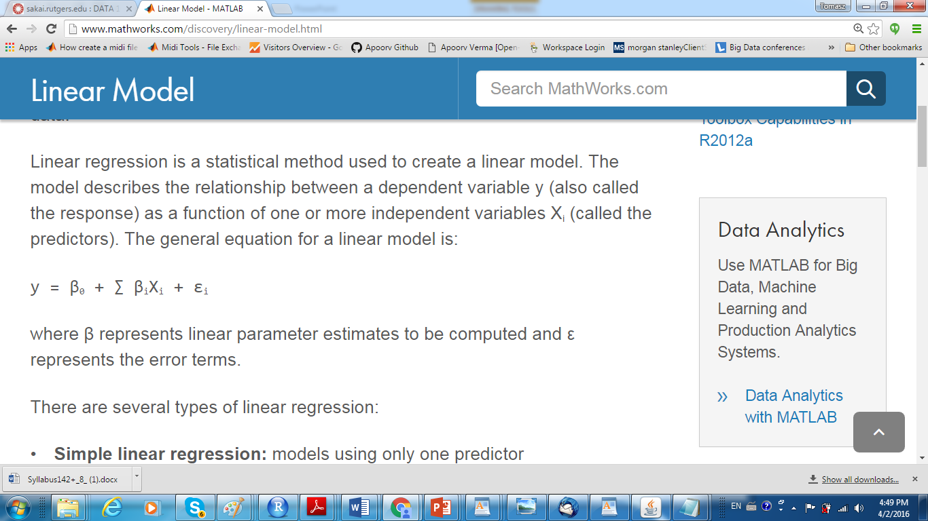

Slide 23
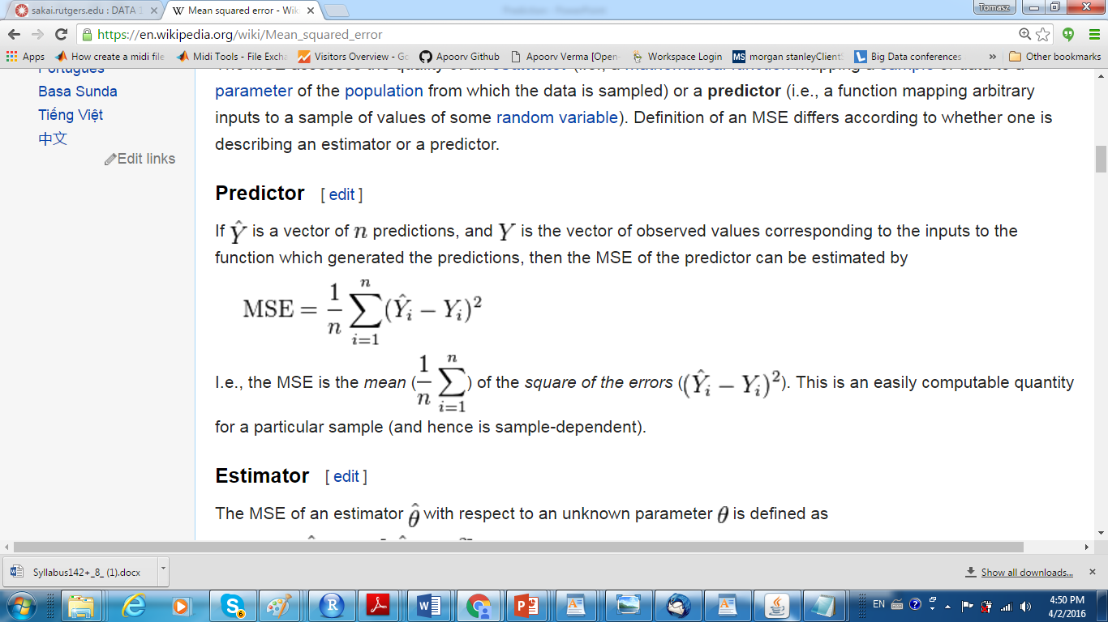
MSE (Kaggle will compute it)

Slide 24
Exhaustive cross-validation methods are cross-validation methods which learn and test on all possible ways to divide the original sample into a training and a validation set.

Slide 25
Leave-p-out cross-validation (LpO CV) involves using p observations as the validation set and the remaining observations as the training set. This is repeated on all ways to cut the original sample on a validation set of pobservations and a training set.

Slide 26
Leave-one-out cross-validation (LOOCV) is a particular case of leave-p-out cross-validation with p = 1.
LOO cross-validation doesn't have the calculation problem of general LpO cross-validation because

Slide 27
k-fold cross-validation[edit]
In k-fold cross-validation, the original sample is randomly partitioned into k equal sized subsamples. Of the ksubsamples, a single subsample is retained as the validation data for testing the model, and the remaining k − 1 subsamples are used as training data.
The cross-validation process is then repeated k times (the folds), with each of the k subsamples used exactly once as the validation data.
The k results from the folds can then be averaged (or otherwise combined) to produce a single estimation. The advantage of this method over repeated random sub-sampling (see below) is that all observations are used for both training and validation, and each observation is used for validation exactly once. 10-fold cross-validation is commonly used,^{[7]} but in general k remains an unfixed parameter.
When k=n (the number of observations), the k-fold cross-validation is exactly the leave-one-out cross-validation.

Slide 28
2-fold cross-validation[edit]
This is the simplest variation of k-fold cross-validation. Also called holdout method.^{[8]} For each fold, we randomly assign data points to two sets d₀ and d₁, so that both sets are equal size (this is usually implemented by shuffling the data array and then splitting it in two). We then train on d₀ and test on d₁, followed by training on d₁ and testing on d₀.
This has the advantage that our training and test sets are both large, and each data point is used for both training and validation on each fold.

Slide 29
Repeated random sub-sampling validation[edit]
This method, also known as Monte Carlo cross-validation,^{[9]} randomly splits the dataset into training and validation data. For each such split, the model is fit to the training data, and predictive accuracy is assessed using the validation data.
The results are then averaged over the splits. The advantage of this method (over k-fold cross validation) is that the proportion of the training/validation split is not dependent on the number of iterations (folds).

Slide 30
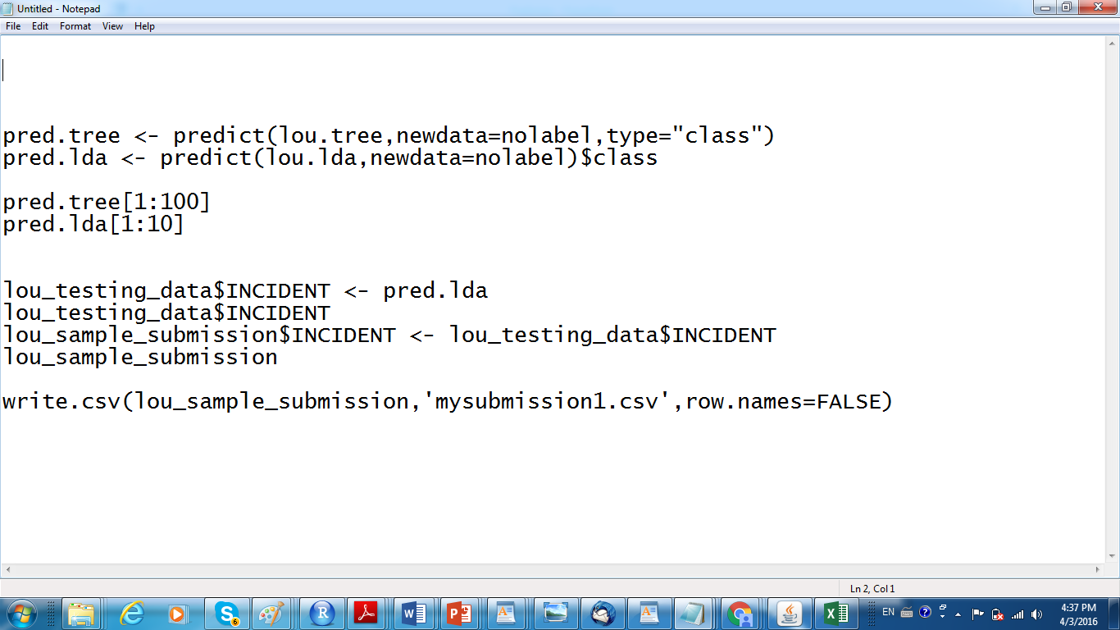
Submitting to Kaggle….(if you not clear)

