Slide 1
Predicting Grades in professor moody’s class
Rushabh Jhaveri NetID: rrj28

Slide 2
what we have – the data
The given dataset has 839 data entries.
It would be folly to try to individually predict the grade for each one of the 839 students.
Thus, it becomes imperative that we find some common trends that enable us to assign grades to multitudes of students at a time.
For this purpose, we make plots, to uncover these trends.

Slide 3

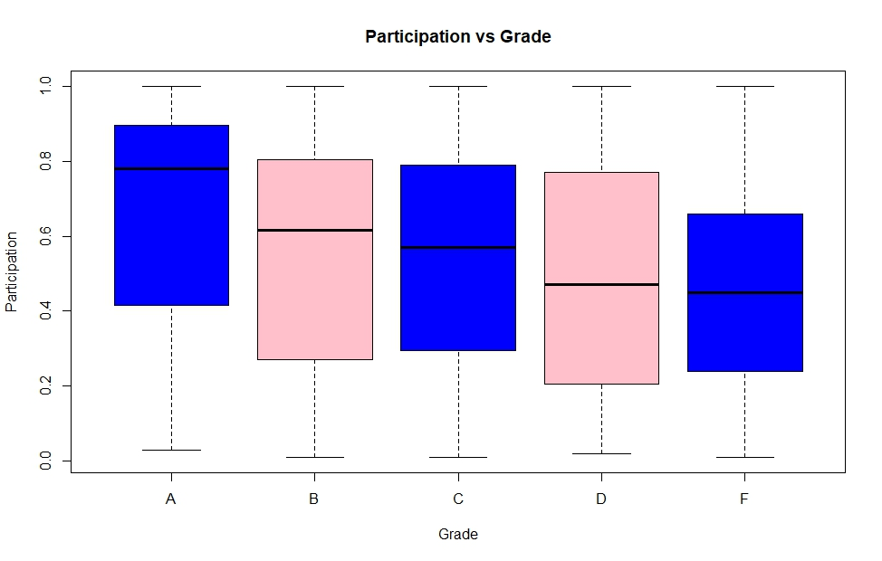
Boxplots
The first plot is a boxplot of participation versus grade.
From the boxplot, we can infer that given the more or less, participation does not really affect the final grade, except for fringe cases.

Slide 4
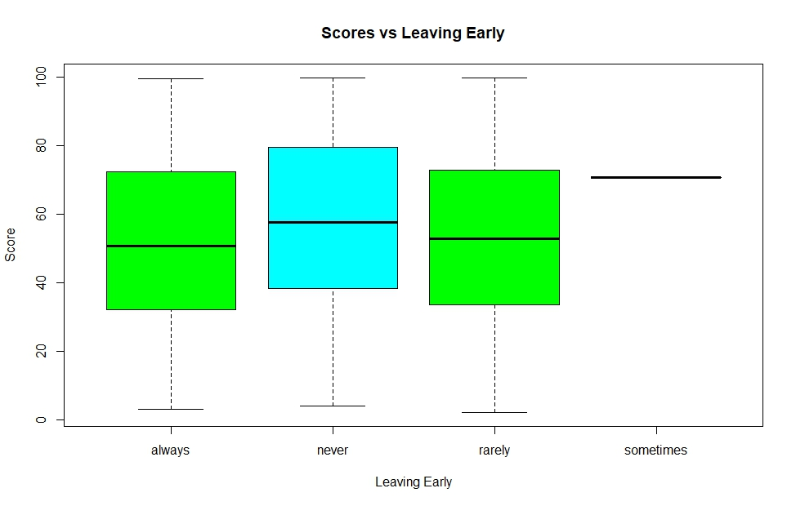
Boxplots
The second plot is a boxplot of score versus the frequency of leaving early.
from the boxplot, we can see that there is one student whose frequency of leaving early is “sometimes” – this student is an outlier whose grade must be predicted using the other available metrics.
Otherwise, we can see that leaving early does not have much effect on final score, except for students on the fringe.

Slide 5
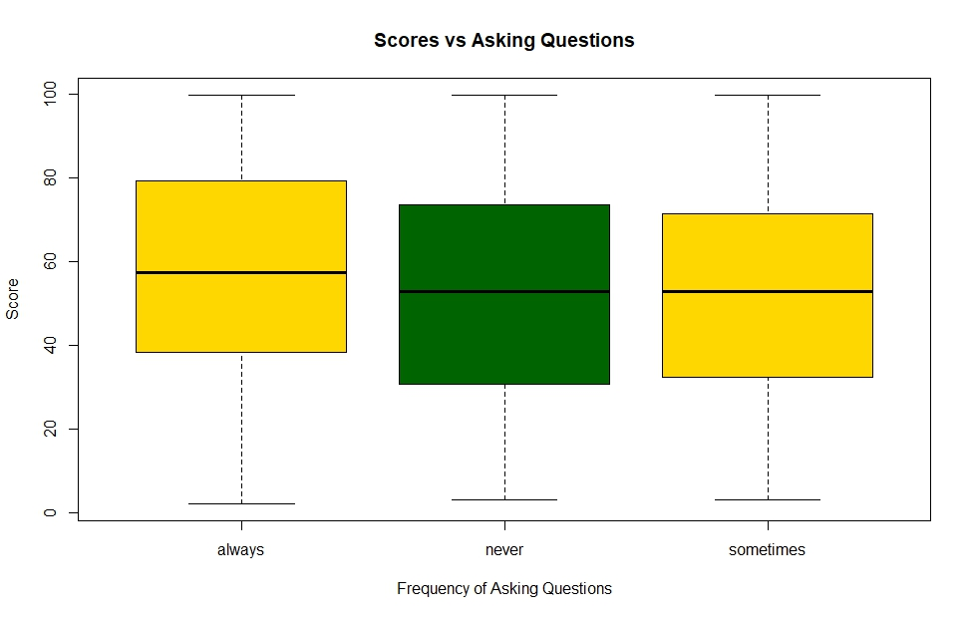
boxplots
The third plot is a boxplot scores versus frequency of asking questions.
While the distribution is more or less even, we see that those who always or never asked questions scored slightly higher.

Slide 6
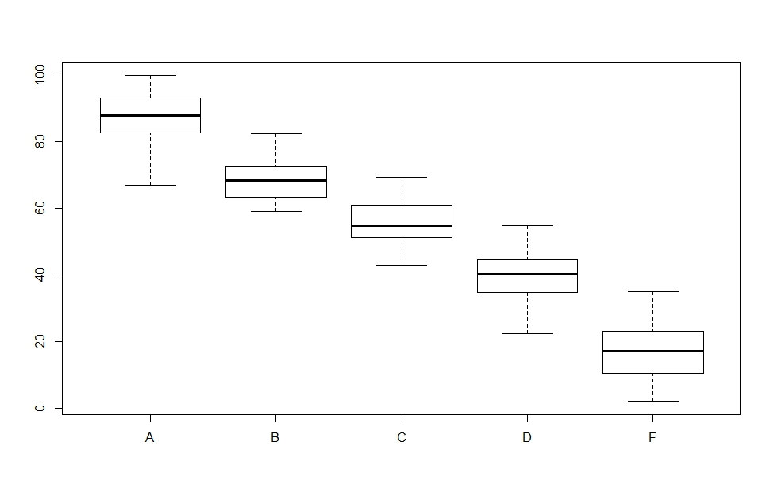
Boxplots
The final plot is a boxplot of scores versus grade.
As we can see, score is the single most significant factor in determining the final grade.

Slide 7
Making predictions
The first prediction I made was based on the maximum and minimum ranges of the grades.
I used the following two R code statements: tapply(train$SCORE, train$GRADE, min) tapply(train$SCORE, train$GRADE, max)
Initially, all grades were set to F.
Thus, for example, decision[train$SCORE>=69.25 & train$SCORE<82.37]="B"
Similarly, i assigned A, B, C, D grades.

Slide 8
Making predictions
For further refinement of the grades, I used a combination of score, asking questions, and participation.
For example, decision[train$SCORE>=66.99 & train$SCORE<82.37 & (train$ASKS_QUESTIONS=="always"|train$ASKS_QUESTIONS=="sometimes") & train$PARTICIPATION>=0.6518]="A«
This process was repeated for every grade, until the predictions were refined.

