Slide 1
Action Repeating Robot
01FB14EEE126 - Rushabh k Patel
01FB14EEE077 - Sanjay k m
01FB14EEE101 - Suraj B Ghale
01FB14EEE084 - Shishir Shastri

Slide 2
Introduction
This project is being done on the Microcontroller ARM Cortex-M3 based NXP LPC1768.
The main objective of the project is to make a Robot repeat the motion, what it has learnt by experience.
That experience can be like the input given to the microcontroller using RFID sensor and store it while doing those set of instructions.

Slide 3
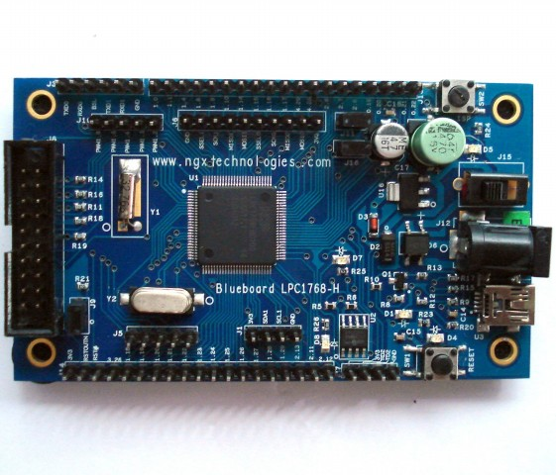
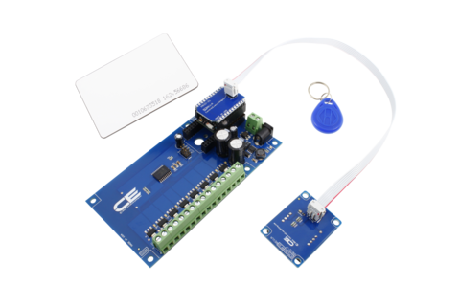
Components
LPC1768 Microcontroller
RFID sensor
Motors and H – Bridge IC
Chasis, connecting wire.. etc

Slide 4
Software Requirements
Keil uVision 5
Flash Magic

Slide 5
Block Diagram
RFID Sensor
Microcontroller
LPC1768
Motors
H – Bridge IC
(L298)

Slide 6
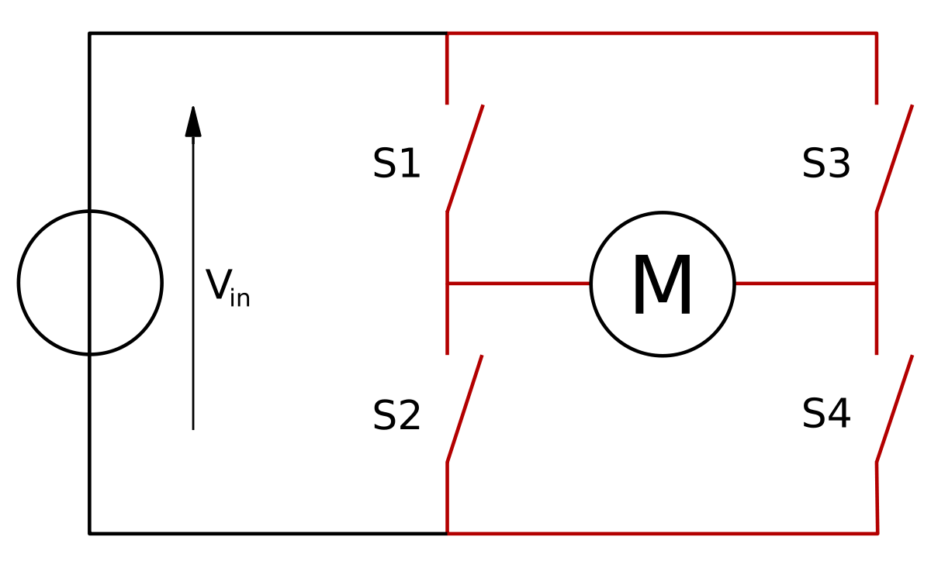
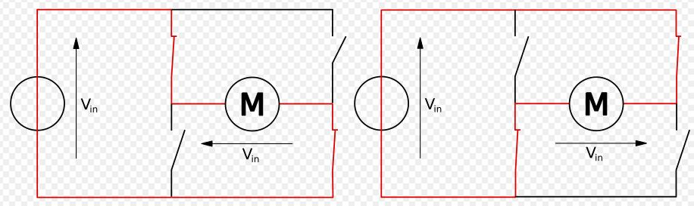

Slide 7
HOW TO GO ABOUT IT?
Build a robot with the motor interfaced, using Dual H-Bridge.
Interface RFID to the ARM Microcontroller.
When the high/low command is given to the Robot for making a movement, an algorithm has to be designed so that the ARM microcontroller stores these inputs while executing them.

Slide 8
Proposed Project Evaluation Criteria
Stage 1 - Movement of Robot using RFID.
Stage 2 - Storing the movement of the Robot on the board.
Stage 3 - Repeating the movement of the Robot from the stored instruction in a loop.

Slide 9
Sources
https://www.engineersgarage.com
https://exploreembedded.com
http://robokits.co.in
http://www.circuitstoday.com

Slide 10


Q&A

Slide 11
Thank You

