Slide 1
Sales Performance Analysis of Walmart Stores Using Advanced MySQL Techniques

Slide 2
Task 1: Identifying the Top Branch by Sales Growth Rate
SQL Query:
SELECT branch, MONTHNAME(new_date) AS months, ROUND(SUM(total), 2) AS total_sale FROM walmart_sales GROUP BY branch, months ORDER BY branch, FIELD(months, 'January', 'February', 'March');

Slide 3
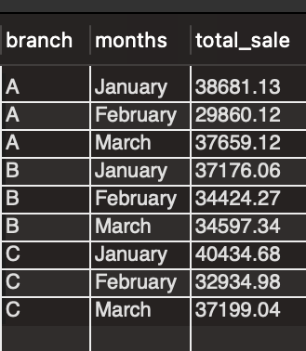
Walmart wants to identify which branch has exhibited the highest sales growth over time. Analyze the total sales for each branch and compare the growth rate across months to find the top performer.

Slide 4
Task 2: Most Profitable Product Line for Each Branch
SQL Query:
CREATE TEMPORARY TABLE profit_ranks AS SELECT Branch, Product_line, ROUND(SUM(gross_income), 2) AS total_profit, RANK() OVER (PARTITION BY Branch ORDER BY SUM(gross_income) DESC) AS rank_profit FROM walmart_sales GROUP BY Branch, Product_line; SELECT Branch, Product_line, total_profit FROM profit_ranks WHERE rank_profit = 1;

Slide 5
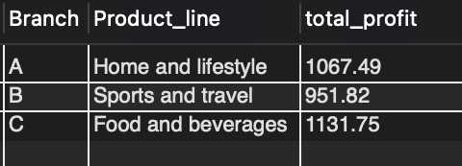
Walmart needs to determine which product line contributes the highest profit to each branch.The profit margin should be calculated based on the difference between the gross income and cost of goods sold.

Slide 6
Task 3: Analyzing Customer Segmentation Based on Spending
SQL Query:
SELECT customer_id, ROUND(AVG(total), 2) AS avg_spending, CASE WHEN AVG(total) >= 320 THEN "High" WHEN AVG(total) >= 300 AND AVG(total) <= 320 THEN "Medium" ELSE "Low" END AS spending_behavior FROM walmart_sales GROUP BY customer_id order by avg_spending asc;

Slide 7
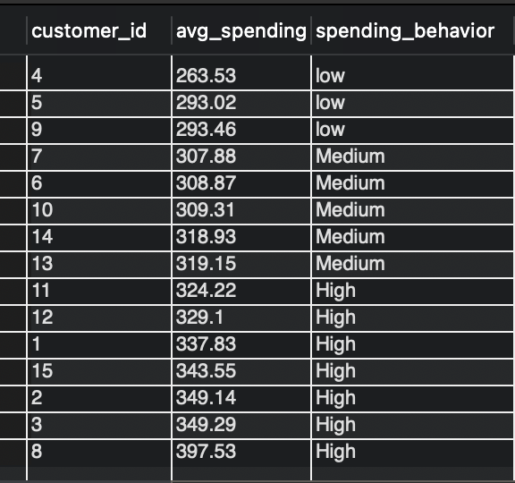
Walmart wants to segment customers based on their average spending behavior. Classify customers into three tiers: High, Medium, and Low spenders based on their total purchase amounts.

Slide 8
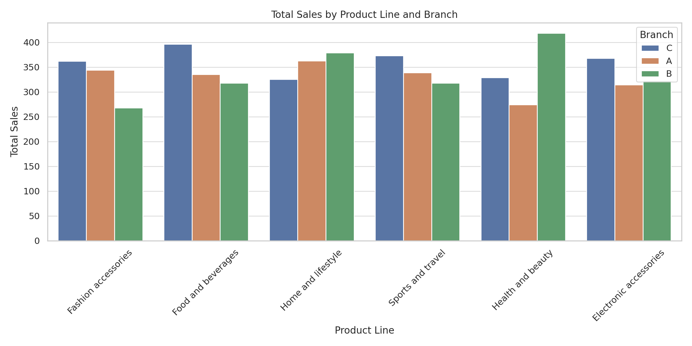
Task 4: Detecting Anomalies in Sales Transactions
SQL Query:
WITH ProductLineAvg AS ( SELECT Product_line, AVG(Total) AS avg_total FROM walmart_sales GROUP BY Product_line ) SELECT w.Invoice_id, w.Branch, w.Product_line, w.Total, a.avg_total FROM walmart_sales w JOIN ProductLineAvg a ON w.Product_line = a.Product_line WHERE w.Total > a.avg_total * 1.5 OR w.Total < a.avg_total * 0.5 ORDER BY w.Total DESC

Slide 9
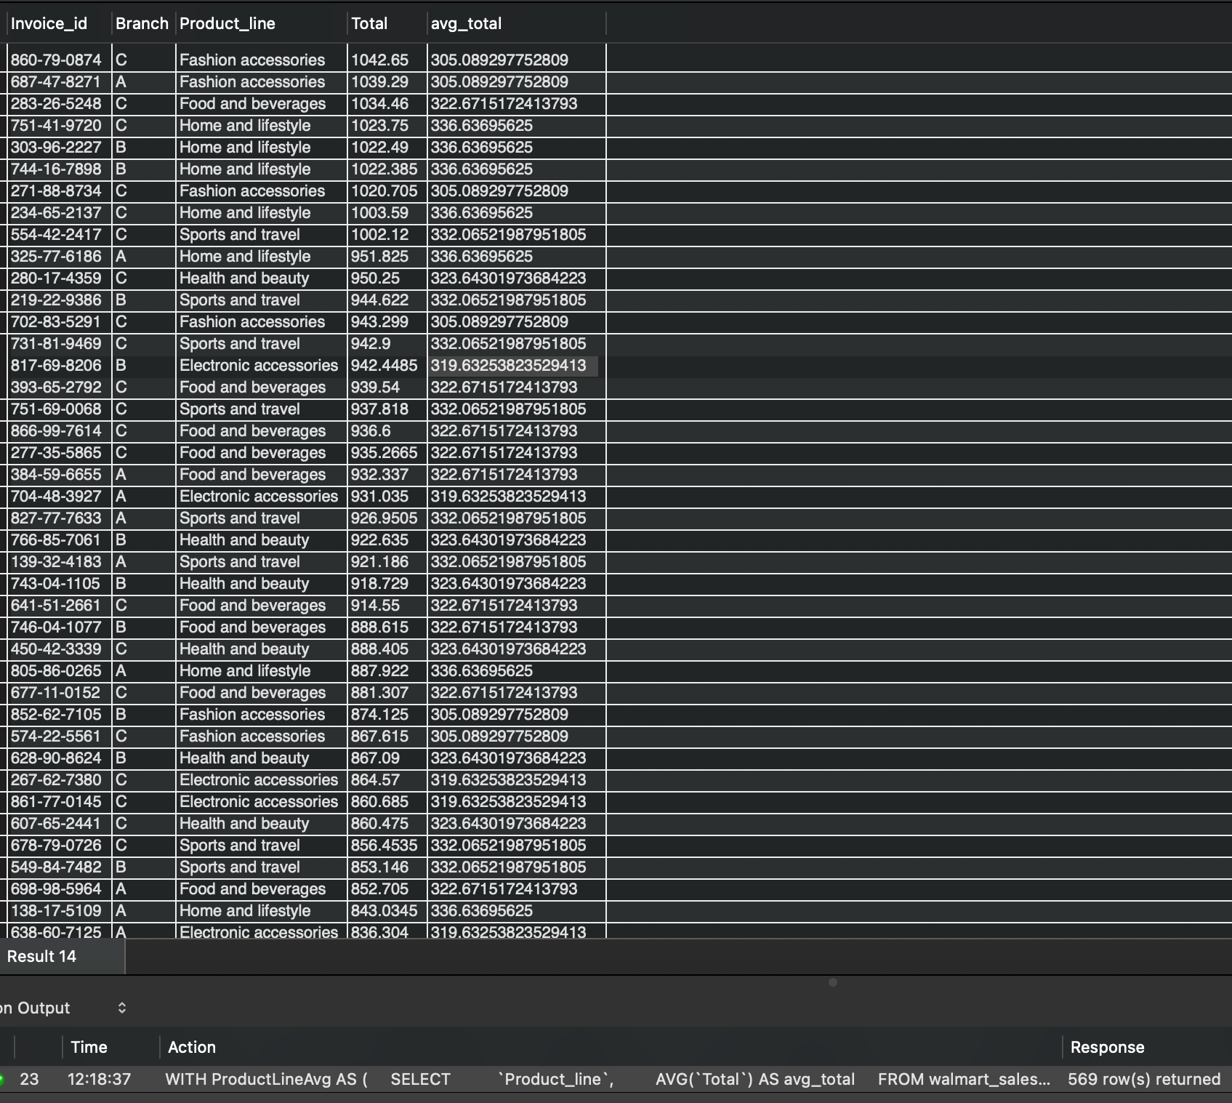
Walmart suspects that some transactions have unusually high or low sales compared to the average for the product line. Identify these anomalies.

Slide 10
Task 5: Most Popular Payment Method by City
SQL Query:
CREATE TEMPORARY TABLE task_5 AS SELECT city, payment, COUNT(payment) AS count_payment, RANK() OVER (PARTITION BY city ORDER BY COUNT(payment) DESC) AS rank_payment FROM walmart_sales GROUP BY city, payment; SELECT city, payment, count_payment FROM task_5 WHERE rank_payment = 1;

Slide 11
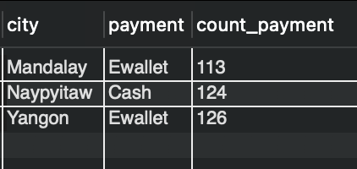
Walmart needs to determine the most popular payment method in each city to tailor marketing strategies.

Slide 12
Task 6: Monthly Sales Distribution by Gender
SQL Query:
SELECT gender, MONTHNAME(new_date) AS months, ROUND(SUM(total), 2) AS total_sales FROM walmart_sales GROUP BY gender, months ORDER BY FIELD(months, 'January', 'February', 'March');

Slide 13
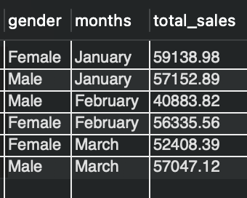
Walmart wants to understand the sales distribution between male and female customers on a monthly basis.

Slide 14
Task 7: Best Product Line by Customer Type
SQL Query:
CREATE TEMPORARY TABLE task_7 AS SELECT customer_type, Product_Line, COUNT(Product_Line) AS total_line, RANK() OVER(PARTITION BY customer_type ORDER BY COUNT(Product_Line) DESC) AS rnk FROM walmart_sales GROUP BY customer_type, Product_Line; SELECT customer_type, Product_Line, total_line FROM task_7 WHERE rnk = 1;

Slide 15
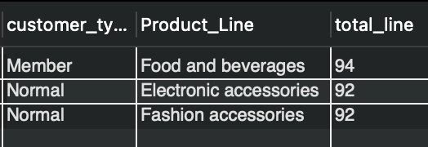
Walmart wants to know which product lines are preferred by different customer types(Member vs. Normal).

Slide 16
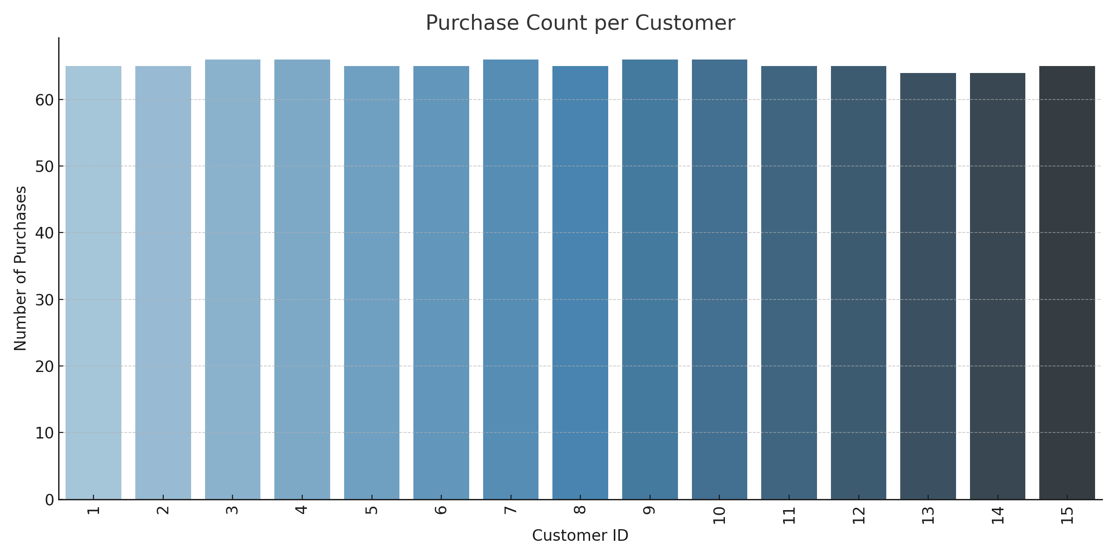
Task 8: Identifying Repeat Customers
SQL Query:
SELECT w1.customer_id, COUNT(DISTINCT w1.invoice_id) AS purchase_count FROM walmart_sales AS w1 JOIN walmart_sales AS w2 ON w1.customer_id = w2.customer_id AND w1.invoice_id <> w2.invoice_id AND DATEDIFF(w2.new_Date, w1.new_Date) BETWEEN 1 AND 30 GROUP BY w1.customer_id HAVING purchase_count > 1 ORDER BY purchase_count DESC;

Slide 17
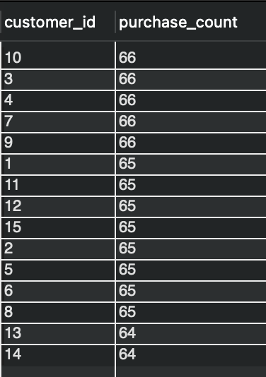
Walmart needs to identify customers who made repeat purchases within a specific time frame (e.g., within 30 days).

Slide 18
Task 9: Top 5 Customers by Sales Volume
SQL Query:
SELECT customer_id, ROUND(SUM(total), 2) AS total_sales FROM walmart_sales GROUP BY customer_id ORDER BY total_sales DESC LIMIT 5;

Slide 19
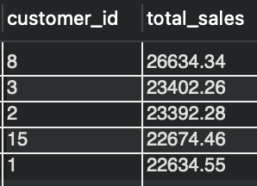
Walmart wants to reward its top 5 customers who have generated the most sales Revenue.

Slide 20
Task 10: Analyzing Sales Trends by Day of the Week
SQL Query:
SELECT DAYNAME(new_date) AS day_of_week, ROUND(SUM(total), 2) AS total_sales FROM walmart_sales GROUP BY day_of_week ORDER BY total_sales DESC;

Slide 21
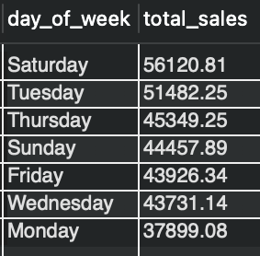
Walmart wants to analyze the sales patterns to determine which day of the week brings the highest sales.

