Slide 1
Text Summarizer
By:
Group No: 04
Aditya Gadekar (07)
Atharva Mhatre (25)
Rushabh Sarvaiya (47)
Under Guidance of:
Prof. Martina D’souza

Slide 2
INTRODUCTION
Automatic summarization is the process of reducing a text Document with a computer program in order to create a summary that retains the most important points of the original document. As The problem of information overload has grown, and as the quantity of data has increased, so has interest in automatic summarization. It is very difficult for human beings to manually summarize large documents of text.

Slide 3
APPLICATION
Automatic summarization reduces a text file into a passage or paragraph that conveys the main meaning of the text.
The searching of important information from a large text file is very difficult job for the users thus to solve this issue summarizeris used to extract the important information or summary of the text file. This summary helps the users to reduce time.
In today’s world to Extracting information from the World Wide Web is very easy. This extracted information is a huge text repository. With the rapid growth of the World Wide Web (internet), information overload is becoming a problem for an increasing large number of people. Automatic summarization can be an indispensable solution to reduce the information overload problem on the web.

Slide 4
Approaches
There are two approaches for automatic summarization:
Extraction
Graph Base
Text Rank
Abstraction.
Aided Summmarization
Encoder-Decoder Model

Slide 5
Extraction:
Extractive methods work by selecting a subset of existing words, phrases, or sentences in the original text to form the summary.
Select relevant phrases of the input document and concatenate them to form a summary (like "copy-and-paste").
Pros: They are quite robust since they use existing natural-language phrases that are taken straight from the input.
Cons: But they lack in flexibility since they cannot use novel words or connectors. They also cannot paraphrase like people sometimes do.

Slide 6
Abstraction:
Generate a summary that keeps original intent. It's just like humans do.
Pros: They can use words that were not in the original input. It enables to make more fluent and natural summaries.
Cons: But it is also a much harder problem as you now require the model to generate coherent phrases and connectors.
Extractive & Abstractive is not conflicting ways. You can use both to generate the summary. And there are a way collaborate with human.

Slide 7
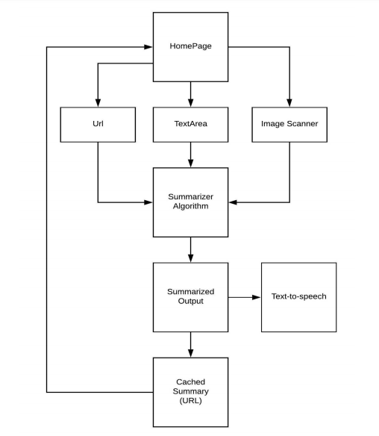
Flowchart

Slide 8
Text Rank
TextRank is based on PageRank algorithm that is used on Google Search Engine. Its base concept is "The linked page is good, much more if it is from many linked page". The links between the pages are expressed by matrix (like Round-robin table). We can convert this matrix to transition probability matrix by dividing the sum of links in each page. And the page surfer moves the page according to this matrix.
TextRank regards words or sentences as pages on the PageRank. So when you use the TextRank, following points are important.
Define the "text units" and add them as the nodes in the graph.
Define the "relation" between the text units and add them as the edges in the graph.
You can set the weight of the edge also.
Then, solve the graph by PageRank algorithm. LexRank uses the sentence as node and the similarity as relation/weight (similarity is calculated by IDF-modified Cosine similarity).
Tools that support TextRank.
gensim
pytextrank

Slide 9
Features:
Summarize:
Normal Text.
Webpage. (Articles)
Image to text.
Text-to-Speech:
Text to be summarized.
Summarized Text.
Extracts Keywords & also Authors if mentioned.

Slide 10
Future Scope:
Summarise document files like pdf, word document,etc.
Developing IoS application for Apple Users.
Using of both extraction and abstraction based methods to get more optimized and correct summary.

Slide 11
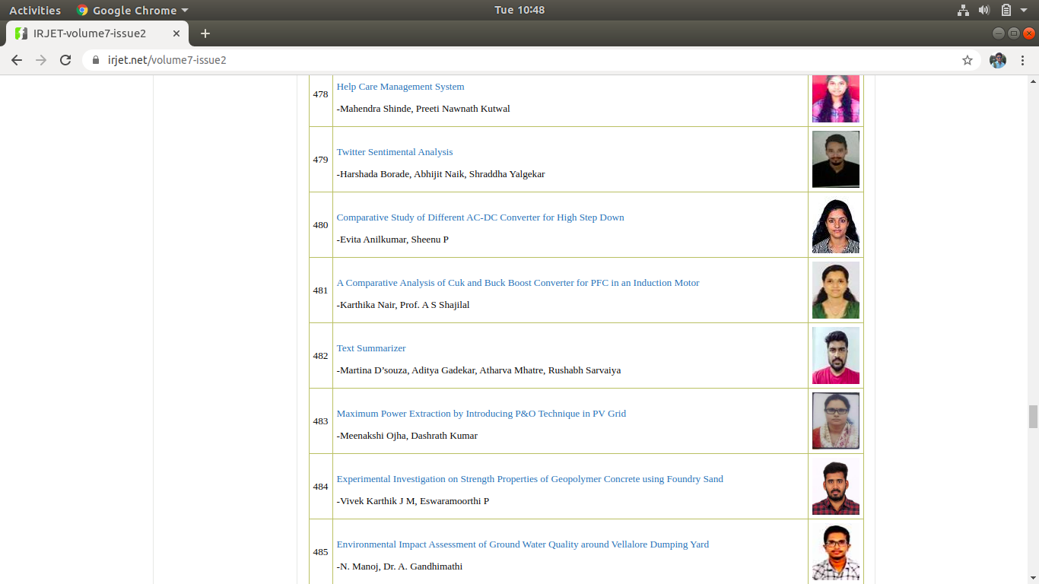
Proof Of Technical Paper Publication.

Slide 12
References
Overview
A. Nenkova, and K. McKeown, "Automatic summarization,". Foundations and Trends in Information Retrieval, 5(2-3):103–233, 2011.
K. Sparck Jones, “Automatic summarizing: factors and directions,”. Advances in Automatic Text Summarization, pp. 1–12, MIT Press, 1998.
Extractive Summarization
R. Mihalcea, and P. Tarau, "Textrank: Bringing order into texts,". In Proceedings of the 2004 Conference on Empirical Methods in Natural Language Processing, 2004.
G. Erkan, and D. R. Radev, "LexRank: graph-based lexical centrality as salience in text summarization,". Journal of Artificial Intelligence Research, v.22 n.1, p.457-479, July 2004.
J. Jagadeesh, P. Pingali, and V. Varma, "Sentence Extraction Based Single Document Summarization", Workshop on Document Summarization, 19th and 20th March, 2005.
P.H. Luhn, "Automatic creation of literature abstracts,". IBM Journal, pages 159-165, 1958.

Slide 13
Abstractive Summarization
M. Banko, V. O. Mittal, and M. J. Witbrock, "Headline Generation Based on Statistical Translation,". In Proceedings of the 38th Annual Meeting on Association for Computational Linguistics, pages 318–325. Association for Computational Linguistics, 2000.
A. M. Rush, S. Chopra, and J. Weston, "A Neural Attention Model for Abstractive Sentence Summarization,". In EMNLP, 2015.
Combination
A. See, P. J. Liu, and C. D. Manning, "Get to the point: Summarization with pointergenerator networks,". In ACL, 2017.
N. Weber, L. Shekhar, N. Balasubramanian, and K. Cho, "Controlling Decoding for More Abstractive Summaries with Copy-Based Networks,". arXiv preprint arXiv:1803.07038, 2018.

