Slide 1

Phishing
Awareness
Training

Slide 2
What Is Phishing?
Phishing is a cyberattack where attackers trick people into revealing sensitive information such as:
Passwords
Credit card numbers
Bank details
Company credentials
Attackers usually pretend to be trusted organizations (banks, IT support, delivery services, managers).

Slide 3
Types of Phishing Attacks
Email Phishing
Spear Phishing
Whaling
Smishing
Vishing

Slide 4
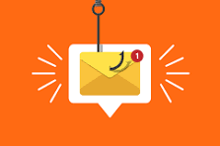
Email Phishing
Fake emails asking you to click links or open attachments.

Slide 5
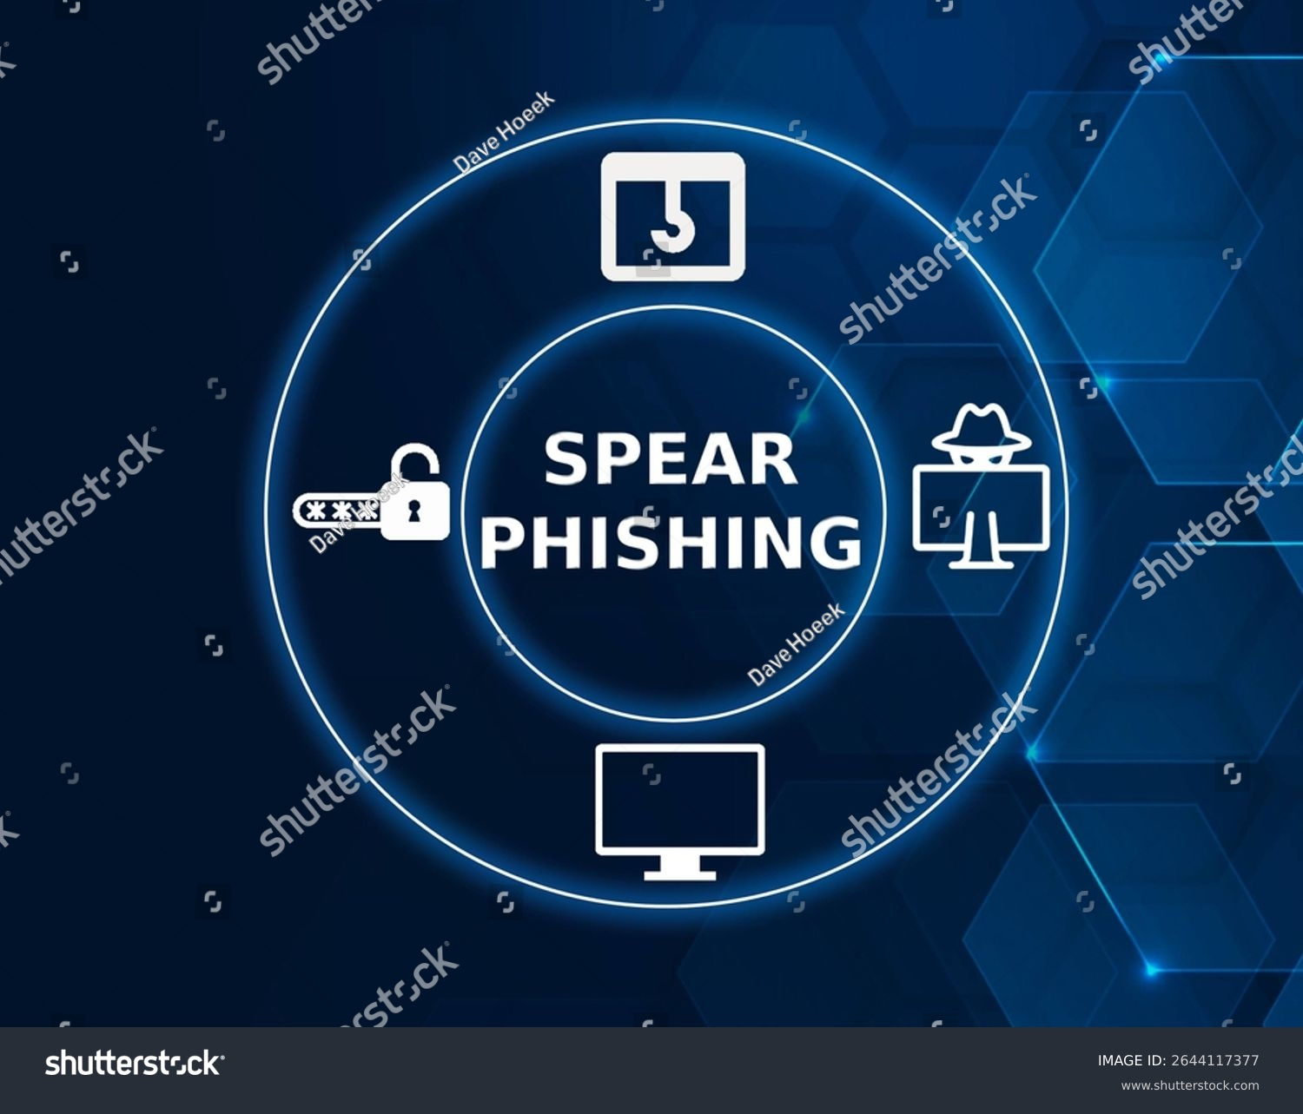
Spear Phishing
Targeted attacks aimed at specific individuals or departments.

Slide 6
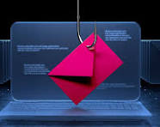
Whaling
Phishing attacks targeting executives or senior management.

Slide 7
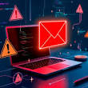
Smishing
Phishing via SMS is done

Slide 8

Vishing
Phishing via phone calls

Slide 9
How to Recognize Phishing Emails and Fake Websites
1. Sender Email Address Inspection
Attackers often spoof or slightly modify email addresses.
Warning Signs:
Misspelled domains
  Example: support@paypa1.com instead of support@paypal.com
Extra characters or unusual domains
  Example: @paypal-security.co or @secure-paypal.net
Display name looks correct but email address is fake
Tip: Always check the full email address, not just the display name.

Slide 10
2. Urgent, Threatening, or Emotional Language
Phishers create panic to stop you from thinking.
Examples:
“Your account will be locked in 24 hours”
“Immediate action required”
“Suspicious activity detected”
Real companies give notice and don’t pressure you immediately.
3. Generic or Unusual Greetings
Legitimate companies usually address you by name.
🚩 Red Flags:
“Dear Customer”
“Dear User”

Slide 11
Social Engineering Tactics Used by Attackers
Social engineering is the practice of manipulating people into giving up confidential information or performing actions that compromise security. Instead of hacking systems, attackers hack human behavior.

Slide 12
1. Authority
Attackers pretend to be someone in a position of power.
How It Works:
Impersonating managers, CEOs, IT staff, or government officials
Using job titles, signatures, or logos to appear legitimate
Example:
“This is the IT department. Send your login credentials immediately to avoid account suspension.”
Why It Works: People are conditioned to obey authority figures.
2. Urgency
Attackers create time pressure to force quick decisions.
How It Works:
Threats of account suspension

Slide 13
Example:
“Your account will be locked in 30 minutes if you don’t respond.”
Why It Works: Panic reduces critical thinking.
3. Fear and Intimidation
Attackers scare victims into compliance.
How It Works:
Claiming suspicious activity
Fake security alerts or legal threats
Example:
“We detected illegal activity on your account. Immediate action required.”
Why It Works: Fear triggers impulsive reactions.

Slide 14
4. Scarcity
Attackers create a sense of limited availability.
How It Works:
Limited-time deals
Threats of losing access or benefits
Example:
“Only 2 hours left to secure your account.”
Why It Works: Scarcity increases perceived value and urgency.
5. Impersonation
Attackers pretend to be someone legitimate.

Slide 15
How It Works:
Using fake email addresses, phone numbers, or websites
Spoofing caller ID or company branding
Example:
“This is your bank’s fraud department.”
Why It Works: Visual and verbal cues create credibility.
6. Pretexting
Attackers create a believable story to extract information.
How It Works:
Fake scenarios (audits, emergencies, troubleshooting)
Gradual information gathering
Example:
“I’m a vendor doing a system check. Can you confirm your .

Slide 16
Best practices and tips to avoid falling victim in detail
1. Think Before You Click
Attackers rely on quick, emotional reactions.
Best Practices:
Pause and analyze every unexpected message
Be suspicious of urgent or threatening language
Ask yourself: Was I expecting this message?
Slowing down is one of the strongest defenses.
2. Verify the Sender’s Identity
Never trust an email or message at face value.

Slide 17
Best Practices:
Check the full email address, not just the display name
Verify requests by contacting the sender through a known, official channel
Be cautious of emails from external or unfamiliar domains
Internal requests for sensitive data should always be verified.
3. Never Share Sensitive Information
Legitimate organizations will never ask for this data via email or phone.

Slide 18
Never Share:
Passwords
One-time passwords (OTP)
PINs
Full credit card or bank details
Security question answers
If someone asks for these, it’s a scam.
4. Use Strong, Unique Passwords
Weak or reused passwords increase risk.

Slide 19
Best Practices:
Use long passwords (12–16 characters minimum)
Combine uppercase, lowercase, numbers, and symbols
Never reuse passwords across multiple accounts
Use a reputable password manager
One compromised password should not expose all accounts.

Slide 20
Real-world phishing examples
Example 1. Fake Bank Alert Email
Email Subject: Urgent: Unusual Activity Detected
Message Content:
“We detected suspicious activity on your account. Please click the link below to verify your identity or your account will be suspended.”
Link: https://secure-bankverify-login.com
Red Flags:
Urgent and threatening language
Suspicious link domain
Request to verify sensitive information
Correct Action: Do not click. Visit the bank’s official website manually or call customer support.

Slide 21
Example 2: CEO Fraud (Business Email Compromise)
Email From: “CEO Name” (spoofed address)
Message Content:
“I’m in a meeting. Need you to urgently purchase gift cards and send me the codes.”
Red Flags:
Urgent request
Unusual payment method
Request for secrecy
Authority pressure
Correct Action: Verify through a phone call or internal messaging system.

Slide 22
Example 3: Fake Delivery Notification
Email Subject: Your Package Is On Hold
Message Content:
“Your package could not be delivered. Open the attached invoice to reschedule.”
Attachment: Delivery_Invoice.zip
Red Flags:
Unexpected attachment
ZIP file (common malware carrier)
No tracking number or sender verification
Correct Action: Delete the email and track deliveries only through official courier websites.

Slide 23
Interactive Quiz (For Engagement)
Quiz 1: Identify the Phishing Sign
Which of the following is a strong phishing indicator?
A. Personalized email greeting
B. Proper grammar
C. Urgent demand for action
D. Known sender
✅ Correct Answer: C

Slide 24
Quiz 2: Safe or Unsafe?
You receive an email from IT asking you to confirm your password.
A. Safe
B. Unsafe
✅ Correct Answer: B
Explanation: IT will never ask for passwords via email.
Quiz 3: Link Inspection
You hover over a link that shows:
https://paypal.account-security-update.com
Is this legitimate?
A. Yes
B. No
✅ Correct Answer: B
Explanation: The real domain is account-security-update.com, not PayPal.

Slide 25
Quiz 4: What Should You Do?
You accidentally clicked a phishing link but didn’t enter information.
A. Ignore it
B. Restart computer
C. Report to IT/security
D. Forward to friends
✅ Correct Answer: C
Quiz 5: Choose the Best Response
Your “manager” texts you asking for an OTP code urgently.
A. Share the OTP
B. Ask for confirmation via another channel
C. Ignore company policy
D. Respond immediately
✅ Correct Answer: B

Slide 26
Thank You …
By: Rushali Rathod

