Slide 1
MovieMagic: The Streaming Aspect for Cinematography
Presented By:
Rusha Manandhar
BCA 6th Semester

Slide 2
Introduction
The rise of online streaming platforms has revolutionized entertainment.
MovieMagic aims to provide a dynamic and user-friendly movie streaming experience.
Key features: personalized recommendations, multilingual support, optimized search, and offline viewing.
Premium feature: AI chatbot for mood-based recommendations.

Slide 3
Problem Statement
Content overload leads to decision fatigue for users.
Lack of mood-based recommendations in existing platforms.
Inadequate multilingual support & subtitle accuracy.
Limited offline viewing options.
Need for interactive assistance in content discovery.

Slide 4
Objectives
To Develop AI chatbot for personalized, mood-based recommendations.
To Enhance multilingual support with accurate subtitles.
To Enable offline viewing for better accessibility.
To Optimize search functionality for easy content discovery.
To Improve user engagement with interactive features.

Slide 5
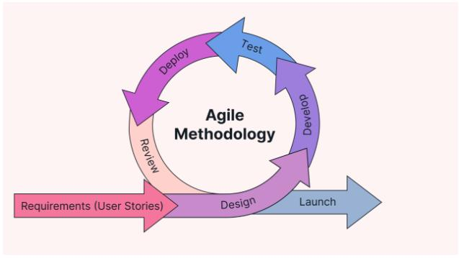
Methodology
Agile Methodology chosen for flexibility and iterative development.

Slide 6
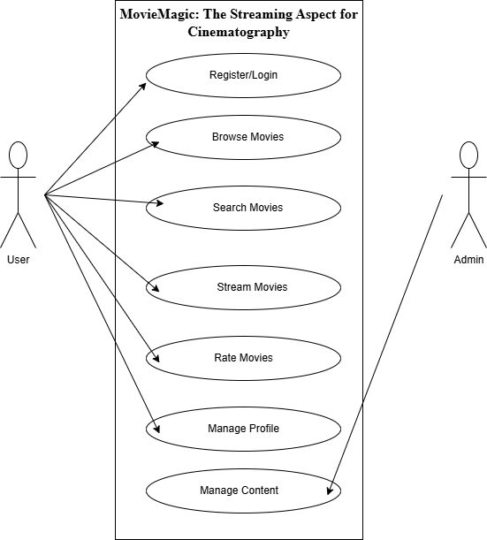
Use-Case Diagram

Slide 7
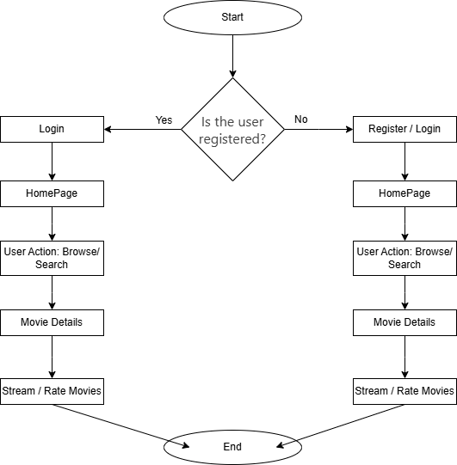
Flow Chart

Slide 8
Algorithm Usage
Collaborative Filtering: Personalized recommendations.
NLP Chatbot: Mood-based suggestions.
Search Optimization: Elasticsearch for quick searches.
DASH Streaming: Adaptive video quality.

Slide 9
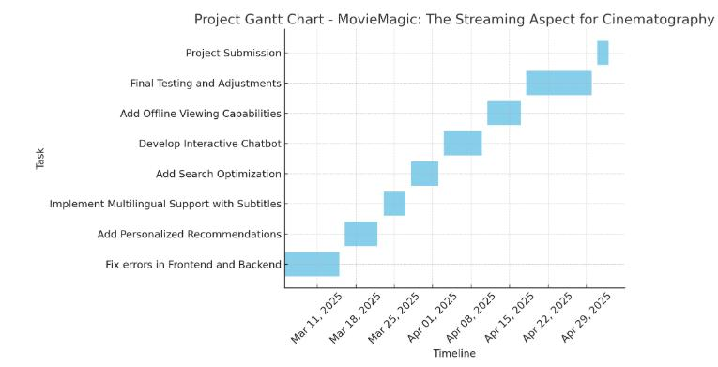
Gantt Chart

Slide 10
Expected Outcomes
A highly personalized and user-friendly streaming platform.
AI chatbot for mood-based recommendations.
Multilingual support to cater to a global audience.
Offline viewing for enhanced accessibility.
Optimized search and content discovery.

Slide 11
THANK YOU Any Queries?

