Slide 1
MovieMagic | Where Every Frame Tells A Story
Presented By:
Jenisha Sthapit
Rusha Manandhar

Slide 2
Introduction
A revolutionary movie streaming platform offering affordability, quality, and accessibility.

Slide 3
Problem Statement
Streaming Quality and Offline Viewing
High Subscription Costs
Advertisements and Interruptions

Slide 4
Objectives:
Enhance user experience with personalized recommendations, HD streaming, offline access, community engagement, and data security.

Slide 5
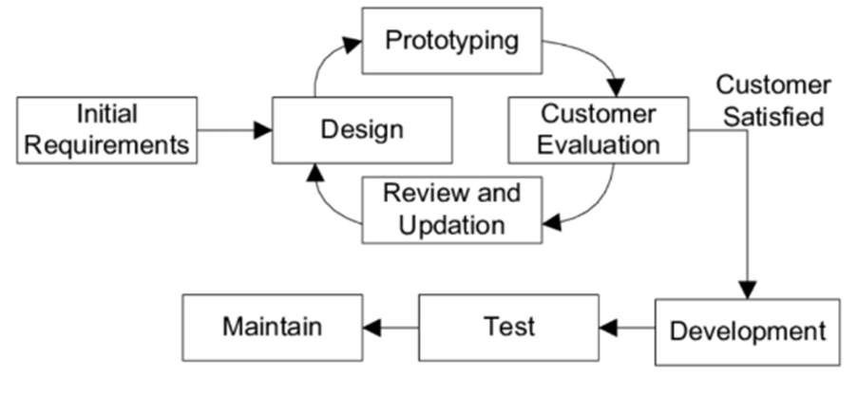
Methodology:
Fig 1: Prototyping Model

Slide 6
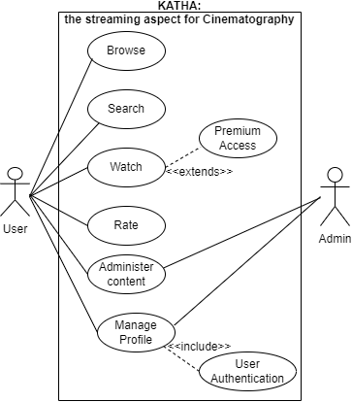
Use Case:
Fig 2: Use Case Diagram of MovieMagic

Slide 7
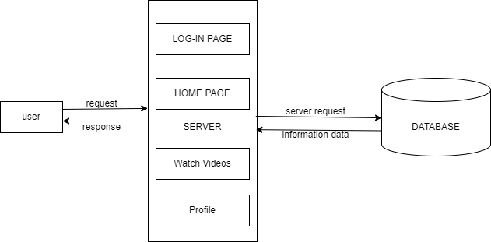
Architectural Diagram:
Fig 3: Architectural Diagram of MovieMagic

Slide 8
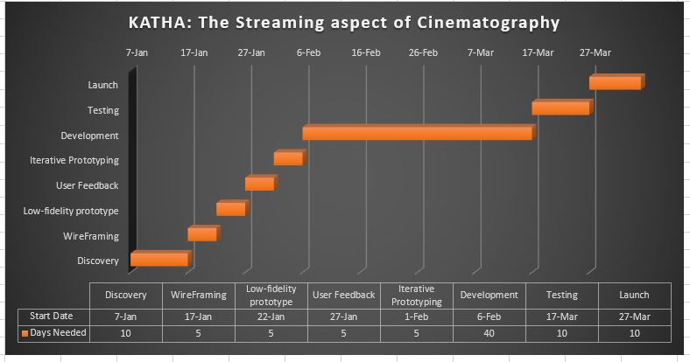
Gantt Chart:
Fig 4: Gantt Chart

Slide 9
Project Status
Login Page
Admin Panel
Home Page
About Page

Slide 10
Future Work
Review Page
Video Playing Page
Personal Recommendations
Offline Viewing

Slide 11
THANK YOU Any Queries?

