Slide 1
MovieMagic: The Streaming Aspect of Cinematgraphy
Presented By:
Rusha Manandhar
6-2-551-178-2021
15th Shrawan, 2082

Slide 2
Introduction
MovieMagic is a smart movie streaming platform that simplifies content discovery through personalized recommendations
It uses a hybrid recommendation system combining content-based and collaborative filtering
Includes location-based trending to suggest popular movies in the user’s area
Fetches real-time movie data from TMDb to ensure accuracy and freshness

Slide 3
Problem Statement
Streaming platforms host thousands of titles, yet users often struggle to find what truly interests them.
Recommendation engines either rely only on viewing history or only on global popularity, ignoring local trends and individual tastes.

Slide 4
Objectives
To develop a movie streaming platform that suggests movies to users by analyzing their watch history and reviews using a combination of content-based and collaborative filtering techniques.
To use the Haversine formula to add location-based features so users can find popular movies that people are watching near them.

Slide 5
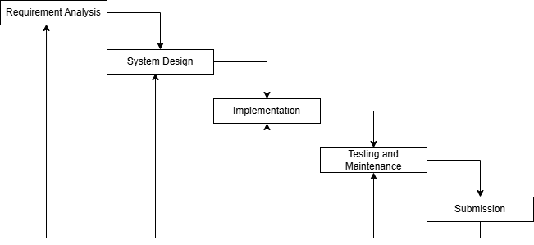
Methodology

Slide 6
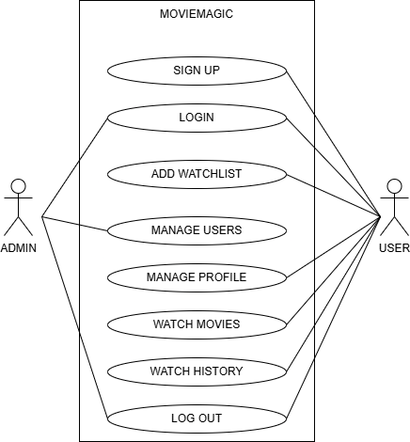
Use-Case Diagram

Slide 7
Technologies Used
Frontend: HTML, CSS, JavaScript
Backend: PHP
Database: MySQL

Slide 8
Algorithm
Content-Based Filtering: Suggests similar movies based on genre, language, actors, etc.
score = 0.7 × (vote_average / 10)
Collaborative Filtering: Suggests based on user behavior and preferences
score = 0.3 × (avg_rating / 5)
Algorithm: Cosine similarity and user ratings

Slide 9
Conclusion
MovieMagic delivers a secure, reliable, and user-friendly streaming experience with features like authentication, personalized recommendations, optimized search, and strong data protection—ensuring both performance and future scalability.

Slide 10
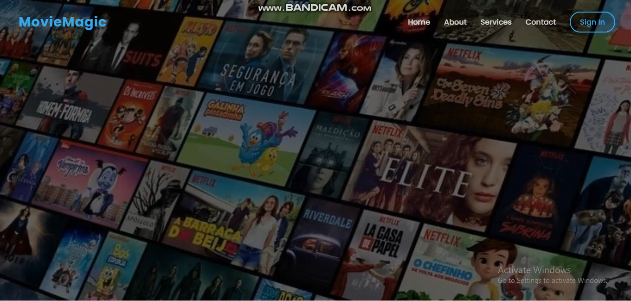
Demo Video

Slide 11
THANK YOU ANY QUERIES?

