Slide 1
MovieMagic: The Streaming Aspect for Cinematography
Presented By:
Rusha Manandhar
BCA 6th Semester

Slide 2
Introduction
The rise of online streaming platforms has revolutionized entertainment.
MovieMagic aims to provide a dynamic and user-friendly movie streaming experience.
Aim: To create a basic movie streaming platform
Focus on content discovery, streaming, and user engagement

Slide 3
Problem Statement
Too many options online make it hard to choose what to watch
Free platforms lack smart suggestions
Users miss relevant and trending content
A need for a simple, engaging movie streaming solution

Slide 4
Objectives
To create a website for streaming movies
Help users find interesting content
Show popular movies and suggest based on genres

Slide 5
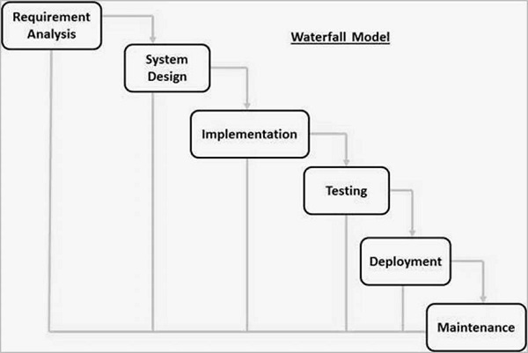
Methodology

Slide 6
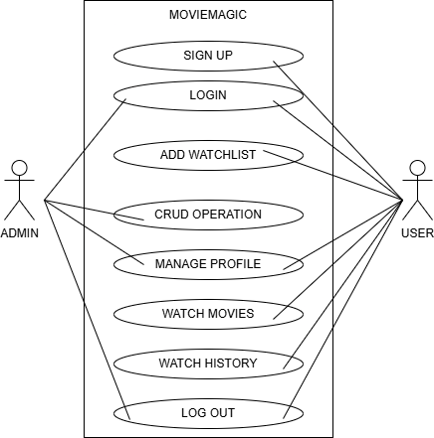
Use-Case Diagram

Slide 7
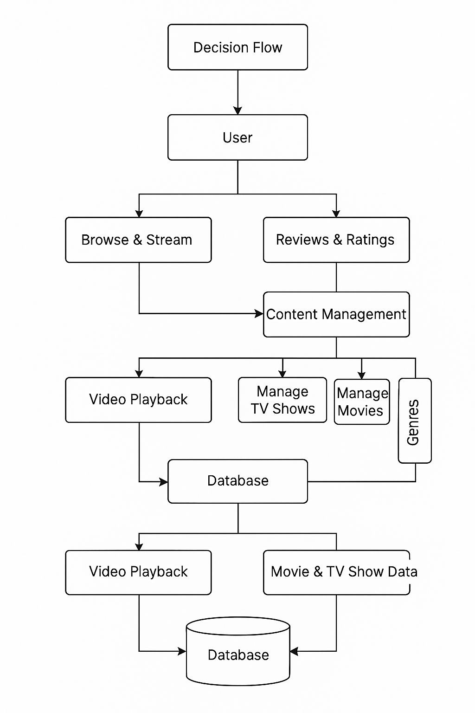
Architectural Design

Slide 8
Algorithm Usage
Collaborative Filtering: Personalized recommendations.

Slide 9
Future Work
API Integration
Algorithm Implimentation

Slide 10
THANK YOU Any Queries?

