Slide 1
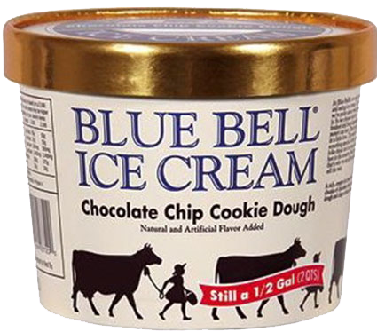

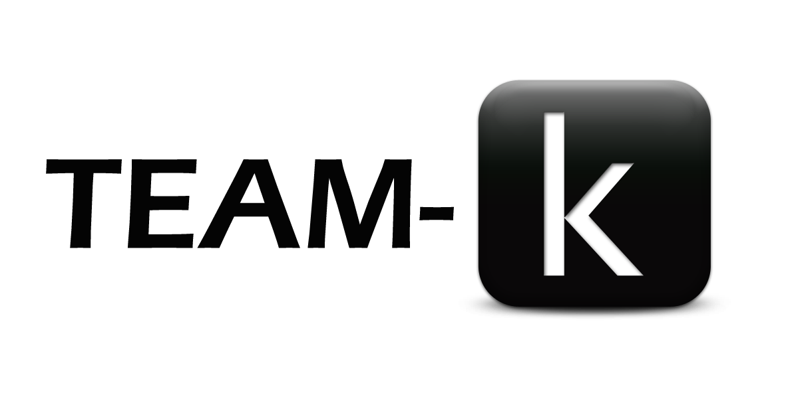
Blue Bell Ice-Cream Recall Analysis

Slide 2
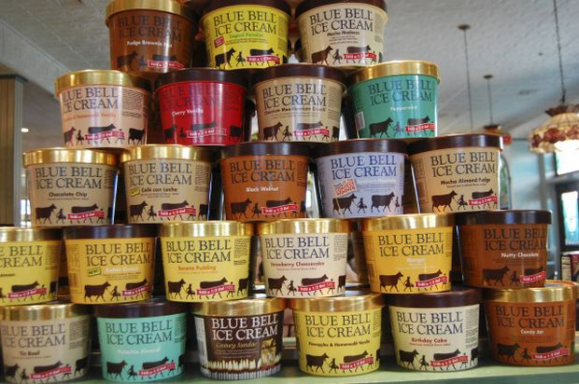
Group Members
Rushan Shakya
Tahrima Mustafa

Slide 3
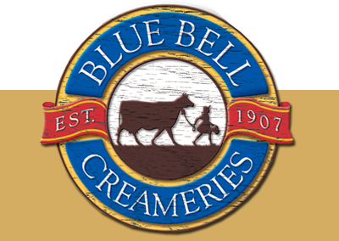
Brief History about the Blue Bell Brand
Based in Brenham, Texas
First opened in 1907
Forbes (2015), worth $1.66 billion
Most popular ice cream brand in the US south
3rd largest ice cream maker in the US

Slide 4
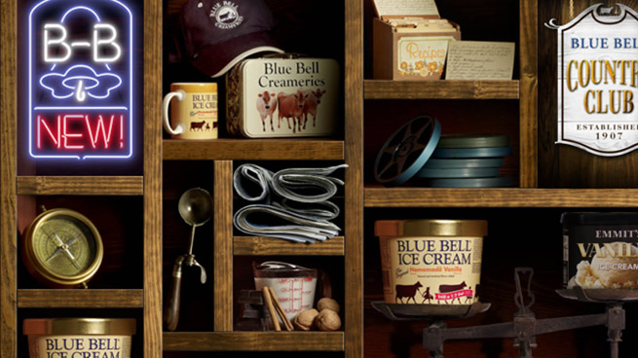
Contents
Introduction
Data Cleansing Process
Graphical Analysis for the Recall
Conclusion
Q & A

Slide 5
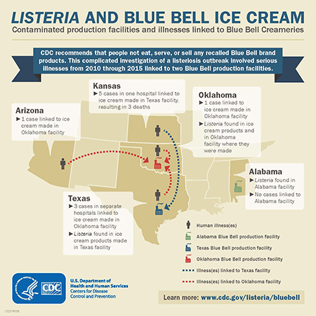
Introduction

Slide 6
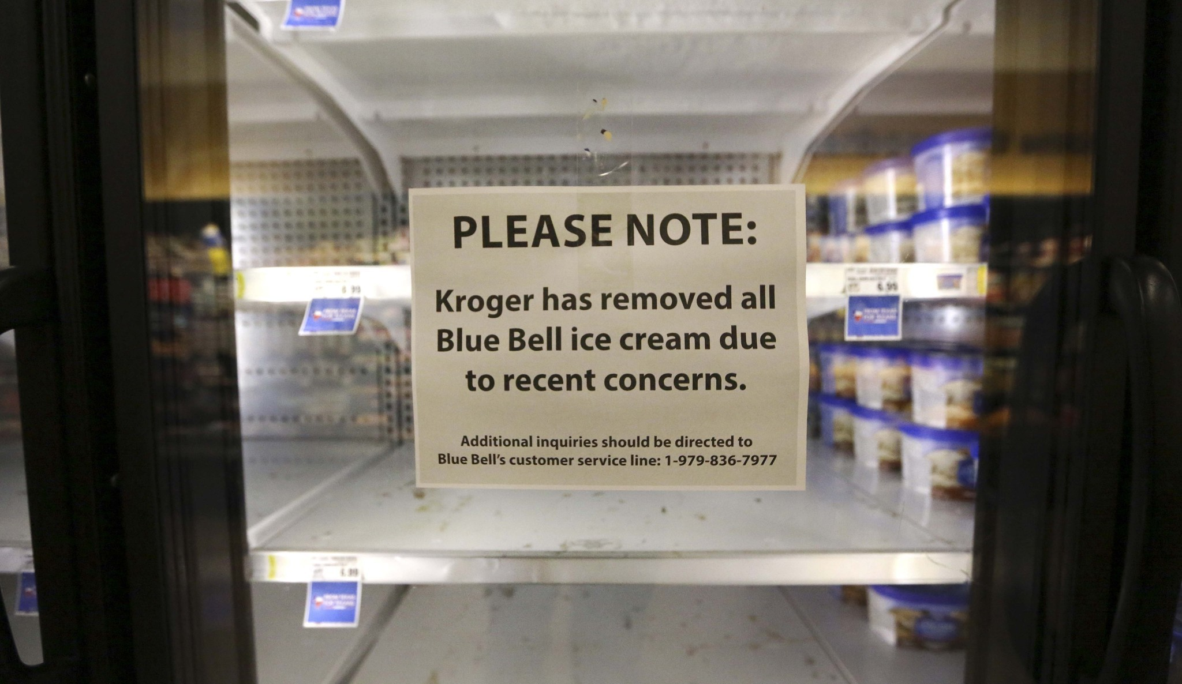
Introduction
So what happened??
Listeria caused deaths reported in OK
Multistate listeria investigation
April 20, 2015 – voluntary recall
Closed down for 4 months
Reopened in August, 2015
What we want to do?
What happened to Blue Bell sales after recall?
Did other ice cream brands take Blue Bell’s market share?
Did Blue Bell recall affect the sales of other ice creams?

Slide 7
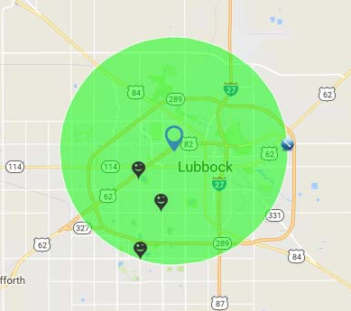
Introduction
Sources of Data:
3 grocery stores in LBK
5 mile radius from RCOBA
Daily transaction records
Data collected from September 2014 to August 2016
24 months of data

Slide 8
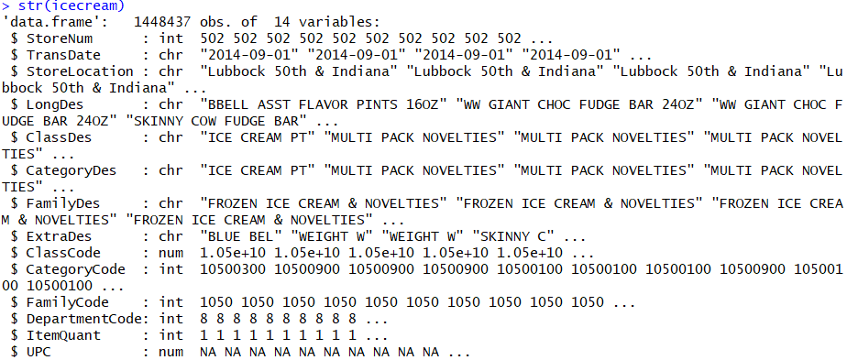
Data Cleansing Process
Raw Data: icecream.csv
Fig: R- output for ice-cream data frame structure

Slide 9
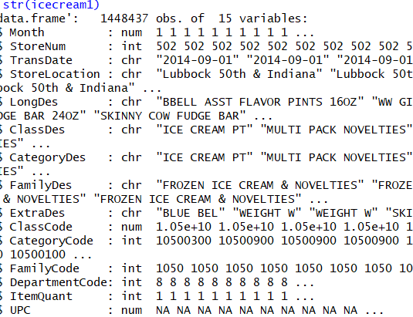
Data Cleansing Process
Data: icecream1 (Added the Month column based on Transaction Date)

Slide 10
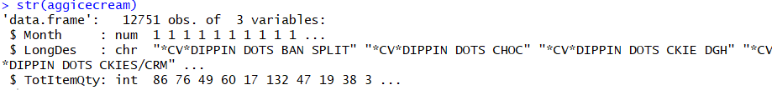
Data Cleansing Process
Data: aggicecream
Grouped icecream1 according to Month and LongDes, and summed up the Item sold quantity as TotItemQty.

Slide 11
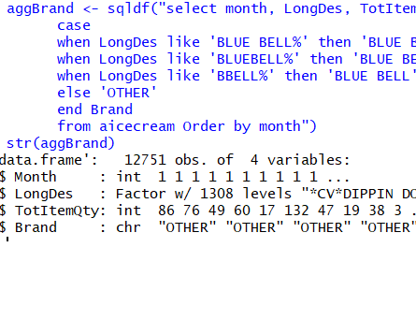
Data Cleansing Process
Data: aggBrand
Added a column to differentiate Blue Bell and other ice cream brands

Slide 12
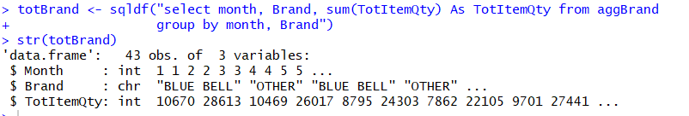
Data Preprocessing
Data: totBrand
Aggregated the aggBrand data by grouping it by Month and Brand while summing up the Item Quantity sold.
Divided the 24 months’ data into 3 periods:
Pre-recall Period: first 7 months
Recall Period: 8th to 15th month
Post-recall Period: 16th to 24th month

Slide 13
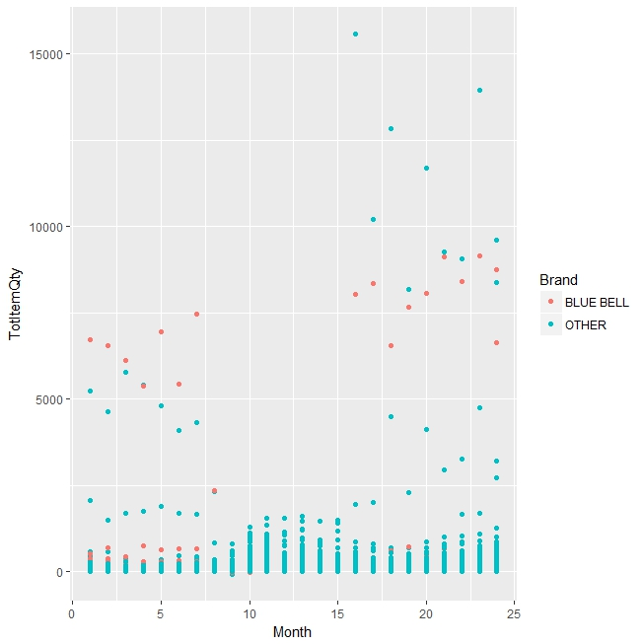
Graphical Analysis for the Recall
Scattered plot
Shows the sales of each ice cream products.
Blue Bell products not seen in the middle months
Prior and post recall, some blue bell ice creams sold really well.

Slide 14
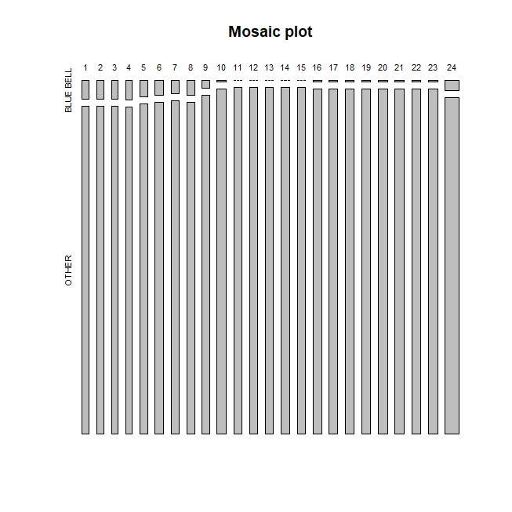
Graphical Analysis for the Recall
Mosaic Plot
Shows the total number of products in 3 study stores over the 2 year period.
Most Blue Bell products were removed from the stores in middle months
Number of Blue Bell Products gradually increased after the recall.

Slide 15
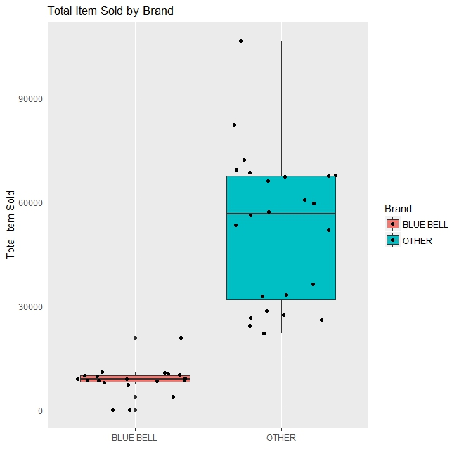
Graphical Analysis for the Recall
Box Plot
Show if the Data has any outliers
Shows the skewness of our data

Slide 16
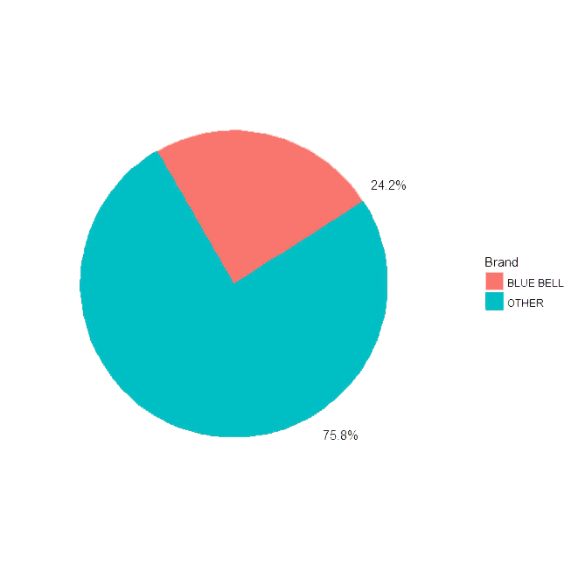
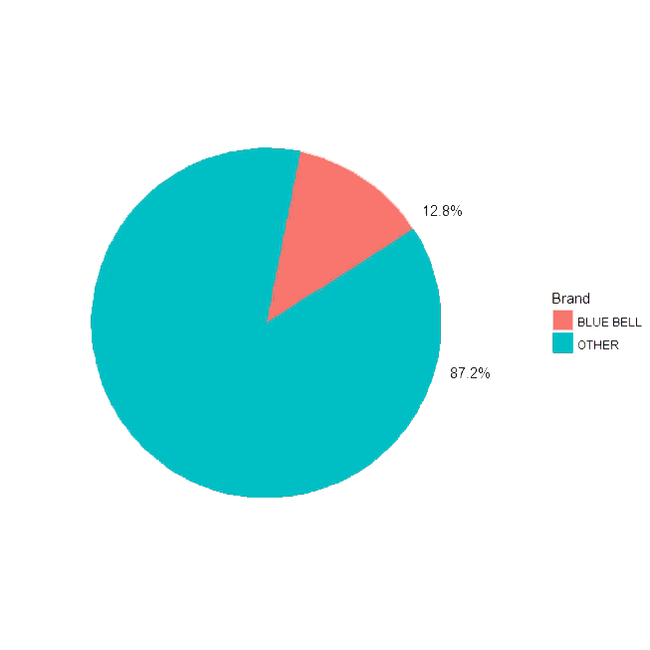
Graphical Analysis for the Recall
Blue Bell Market-Share Pre-Recall
Blue Bell Market Share Post-Recall

Slide 17
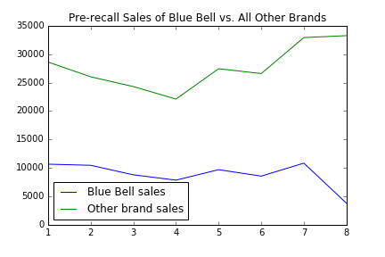
Graphical Analysis for the Recall
Pre-recall period: Sept ‘14 till April ’15
Sales volume is decreasing towards the end

Slide 18
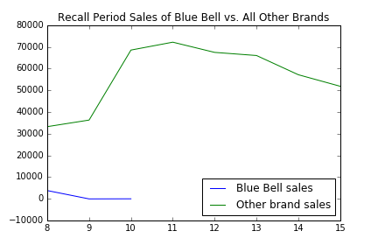
Graphical Analysis for the Recall
Recall Started: April 20, ‘15
Total Shutdown: August ‘15 till December ’15
Partial recall was made at the beginning of the period

Slide 19
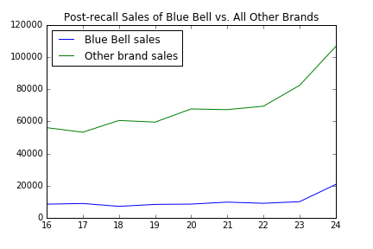
Graphical Analysis for the Recall
Post-recall period: January ‘16 till August ‘16
The sales of Blue Bell spiked up a little bit towards the end

Slide 20
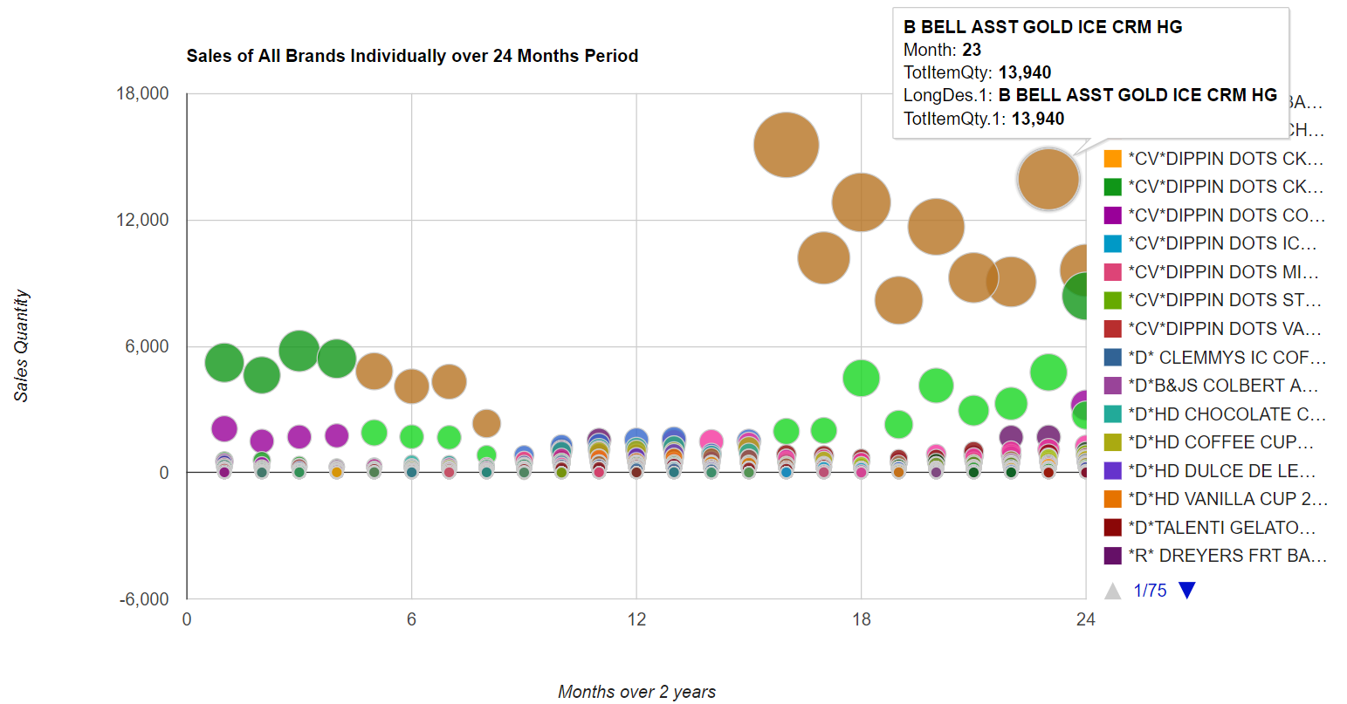
Graphical Analysis for the Recall

Slide 21
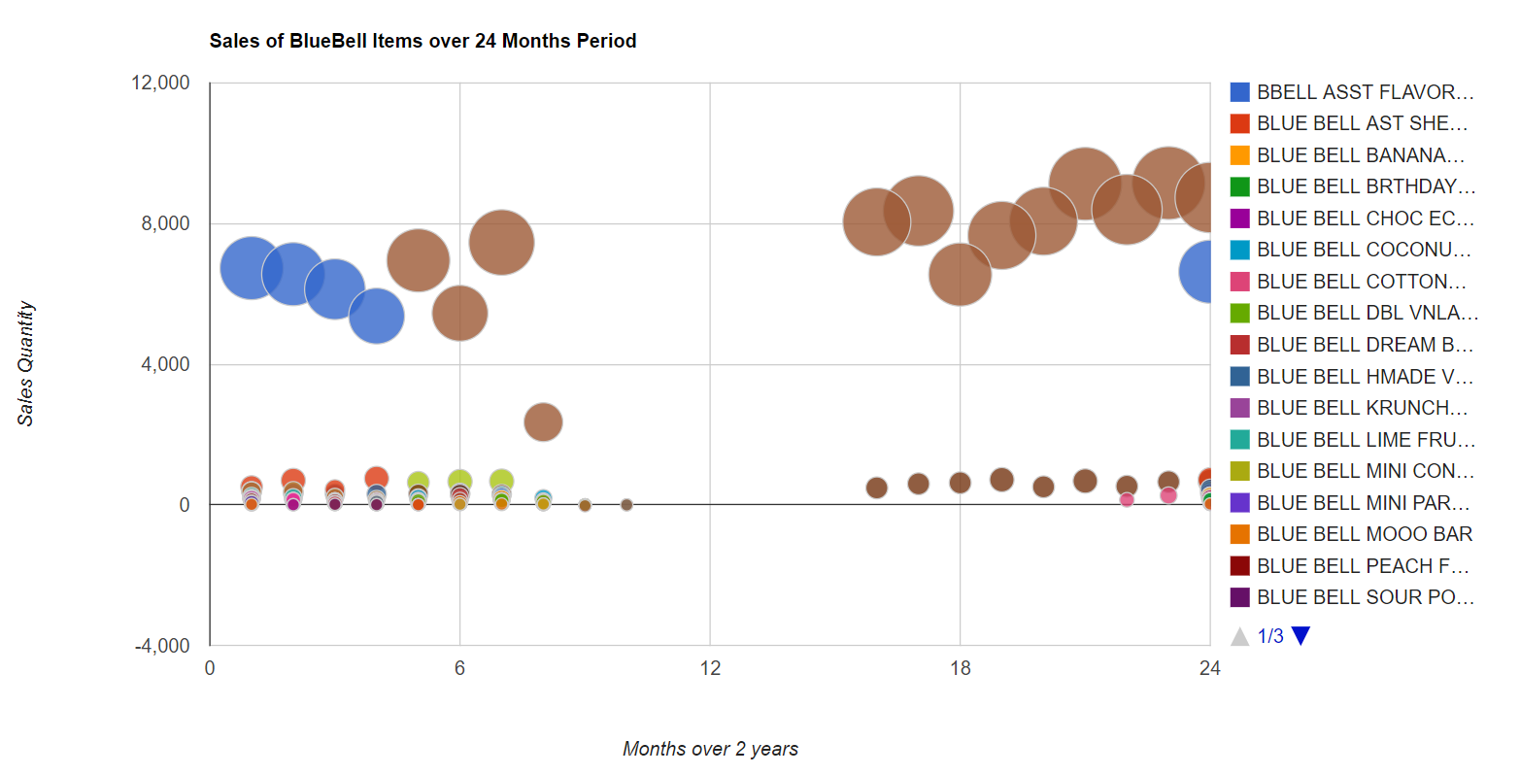
Graphical Analysis for the Recall

Slide 22
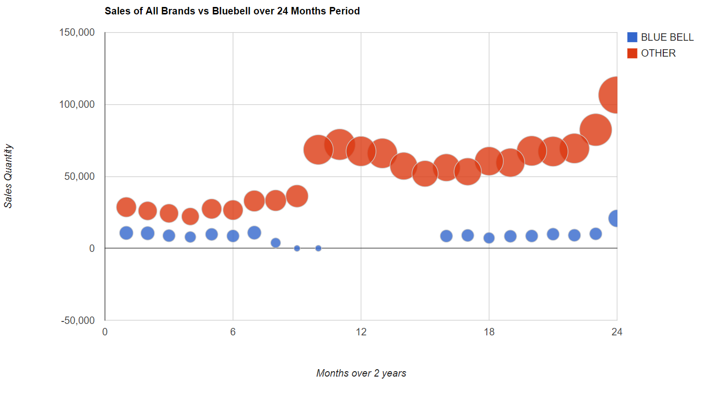
Graphical Analysis for the Recall

Slide 23
Review of Main Points
Blue Bell had a massive recall due to Listeria concerns
The effect the recall had in the Blue Bell brand
Sale of other ice cream brands during recall
Sale of Blue bell ice cream brands after recall
What happened to Blue bell’s market share?

Slide 24
Conclusion
Sales on Blue Bell products decreased after the Listeria incident
Sales of other brands in recall period became high
In post-recall period the sales of Blue Bell is slightly low than before
The Listeria incident has an effect on Blue Bell brand market share which decreased by approximately 12% post-recall period

Slide 25
Any Questions???

