Slide 1



HackIllinois 2021
Caterpillar Challenge
By Eyasu, Gabe, Om, Rushat, Bassel

Slide 2

Team Members
Gabe - Freshman CE student at College of DuPage
Om - Sophomore Eng. Student at UIUC
Rushat - Junior CS student at NIT Allahabad
Eyasu - Senior CS student at Temple U.
Bassel - MEng ECE at UIUC

Slide 3
Project Objectives
Objectives:
Imagine you are national fleet manager:
Network of assets too big to optimize individually
Green Fleet will help a national fleet manager by:
Identifying which parts of the fleet are underperforming
Provide an in-depth interactive model of fleet fuel consumption as a web service

Slide 4
Workflow Components
Back-end Development:
Used Python Pandas and Jupyter Notebooks to read data and find trends.
Used ML models to categorize data through k-means clustering and aggregation algorithms.
Deployed on Heroku Cloud platform as a web-service
Digital Ocean spaces as data lake
Front-end Development:
Used CSS for application layout and styling
Used Plotly Dash framework for graph rendering

Slide 5

Video Demonstration!

Slide 6
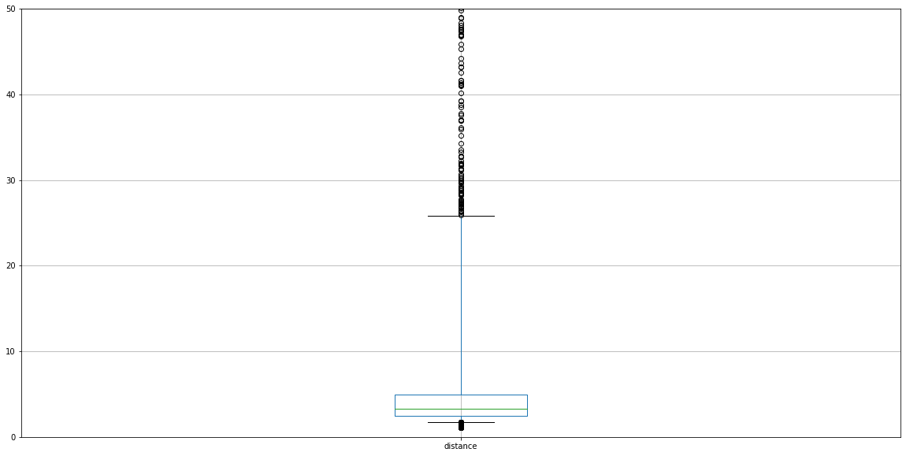
Miles
Distance

