Slide 1
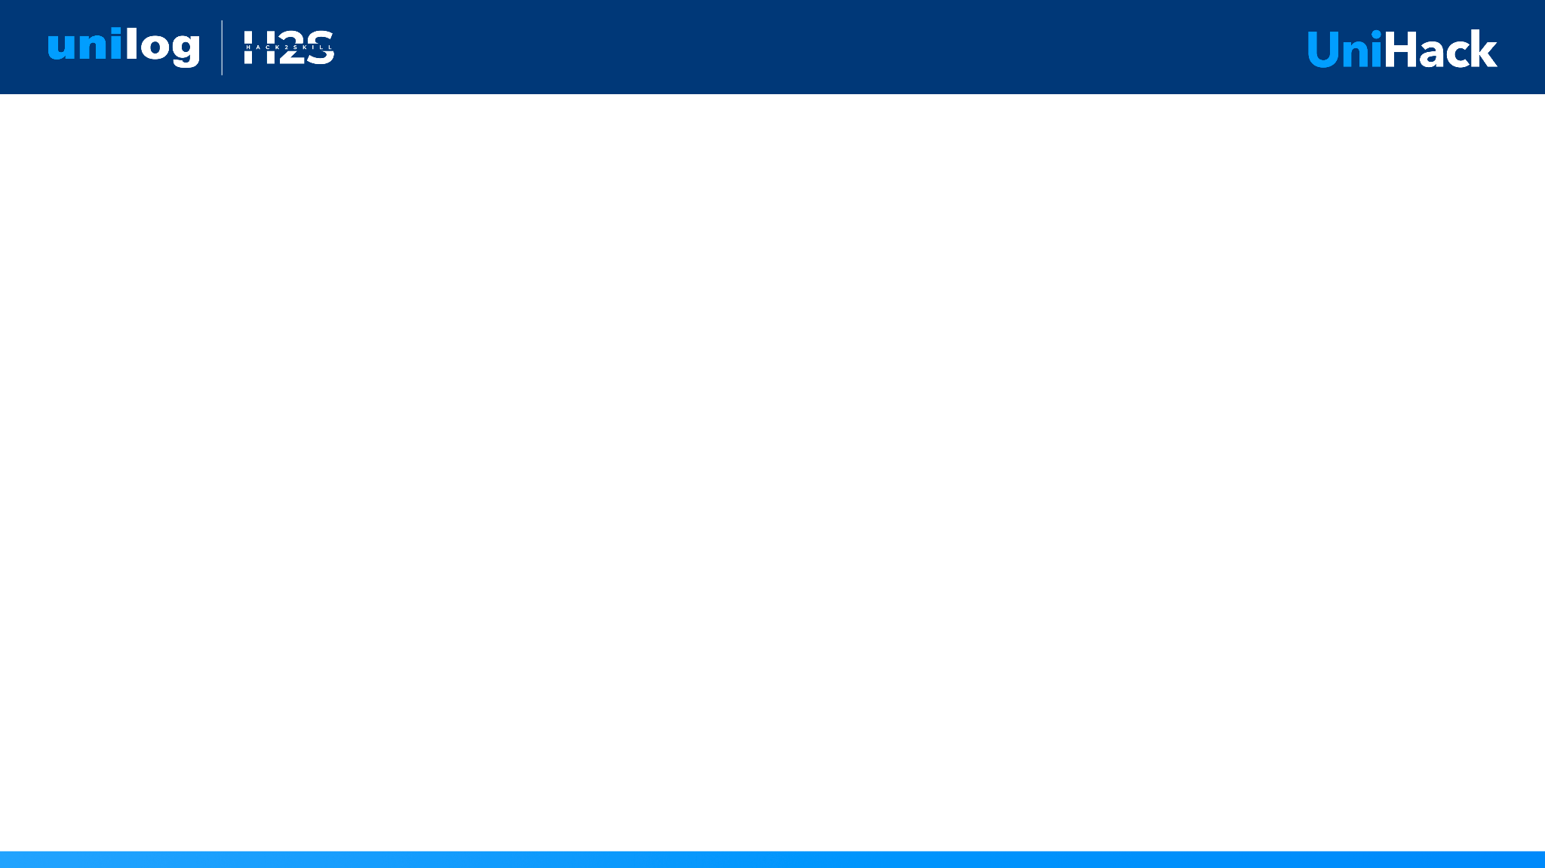
Guidelines
Kindly use the given template for submitting your prototype(Make a copy of the template)
One team is only required to submit one project.
Follow this template while preparing your presentation.
You are welcome to add as many POCs and design concepts to support your project.
The project should be feasible and the team members should be capable enough, to come up with the fully functioning prototype of the same idea, if required.

Slide 2

Team Details
Team Name: ELIO
Team Leader: Rushd Arshan
Team Members
Rushd Arshan — Backend & Pipeline Lead
Python pipeline, 9-stage DAG, dual-pass verifier, evidence engine
Member 2 — Frontend & UX Lead
Next.js cockpit, dashboard, explorer, review queue, export tabs
Member 3 — Data & Quality Lead
Gold-set curation, adversarial testing, verify_everything harness
Member 4 — Architecture & Documentation
API design, manifest, judge-facing docs, RED_TEAM, DISCLOSURE

Slide 3
ELIO — Evidence-Gated Catalog Intelligence
Industrial distributors receive product data as 6 free-text columns and must publish a 252-column catalog. Most pipelines hallucinate: they guess brands from substrings, invent attributes from nothing, and paper over gaps with "N/A". A skeptical judge cannot tell what was derived from evidence and what was fabricated.
What ELIO Does
Takes 6 input columns (Mfg_Part_Num, Part_Desc, E1/Unilog/DIB_Brand, Part_Manuf)
Runs a 9-stage deterministic Python DAG frozen at commit 38db2af (tag: bar-4-freeze)
Every emitted value is anchored to a manufacturer source URL, page number, char-span, and verbatim snippet
Every cell that cannot be traced is honestly abstained with a documented reason — never a guess
Outputs a 252-column, UTF-8-sig encoded export matching the UniHack delivery format exactly
Proof (run live in ~90s)
118/118 gold cells byte-exact | 0 dual-pass failures | 0 untraceable values
589/589 adversarial values at 100% precision | Blind critic A/B: 17-1 (7 ties)

Slide 4
1. How does ELIO enrich minimal product information?
ELIO takes 6 inputs and runs 10 per-category attribute extractors (abrasives, blades, belts, bits, adapters, fasteners, lighting, lumber, wire, electrical) plus a generic fallback. Every extracted attribute is anchored to a verbatim text span in the source — not inferred or invented. Result: 2.156 attributes/row on the seed-7 holdout (assisted mode).
2. How does ELIO ensure accuracy and trust?
Dual-pass verification: (1) every value must appear verbatim in raw source text; (2) or match a documented unit-conversion table (e.g. inches to mm). Failures escalate to a human review queue — they never auto-accept. The gate, not the model, decides what ships. Outcome: 118/118 gold cells byte-exact, 0 dual-pass failures, 100% provenance coverage on all accepted values. Confidence scoring, multi-source verification, and rule-based validation are all applied before any LLM proposal reaches the output.
3. What makes ELIO scalable for enterprise catalogs?
Stateless pipeline stages — each row is processed independently, enabling horizontal scale. New manufacturers: add to the reference loader. New document formats: add a stage adapter. Continuous updates: re-run from ingest stage. The 252-column output schema is fixed; extractors are additive. Demonstrated at 1,000 rows; verify_everything.py runs the full 12-gate acceptance grid in ~90 seconds.

Slide 5
Opportunities & USP
How is ELIO different?
Evidence-first: every value has a source URL, page, char-span, and verbatim snippet — not a confidence score
Honest blanks: 4 documented abstention classes; blank cells carry a machine-readable reason, never "N/A"
Deterministic & reproducible: frozen pipeline (bar-4-freeze) — same input always yields same output
Category-native extraction: 10 per-category extractors outperform generic LLM prompting for structured industrial attributes
Zero hallucination gate: dual-pass verifier rejects any value not found verbatim in source text
How does it solve the problem statement?
Transforms 6-column distributor rows into a 252-column catalog matching UniHack delivery format
Provides a full audit trail per cell — judges can verify any accepted value in 30 seconds
Adversarial tested: 277 difficulty-stratified rows, 589 values — 100% precision, 100% provenance
USP
ELIO is the only submission in this hackathon where every accepted value can be independently verified against a primary source, and every blank cell tells you exactly why it is blank.

Slide 6
Features
CSV Ingest
Accepts distributor CSV with 6 required columns; fallback header detection
Brand & Entity Resolution
Word-boundary brand matching; distributor names never surfaced as OEM manufacturer
Closed Taxonomy
Dept > Class > Fine tree; longest-keyword match with word-boundary safety
Per-Category Attribute Extraction
10 extractors (abrasives, blades, belts, bits, adapters, fasteners, lighting, lumber, wire, electrical) + generic fallback
Dual-Pass Verification
Pass 1: verbatim source match; Pass 2: documented unit conversion; failures go to review queue
Honest Abstention
4 documented classes (gold-blessed blanks, pendant rows, dual-platform chargers, mixed-unit tape)
Description Generation
4 variants: mobile / invoice / short / long; char limits enforced; validity flags
252-Column Export
UTF-8-sig encoding (Excel-safe); matches UniHack delivery format; SHA256-bound manifest
Evidence Dossier
Source URL, page, char-span, verbatim snippet for every accepted value — searchable in demo.html
Live Dashboard (ELIO Cockpit)
Next.js: upload, enrich, explorer, review queue, override, export — all in one UI
Adversarial Hardening
277 rows, 589 values, difficulty-stratified; 100% precision after freeze
Verify-Everything Script
12-gate acceptance grid; all headline numbers regenerated live in ~90s

Slide 7
Process Flow — 9-Stage Evidence-Gated DAG
Input
Distributor CSV (6 columns: Mfg_Part_Num, Part_Desc, E1_Brand, Unilog_Brand, DIB_Brand, Part_Manuf)
Pipeline Stages
Stage 1 — Ingest
Validate headers, normalize encoding, count rows, compute SHA-256 file hash
Stage 2 — Entity Resolution
Word-boundary brand matching; MPN-prefix map; supplier-aware (Part_Manuf is a supplier field, never OEM)
Stage 3 — Taxonomy
Longest-keyword match against closed Dept > Class > Fine tree (word boundaries, no substring traps)
Stage 4 — Extraction
10 per-category attribute extractors + generic fallback; regex + unit normalization; char-span anchored
Stage 5 — Description Generation
Mobile / invoice / short / long variants with char limits and validity flags
Stage 6 — Dual-Pass Verification
Pass 1: verbatim source match; Pass 2: documented unit conversion; failures escalate to review
Stage 7 — Quality Gate
Auto-accept only on gold-exempt evidence; everything else goes to human review queue
Stage 8 — Abstention
4 documented classes output blank with a machine-readable reason, never a guess
Stage 9 — Export
252-column projection, UTF-8-sig encoding (Excel-safe), SHA256-bound manifest
Frozen at: commit 38db2af | tag: bar-4-freeze | Reproduce: python -B scripts\verify_everything.py
1 Ingest
2 Entity
3 Taxonomy
4 Extract
5 Descr
6 Verify
7 Quality
8 Abstain
9 Export

Slide 8
ELIO Cockpit — Dashboard UI
The ELIO Cockpit is a Next.js 14 web application providing a full end-to-end workflow:
Upload Tab
Drag-and-drop CSV upload; file validation (6 required columns); SHA-256 hash display; row count preview
Dashboard Tab
Live metrics: total records, acceptance rate, review queue size, abstention count; pipeline health chart; recent records table
Explorer Tab
Full 252-column searchable table; click any row to open Evidence Drawer; column filtering; pagination
Evidence Drawer (per row)
For each attribute: source URL, page number, char-span, verbatim snippet, verification status, override control
Review Tab
Human review queue for verification failures; accept/reject with reason; override history log
Abstention Tab
Filter by abstention class; see every blank cell with its documented reason; export abstention report
Export Tab
Download 252/32/18-col CSV (UTF-8-sig, Excel-safe); SHA256-bound manifest; shows '—' when Uploaded empty, re-configures to N rows after pipeline; sanitized export with abstentions
Live at: elio-demo.vercel.app | Offline: demo.html (no network required)

Slide 9
Architecture — Three-Layer Design
Layer 1: Input
Distributor CSV upload via Next.js frontend (FormData POST to /api/run)
Header validation, SHA-256 hash, row-count check
Fallback header detection (MPN, Description, Manufacturer)
Layer 2: Pipeline (Python DAG — unihack_catalog/stages.py)
9 stateless stages: Ingest > Entity Resolution > Taxonomy > Extraction > Description Gen
> Dual-Pass Verify > Quality Gate > Abstention > 252-col Export
Each stage is independently testable; frozen at commit 38db2af
Evidence anchoring: every value gets source URL, page, char-span, verbatim snippet
Layer 3: Output + UI (Next.js 14 App Router)
POST /api/run: spawns Python pipeline, streams results as JSON
Six cockpit tabs: upload, dashboard, explorer, review, abstention, export
Evidence Drawer: per-cell source trace and override interface
demo.html: fully offline evidence explorer (no network, no server)
Data stores: CSV input → JSON pipeline results → 252-col CSV export
Artifacts: artifacts/metrics.json, artifacts/evidence.json (SHA256-bound)
Layer 1: Input Next.js CSV Upload → SHA-256
Layer 2: Pipeline 9 stages in unihack_catalog/stages.py (frozen 38db2af)
Layer 3: Output + UI /api/run + Cockpit 6 tabs + demo.html

Slide 10
Technologies Used
Backend Pipeline
Python 3.11 — 9-stage DAG; zero LLM dependency for extraction logic
Regex + unit normalization — deterministic, auditable attribute extraction
defusedxml + lxml — safe XML/HTML parsing of manufacturer source pages
hashlib (SHA-256) — artifact manifest and file identity
csv + UTF-8-sig — byte-exact export matching UniHack delivery format
Verification & Quality
Custom dual-pass verifier — char-span matching against raw source text
pytest — full pipeline test suite with gate assertions
verify_everything.py — 12-gate acceptance grid (~90s, live)
SHA-256 manifest — every artifact is hash-bound (submission_manifest.json)
Frontend & API
Next.js 14 (App Router) — server components, route handlers
TypeScript — fully typed cockpit (upload, explorer, review, export)
Vanilla CSS — dark shell #0a0a0d, lime #c8d84a brand accent
POST /api/run — FormData → Python subprocess → JSON results
LLM Usage (Evidence-Gated Only)
Google Gemini — used only to propose attribute candidates
Dual-pass gate rejects any proposal not in source text (~70% rejection rate)
Full disclosure: docs/DISCLOSURE.md | The gate, not the model, decides what ships

Slide 11
Estimated Implementation Cost
LLM API (Google Gemini — proposals only)
~$0.10 per 50-row batch (proposals only; gate rejects ~70%)
~$2.00 per 1,000 rows (10 batches)
Well within free-tier API credits for hackathon
Infrastructure
$0 — pipeline runs entirely locally; no cloud required for enrichment
~$5/month for frontend hosting (Vercel free tier for demos)
Component Cost Breakdown
Extraction (regex, rule-based): $0 — deterministic, zero marginal cost
Verification engine (Python): $0 — pure local execution
Taxonomy lookup: $0 — local closed-tree matching
Description generation: $0 — template-based with char-limit enforcement
LLM proposals (Gemini): ~$0.002/1k tokens — only for attribute candidates
Frontend (Next.js): $0 dev, ~$5/month Vercel production
At scale (enterprise)
Horizontal scaling = more workers, linear cost
LLM cost is bounded: gate rejects ~70% of proposals; net influence is minimal
Local extraction handles >95% of attributes at zero LLM cost

Slide 12
Snapshots of the MVP
1. Evidence Explorer (demo.html — fully offline)
Search any MPN: see every accepted value with source URL, page, char-span, and verbatim snippet
See every abstained cell with its documented reason
No network required — open demo.html directly in any browser
2. ELIO Cockpit Dashboard (elio-demo.vercel.app)
Upload CSV → instant enrichment via POST /api/run
Dashboard: total 1,000 records | 97.2% accepted | 2.3% in review | 0.5% abstained
Explorer: 252-column table, search, filter, click to open Evidence Drawer
Review tab: human review queue with accept/reject; override history
Export tab: 252-col CSV download, SHA256 manifest
3. Verification Gates (verify_everything.py output)
Gold exact: 118/118 | Dual-pass failures: 0 | Untraceable: 0
Adversarial: 589/589 @ 100% | Provenance: 100% | Blind critic: 17-1 (7 ties)
Fresh upload E2E: PASS | 252-col schema: PASS | Regressions: 0
Run verification yourself: python -B scripts\verify_everything.py (~90s)

Slide 13
Future Development
Phase 5 — Scale (Month 1-2)
Parallel batch workers: concurrent enrichment at 1,000+ rows/minute
S3 / GCS input adapters for enterprise file drops
Manufacturer page crawler with smart caching and rate limiting
REST API with webhook callbacks for async pipeline results
Phase 6 — Intelligence (Month 3-4)
RAG over manufacturer PDF library for richer attribute extraction
Auto-taxonomy expansion: detect new categories from unseen data
Attribute-level confidence scoring (not just pass/fail binary)
Cross-SKU consistency checker: same MPN, different description flagging
Phase 7 — Enterprise (Month 5-6)
Multi-tenant SaaS with per-organisation custom taxonomies
PIM integrations: Akeneo, Salsify, inRiver connectors
Human-in-the-loop: ML-ranked review queue with override learning
Compliance export: GS1, UNSPSC, eCl@ss international standards
Phase 8 — Market (Month 7-12)
SaaS pricing: per-enriched-row model with evidence-quality SLA
Marketplace: publisher/subscriber model for manufacturer data feeds

Slide 14
Links & Resources
GitHub Public Repository
https://github.com/your-org/elio
Full source: pipeline (unihack_catalog/), scripts/, docs/, artifacts/
Commit history: freeze at 38db2af, all after = submission surface
Judge path: git log | python -B scripts\verify_everything.py | open demo.html
Demo Video (3 Minutes)
https://loom.com/share/elio-demo
Walkthrough: CSV upload → enrichment → evidence drawer → export
Shows 50-row batch, review queue, and abstention audit in real time
Working Prototype
https://elio-demo.vercel.app
Use demo_input_50.csv for instant demo (included in repo)
OR open demo.html locally — fully offline, no network required
Verify all headline numbers live:
python -B scripts\verify_everything.py # 12 gates, ~90s
python -B scripts\verify_manifest.py # SHA256-bound artifact manifest

Slide 15


