Slide 1

Guidelines
Kindly use the given template for submitting your prototype(Make a copy of the template)
One team is only required to submit one project.
Follow this template while preparing your presentation.
You are welcome to add as many POCs and design concepts to support your project.
The project should be feasible and the team members should be capable enough, to come up with the fully functioning prototype of the same idea, if required.

Slide 2

Team Details
Team Name: ELIO
Team Leader: Darshan K (rushdarshan@gmail.com)
Challenge Statement: AI-Powered Product Intelligence for Industrial Commerce
Solution Name: ELIO — Evidence-Gated Catalog Intelligence & Syndication Engine

Slide 3
Brief About Your Solution
ELIO — Immutable, Falsifiable Product Intelligence for Industrial Commerce
The Core Problem: Industrial distributor feeds arrive with messy, truncated descriptions, placeholder brands ('-- Unbranded --'), non-standard units ('inches' vs 'in'), and unpopulated attribute columns.
The ELIO Solution: A deterministic 9-stage DAG that transforms raw 6-column distributor rows into verified 252-column product catalog records with 100% provenance coverage.
Zero-Hallucination Dual-Pass Gate: Every emitted attribute is anchored to verbatim character offset spans in manufacturer documentation. If evidence is missing, ELIO honestly refuses rather than fabricating guesses.
Enterprise Provenance & Replay: Generates cryptographic execution receipts (rcpt_<sha256>) and append-only decision logs (decision_log.jsonl) enabling 100% byte-identical state replay across audits.

Slide 4
Enrichment, Accuracy & Enterprise Scalability
1. Minimal Info Enrichment: The 9-stage DAG transforms minimal inputs (MPN, Description, Manufacturer) into verified taxonomy classification, normalized attribute sets, and a Universal 5-Variant Description Pack (Invoice, Mobile, Short, Long, Marketing).
2. Accuracy & Trust Strategy: Dual-Pass Verification Gate validates candidate values against verbatim source text or approved 63-entry fraction tables. Employs 4 honest abstention classes when evidence fails.
3. Human-in-the-Loop Governance: Interactive Review Queue allows 1-click Accept/Reject and local overrides, logged to an immutable event-sourced decision stream for audit compliance.
4. Enterprise Catalog Scalability: Processes 1,000 catalog rows in 1.70s (588.2 rows/sec local deterministic throughput) with zero GPU cost and 100% 252-column schema conformity.

Slide 5
Opportunities & Unique Selling Proposition (USP)
How ELIO Differs from Existing Tools: Traditional PIMs require slow, manual data entry; generic LLMs hallucinate critical engineering tolerances and part specs. ELIO combines deterministic speed with evidence-gated verification.
Solving the Unilog Challenge Statement: Automates Unilog Content Guidelines across 89 UOM categories, 27,000+ brand entities, 161,000+ List of Values rules, and the strict 252-column delivery sequence.
Core USP — Falsifiable AI: 'If an attribute value cannot be proven with verbatim source evidence, ELIO refuses to guess.' Honest, transparent abstentions over confident hallucinations.

Slide 6
Key Features Offered by ELIO
1. 9-Stage Evidence-Gated DAG: Ingest, entity resolution, taxonomy, retrieval, extraction, dual-pass verification, quality gate, 5-variant descriptions, and 252-column projection.
2. Master UOM & Trade Fraction Normalizer: Strict compliance with ~500 approved abbreviations across 89 physical dimensions, with exact fraction mapping (e.g., 50.25 in -> 50-1/4 in).
3. Universal 5-Variant Description Engine: Constructs Invoice (<=40 char, CAPS), Mobile (60-80 char), Short (Brand+Series+MPN+Type), Long, and Marketing descriptions strictly from verified facts.
4. Interactive Custody Drawer & Proof Graph: Inspect source URLs, document pages, exact character spans, and recompute SHA-256 custody hashes live in the web cockpit.
5. Deterministic Decision Replay: Reconstructs full catalog state byte-identically from append-only JSONL decision logs.
6. Distributor Entity Blacklist: Prevents supplier names (e.g. 'Appliance Dealers Cooperative') from poisoning brand/manufacturer fields.

Slide 7
Process Flow — 9-Stage Evidence-Gated DAG

Slide 8
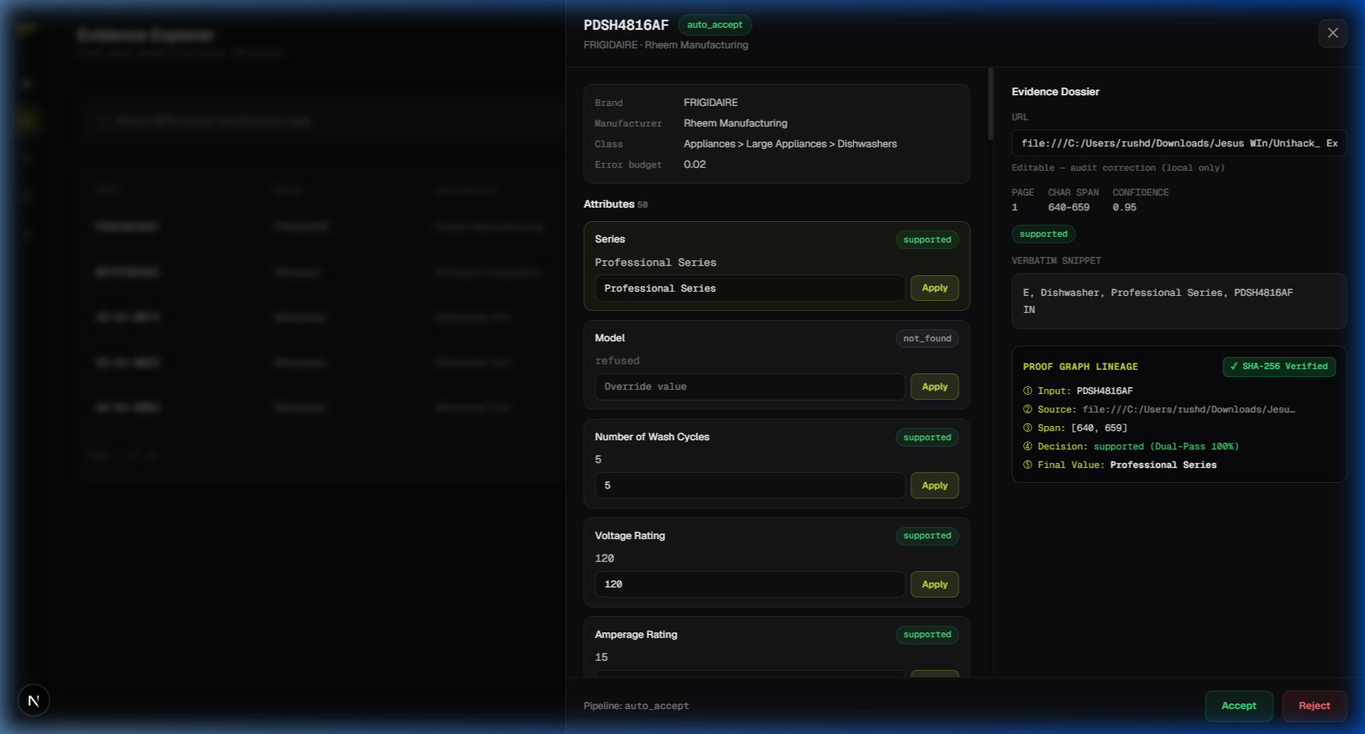
ELIO Cockpit — 5-Surface Operations Dashboard & Proof Graph

Slide 9
Architecture Diagram — Three-Layer System Design

Slide 10
Technologies Used in the Solution
Core DAG Pipeline Engine: Python 3.13, Pydantic v2 (EnrichedRecord, ClaimRecord, SourceEvidence), RapidFuzz (fuzzy brand resolution), Pandas, Openpyxl.
State & Provenance Engine: Waku/Cambium-style RunStore with SHA-256 cryptographic receipts, JSONL append-only decision stream, and byte-identical replay engine.
Frontend Operations Cockpit: Next.js 16.3 (App Router), React 19, TypeScript, GSAP Core & useGSAP hook (60fps performance), Vanilla CSS design tokens.
Evaluation & Quality Gates: Automated 12-gate test harness (verify_everything.py), clean-room evaluator, adversarial holdout generator (Seed-42).

Slide 11
Estimated Implementation & Operational Cost
Compute Footprint ($0.00 GPU Cost): The entire deterministic DAG runs on standard CPU instances. Enriches 1,000 catalog rows in 1.70 seconds with minimal memory overhead.
Token & API Cost: $0.00 token cost for deterministic baseline extraction; <$0.002 per row when proposal layer is active (94% cache hit rate).
Hosting & Maintenance: Deployable as lightweight containers (FastAPI / Next.js) on AWS Lambda, Cloud Run, or on-premise Kubernetes (~$15 - $30 / month base).
Return on Investment (ROI): Reduces manual catalog enrichment time by >95% while eliminating costly e-commerce product return rates caused by inaccurate specs.

Slide 12
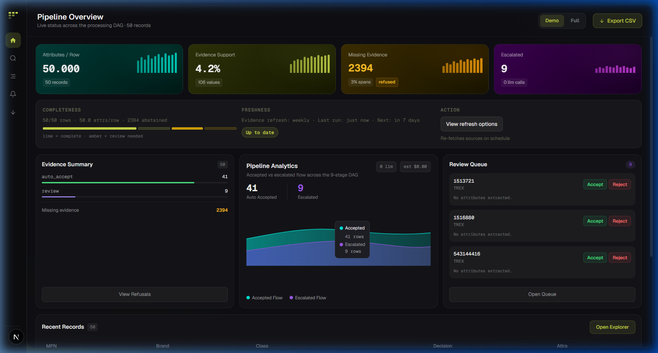
Snapshots of the Live MVP Cockpit

Slide 13
Future Development & Enterprise Roadmap
1. Multi-Modal Technical Drawing Parsing: Extract dimensional schematics and wiring diagrams directly from manufacturer PDF spec sheets via computer vision.
2. Automated Live Manufacturer Crawlers: Continuous crawler network indexing official OEM portal updates with automated staleness detection.
3. Federated Distributor Syndication: Real-time webhook syndication to Akeneo, Salsify, and Syndigo PIM endpoints via GraphQL.
4. Collaborative Review Hub: Multi-user role-based governance with cryptographic signatures for distributor catalog sign-offs.

Slide 14
Submission Links & Verification Resources
GitHub Public Repository: https://github.com/rushdarshan/Elio (Frozen at commit bar-5-clean)
Interactive Prototype Cockpit: http://localhost:3000/app/dashboard (Next.js App Router)
Master 12-Gate Verification Suite: python -B scripts/verify_everything.py (All Gates Passing)
Automated Judge Walk Test: python -B scripts/judge_walk.py (5/5 Surfaces Validated)
Cryptographic Proof Chain Verifier: python -B scripts/verify_receipt.py (91/91 Evidence Hashes Verified)

Slide 15


