Slide 1

NIIT
MINI PROJECT
IDBC BANK MANAGEMENT SYSTEM
- Rushikesh Mule
Under guidance :
Sangeeta Mam
-Hasib Sir
- Saurabh Sir

Slide 2
AIM
To develop a software for solving financial applications of a customer in banking environment in order to nurture the needs of an end banking user by providing various ways to perform banking tasks. Also to enable the user’s workspace to have additional functionalities which are not provided under a conventional banking software.

Slide 3
Problem Description
The bank management system is an application for maintaining a person’s account in a bank. The system provides the access to the customer to create an account, deposit/withdraw/transfer the cash from his account. The following presentation provides the specification for the system.

Slide 4




SYSTEM REQUIREMENTS ::
MYSQL
JDBC
WINDOWS 8+
INTELLIJ / ANY IDE

Slide 5
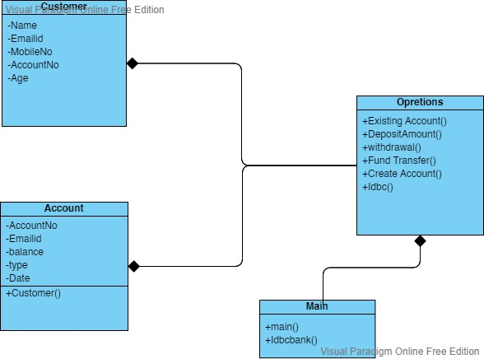
CLASS DIGRAM

Slide 6
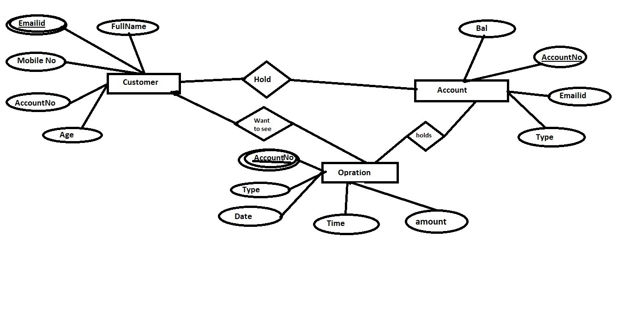
ER DIGRAM

Slide 7
Module Description ::
Open account
Opens a new account for the user by accepting input such as
account number, name, emailid, mobilno and Current balance etc.
Existing Customer Details
Provides options to Display All info from the given
account number .
Deposit
Provides options to deposit amount from the given
account number .
Withdraw
Provides options to withdraw amount from the given
account number.
Fund Transfer
Provides options to Transfer amount from the given
account number to anther Account with Date ,Time and
Account Type.

Slide 8
CONCLUSION ::
This project is developed to nurture the needs of a
user in a banking sector by
embedding all the tasks of transactions taking place in a bank.
Thus the Bank Management System it is developed and executed successfully.

Slide 9


