Slide 1
inteSIN
integrate sample-specific inference network methods
@Huahui Ren

Slide 2
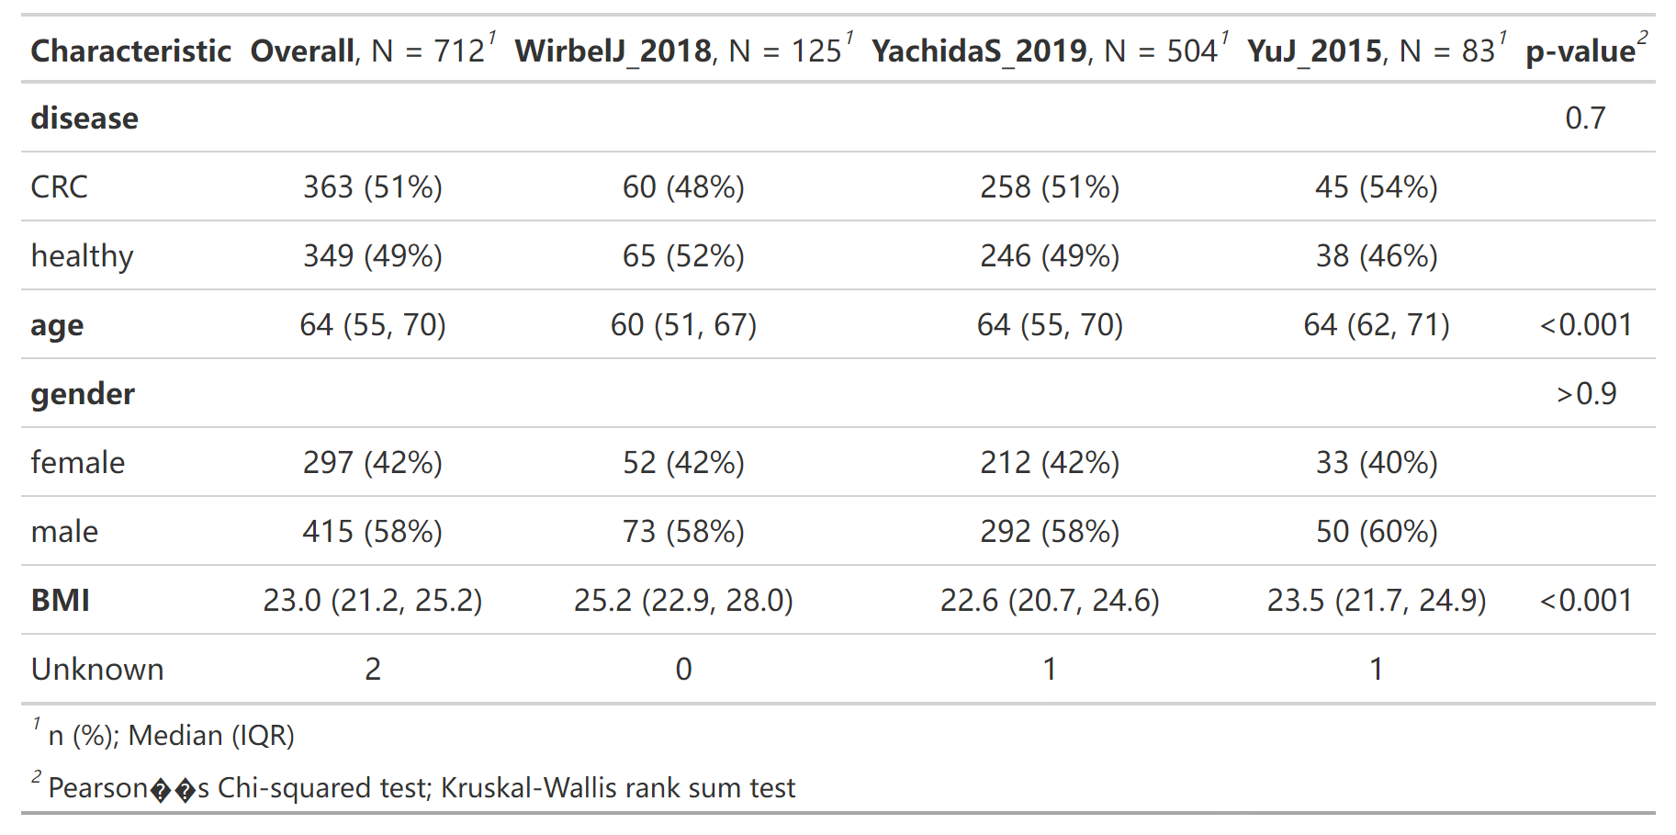

Slide 3
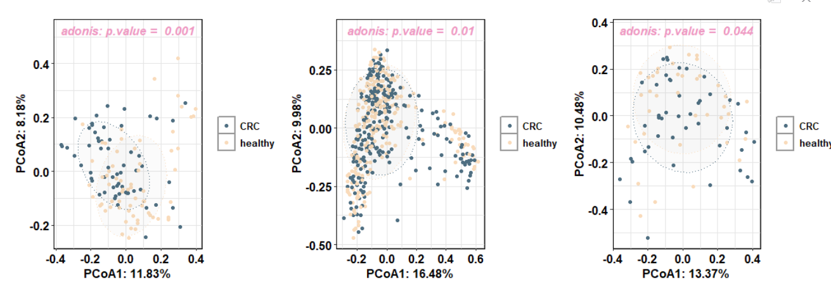

Slide 4
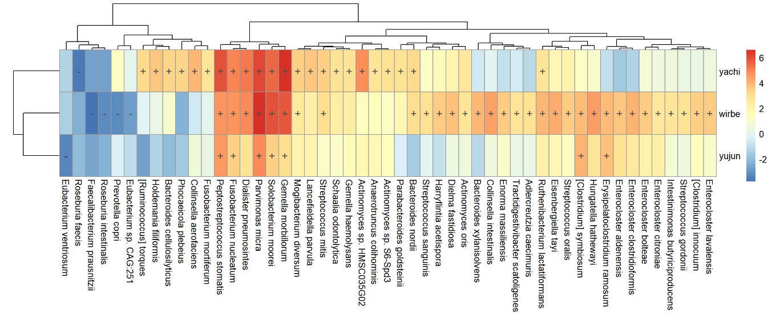

Slide 5
