Slide 1
IDENTIFY NEW BIKES
Trainer :
Venkatesh Indramohan
(QEA21QE003)
Batch-2

Slide 2
Team Members
K.Kalyani -- 899488
O.Ashalatha -- 899412
O.Vyshnavi -- 899426
K.Sahithi -- 899446
K.Jhansi -- 899389

Slide 3
Problem Statement: Identify Problem statement: Identify New BikesNew Bikes
Display "Upcoming" bikes details like bike name, price and expected launch date
in India, for manufacturer 'Honda' & Bike price should be less than 4 Lacs.
For Used cars in Chennai, extract all the popular models in a List; Display the same
Try to 'Login' with Google, give invalid account details & capture the error message.
(Suggested site: zigwheels.com)

Slide 4
Key Automation Scope
Handling windows & frames
Filling simple form, Capture warning message
Extract menu items from frames & store in collections
Handling different WebBrowsers

Slide 5
Detailed Description
Website Used:
https://www.zigwheels.com/
Zigwheels is the best car & bike research app in India to buy, sell and compare cars and bikes, be it new or used. It gives you in-depth information, price alerts and offers about new cars, used cars, new motorcycles, second hand bikes and scooters.
In our project we are testing for three modules.
Upcoming Bikes
Used Cars
Login

Slide 6

1
Testcases
Documents
PHASES OF PROJECT
2
POM
TestNG
3
Maven
Jenkins
4
Results
Reports

Slide 7











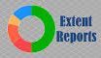


Concepts that are used in our project:-
Java
Selenium
Choice of Web Browser
Data Driven Framework
POI
TestNG
Extent Report Logger
Web Page Synchronization
Functional Testing Report
Error/ Exception Handling
Jenkins
Maven
E2E Execution

Slide 8
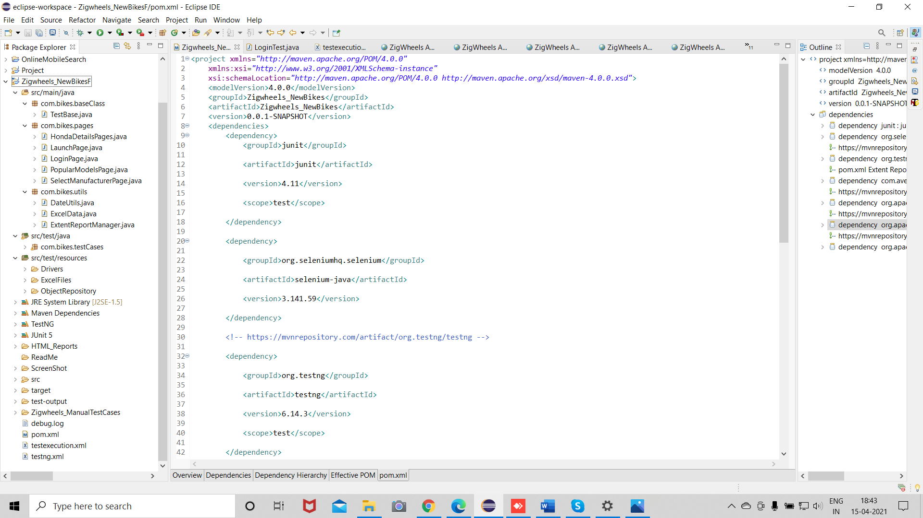
Structure of Maven

Slide 9
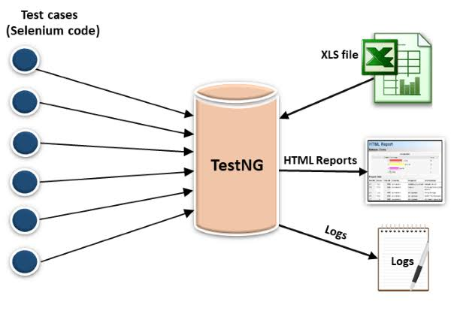
TestNG: It is a open sourse testing Framework which is used to manage and execute the Test cases .

Slide 10
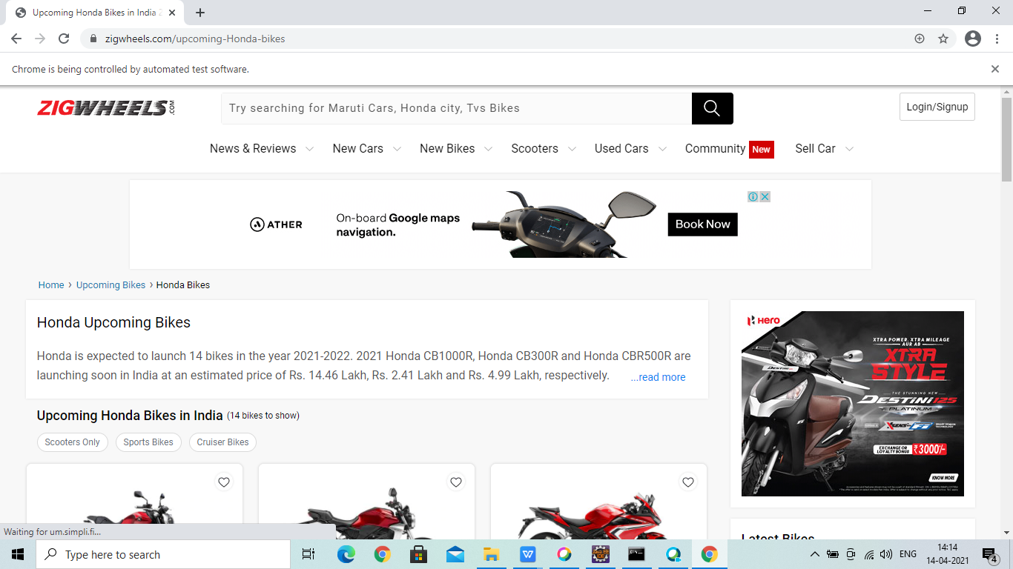
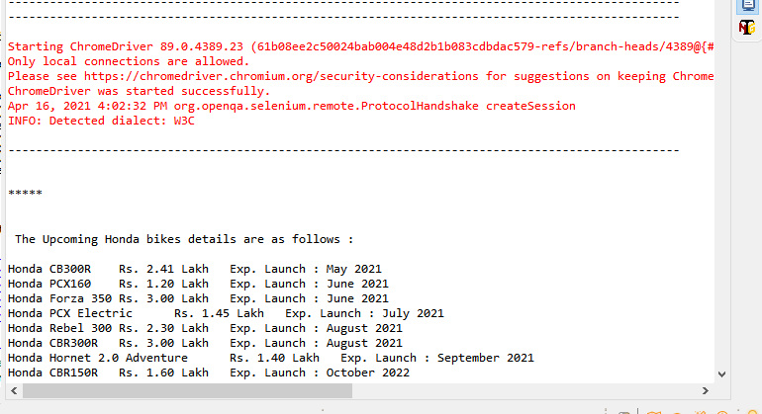
Module-1
Display "Upcoming" bikes details like bike name, price and expected launch date.
Application:-
Console Output:-

Slide 11
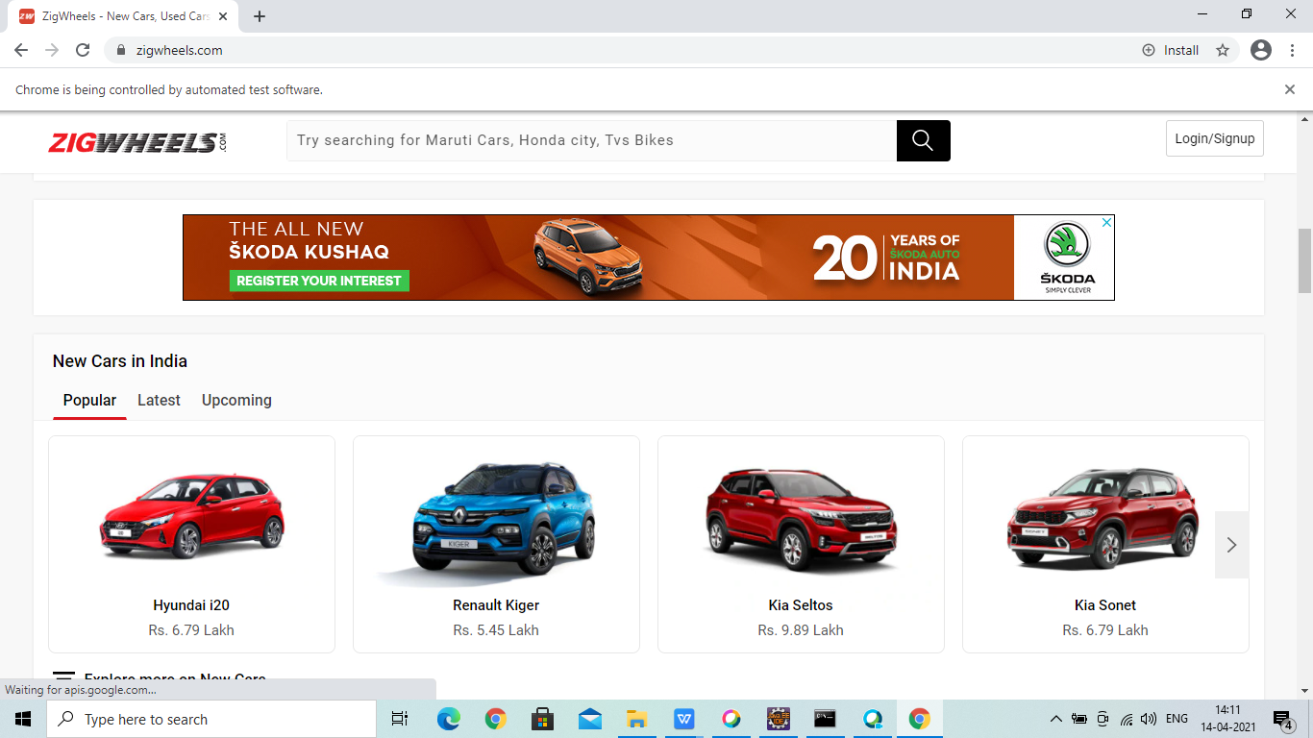
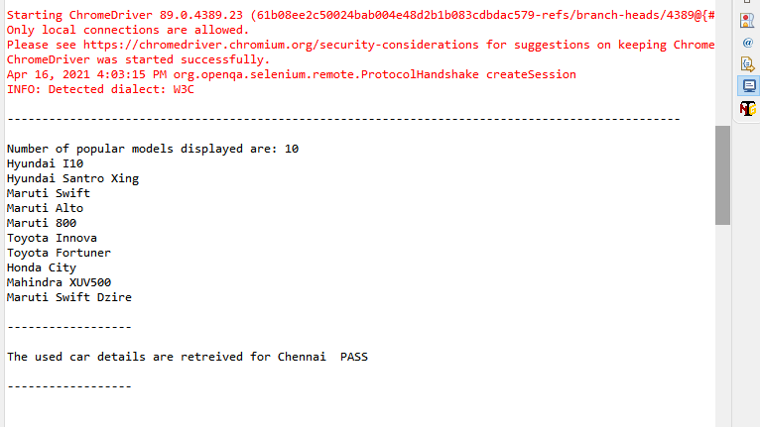
Module-2
For Used cars in Chennai, extracting all the popular models into a List and displaying the same.
Application:-
Console Output:-

Slide 12
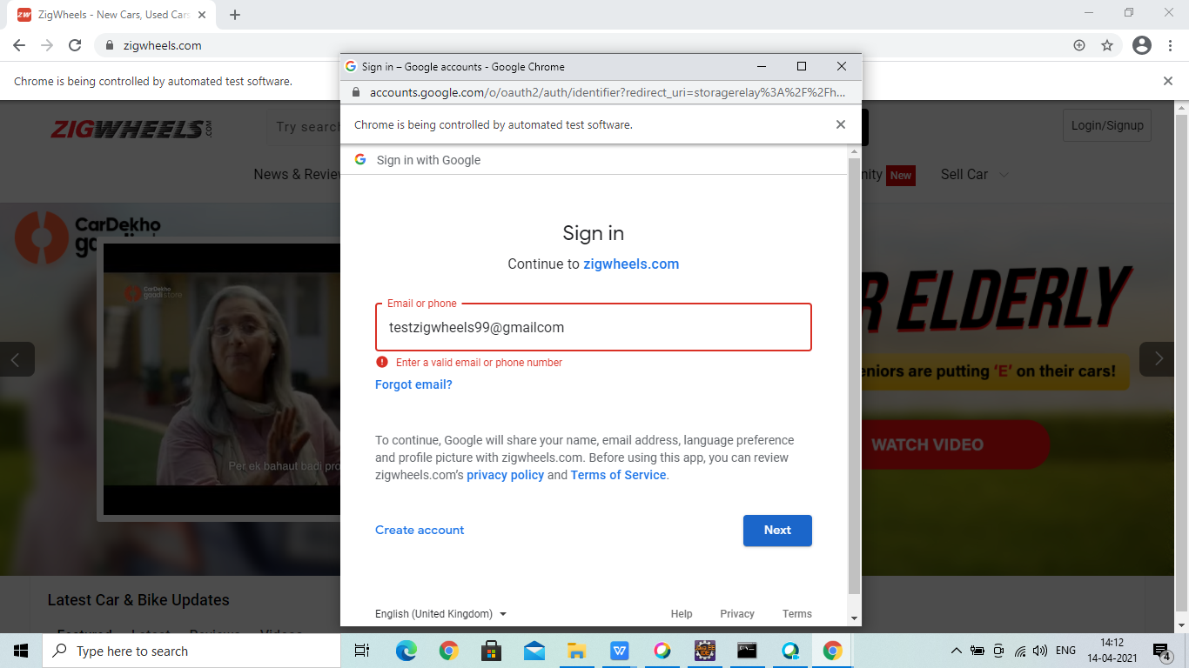
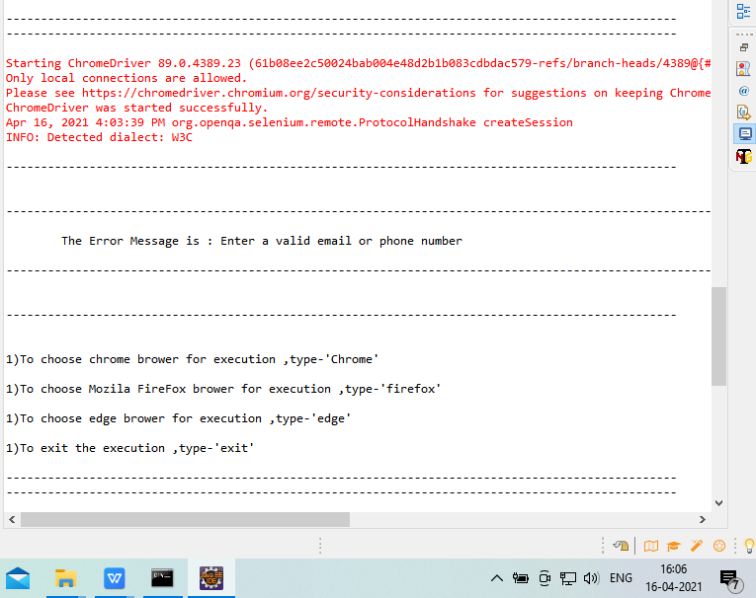
Module-3
We have to try ‘Login’ with Google, by giving invalid account details & capture the error message.
Application:-
Console Output:-

Slide 13
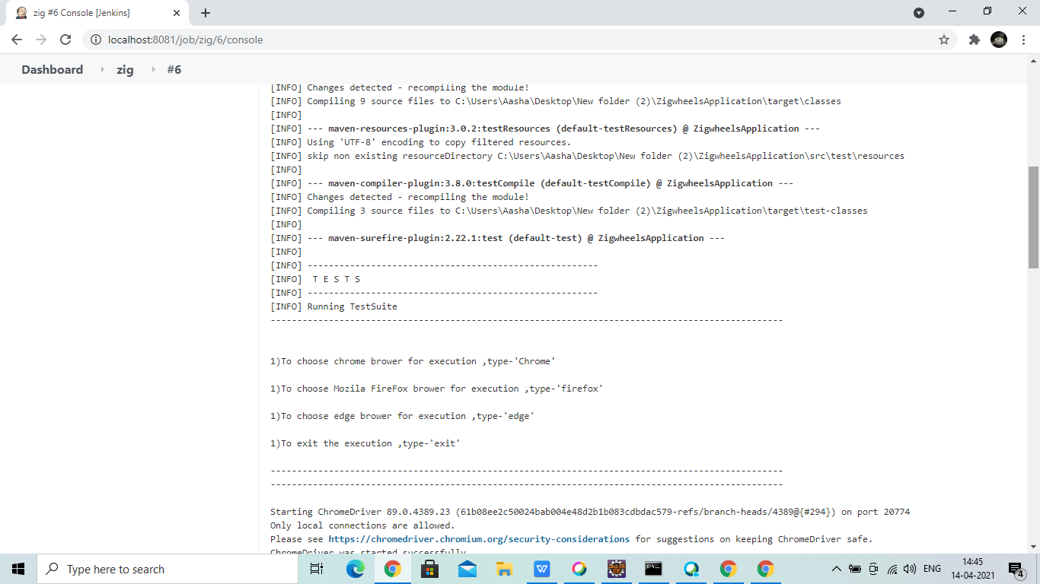
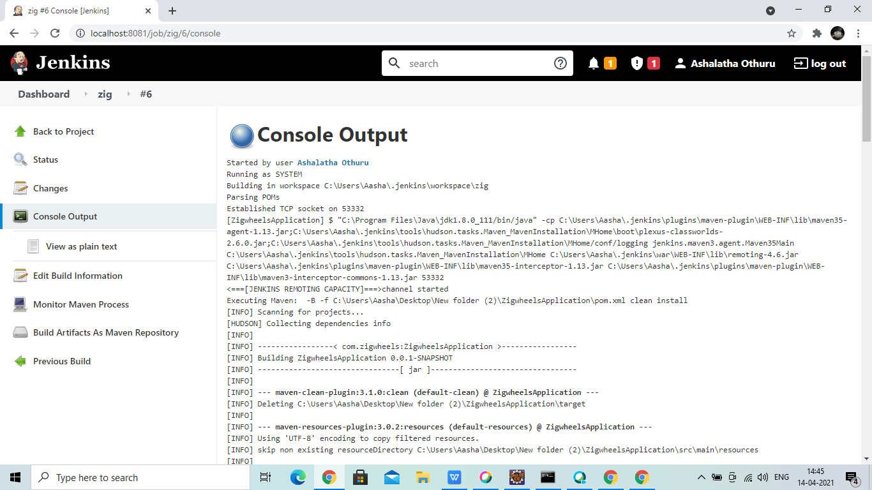
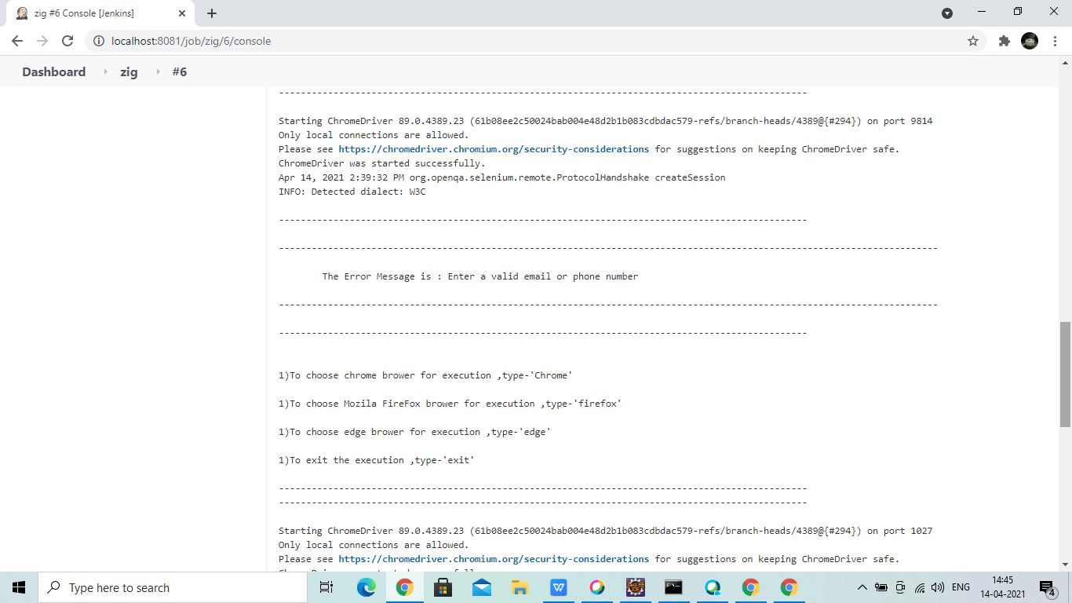
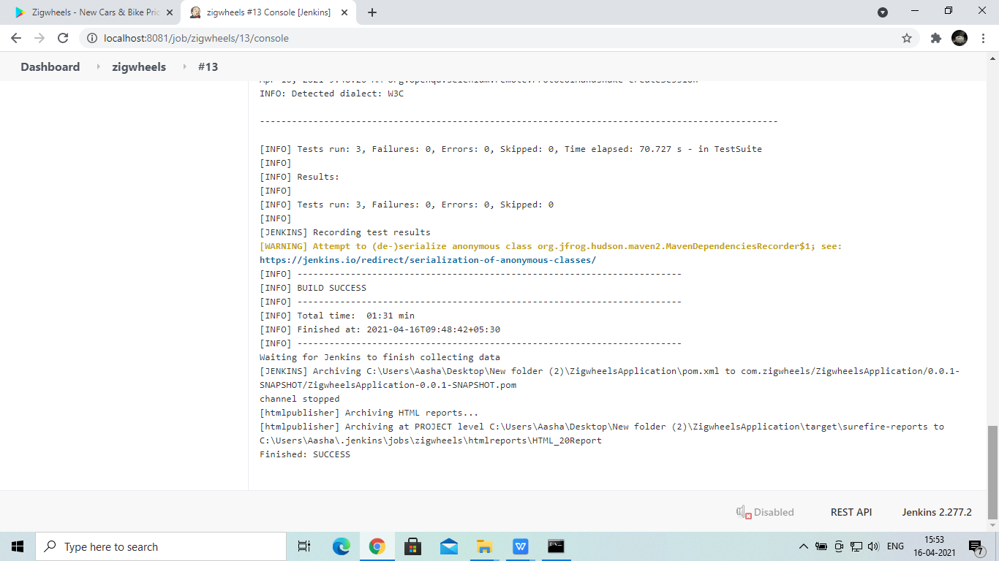
Jenkins Screenshots

Slide 14
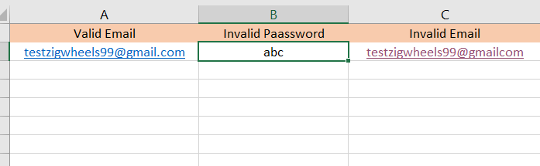
INPUT EXCEL FILE

Slide 15
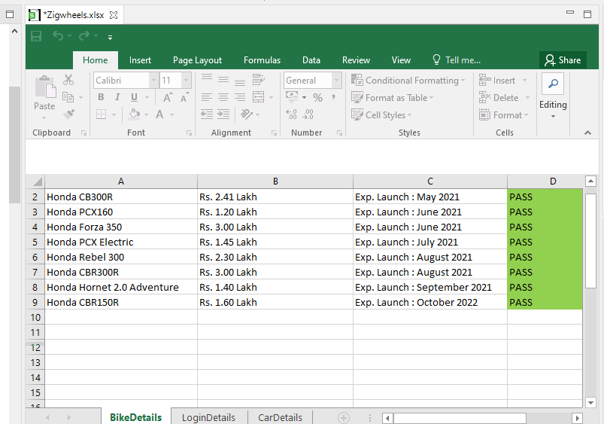
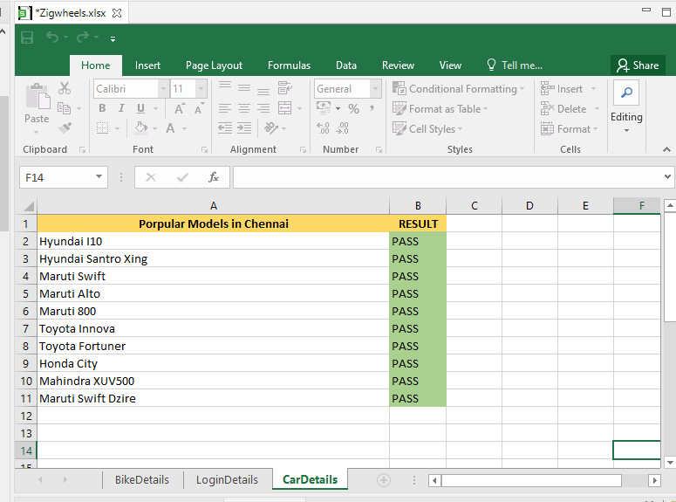
Output Excel Files

Slide 16
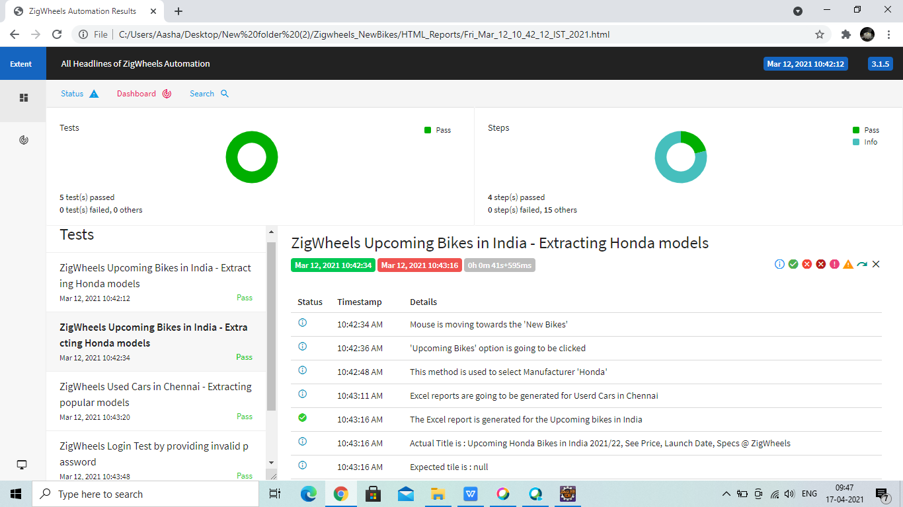
FINAL OUTPUT

Slide 17
Thank you.!!

