Slide 1
Intrusion detection system using a various classifiers applying genetic algorithm
Ajaykumar Dawande 111503003 Guided By
Rushikesh bhadane 111503013 R. b. adhao
Aakash Zure 141603015

Slide 2
Why it is needed
The flow of data is increasing everyday exponentially
Increasing attacks
New types of attacks
Detection at such speed is hard

Slide 3
Flow based vs packet based
Packet based nids checks every packet
Takes too much time and resources
Not possible with increasing demands
Flow based Doesn’t check packets
Works on principle of sampling
Faster but less accurate

Slide 4
Flow based IDS
Based on information in packet headers
Netflow is a cisco proprietary protocol
Allows routers to collect flows
Processes much less information
processed only 0.1% of total packets.

Slide 5
Detection
Process of monitoring and analyzing events in a system is detection
Signature based
Anomaly based
Signature : definition for different types of attacks
Anomaly : safe state and unsafe state of system
Signature : takes less resources and fast
Anomaly : can detect new types of attacks

Slide 6
Accuracy
Every packet is not checked
Hard to detect every intrusion
Need of higher performance day by day
So in order to achieve this we apply different feature selection techniques
For accuracy we use ensemble methods

Slide 7
A small account of literature review
We have got the basic ideas about the flow based IDS from the works of Anna sperotto et al.
In a paper published in march 2018 Kai peng, Chao et al[12] proposed an IDS system based on decision tree. They proposed a Pre-processing algorithm to digitize the strings in the given dataset and then normalize the whole data, to ensure the quality of the input data so as to improve the effciency of detection. Secondly, they used decision tree method for their IDS system, and then compared this method with Nave Bayesian method as well as KNN method. This method not only completely detected four kinds of 4 attacks but also enabled the detection of twenty-two kinds of attacks. Though it could detect 22 kinds of attacks the eciency was substantially less as the number of attacks grew in their test databases.

Slide 8
Feature selection
Feature Selection is a process that chooses an optimal subset of features according to a certain criterion.
Why we need FS:
to improve performance (in terms of speed, predictive power, simplicity of the model).
to visualize the data for model selection.
To reduce dimensionality and remove noise.

Slide 9
Contd…
Reasons for performing FS may include:
removing irrelevant data.
increasing predictive accuracy of learned models.
reducing the cost of the data.
improving learning efficiency, such as reducing storage requirements and computational cost.
reducing the complexity of the resulting model description, improving the understanding of the data and the model.

Slide 10
Feature Selection vs Dimensionality Reduction
Dimensionality Reduction
When classifying novel patterns, all features need to be computed.
New features are combinations (linear for PCA/LDA) of the original features (difficult to interpret).
Feature Selection
When classifying novel patterns, only a small number of features need to be computed (i.e., faster classification).
New features is just a subset of the original features.

Slide 11
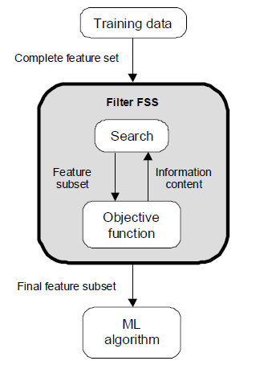
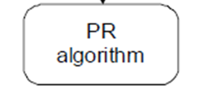
Evaluation Strategies
Filter Methods
Evaluation is independent of the classification algorithm.
The objective function evaluates feature subsets by their information content, typically interclass distance, statistical dependence or information-theoretic measures (e.g., mutual information).

Slide 12
Contd…
Filters:
measuring uncertainty, distances, dependence or consistency is usually cheaper than measuring the accuracy of a learning process. Thus, filter methods are usually faster.
it does not rely on a particular learning bias, in such a way that the selected features can be used to learn different models from different DM techniques.
it can handle larger sized data, due to the simplicity and low time complexity of the evaluation measures.

Slide 13
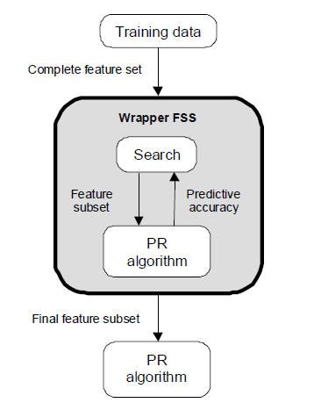
Evaluation Strategies
Wrapper Methods
Evaluation uses criteria related to the classification algorithm.
The objective function is a pattern classifier, which evaluates feature subsets by their predictive accuracy (recognition rate on test data) by statistical resampling or cross-validation or exhaustive search.

Slide 14
Contd…
Wrappers:
can achieve the purpose of improving the particular learner’s predictive performance.
usage of internal statistical validation to control the overfitting, ensembles of learners and hybridizations with heuristic learning like Bayesian classifiers or Decision Tree induction.
filter models cannot allow a learning algorithm to fully exploit its bias, whereas wrapper methods do.

Slide 15
Filter vs Wrapper Approaches
Advantages
Accuracy : achieve better accuracy because specific interactions between classifier and dataset.
Ability to generalize : mechanism to avoid overfitting, since they use cross validation measures of predictive accuracy
Disadvantages
Slow execution: training classifier for each subset
Lack of generality : biased towards classifier used in evaluation function. Optimal feature subset is specific to classifier.

Slide 16
System Design 1
Genetic Algorithm for feature selection
Logistic Regression or Random forest Classifier for classification

Slide 17
Genetic Algorithm
Finds best hypothesis
Creates population containing individuals
Each hypothesis evaluated to fitness function
Hypothesis with greater probability chosen to next generation
Crossover, mutation , selection
Each individual represents a possible solution

Slide 18
Steps

Slide 19
Input features
Random population
Fitness function
Optimized output features
Determination of the fittest
Next generation
Mutation & crossover
Fig. Genetic Algorithm

Slide 20
Encoding
Each solution in the search space is represented as a finite length string (chromosome) over some finite set of symbols.
e.g., using binary encoding

Slide 21
Fitness Evaluation
A fitness function f() is used to evaluate the “goodness” of each solution.
The fitness function is “problem specific”.

Slide 22
Searching
Population of
encoded solutions
Population of
encoded solutions
10010110… 10010110…
01100010… 01100010…
10100100... 10100100…
10010010… 01111001…
01111101… 10011101…
GA operators:
Selection
Crossover
Mutation
Current Generation
Next Generation

Slide 23
Selection
Probabilistically filters out solutions that perform poorly, choosing high performance solutions to exploit.
Fitness

Slide 24
Crossover
Explore new solutions:
Crossover: information exchange between strings.
Generate new chromosomes that, hopefully, will retain good features from the previous generation.
It is applied to randomly selected pairs of chromosomes with a probability equal to a given crossover rate.

Slide 25
Mutation
Explore new solutions:
Mutation: restore lost genetic material.
It protects GAs against irrecoverable loss of good solution features.
It changes a symbol of some chromosome with a probability equal to a very low given mutation rate.
mutated bit

Slide 26
Random forest
Ensemble classifier
Creates subsets from training data
Forms decision tree for each subset
Single data point will be classified according to the majority vote of decision trees.

Slide 27
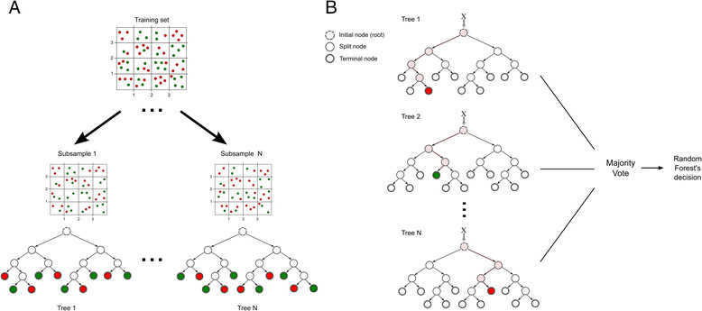

Slide 28
Input dataset
Genetic algorithm
Decision tree 1
Decision tree 2
Decision tree 3
Random forest classifier
Compare results
Final output

Slide 29
System Design 2
Principal Component Analysis for feature transformation
Genetic Algorithm for feature selection
Random Forest Classifier for classification.

Slide 30
Principal component analysis
An exploratory technique used to reduce the dimensionality of the data set to 2D or 3D
Can be used to:
Reduce number of dimensions in data
Find patterns in high-dimensional data
Visualize data of high dimensionality
Feature used here
Gene expression matrix

Slide 31
Principal Components
1. principal component (PC1)
The eigenvalue with the largest absolute value will indicate that the data have the largest variance along its eigenvector, the direction along which there is greatest variation
2. principal component (PC2)
the direction with maximum variation left in data, orthogonal to the 1. PC
In general, only few directions manage to capture most of the variability in the data.

Slide 32
Steps of PCA
Let be the mean vector (taking the mean of all rows)
Adjust the original data by the mean
X’ = X –
Compute the covariance matrix C of adjusted X
Find the eigenvectors and eigenvalues of C.
For matrix C, vectors e (=column vector) having same direction as Ce :
eigenvectors of C is e such that Ce=λe,
λ is called an eigenvalue of C.
Ce=λe ⇔ (C-λI)e=0
Most data mining packages do this for you.

Slide 33
Principal Component Analysis
X2
Y1
Y2
x
x
x
x
Note: Y1 is the first eigen vector, Y2 is the second. Y2 ignorable.
x
x
x
x
x
x
x
x
x
x
x
x
x
X1
x
x
x
Key observation:
variance = largest!
x
x
x
x
x

Slide 34
Cell 3
PCA 2
Cell 1
Cell 2
PCA 1

Slide 35
Input dataset
Principal component analysis
Feature transformation
Genetic algorithm
Feature selection
Random Forest classifier
Detection / compare results
Decision

Slide 36
Datasets
CIC17
Canadian Institute of cybersecurity
It contains the data of 5 days starting from 3rd July to 7th july
Has benign and most common up too date attacks
Disadvantages
Scattered data- 8 files
Huge volume
Missing values -288602 cases of missing class labels
High class imbalance

Slide 37
Panigrahi 2018
To overcome limitations of CIC17
Combined all files of CIC 17
Unwanted cases removed
Similar classes merged to reduce imbalance

Slide 38
Performance measures
True Positives (TP) - These are the correctly predicted positive values which means that the value of actual class is yes and the value of predicted class is also yes. E.g. if actual class value indicates that this passenger survived and predicted class tells you the same thing.
True Negatives (TN) - These are the correctly predicted negative values which means that the value of actual class is no and value of predicted class is also no. E.g. if actual class says this passenger did not survive and predicted class tells you the same thing.

Slide 39
Contd…
False positives and false negatives, these values occur when your actual class contradicts with the predicted class.
False Positives (FP) When actual class is no and predicted class is yes. E.g. if actual class says this passenger 24 did not survive but predicted class tells you that this passenger will survive.
False Negatives (FN) When actual class is yes but predicted class in no. E.g. if actual class value indicates that this passenger survived and predicted class tells you that passenger will die.

Slide 40
Accuracy & Precision
Accuracy
Most intuitive
Ratio of correctly predicted observations to total observation
Accuracy = TP+TN/TP+FP+FN+TN
Precision
Ratio of correctly predicted positive observations to total predicted positive
High precision = low false positive
Precision = TP/TP+FP

Slide 41
Recall & F-score
Recall
Ratio of correctly predicted positive to all positive observations
Recall = TP/TP+FN
F-Score
weighted average of Precision and Recall.
Takes both FP & FN in account
Not intuitive but more useful than accuracy
F1 Score = 2*(Recall * Precision) / (Recall + Precision)

Slide 42
CIC 17 results Genetic Algorithm + Random Forest
Dataset | Accuracy (All feat.) | Accuracy (feature subset) | No of features | Build time
Tuesday | 0.999777981 | 0.99979816507 | 38 | 257.056
Friday | 0.999304512 | 0.999481711 | 38 | 174.8523
Thursday | 0.999944561 | 0.99993763 | 35 | 82.984
Type of attack | TPR/Recall | Precision | F-Score
FTP Patator | 0.49236484 | 1.00E+00 | 0.65984513
SSH Patator | 0.47568474 | 9.01E-01 | 0.62253109
DDOS | 0.63199102 | 0.76E-01 | 0.77450306
Infiltration | 0.77777778 | 1.00E+00 | 8.75E-01

Slide 43
PCA + GA + RF
Dataset | Accuracy (All feat.) | Accuracy (feature subset) | No of features | Build time
Tuesday | 0.999875044 | 0.99987505442 | 45 | 298.0881
Friday | 0.9997088994 | 0.9997088994 | 35 | 207.9769
Thursday | 0.9998911009 | 0.99989110087 | 39 | 97.95788
Wednesday | 0.9993730555 | 0.99937305587 | 41 | 1627.6957
Tuesday – FTP Patator, SSH Patator
Friday – DDOS
Thursday – Infiltration
Wednesday – DOS SlowLoris, DOS slowhttptest, DOS Hulk, DOS Goldeneye, Heartbleed

Slide 44
Recall, Precision & F-Score
Type of attack | TPR/Recall | Precision | F-Score
FTP Patator | 0.99793644 | 1.00E+00 | 0.99896716
SSH Patator | 0.98993851 | 9.98E-01 | 0.99382716
DDOS | 0.9950414 | 1.00E+00 | 0.99967372
Infiltration | 0.44444 | 1.00E+00 | 6.15E-01
DOS slowloris | 0.99160207 | 0.99707697 | 0.99433198
DOS slowhttptest | 0.99955206 | 0.99939321 | 0.99947263
DOS Hulk | 0.99459459 | 0.99638989 | 0.99295775
DOS Goldeneye | 0.99063232 | 0.99529412 | 0.99295775
HeartBleed | 0.83333 | 1 | 0.90909091

Slide 45
Panigrahi[28] Genetic Algorithm + Logistic Regression
Type of attack | TPR/Recall | Precision | F-Score
Brute Force | 0.527897 | 0.9192825 | 0.6706652
DOS/DDOS | 0.83773698 | 0.8566017 | 0.8470643
Portscan | 0.9953771 | 0.9814696 | 0.9883744

Slide 46
Genetic Algorithm + Random Forest
Type of attack | TPR/Recall | Precision | F-Score
Brute force | 0.49963829 | 0.9995176 | 0.6662379
DOS/DDOS | 0.62104321 | 0.9878631 | 0.7626289
PortScan | 0.4821447 | 0.996623 | 0.6498961
WebAttack | 0.0089153 | 0.999998 | 0.0176731

Slide 47
Principal Component Analysis + genetic Algorithm + Random Forest
Type of attack | TPR/Recall | Precision | F-Score
Brute force | 0.996141719 | 0.9973443 | 0.9967427
DOS/DDOS | 0.97782838 | 0.9856339 | 0.9817156
PortScan | 0.9995387 | 0.999015 | 0.9992768
WebAttack | 0.9524517 | 0.984639 | 0.968278
Model | Accuracy (all features) | Accuracy (subset) | No.of features | Build time
PCA+GA+RF | 0.988395 | 0.987628 | 44 | 1989.856
GA+RF | 0.934038251 | 0.9325829478 | 47 | 1526.894
GA + LR | 0.80843822 | 0.804919098 | 39 | 4895.542

Slide 48
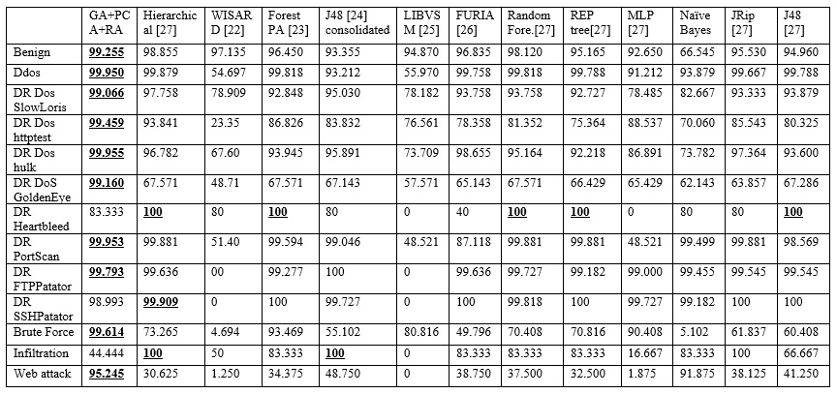
Performance Comparison – Detection rate/recall

Slide 49
Conclusion
We have studied various feature selection techniques.
Combination of feature selection methods with classifier methods are more efficient.
Flow bases IDS are scalable and fast
But there is need to do some more research in the field of feature selection techniques

Slide 50
References
22. M. De Gregorio and M. Giordano - An experimental evaluation of weightless neural networks for multi-class classification, - Applied Soft Computing, vol. 72, pp. 338354 - 2018.
23. M. N. Adnan and M. Z. Islam - Forest pa: Constructing a decision forest by penalizing attributes used in previous trees, - Expert Systems with Applications, vol. 89, pp. 389403 - 2017.
24. I. Ibarguren, J. M. Perez, J. Muguerza, I. Gurrutxaga, and O. Arbelaitz - Coverage-based resampling: Building robust consolidated decision trees, - Knowledge-Based Systems, vol. 79, pp. 5167 - 2015.
25. C.C. Chang and C.-J. Lin - Libsvm: a library for support vector machines, - ACM transactions on intelligent systems and technology (TIST), vol. 2 - 2011.
26. J. C. Huehn and E. Huellermeier - Furia: An algorithm for unordered fuzzy rule induction, - Data Mining and Knowledge Discovery, 2009.
27. Ahmed Ahmim, Leandros Maglaras, Mohamed Amine Ferrag, Makhlouf Derdour, Helge Janicke - A Novel Hierarchical Intrusion Detection System based on Decision Tree and Rules-based Models - 1st International Workshop on Security and Reliability of IoT Systems - SecRlot At Greece - 2019
28. Ranjit Panigrahi; Samarjeet Borah - A detailed analysis of CICIDS2017dataset for designing Intrusion Detection Systems - International Journalof Engineering Technology - aug. 2018

