Slide 1
Wel-Come

Slide 2
A
Project
on
Two Wheeler Vehicle Showroom System,Ashta
Submited by
Rushikesh Popatrao Bavachkar
Snehal Babaso Kamble
Priyanka Rajaram Khot
Archana Sanjay Patil
BCA -III, Sem-VI
Guidance by
M.S.Patil
Submited To
Arts & Commerce,Ashta.
Aug2021

Slide 3
Introduction
We have a design system management windows based project of “Two wheeler vehicle showroom , Ashta.” This project contain brief information of Two wheeler showroom, Ashta.
There are some process in showroom as follows-
Selling process, Billing process, dealing process etc.
There are some create forms related to this project as follows-
Admin login, vehicle information, model information, supplier information, customer information, billing information etc.
So we create a windows based project of vehicle showroom , Ashta to introduce information of showroom.

Slide 4
Project Profile
Project Name | Vehicle showroom
Developed At | Art’s & Commerce college,ashta
Objective | Information of Two wheeler Vehicle
Front-end | C#
Back-end | MS Access Server
Tools Used | Ms-Word
Project Guide | M.S.Patil

Slide 5
Proposed System
The New system is computerized version of the existing system.
Provides easy and quick access over the data.
Admin Authorization schemes.
Admin is easy to change or update the customer details.

Slide 6
Scope of computer System
This is a 21 century, it is important to give plans information to all people. So in manually system people have to go at“Sai Auto Showroom".
And all transaction is done by manually

Slide 7
Requirement Specification
Admin:
Show the all data of customer & supplier.
Handle the data(Insert , Update , Delete).
User:
Customer visit to the showroom .
Show the basic information of the
showroom.

Slide 8
Requirements
Hardware Requirement
Software Requirement
Following Hardware configuration is preferred for the system-
Hard disk:80GB
Keyboard
Ram:1GB
Mouse
Monitor
Printer
Following Software configuration is preferred for the system-
Operating system windows xp
Microsoft Visual Studio 2010
Microsoft office 2007
Google ,Chrome etc.
Microsoft Access Database File.

Slide 9
Model_Id
Model_Name
Models
Color
Price

Slide 10
ERD-
Register
Customer
Admin
booking
Supplier
Order booking
Showroom

Slide 11
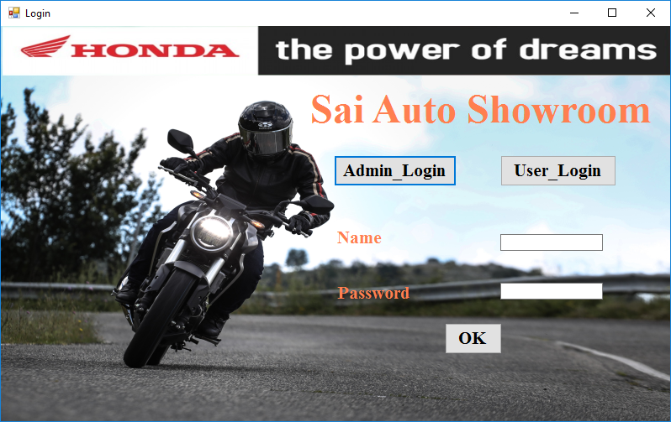
Admin Login

Slide 12
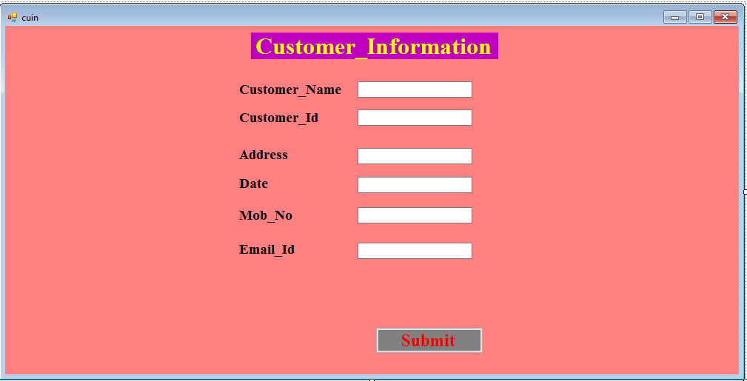
Customer information

Slide 13
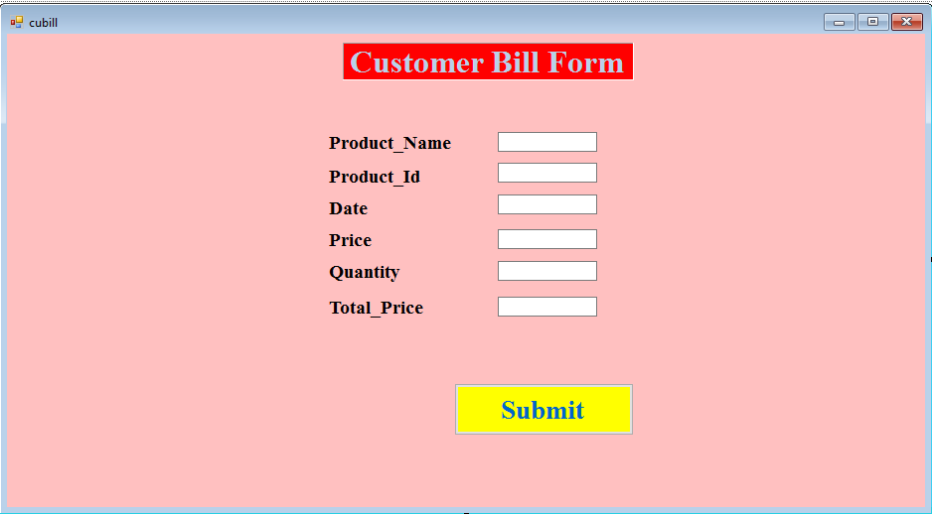
Customer Bill Form

Slide 14
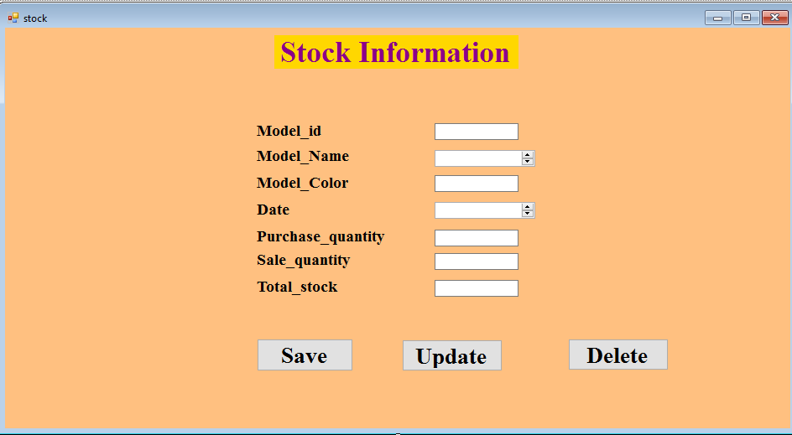
Stock Information

Slide 15
Conclusion
Conclusion:-
System is developed in visual studio 2010 having windows 10 operating system it provides good user interface for end user.
The present computerized system “Sai Auto Showroom, Tasgaon” is useful for the transaction like payments.

Slide 16
Future Enhancement
In future we will send message to user.
I want to use Ajax in future.

Slide 17
Thank You

