Slide 1



Vehicle CO2 Emission Tracker
L.D. College of Engineering
Rushi Mujpara(Group Leader)
Mihir Jethava
Rohan Chaudhari
Priyank Badarshahi
Date:17/03/2026
Mentor : Priya Shah

Slide 2
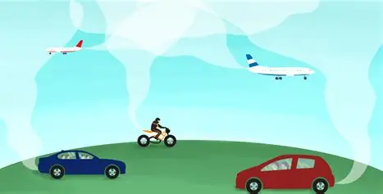
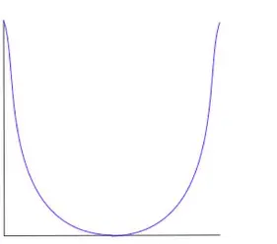
Problem Statement
Brief Overview:
Urban traffic congestion directly impacts environmental health. This project establishes the relationship between vehicle speed and emissions (the "U-shaped curve") to predict and map real-time carbon footprints across city road segments using machine learning.
Shortly, Project Estimated and predicts the CO₂ emissions using Machine Learning, Live API and Computer Vision.
Key Objectives:
Process and engineer features from vehicle emission datasets.
Train an ML model to accurately predict CO₂ output (grams/km).
Integrate a live traffic API to feed real-time data to the model.
Build an interactive dashboard to visualize emission hotspots and trends.

Slide 3
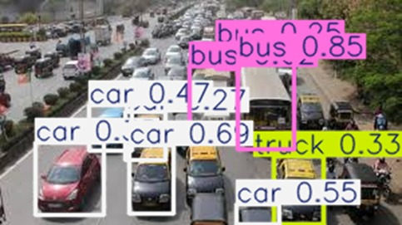
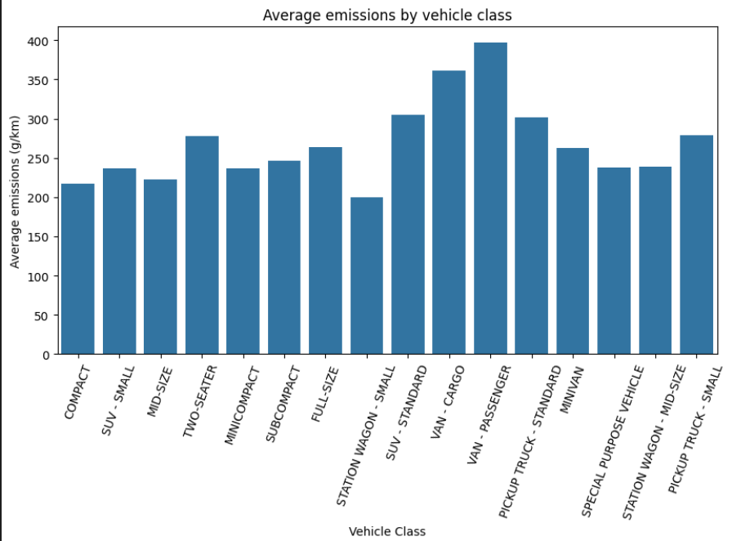
Dataset Overview
Dataset Description:
Historical Data: Kaggle Vehicle CO₂ Dataset acts as the "source of truth" for training the AI model.
Live Data: TomTom API (Flow Segment Data) is used to pull real-time vehicle speeds for specific city coordinates.
Visual Recognition: we have also intergraded the YOLO-n model for finding the no. Vehicles and then finding its emission factor.
Data Preprocessing:
Cleaned the Kaggle dataset using the Pandas library.
Applied One-Hot Encoding to handle categorical variables such as "Fuel Type."
Performed feature engineering to create new variables, including "Fuel Efficiency" and "Congestion Level" (calculated as Current Speed / Free Flow Speed).

Slide 4
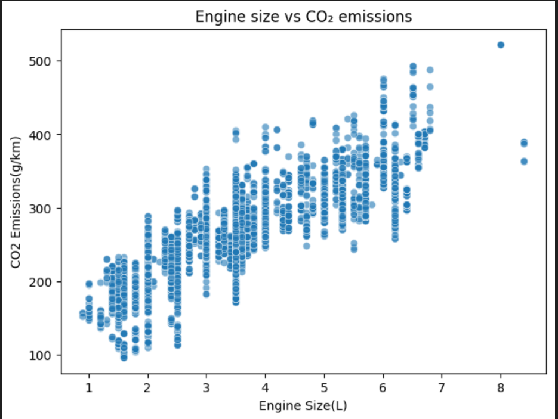
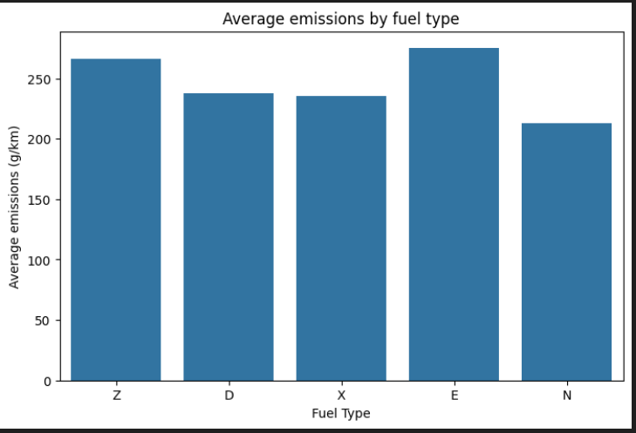
Methodology
Approach:
Built a Python API wrapper to ping TomTom for bounding box speed data.
Developed an inference engine to feed live speeds into the trained model.
Set up an SQLite database logging system to record predictions hourly.
Designed a Streamlit frontend with a Folium map to render live traffic data.
Algorithms Used:
XGBoost Regressor was selected to handle the complex, non-linear relationship between traffic features and emissions.
Evaluation Metrics: Root Mean Squred Error :was calculated using a 70/30 train-test split to validate model accuracy before real-time deployment.

Slide 5
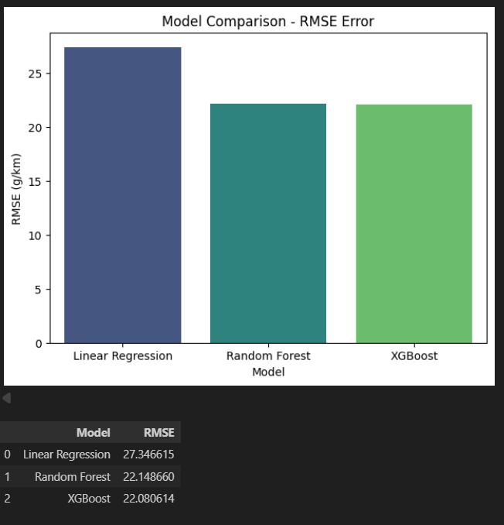
Result
Model Performance:
The XGBoost model achieved a low Root Mean Squared error, confirming its reliability for live inference and accurate real-time CO₂ prediction.
Graphs/Visualizations: Folium Map: Renders city polyline segments color-coded by emission severity (Green: <100g/km, Yellow: 100-200g/km, Red: >200g/km).
Plotly Line Chart: Displays dynamic emission trends over a rolling 24-hour period.
Metric Cards: A dashboard widget actively highlighting the "current worst hotspot" in the city.

Slide 6
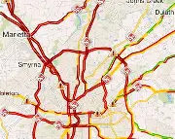
Discussion
Insights:
The system successfully identifies the "Best Time to Travel" by analyzing logged data to find hours with the lowest average emissions.
The UI's "What-If Simulator" visually proves the massive environmental benefit of transitioning city traffic to Electric Vehicles (e.g., simulating 50% EV adoption).
Challenges Faced:
Merging static historical datasets with live JSON API responses.
Mapping complex coordinate polylines dynamically onto the Folium interface.
Ensuring the SQLite logging system updated smoothly without bottlenecking the real-time Streamlit dashboard.

Slide 7
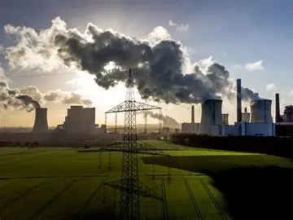

Solution Impact
Sustainability Impact:
Directly contributes to environmental monitoring by highlighting how speed and congestion influence carbon output. It generates automated precautions (e.g., "High Congestion: Recommend carpooling") to encourage greener travel habits.
Practical Implementation: The dashboard can be utilized by city planners or everyday commuters to monitor local pollution. The architecture is designed to be easily scaled into a Smart City grid using embedded systems like Jetson or Raspberry Pi.

Slide 8

Conclusion
Summary:
This project successfully combines data engineering, live API integration, and machine learning (XGBoost) to create a fully functional,
real-time vehicle emission tracking system.
The Streamlit dashboard transforms raw traffic data into actionable, visual environmental insights.
Future Work:
Scale the application for Smart City embedded systems (edge computing).
Incorporate diverse datasets covering weather patterns and heavier commercial vehicle types.
Develop an eco-routing feature to actively suggest the greenest path to a destination.

Slide 9





References
https://www.kaggle.com/code/tatianafuentes/co2-vehicles-emission
https://developer.tomtom.com/pricing
https://www.python.org/
https://streamlit.io/
https://www.kaggle.com/datasets/debajyotipodder/co2-emission-by-vehicles/data
https://docs.ultralytics.com/
https://docs.ultralytics.com/models/yolo26/
https://github.com/ruhyadi/vehicle-detection-yolov8

Slide 10
Thank You
Notes:
Thank You !!

