Slide 1
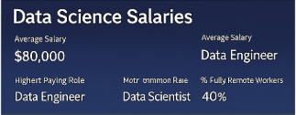
Project Agenda
Introduction:
Before diving into data, we must ask: What truly drives salary differences in the Data Science industry?
This Exploratory Data Analysis (EDA) of the Data Sciences Salaries Dataset goes far beyond basic averages.
Our goal is to understand the shifting global compensation patterns shaped by:
Experience level and skill maturity.
Job roles such as Data Scientist, AI Engineer
Company size and industry domain.
Remote work ratio and global workforce changes.
Geographical location remains the most powerful salary driver.
Through this analysis, we aim to uncover the hidden correlations and strongest predictors of a data professional’s earning potential, helping both aspiring and experienced professionals understand where the industry is heading. Job roles such as Data Scientist, AI Engineer

Slide 2
Analytical Objective
Problem Statement:
The Salary Curve Insight: What does the Salary Distribution reveal about how earnings are spread across the industry? Are salaries heavily skewed toward the higher range, and how many outliers exist?
Experience-Pay Growth: How strongly does Experience Level impact salary? What is the exact salary jump from Entry Level to Mid, Senior, and Executive positions?
Company Size Effect: Do Large companies consistently pay more than Medium and Small firms? How does salary variability differ across company sizes?
Remote Work Dynamics: How is the Remote Ratio distributed across the workforce? Does working fully remote or hybrid influence earning potential?
Correlation Reality Check: Which factors show the strongest correlation with Salary in USD, Experience Level, Company Size, or Remote Ratio? Are there negative or weak correlations?
Hiring Patterns Across Experience Levels: Which company size hires the most Entry, Mid, Senior, or Executive-level professionals? Do medium-sized companies dominate senior-level hiring?

Slide 3
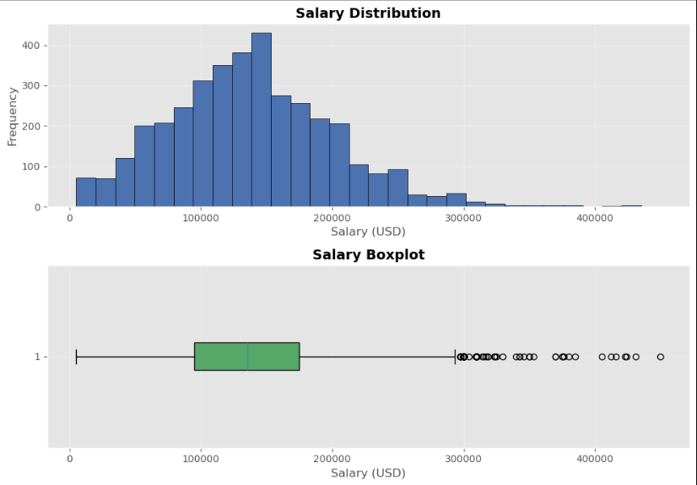
Salary Distribution & Outlier Analysis
Insights:
Salaries Are Right-Skewed:
Most professionals earn between $80K–$170K, with fewer high-earners at the top.
Median Around $140K:
The boxplot shows a stable central salary cluster near the median $140K.
Many High-End Outliers:
Several salaries above $250K indicate specialized and senior-level roles.

Slide 4
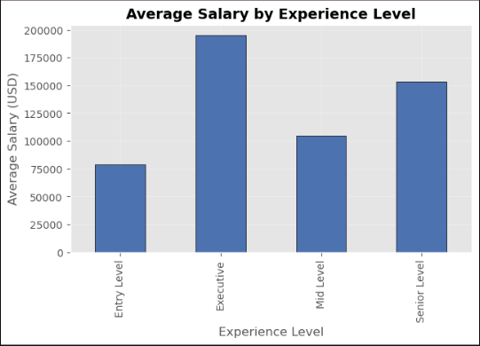
Salary Growth by Experience Level
Insights:
Executive-Level Earns the Highest:
Executive professionals earn close to $200K, the highest across all experience groups.
Strong Salary Jump After Entry Level:
Salary increases sharply from Entry (~$80K) to Mid Level (~$105K), showing fast early-career growth.
Senior Roles Maintain High Pay:
Senior-level salaries reach around $155K, confirming steady upward growth with experience.

Slide 5
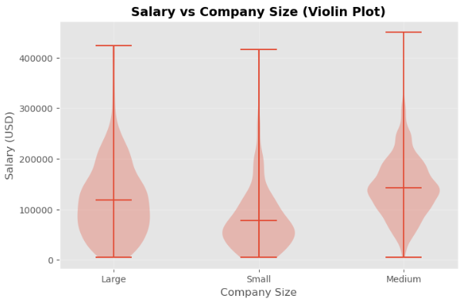
Salary Variation Across Company Sizes
Insights:
Large Companies Show Higher Median Salaries:
Large organizations offer the highest median pay, indicating stronger compensation structures.
Small Companies Have Wider Variability:
Smaller firms show greater salary spread, meaning pay can range from very low to unexpectedly high depending on the role.
Medium Companies Offer Stable Salaries:
Medium-sized companies display balanced and consistent salary ranges, with fewer extremes compared to small companies.

Slide 6
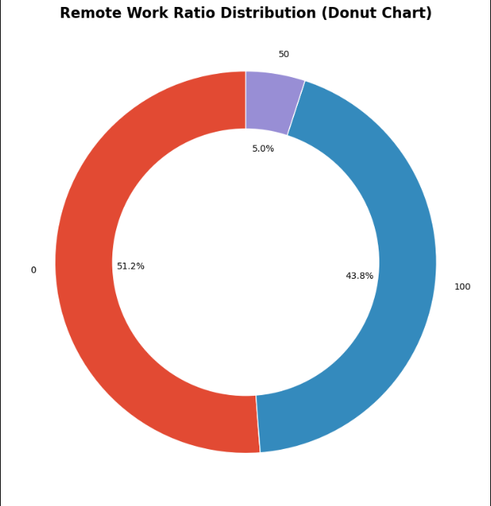
Remote Work Ratio Breakdown
Insights:
Majority Roles Are On-Site:
Over 51% of the workforce operates fully on-site, showing that many companies still prefer physical presence.
Strong Remote Workforce:
Almost 44% of roles are fully remote, highlighting the growing acceptance of remote data roles worldwide.
Hybrid Work Is Minimal:
Only 5% of jobs fall under hybrid mode, indicating that companies either prefer full office or full remote setups rather than mixed arrangements.

Slide 7
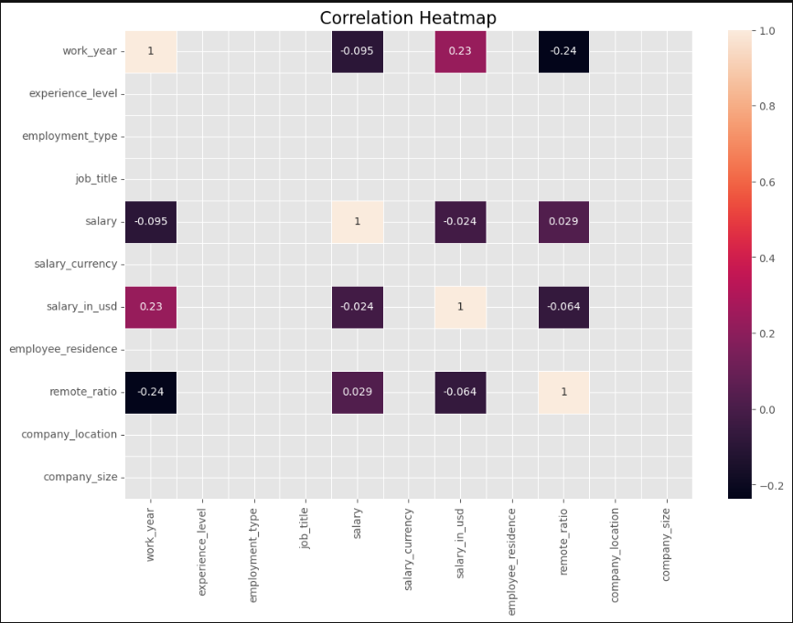
Correlation Insights Overview
Insights:
Experience Has a Mild Positive Impact:
Experience Level shows a small positive correlation with salary (0.23), indicating that higher experience generally leads to better pay.
Remote Work Shows Slight Negative Relation:
Remote Ratio has a mild negative correlation (–0.24) with salary, suggesting that fully remote roles may pay slightly less on average.
Salary Currency & Location Have Minimal Effect:
Salary currency and employee/company location show very weak correlations, meaning location factors don’t strongly influence salary in this dataset.

Slide 8
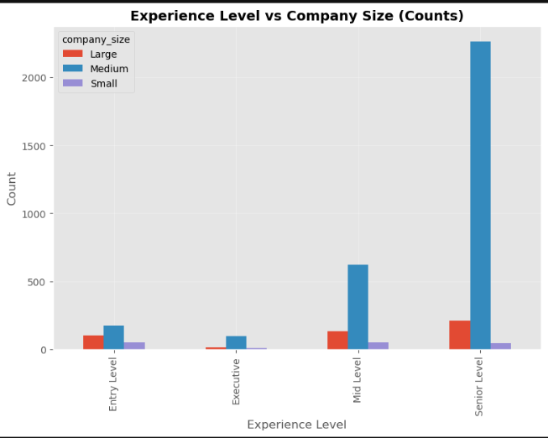
Hiring Trends by Experience Level Across Company Sizes
Insights:
Medium Companies Hire the Most:
Medium-sized companies dominate hiring across all experience levels — especially Senior Level, where counts exceed 2,200+.
Large Companies Prefer Experienced Talent:
Large firms hire more Senior and Mid-Level professionals compared to Entry Level, indicating a preference toward skilled candidates.
Small Companies Maintain Low Hiring Volume:
Small companies show consistently low hiring numbers across all experience levels, reflecting limited workforce size or tighter budgets.

