Slide 1
Project Agenda — Titanic Survival EDA
Before diving into charts and models, the goal is to understand:
What factors truly determined who survived the Titanic disaster?
This Exploratory Data Analysis (EDA) of the Titanic Dataset goes far beyond basic counts and percentages.
Our objective is to uncover the human patterns behind survival, influenced by:
Passenger Class (P class)
Gender & Age distribution
Family size and travel type (Solo vs Family)
Fare differences and economic status
Boarding port influence (C/Q/S)
Demographic patterns such as children, the elderly, etc.
Through this study, we aim to identify the strongest survival predictors and understand how social class, demographics, and travel patterns shaped the outcome of this historic tragedy.

Slide 2
Analytical Objectives
Understand the Survival Rate
– Total survivors vs. non-survivors
Analyze Gender Impact
– Compare survival between males and females.
Study Class Influence (P class)
– Identify which class had the highest survival.
Examine Age Effect
– Check survival patterns among children, adults, and the elderly.
Compare Solo vs. Family Travel
– See if family groups had better survival chances than solo travelers.
Evaluate Fare Influence
– Understand if a higher ticket fare relates to higher survival.

Slide 3
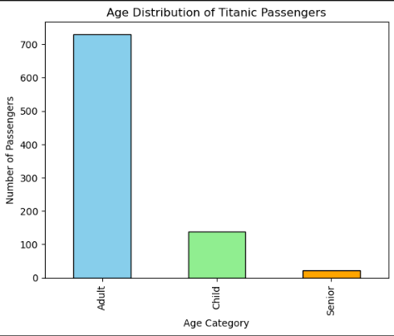
Age Distribution
Observation:
Adults are the largest group on the ship.
Children are much fewer compared to adults.
Seniors are the smallest age group.

Slide 4
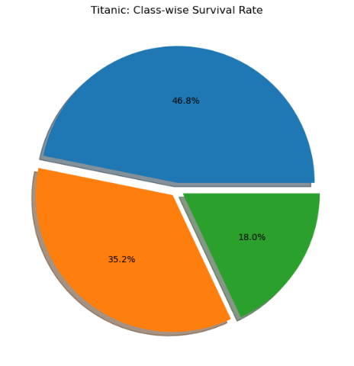
Class-wise Survival Rate
Observation:
1st class shows the highest survival share.
2nd class survival is moderate.
The 3rd class has the lowest survival percentage.

Slide 5
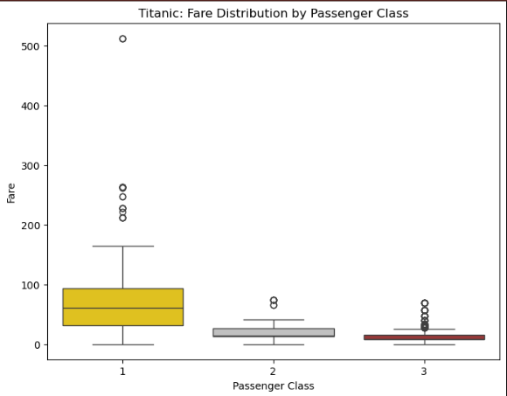
Fare Distribution by Class (Boxplot)
Observation:
1st class passengers paid the highest fares.
2nd class fares are mid-range.
The 3rd class has the lowest and tightest fare range.

Slide 6
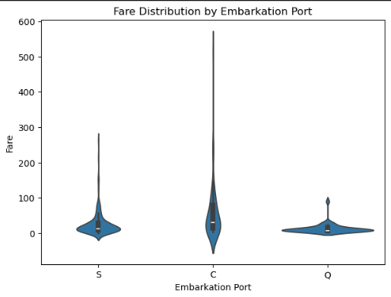
Fare Distribution by Embarkation Port (Violin Plot)
Observation:
Port C shows the highest fare variation.
Port S mostly has low-fare passengers.
Port Q has limited variation and mostly low fares.

