Slide 1

Crude Oil Characterization and Quality Prediction
CH510L
Machine Learning in Process Engineering
A Machine Learning Approach
CH23B024 – Kedhar Reddy
CH23B033 – Rushikesh Amale

Slide 2
Agenda
Project Foundation
Dataset Overview
Exploratory Data Analysis (EDA)
01
02
03
Problem Statement, Motivation, and Objectives
Introducing the 33 crude oil properties
Key Insights from Grouped Statistics and the Correlation Matrix
Data Preprocessing and Feature Selection
Machine Learning Models
Results & Conclusions
04
05
06
Feature Selection based on EDA, Label Encoding
Implementation of Classification and Regression
Model performance metrics and Summary of findings

Slide 3

Project Foundation
01

Slide 4
Why Crude Oil Quality Matters
The Real-World Challenge:
Refinery Complexity: Crude oil quality (specifically API Gravity and Sulphur) dictates the necessary refinery equipment
Cost & Safety: Processing low-quality crude (Heavy/Sour) is expensive, consumes more energy, and can damage catalysts and equipment.
Valuation: Crude price is primarily determined by its API Gravity and Sulphur content.
Our Solution: Machine Learning
Automation: Build predictive models to rapidly and automatically assess crude quality.
Optimization: Provide data-driven insights to help refiners select the most suitable crude for their specific plant setup.
Prediction: Forecast key quality metrics using underlying chemical properties.

Slide 5
Our Machine Learning Objectives
Objective 1: Crude Oil Classification
Goal: To accurately classify crude samples into their market-relevant categories.
Targets: Predict Crude type (Light, Medium, Heavy) and Sulfur Flavour (Sweet, Sour).
ML Methods: Applying various Classification Models taught in course.
Insight: Determines Refinery Suitability and required processing technology.
Objective 2: Quality Parameter Regression
Goal: To predict the exact value of the two most critical pricing variables.
Targets: Predict API Gravity and Total Sulfur (% wt).
ML Methods: Applying various Regression models taught in course.
Insight: Establishes Data-Driven Valuation and identifies primary quality drivers.

Slide 6

Dataset Overview
02

Slide 7
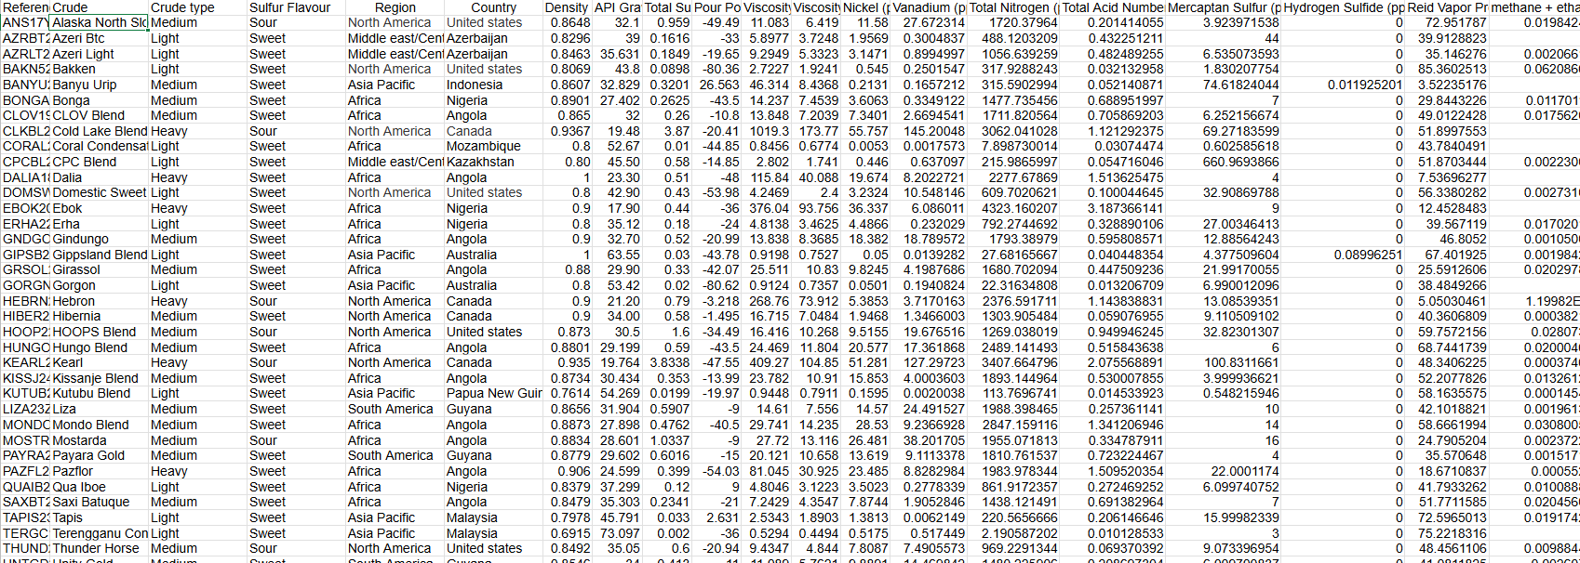
Crudeoil.xlsx

Slide 8
The Crude Oil Dataset
Scale
Features
41 Unique Global Crude Oil Samples
33 Properties (No missing data, high quality)
Category | Example Features | Significance
Physical Descriptors | API Gravity, Density, Viscosity | Measures of weight, flow, and refinement complexity.
Contaminants | Total Sulphur, Nickel, Vanadium | Indicators of environmental impact and potential for catalyst poisoning.
Light Components | Propane, Butane, RVP | Measures of volatility and stabilization requirements.
Target Labels | Crude type (Light/Medium/Heavy), Sulfur Flavour (Sweet/Sour) | Our primary variables for classification models.

Slide 9

Exploratory Data Analysis (EDA)
03

Slide 10
Univariate Statistics
Analyzed crude oil quality and composition (41 samples).
Cleaned 33 features (27 numerical, 6 categorical); no missing values.
Calculated Mean, Mode, SD, and Range to find averages and outliers.
Mapped distributions of crude types, regions, and sulfur levels.

Slide 11
Key Statistics
Quality (Numerical)
API Gravity:
  Mean: 35.7° (Medium-Light crude).
  Range: 17.9° - 73.1° (Diverse quality).
Sulfur Content:
  Mean: 0.59% wt (Low).
  Outliers: Max 3.87% (High sour).
Viscosity:
  Mean: 65.3 cSt @ 20°C.
  Trend: High variance; some samples extremely heavy/viscous.
Composition & Origin (Categorical)
Crude Type:
  Medium: 49% (Dominant).
  Light: 37%.
  Heavy: 15%.
Sulfur Flavour:
  Sweet: 80.5% (High value, low pollution).
  Sour: 19.5%.
Geography:
  Top Region: Africa (44%).
  Top Country: Angola (24%).

Slide 12
Conclusion & Strategic Value
Quality Summary: The dataset represents mostly high-quality, sweet, medium-light crudes.
Low sulfur content suggests lower processing costs (less desulfurization needed).
Wide API range requires flexible distillation capabilities.
High variance in viscosity and metals suggests that while "average" quality is high, individual handling protocols must be strictly tailored to the specific crude batch.

Slide 13
Univariate Plots
Visualized data structure beyond simple averages.
Histograms: Analyzed distribution shapes (Normal vs. Skewed).
Box Plots: Identified statistical outliers and data spread.
Focus: Key quality drivers (API, Sulfur, Viscosity).

Slide 14
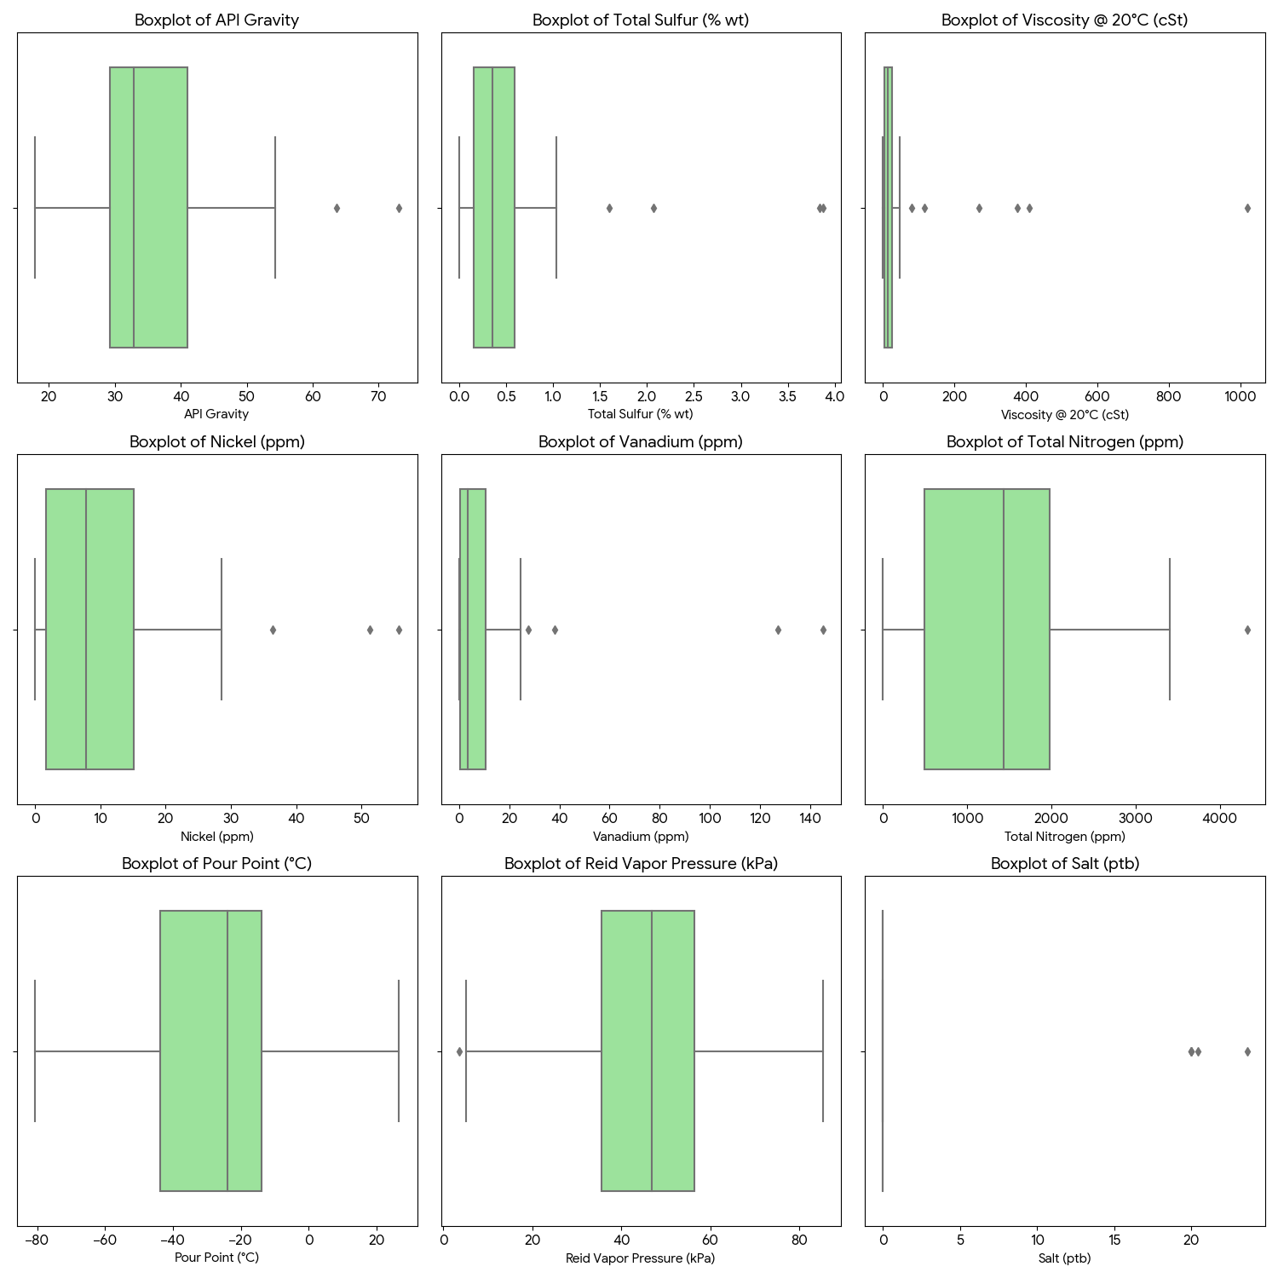
Box Plot Analysis (Outliers and Extremes)
Viscosity (@ 20°C):
  Observation: Extreme outliers (up to 1000 cSt).
  Critical Action: "Average" transport methods will fail; specific outlier batches require heated pipelines/tanks to prevent clogging.
Metals (Nickel/Vanadium):
  Observation: Significant outliers far above the median.
  Critical Action: High-metal outliers are catalyst poisons; these specific batches must be segregated or demetallized before refining.
API Gravity:
  Observation: Wide box (High Variance).
  Critical Action: Refinery intake must be flexible enough to handle density swings from 17.9° (Heavy) to 73.1° (Condensate).

Slide 15
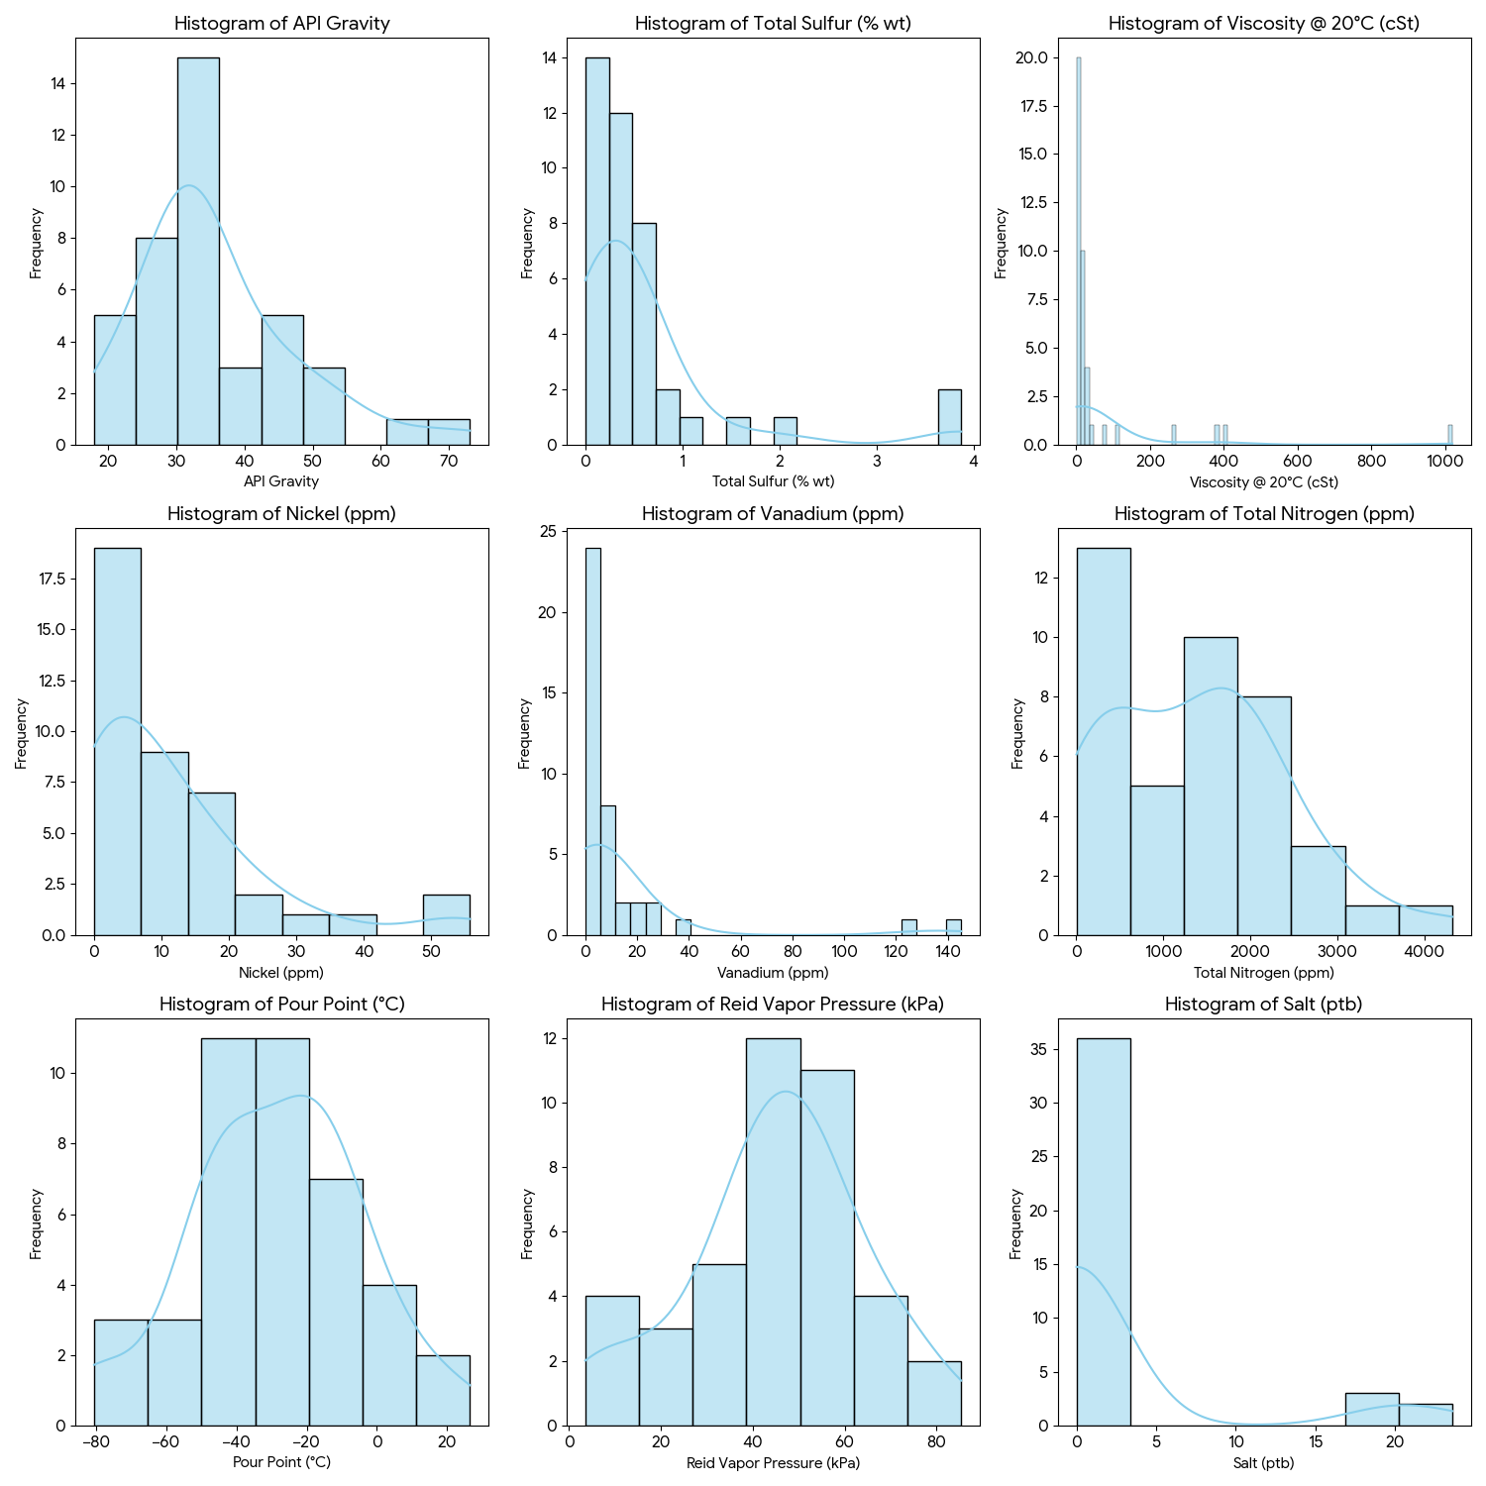
Histogram Analysis (Distribution & Shape)
API Gravity:
  Shape: Normal-like distribution.
  Insight: Balanced portfolio of Light, Medium, and Heavy crudes; suitable for diverse refining needs.
Viscosity & Metals (Ni/V):
  Shape: Highly right-skewed (Long tail).
  Insight: Most samples are high-quality (low viscosity/metals), but the skew indicates a sub-set of "heavy/dirty" samples that distort the average.
Total Sulfur:
  Shape: Right-skewed.
  Insight: The majority of the dataset is "Sweet" (<0.5%), with a smaller frequency of "Sour" crude, confirming the dataset's premium nature.

Slide 16
Bivariate Statistics
Uncovered hidden relationships and dependencies between different crude oil properties.
Pearson Correlation: Measured linear relationships (straight-line trends).
Spearman Correlation: Captured non-linear/rank-based trends (curved relationships).
Mutual Information: Quantified how much one variable tells us about another.

Slide 17
Critical Feature Relationships
(Sulfur ↔ Vanadium)
Stat: Extremely strong linear correlation (r = 0.92).
Insight: Total Sulfur is a near-perfect predictor of Vanadium content.
Action: Use Sulfur lab tests (faster/cheaper) to instantly estimate metal poisoning risks without waiting for complex metal assays.
(API Gravity ↔ Viscosity)
Stat: Weak Linear (r = -0.45) vs. Strong Rank Correlation (ρ = -0.95).
Insight: The relationship is Exponential, not linear. A small drop in API (heavier oil) causes a massive, non-linear spike in viscosity.
Action: Linear models will fail here. Log-transform Viscosity before any predictive modeling to capture this curve.
(API Gravity ↔ Nickel)
Stat: Strong Inverse Correlation (ρ = -0.86).
Insight: Lighter crudes (High API) are systematically "cleaner."
Action: API Gravity serves as a dual-indicator: it predicts both yield (light products) and refining safety (low catalyst poisoning).

Slide 18
Summary of Statistical Dependencies
Linear Dependencies: Sulfur, Nitrogen, and Metals rise and fall together. If a crude is "Sour" (High Sulfur), it is guaranteed to be "Dirty" (High Metals).
Non-Linear Dependencies: Viscosity does not scale evenly with density. Heavy crudes require exponentially more heating/pumping energy than medium crudes.
Strategic Conclusion: Predictive Power: We can confidently impute missing Vanadium/Nickel values using Sulfur data due to the 90%+ correlation.

Slide 19
Multivariate Graphical Analysis
Visualized complex interactions, clusters, and patterns across the entire dataset
Correlation Heatmaps: Mapped the intensity of relationships to identify co-varying features
Scatter Plot: Visualized the strongest correlations
Grouped Pair Plots: Analyzed multivariate behaviors within logical categories

Slide 20
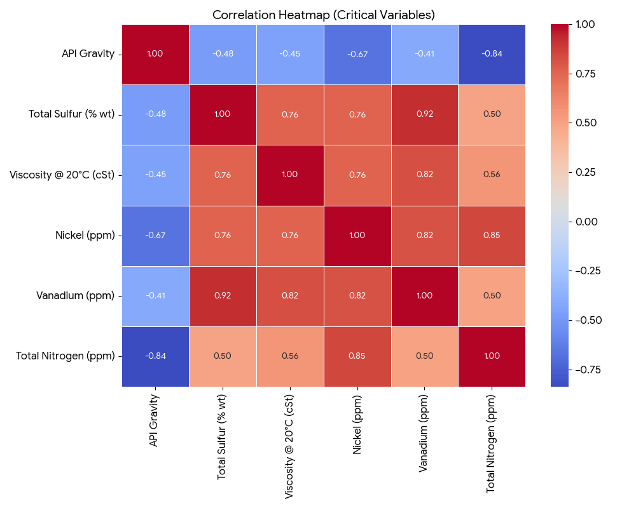
Correlation Heatmap (Relationships)
Visual: The heatmap of critical variables shows distinct "hot spots" (red) and "cold spots" (blue).
Insight 1 (The Red Block): There is a strong, red rectangular block of correlation between Sulfur, Nitrogen, Nickel, and Vanadium. This visually confirms that "contaminants travel together." If a crude has one, it likely has them all.
Insight 2 (The Blue Band): API Gravity shows strong negative correlation (blue) with all these contaminants. This visually proves the "Quality Rule": Lighter oil (Higher API) is cleaner oil.

Slide 21
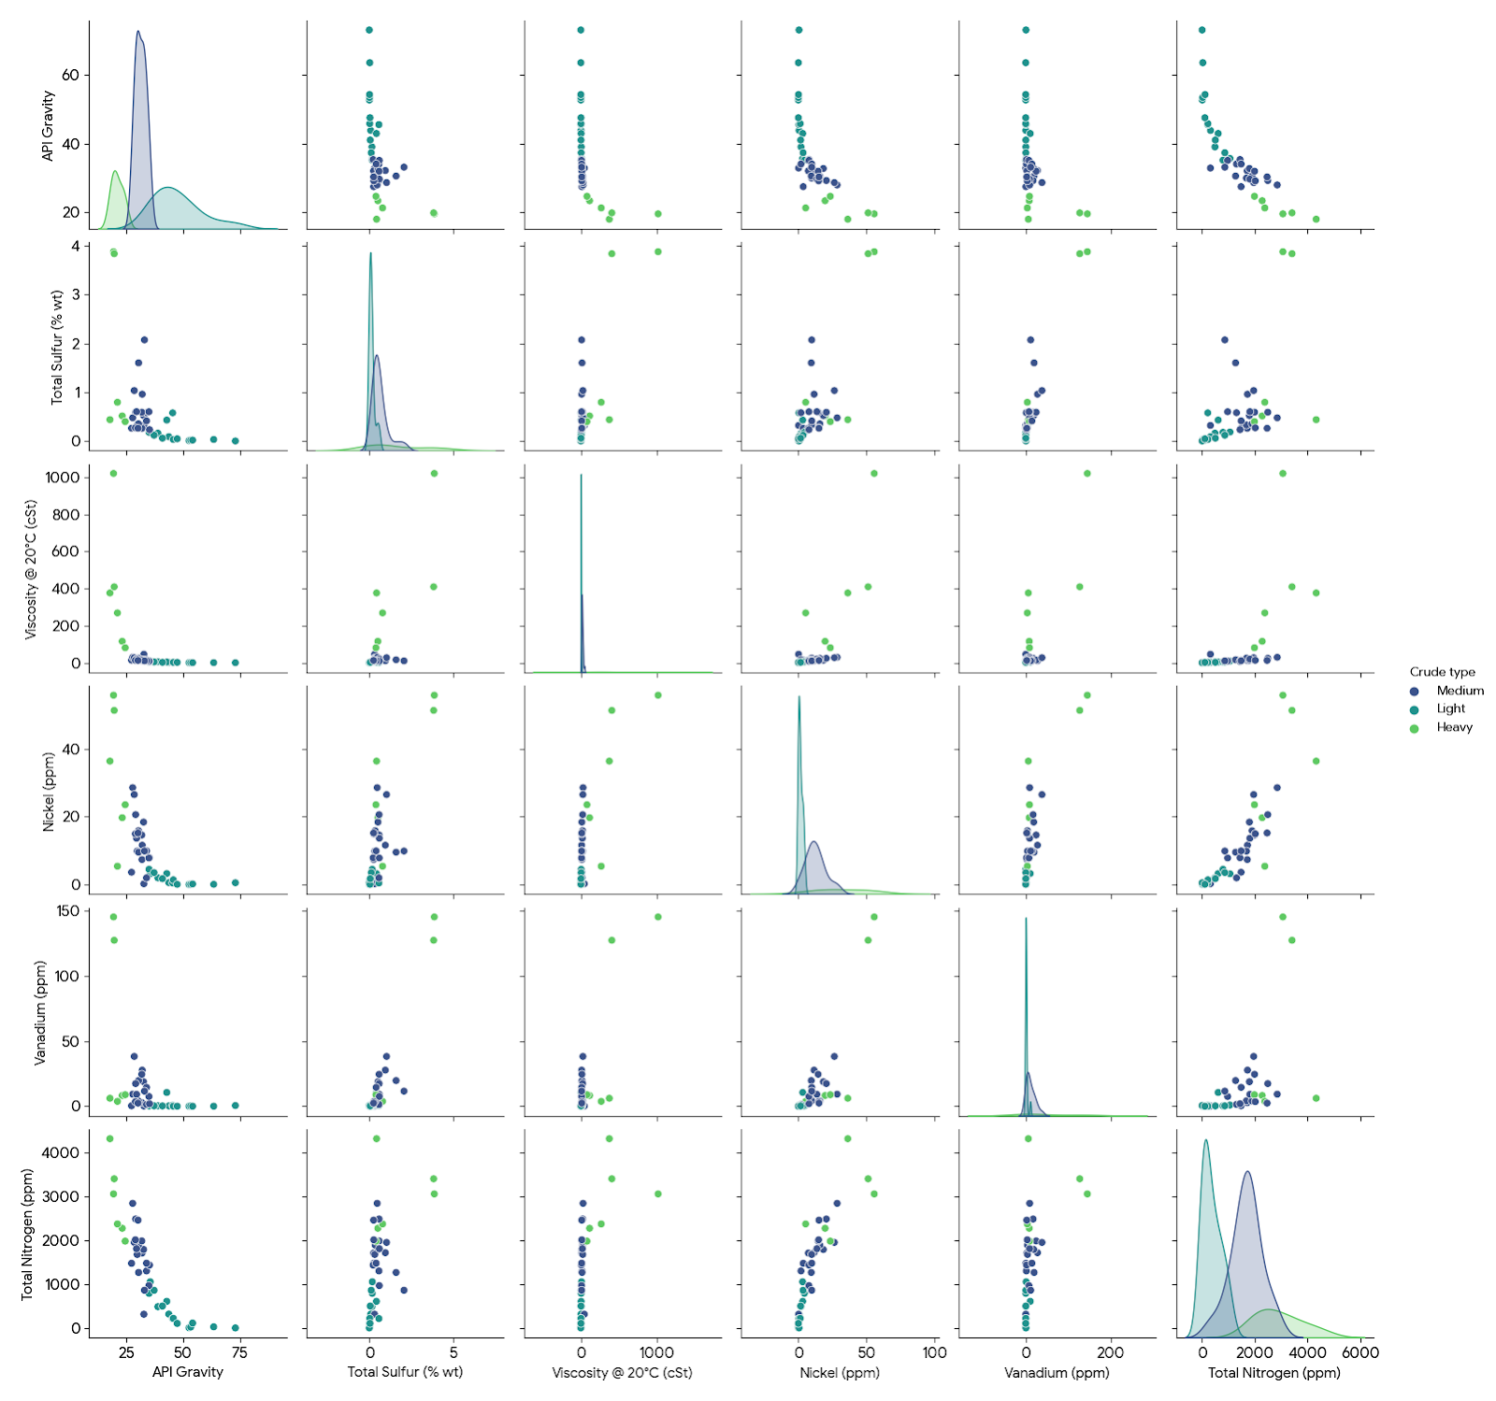
Pair Plot (Cluster Identification)
Visual: The pair plot matrix, colored by "Crude Type", reveals distinct clusters.
Insight:
  Medium Crudes (Green/Teal): Cluster tightly in the center - consistent and predictable.
  Heavy Crudes (Yellow/Purple): Appear scattered at the extremes of Viscosity and Metals.
  Light Crudes: Cluster at the high end of API and near zero for all contaminants.
Takeaway: The classes are chemically distinct. You can draw clear lines between them based on simple API/Sulfur cutoffs.

Slide 22
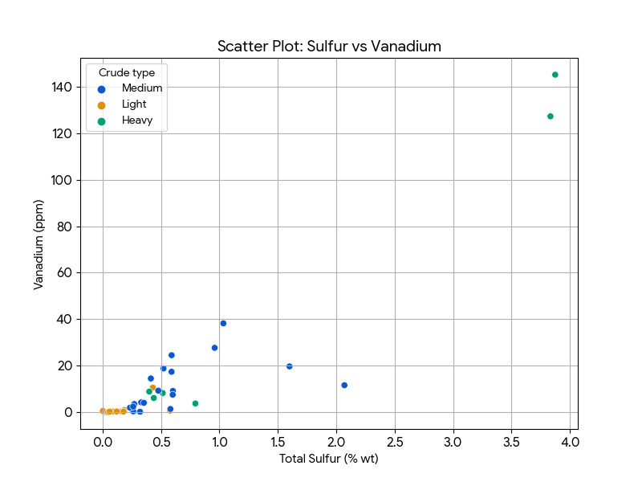
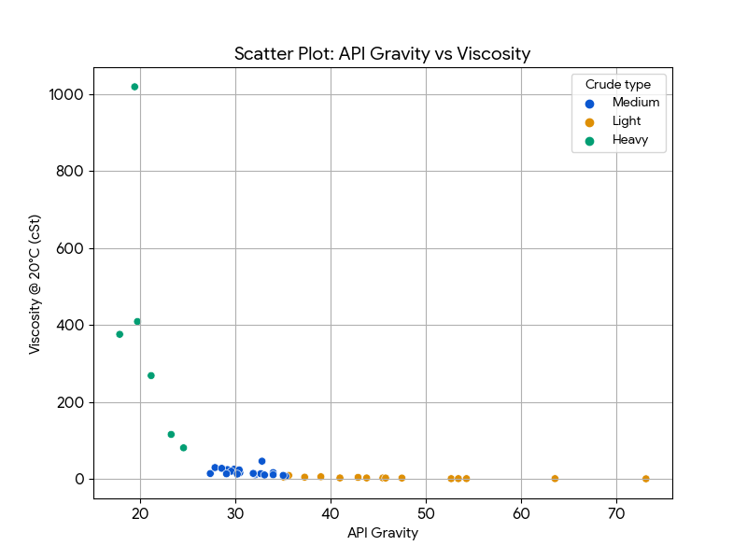
Scatter Plots (Specific Trends)
Sulfur vs. Vanadium:
  Pattern: A tight, linear diagonal line.
  Meaning: High predictability. A simple linear equation can model this relationship perfectly (R² > 0.9).
API vs. Viscosity:
  Pattern: An "L-shape" or exponential decay curve.
  Meaning: Viscosity stays low and flat for a long time as density increases, then suddenly spikes vertically for heavy crudes. This visualizes the operational risk of heavy oil—once you cross a threshold, flow assurance becomes a nightmare.

Slide 23

Data Preprocessing and Feature Selection
04

Slide 24
Feature Selection
(Regression)
Target A: API Gravity
Goal: Predict crude density/quality.
Variables to Use:
  Light Ends: C7 paraffins, C6 paraffins, n-pentane, n-butane. (These are light hydrocarbons; their presence directly increases API).
  Contaminants (Inverse): Total Nitrogen, Total Sulfur. (High contaminants generally mean heavier, lower API crude).
  Physical: Pour Point.
  Excluded Density from this analysis because it is mathematically identical to API Gravity. Do not use Density to predict API.
Target B: Total Sulfur (% wt)
Goal: Predict sulfur impurity levels.
Variables to Use:
  Metals (The Best Predictor): Vanadium is by far the strongest predictor. As seen in the EDA, Vanadium and Sulfur are chemically linked.
  Geography: Region_North America and Country_UAE. (Geology determines sulfur content).
  Acidity: Total Acid Number and Mercaptan Sulfur.
  Sulfur Flavour (Sweet/Sour) was excluded as it is a direct label for Sulfur content.

Slide 25
Feature Selection
(Classification)
Target C: Crude Type (Light / Medium / Heavy)
Goal: Classify the crude category.
Variables to Use:
  Density/API: Density @ 15°C, API Gravity. (These define the class).
  Viscosity: Viscosity @ 20°C, Viscosity @ 40°C. (Heavy crudes are exponentially more viscous).
  Composition: C7 naphthenes, C7 paraffins.
  Contaminants: Total Nitrogen, Nickel.
Target D: Sulfur Flavour (Sweet / Sour)
Goal: Classify if the crude is Sweet or Sour.
Variables to Use:
  Metals: Vanadium. (High Vanadium almost guarantees a "Sour" classification).
  Region: Region_North America. (High probability of Sour crude).
  Crude Type: Crude type_Light. (Light crudes are usually Sweet).
  Excluded Total Sulfur to simulate a real-world scenario where you might want to predict "sourness" from other chemical markers (like metals) without a direct sulfur test.

Slide 26
Data Preprocessing & Encoding Strategy
Handling Categorical Data (Encoding):
Region (5 unique values): Used One-Hot Encoding. (e.g., Region_Africa, Region_NorthAmerica).
Sulfur Flavour (2 unique values): Used Binary Encoding (0 for Sour, 1 for Sweet).
Scaling (Normalization):
Since our features have vastly different scales (e.g., Density is 0.8, Viscosity is 1000, Metals are 50), we must scale data.
Handling Outliers:
Applied a Log Transformation (log(x+1)) to Viscosity, Nickel, and Vanadium columns to reduce the impact of the extreme outliers we found in the EDA.

Slide 27

Machine Learning Models
05

Slide 28
Classification
Task 1: Crude Type (Multi-Class), Goal: Classify into Light / Medium / Heavy.
Tested Logistic Regression (Baseline) vs. SVM (Linear & Non-Linear Kernels).
Validation: 80/20 Train-Test split with Stratified Sampling.
Task 2: Sulfur Flavour (Binary), Goal: Classify into Sweet / Sour (using metal proxies).

Slide 29
Task 1: Crude Type (Multi-Class)
Crude Type Classification Results (Light / Medium / Heavy)
Linear SVM achieved perfect accuracy (100%) on the test set.
Why? The classes ("Light", "Medium", "Heavy") are likely linearly separable in the high-dimensional space created by features like Density and Viscosity. Since we defined these classes based on physical properties (API Gravity), a linear boundary works perfectly to separate them.
Model | Accuracy | Precision | Recall | F1 Score
SVM (Linear Kernel) | 100% | 1.00 | 1.00 | 1.00
SVM (RBF Kernel) | 88.9% | 0.91 | 0.89 | 0.88
Logistic Regression | 77.8% | 0.78 | 0.78 | 0.78

Slide 30
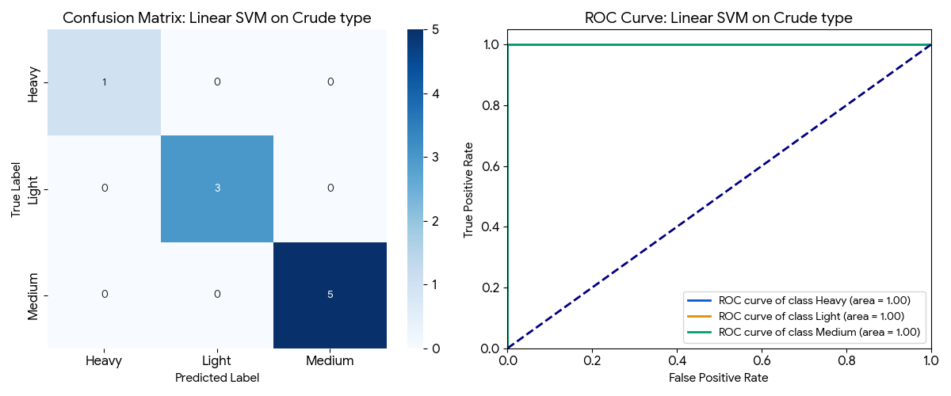
Linear SVM on Crude Type
Crude Type (Linear SVM):
Confusion Matrix: Shows perfect classification (diagonal populated, off-diagonals are zero). This aligns with the 100% accuracy we saw earlier.
ROC Curve: All classes have an AUC (Area Under Curve) of 1.00, confirming perfect separability. The lines hug the top-left corner perfectly.

Slide 31
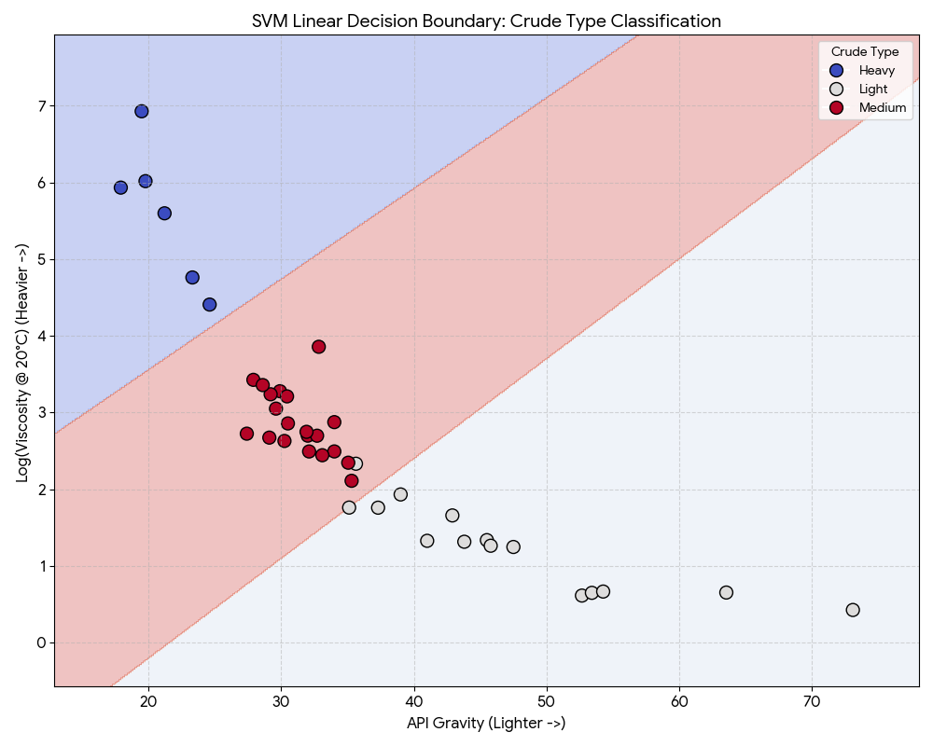
Linear SVM decision boundary
Since decision boundaries are best viewed in 2-Dimensional space, We selected the two most critical physical features for determining Crude Type:
API Gravity (X-axis): Represents density.
Viscosity (Y-axis): Represents flow resistance (Log-transformed).
The Regions: You will see three distinct colored regions (Blue, White/Grey, Red) representing the model's prediction zones for Light, Medium, and Heavy.
The Lines: The straight lines separating these regions are the "Hyperplanes." This confirms why the Linear SVM performed so well (100% accuracy)—the physics of crude oil allows for clean, straight-line cuts between types.

Slide 32
Task 2: Sulfur Flavour (Binary)
Sulfur Flavour Classification Results (Sweet / Sour)
All models (Logistic Regression, SVMs) performed identically with ~89% Accuracy.
Why? The feature Vanadium is such a strong predictor (proxy for sulfur) that the problem becomes trivial. The model just learns a simple rule: "If Vanadium > X, it is Sour."
Used Logistic Regression. Since performance is identical, choose the simplest model.
Model | Accuracy | Precision | Recall | F1 Score
All Models | 88.9% | 0.88 | 1.00 | 0.93

Slide 33
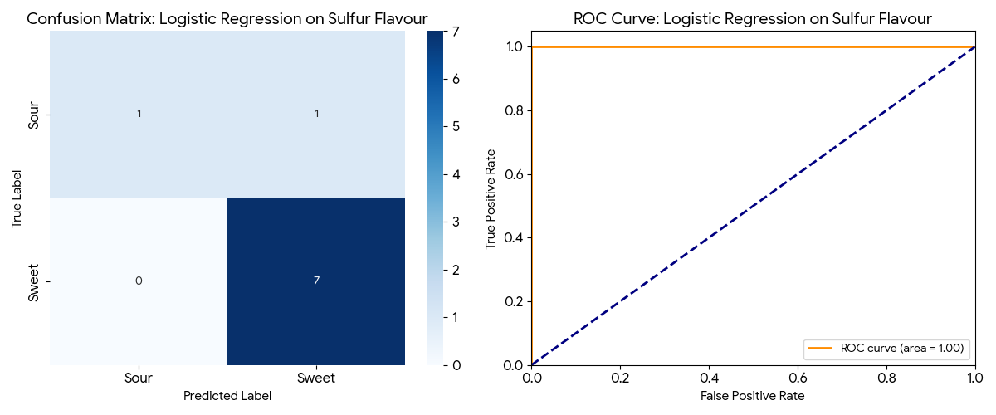
Logistic Regression on Sulfur Flavour
Sulfur Flavour (Logistic Regression):
Confusion Matrix: Shows correct predictions for most samples, but likely 1 misclassification (since accuracy was ~89%).
ROC Curve: Shows a very high AUC (close to 1.00), indicating excellent discrimination between Sweet and Sour crudes.

Slide 34
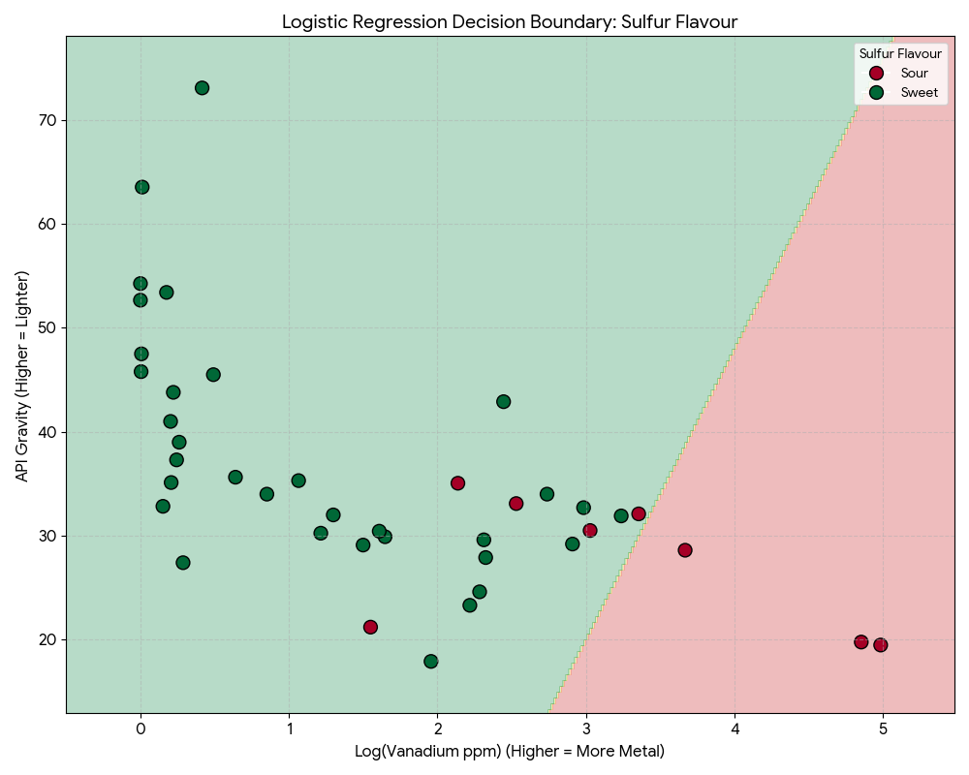
Logistic Regression decision boundary
We selected Vanadium (Log-transformed) as the X-axis because our analysis identified it as the strongest proxy for sulfur, and API Gravity as the Y-axis to represent crude density.
The Vertical Split: Notice how the decision boundary (the line between Red and Green) is almost perfectly vertical.
  Meaning: The model depends almost entirely on Vanadium (X-axis) to make its decision. API Gravity (Y-axis) matters very little.
  Insight: There is a clear "Metal Threshold" (around 3 on the log scale, or approx 20 ppm). If Vanadium is higher than this, the crude is classified as Sour (Red). If it's lower, it's Sweet (Green).

Slide 35
Regression
Task 1: API Gravity, Goal: Estimate crude lightness and product yield.
Predicted continuous physicochemical values for precise refinery planning.
Evaluated Linear Models (Simple, Ridge, LASSO) vs. SVR (Linear & Non-Linear).
Task 2: Total Sulfur, Goal: Estimate exact impurity percentage.
Validation: 80/20 Train-Test split with Stratified Sampling.
Key Metric: R² Score and RMSE (Root Mean Square Error)

Slide 36
Task 1: Estimate API Gravity
API Gravity Prediction Results
Linear SVR is the best model, explaining 95.1% of the variance in API Gravity. Ridge Regression is a very close second.
Why Linear Works: API Gravity is physically defined by the mixture of light hydrocarbons. The selected features (C7 paraffins, C6, n-Pentane) have a direct, additive (linear) contribution to density.
Why RBF Failed: The RBF kernel (non-linear) performed poorly (R² = 0.16), likely due to the small dataset size (41 samples). Complex models often overfit or fail to converge on small data, whereas linear models are robust.
Model | R² Score | RMSE | MAE
SVR (Linear) | 0.951 | 2.10 | 1.75
Ridge Regression | 0.949 | 2.14 | 1.55
Linear Regression | 0.927 | 2.57 | 1.56
LASSO Regression | 0.919 | 2.70 | 2.01
SVR (RBF) | 0.159 | 8.72 | 5.37

Slide 37
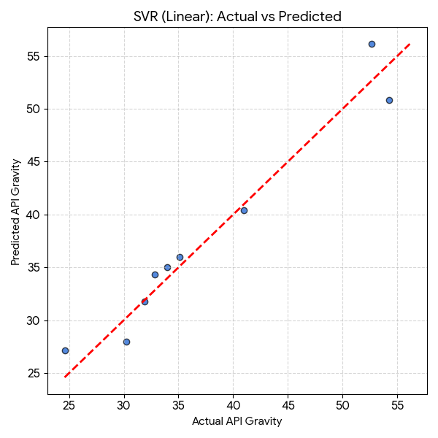
Linear SVR for API Gravity
API Gravity Plot (Linear SVR)
What to look for: You will see the blue dots hugging the red dashed line very tightly.
The scatter plot demonstrates a strong linear alignment (R² = 0.951), confirming that the selected light hydrocarbon features are excellent predictors of API Gravity. The low spread of residuals indicates high model precision.

Slide 38
Task 1: Estimate Total Sulphur
Total Sulfur Prediction Results
Issue: Negative R2 means the models are performing worse than a simple horizontal line (mean value).
Cause: The "Total Sulfur" variable is highly skewed with extreme outliers (3.87%, Mean 0.59%). The test set likely contained one of these outliers that the model failed to predict, causing massive penalization in the R² score. However, look at the RMSE (0.22). The average error is actually quite low (0.22% sulfur error).
Recommendation: While the R² is bad (due to outliers), an error of 0.22% wt might be acceptable for rough screening. To improve this, we would need more data or a specialized model for outliers
Model | R² Score | RMSE | MAE
SVR (RBF) | -0.08 | 0.22 | 0.18
SVR (Linear) | -0.35 | 0.24 | 0.21
Ridge Regression | -3.37 | 0.44 | 0.38
Linear Regression | -4.39 | 0.49 | 0.42

Slide 39
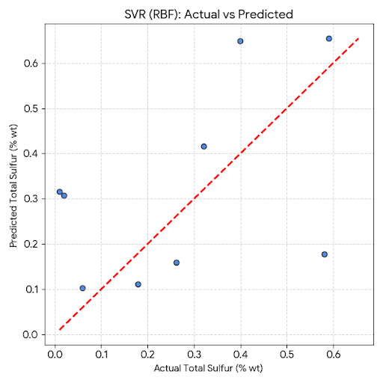
SVR (RBF) for Total Sulphur
Total Sulphur Plot (SVR - RBF)
What to look for: You will likely see a cluster of points near the bottom-left (low sulfur) that fit reasonably well, but one or two points far away from the red line.
The dispersion in the Sulfur prediction plot highlights the challenge of outliers. While the model predicts low-sulfur samples accurately, the extreme 'sour' samples deviate from the trend line, reducing the overall R² score.

Slide 40
Clustering
Discovered hidden chemical patterns without using pre-existing labels.
Identified 3 Natural Clusters (Condensates, Baseload, Heavy/Sour).
K-Means: Grouped crude oils into distinct clusters based on similarity.
Dendrogram: Built a "Family Tree" to visualize relationships and substitutes.

Slide 41
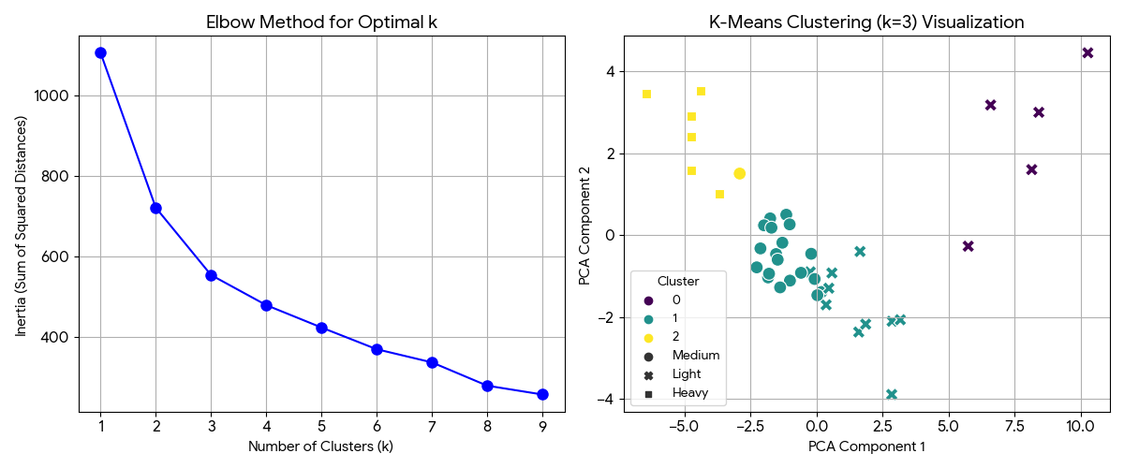
K-means Clustering (Visual Insight)
We performed K-Means Clustering (using the Elbow Method to determine the optimal number of groups)
The analysis found a distinct sub-group (Cluster 0) of extremely high API, low-sulfur crudes that are chemically distinct even from the standard "Light" category. These are likely highly valuable Condensates.
The scatter plot (generated in the code output) shows:
  Cluster 2 (Heavy) is isolated far away from the others, confirming it is chemically unique.
  Cluster 0 (Super Light) and Cluster 1 (Medium) are closer but still distinct, suggesting a continuous spectrum of quality that K-Means successfully segmented.

Slide 42
K-means (3 Clusters)
Clustering Results (K-Means, k=3)
Cluster | API Gravity (Mean) | Viscosity (Mean) | Sulfur (Mean) | Nickel (Mean) | Interpretation
Cluster 0 | 59.4° | 0.8 cSt | 0.02% | 0.16 ppm | "Super Light / Condensate" Extremely pure, almost water-like viscosity.
Cluster 1 | 34.9° | 13.0 cSt | 0.45% | 8.33 ppm | "Conventional Light/Medium" The standard refinery baseload (matches most "Medium" samples).
Cluster 2 | 22.1° | 328.3 cSt | 1.56% | 31.2 ppm | "Heavy / Sour" High viscosity, high metal, high sulfur. Requires complex processing.

Slide 43
Hierarchical Clustering
Dendrogram Analysis (The "Family Tree" of Crude)
Colored Branches = Distinct Chemical Families
Different colors represent crude oils that are chemically distinct enough to be treated as separate groups by a refinery.
Height of Color Change: The lower the color change happens, the more specific the subgroup.
Cluster 1 (Green Branch): The "Complex" Group
  Composition: Heavy, Sour, High-Viscosity oils.
  Refining Need: Requires specialized hardware (Cokers/Hydrotreaters).
  Risk: High metal content (Catalyst poisons).
Cluster 2 (Orange Branch): The "Clean" Group
  Composition: Light, Sweet, Low-Metal oils.
  Refining Need: Simple distillation; high yield of gasoline/diesel.
  Value: Premium market price.

Slide 44
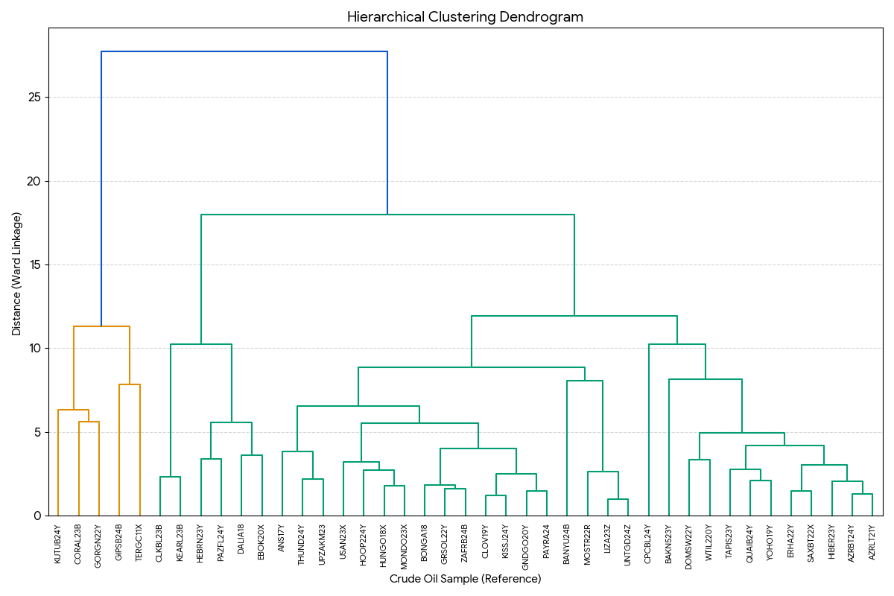
Dendrogram

Slide 45

Results and Conclusions
06

Slide 46
Executive Summary
Core Finding: Crude oil quality is not random; it follows three distinct chemical regimes.
Ultra-Light Condensates (Premium).
Baseload Medium Crudes (Standard).
Heavy/Sour Crudes (Distressed/Complex).
Key Insight: Industry labels ("Light/Heavy") are scientifically valid and mathematically separable.

Slide 47
Key Physicochemical Insights (EDA)
Viscosity scales non-linearly. Below 25° API, pumping resistance spikes exponentially.
Near-perfect correlation (r > 0.9) between Sulfur and Metals (Vanadium/Nickel).
"Sour" crude is guaranteed to be "Dirty" (high metal).

Slide 48

Predictive Modeling Results
Classification (Automated Grading):
Crude Type: 100% Accuracy (Linear SVM). Separated purely by Density & Viscosity.
Sulfur Flavour: ~89% Accuracy (Logistic Regression). Successfully used Vanadium as a proxy for Sourness.
Regression (Property Estimation):
API Gravity: R² = 0.95 (Linear SVR). Highly predictable using light hydrocarbon composition.
Total Sulfur: Regression failed (R² < 0) due to extreme outliers.
Takeaway: Classifying sulfur risk (High/Low) is safer than predicting exact percentages.

Slide 49
Unsupervised Discovery - Clustering
Method: K-Means Clustering (Blind / No Labels).
Discovered 3 Natural Groups that match physical reality
Cluster 0: Super-Light Condensates (API ~59°).
Cluster 1: Standard Baseload (API ~35°).
Cluster 2: Heavy/Sour Outliers (API ~22°, High Metals).
Confirmed that "Condensates" are a distinct, premium asset class.

Slide 50
Strategic Recommendations
Operational:
Proxy Testing: Use rapid metal assays to flag "Sour" crude risks immediately.
Segregation: Strictly isolate Cluster 2 (Heavy) oils to prevent contamination of premium stock.
Data Strategy:
Use Linear Models for physical properties (API, Density).
Use Classification for contaminant risk (Sulfur, Acidity).
Do not extrapolate viscosity linearly for heavy oils; use log-models.

Slide 51
Thank You

